Slide 1
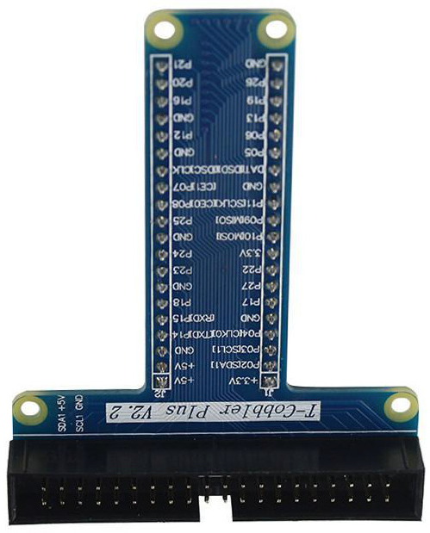
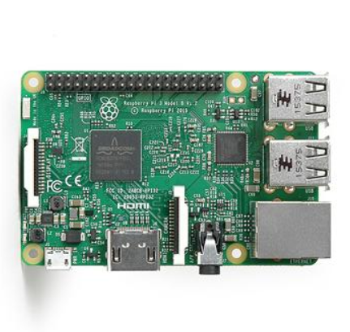
Temp/Humidity-only Probe
direct connection to GPIO
or simple cable connection
to a PCB with sensors
extends outside case
horiz/vert?
Power-over-Ethernet
external to RasPi
keep transformer separate
reduce heat near sensor
PoE to USB?
PoE to GPIO pins?

