Slide 1



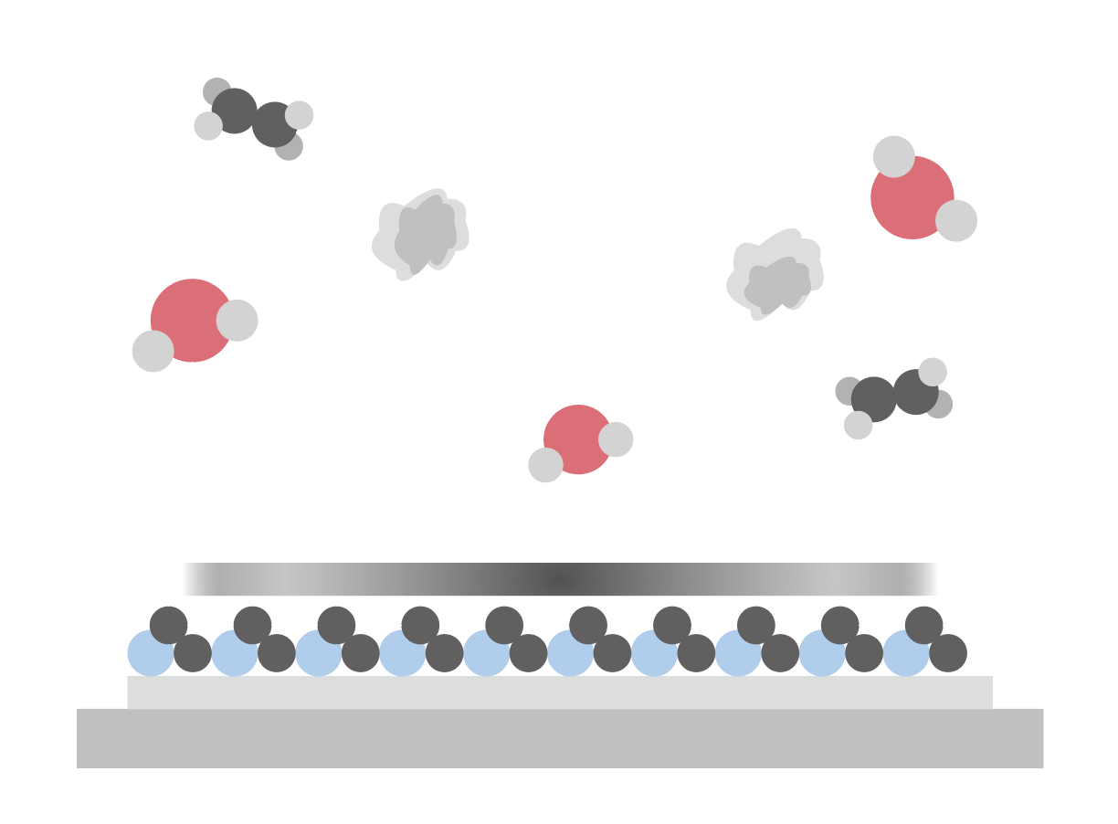
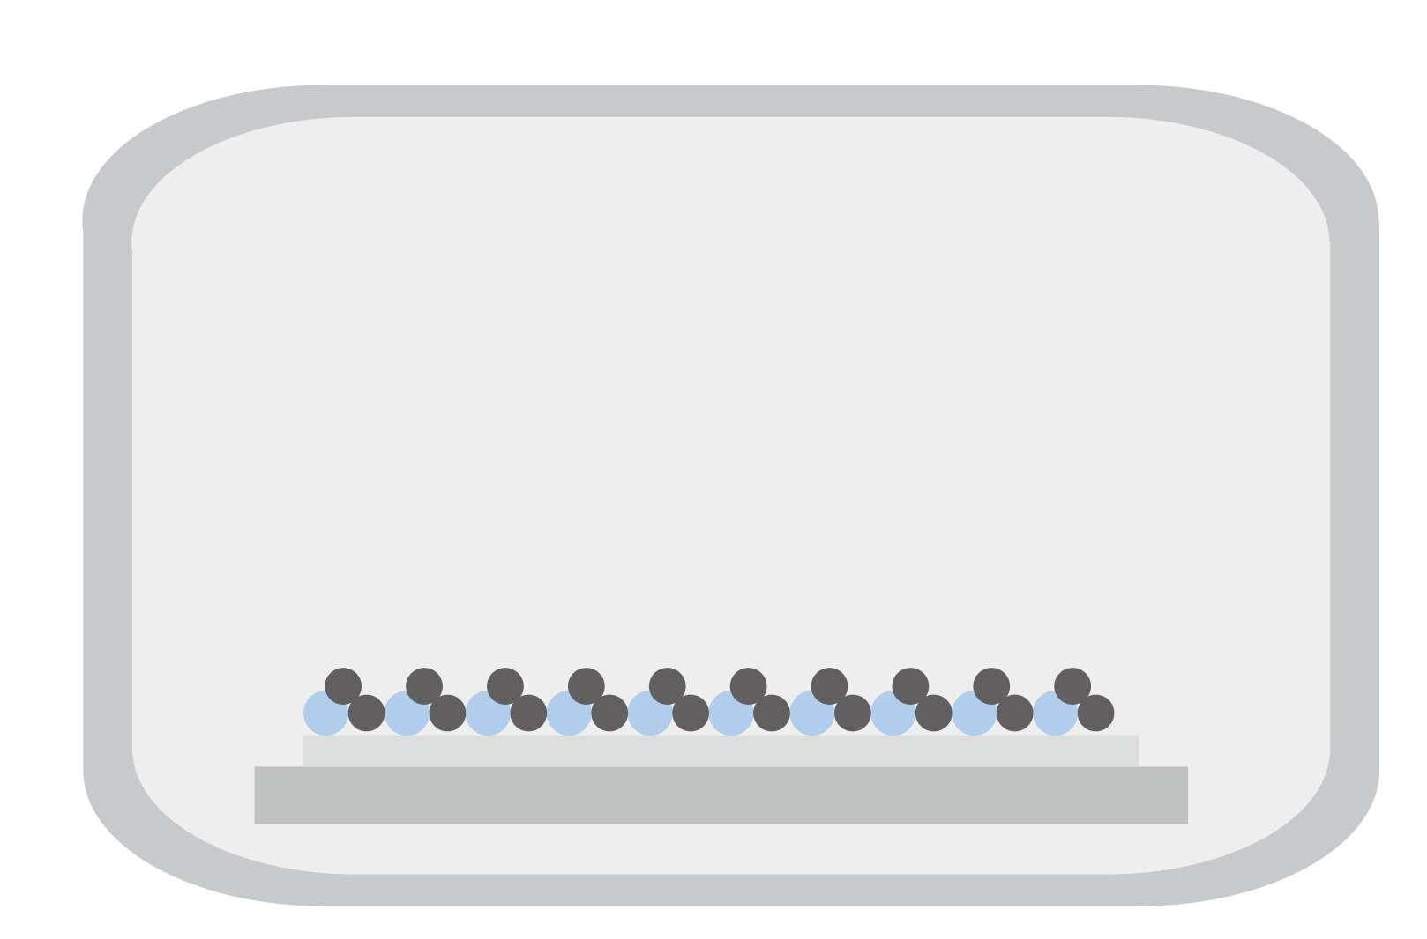
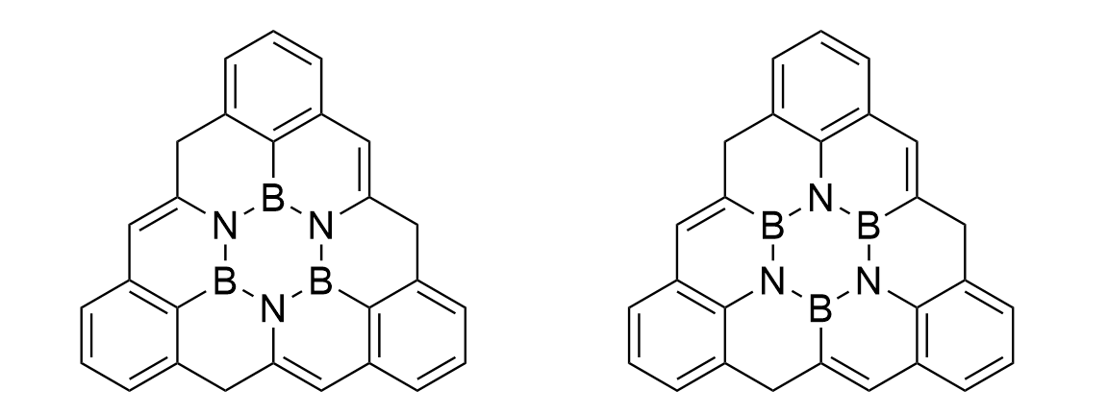
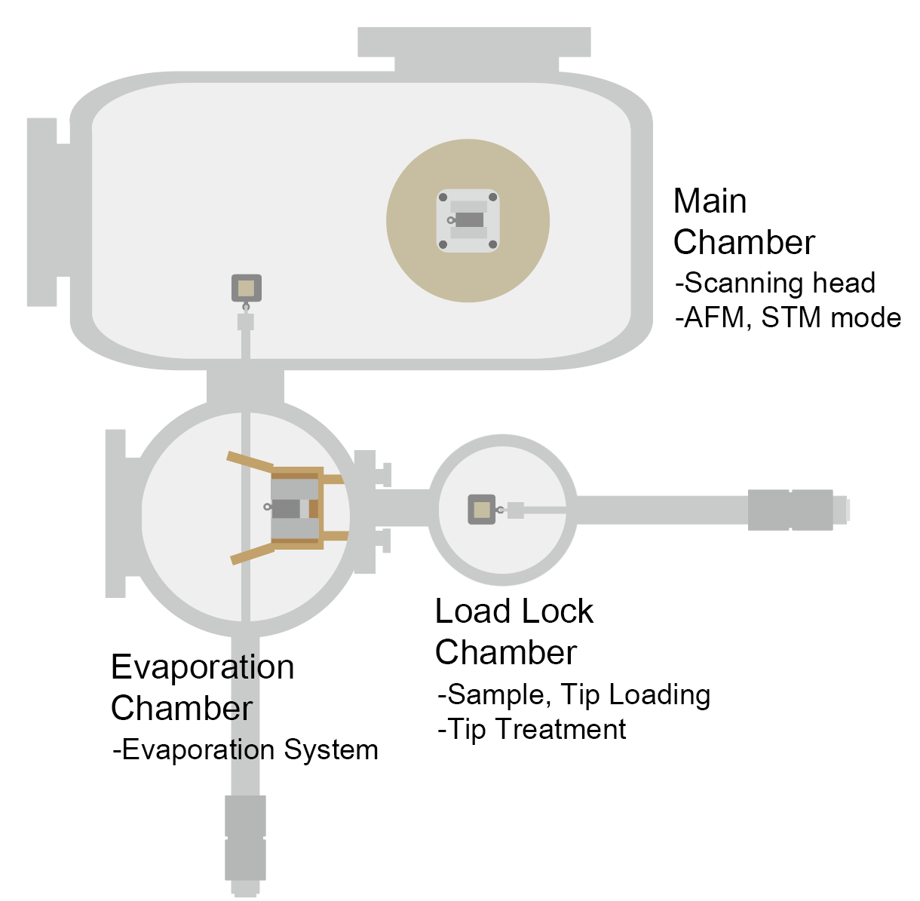
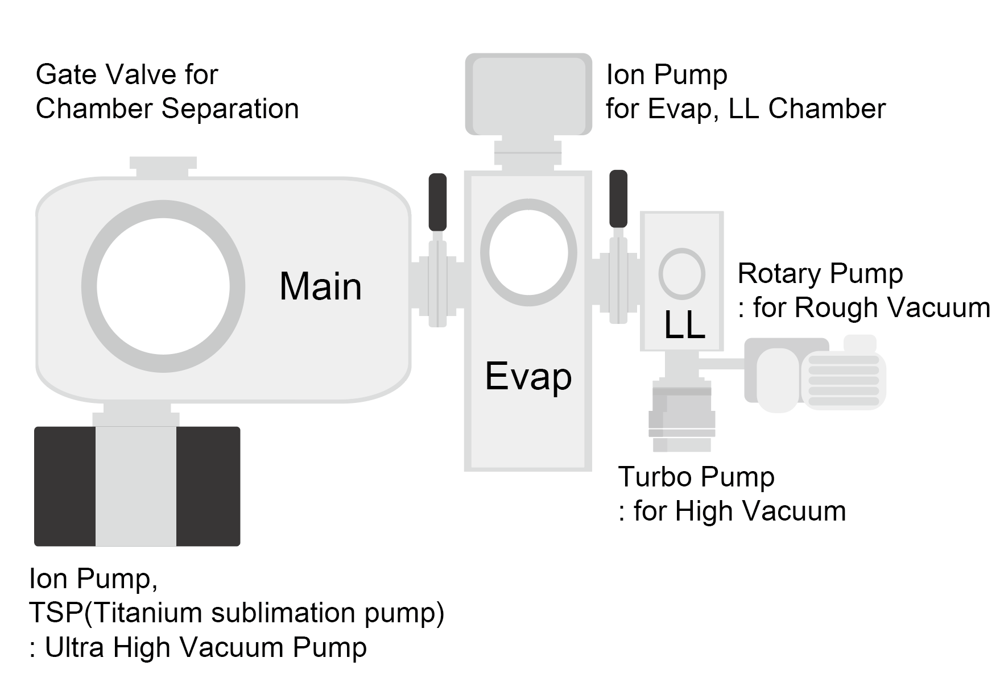
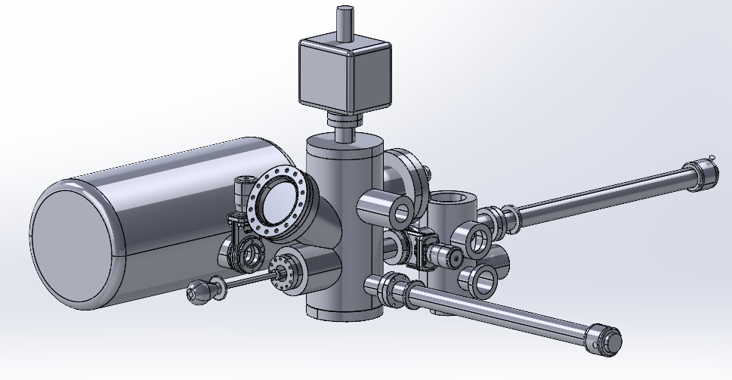
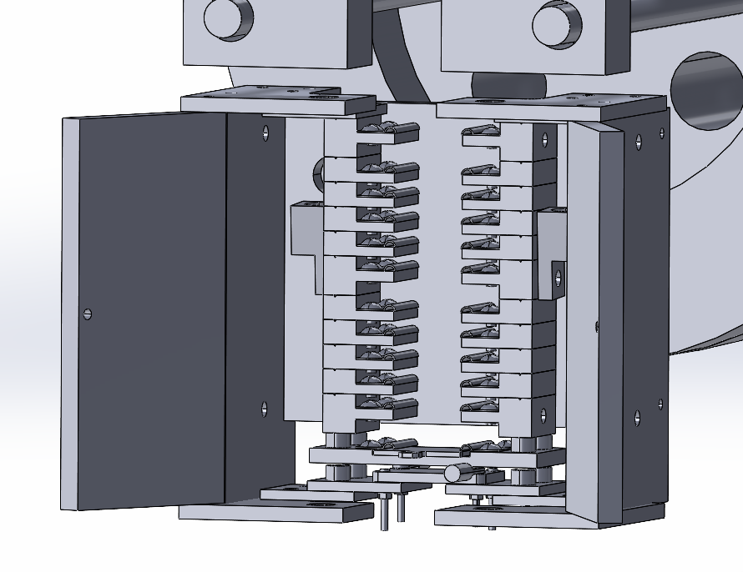
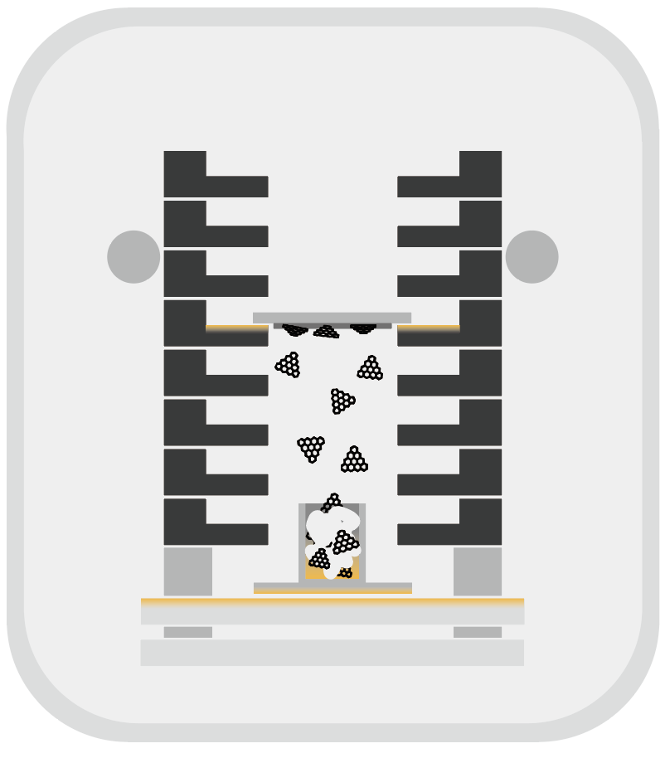
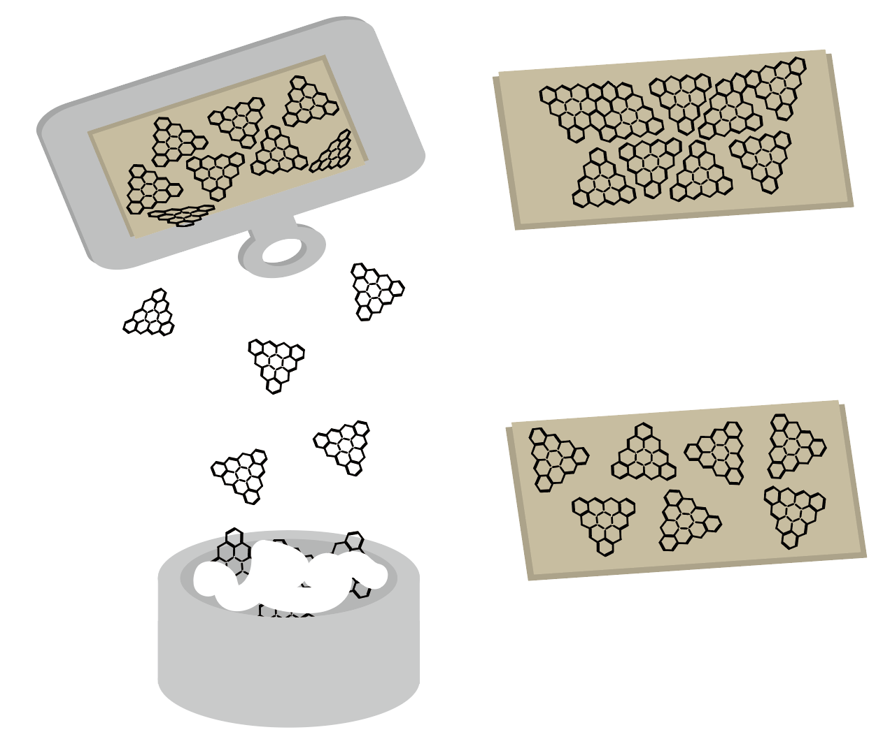
Evaporation-Assisted In-situ BCN Synthesis and Nanoscale Characterization in an Integrated UHV System
Abstract
SEOUNGEUN LEE, JEONG WON JIN, TAEGEUN YOON, YONGTAE CHA, JUNSEO CHOI
YOUNG JAE SONG, HYEON SUK SHIN
Boron carbon nitride (BCN) is a promising platform for studying heteroatom-induced electronic modulation in graphene-like structures. However, ex-situ transfer can expose the as-grown surface to water, oxygen, organic residues, and dust, disturbing surface-sensitive AFM(Atomic Force Microscopy)/ STM(Scanning Tunneling Microscopy) measurements. To address this issue, we present an integrated UHV system for evaporation-assisted in-situ BCN synthesis and nanoscale characterization.
The system consists of a main measurement chamber, an evaporation chamber for thermally controlled precursor deposition, and a load-lock chamber for sample/tip exchange. Gate valves isolate each chamber to maintain the UHV environment. In the evaporation chamber, precursor evaporation, vapor transport, and deposition are controlled by heating both the precursor source and substrate. This in-situ system is expected to reduce contamination, preserve the as-grown BCN surface, and directly link synthesis conditions with nanoscale morphology and electronic properties. Future studies will use N-doped and B-doped molecular precursors for on-surface BCN synthesis.
Intro
Future BCN Study
Why did we design an in-situ evaporation system?
• Two types of BCN precursors:
[Ex-situ Evaporation]
[In-situ Evaporation]
H₂O
dust
UHV Chamber
O₂, organics
contamination layer
N-type doped triangulene
B-type doped triangulene
• Minimized contamination from air, water, organics, and dust
• Preservation of the as-grown surface state
• Direct correlation between synthesis conditions and AFM/STM properties
• Target system: BN-doped open-shell nanographene / BN-doped triangulene
• Key interest: effect of B–N bond polarization on spin density and electronic symmetry breaking
Schematic chamber layout of the modified STheM platform
Vacuum System
System for maintaining UHV
Ultra-High Vacuum (UHV) condition : ~10⁻¹¹ Torr
Sample, Tip, Precursor
UHV conditions minimize surface contamination and preserve the intrinsic surface state for reliable AFM/STM characterization.
Load-Lock chamber vacuum system
Atmosphere ↔ UHV enables sample/tip transfer
via rotary & turbomolecular pumping
Evaporation system
Overall upgraded STheM platform
Detailed view of Evaporation chamber
UHV evaporation system
BCN Deposition Process
Evaporation
Chamber
UHV Chamber
Heated Substrate
[Heated Substrate]
ΔT
[PBN heater]
Precursor
[Unheated Substrate]
Slit with Adjustable Height
and Temperature
The PBN heater directly heats the precursor carrier, leading to precursor evaporation and subsequent deposition onto the substrate.
Substrate heating can be selectively applied during deposition, which improves the ordering of the BCN layer.

Slide 2


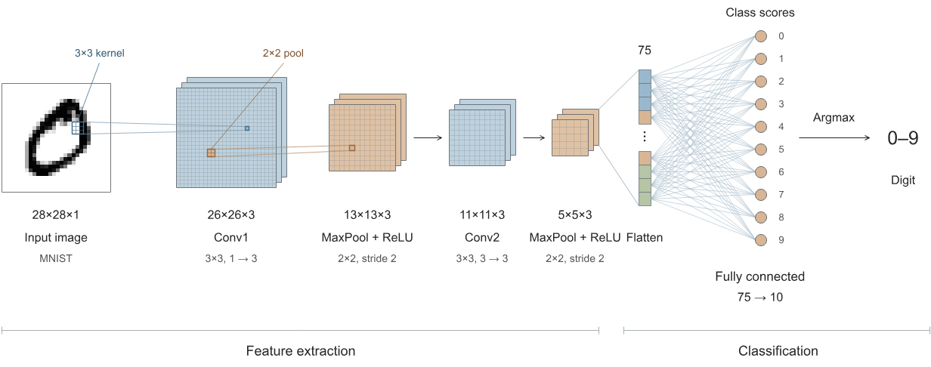
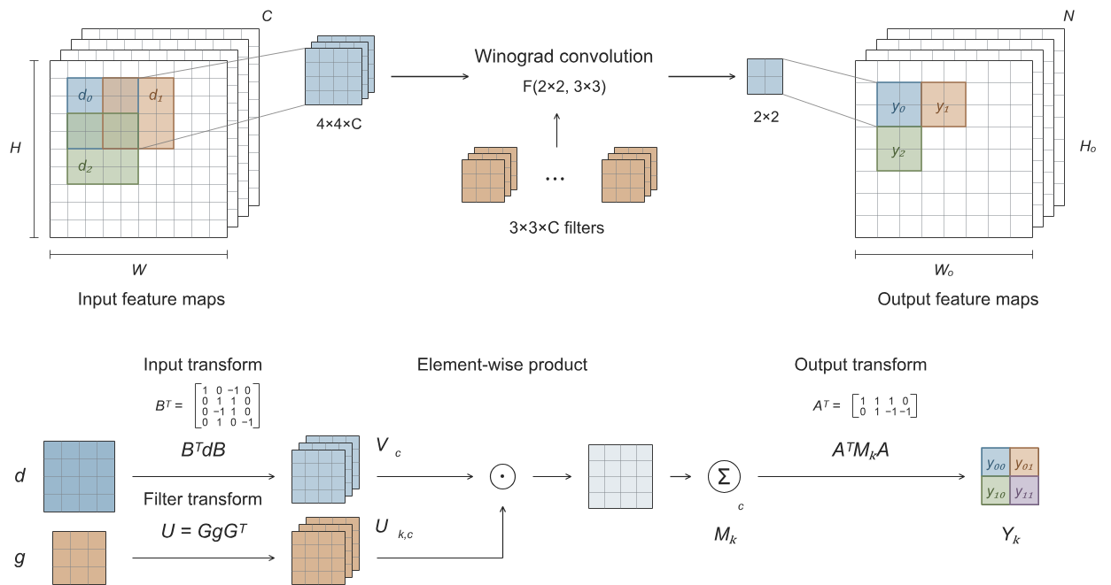
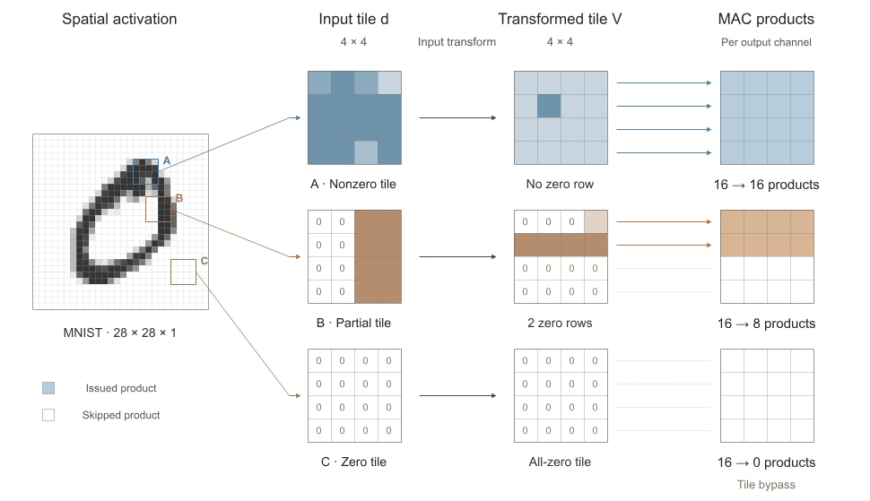
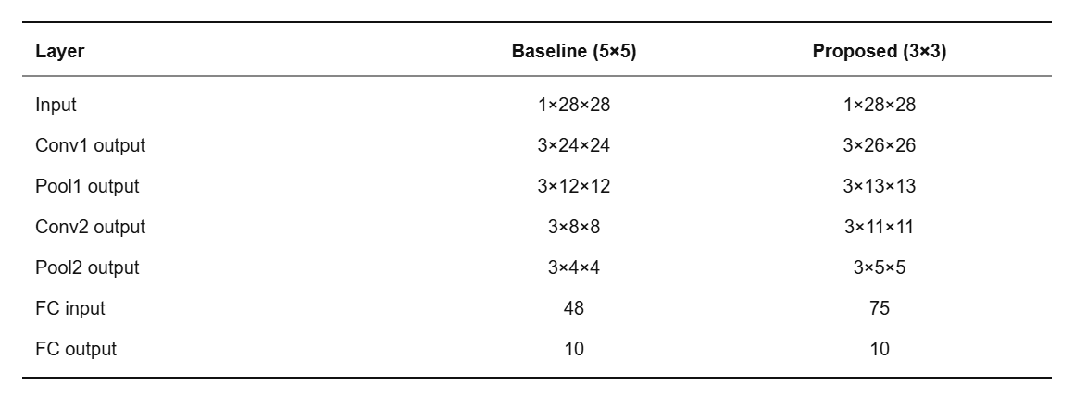
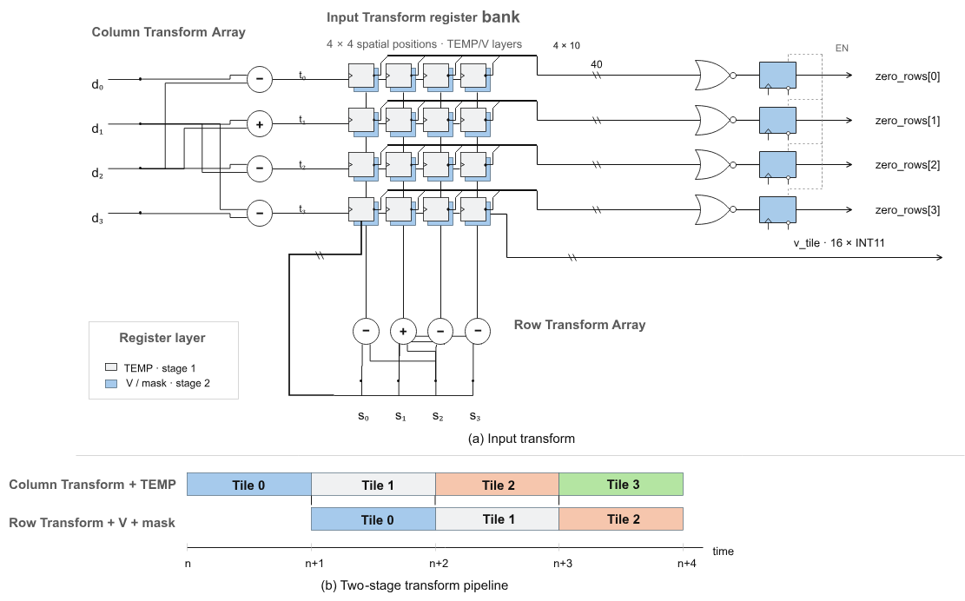
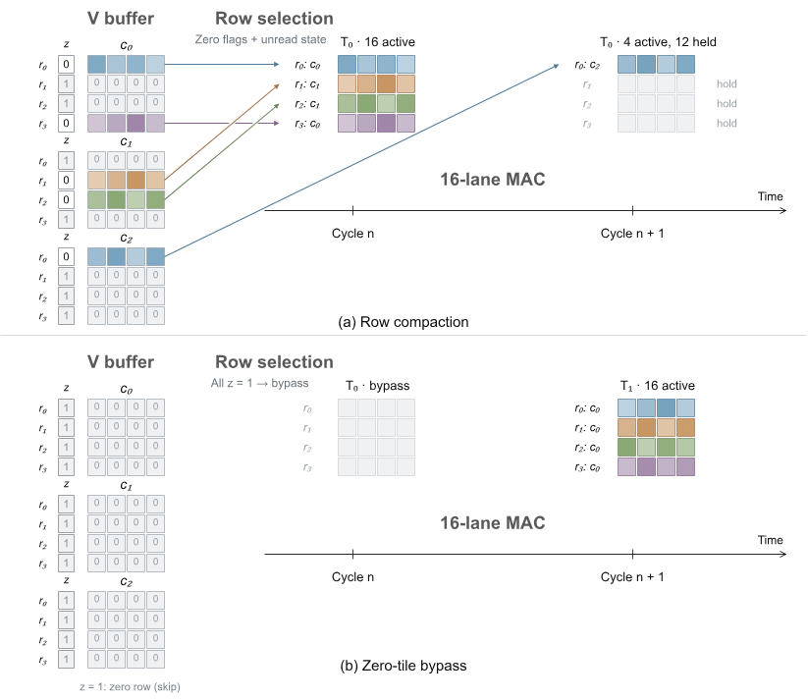
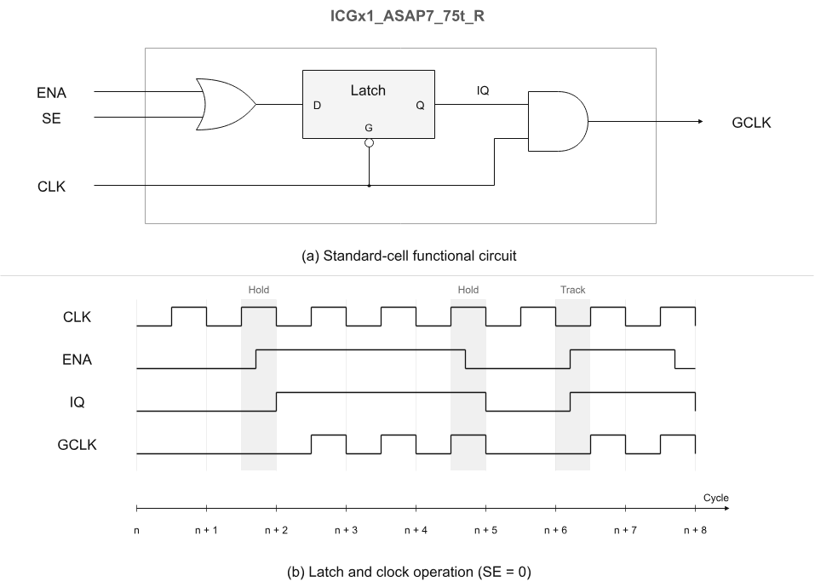
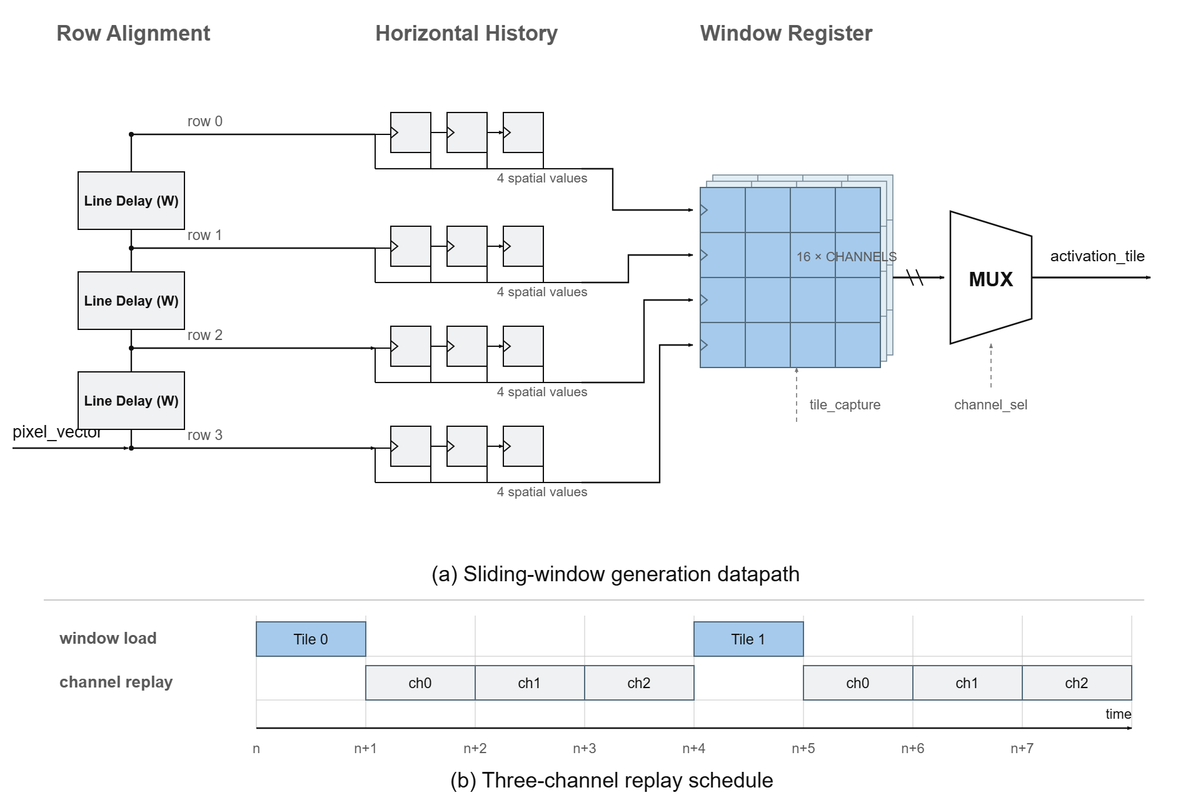
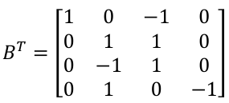
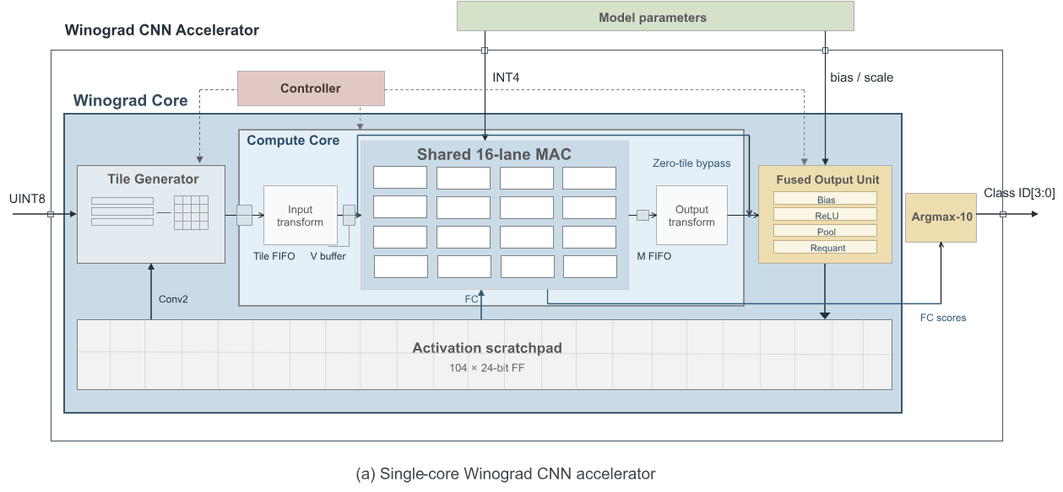
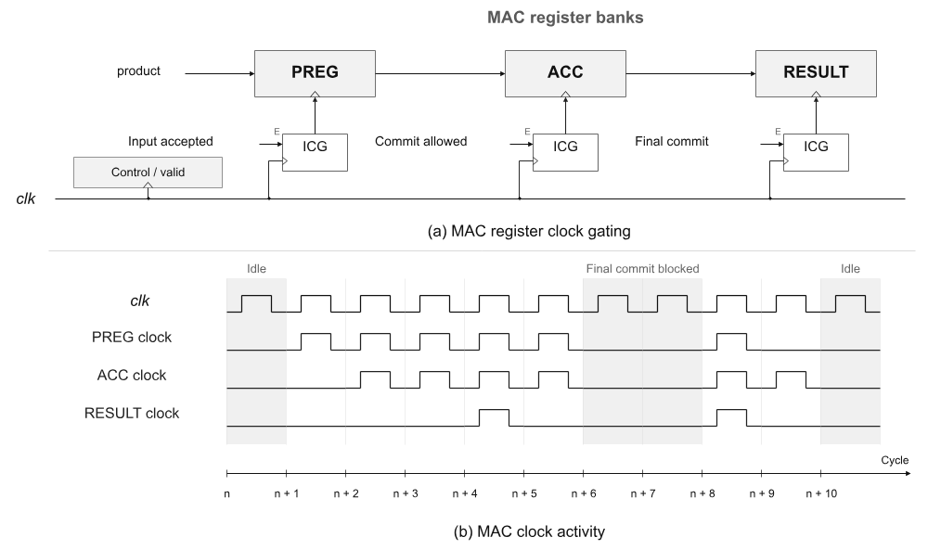
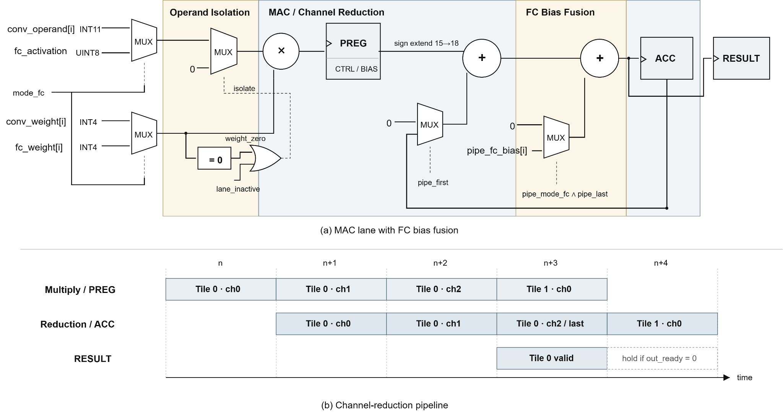
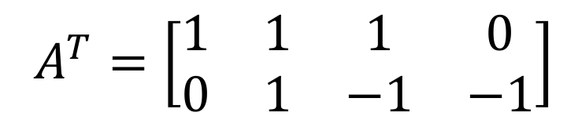
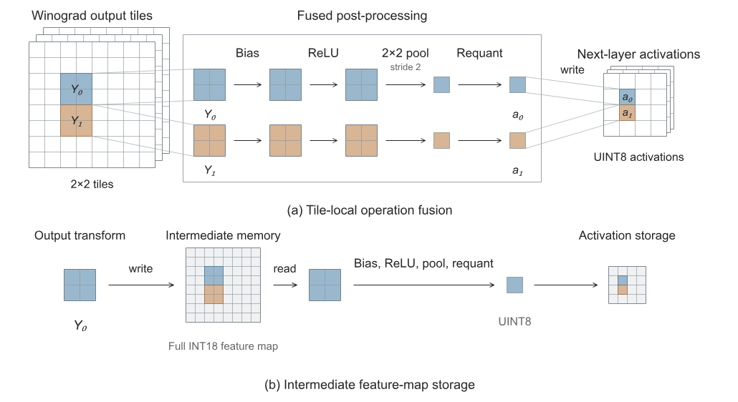
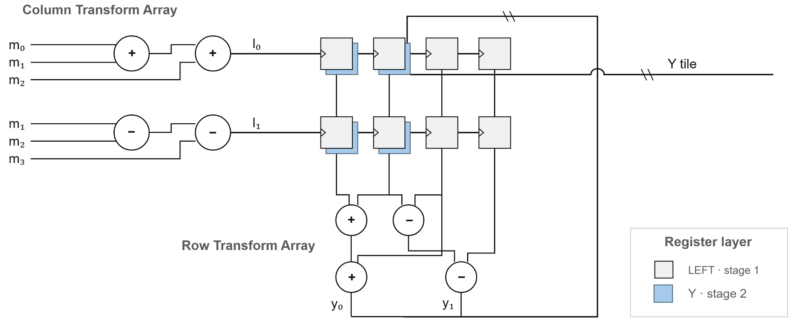
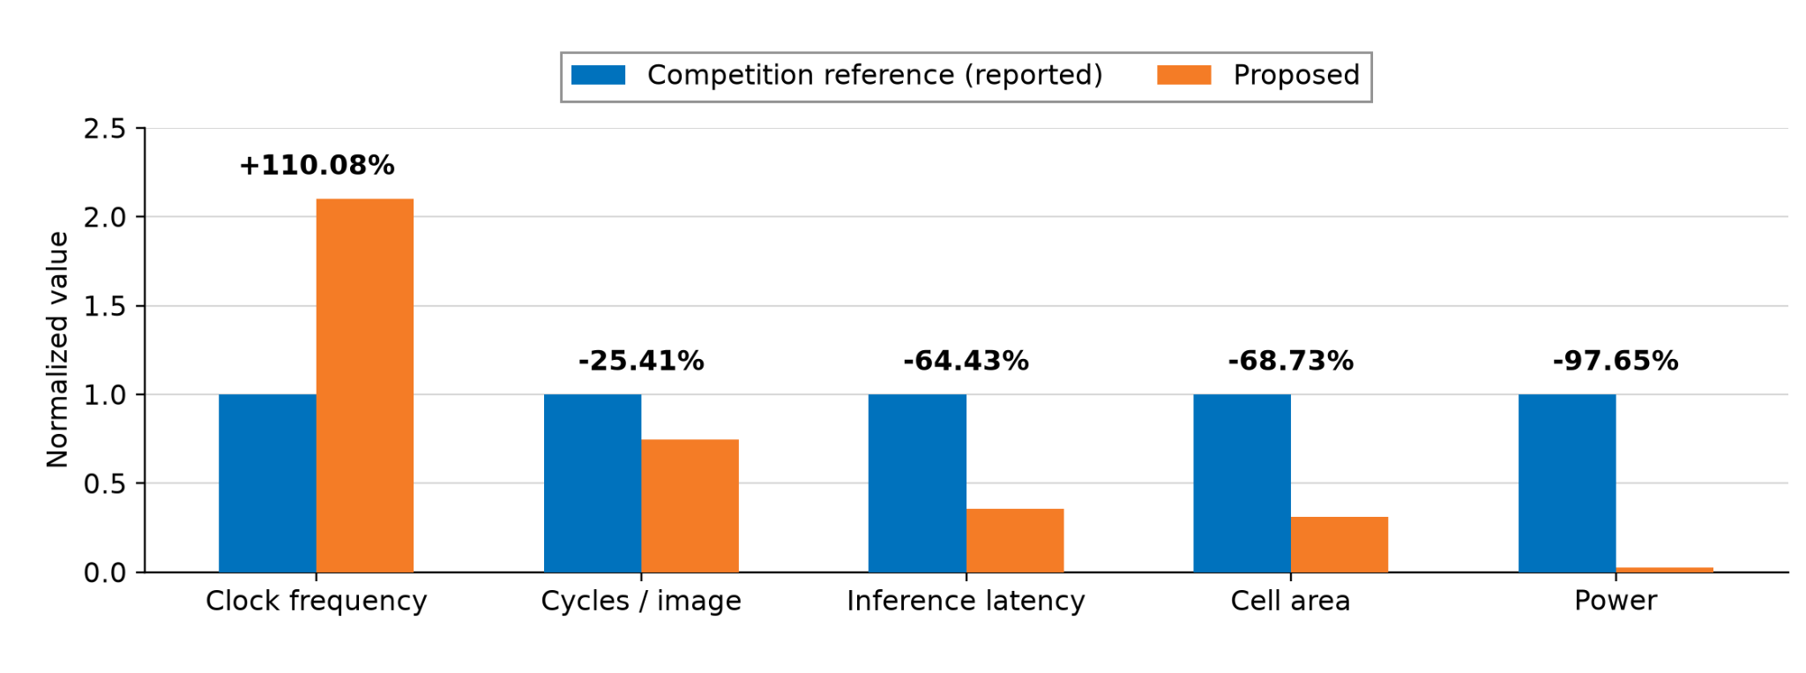
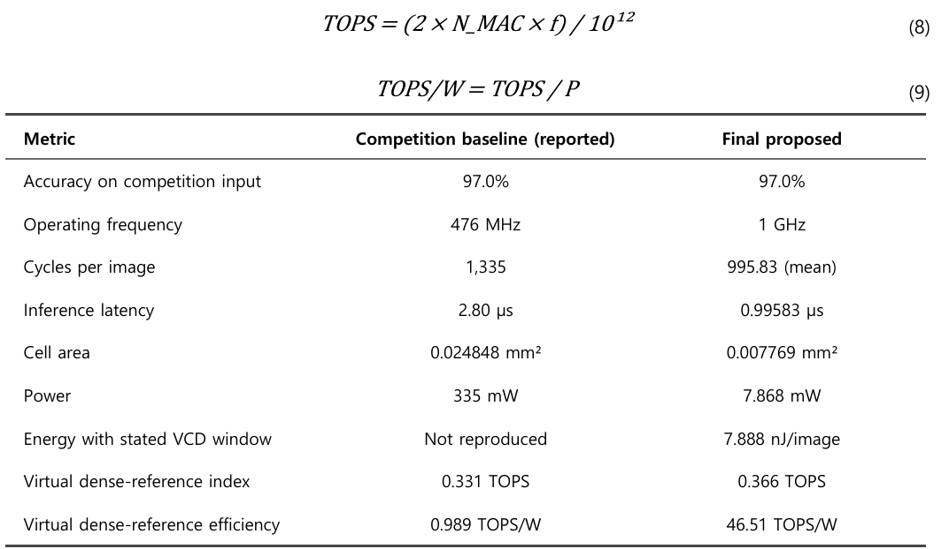
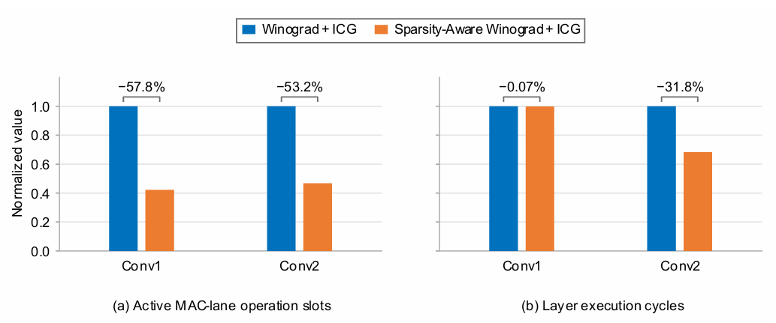
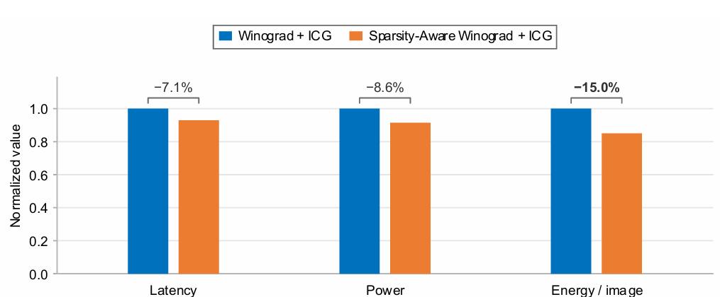
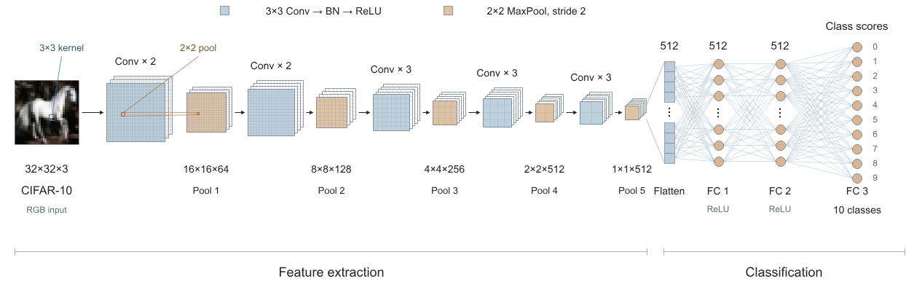
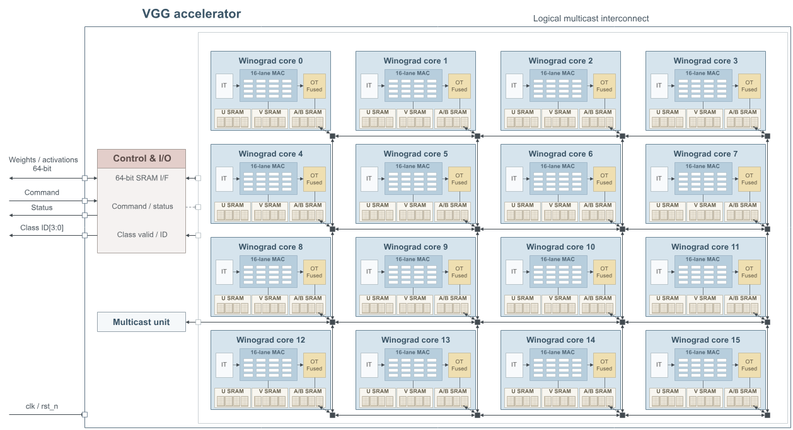
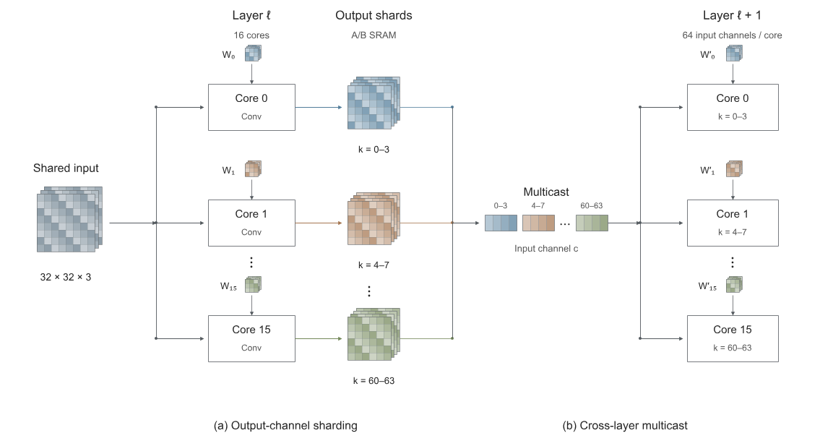
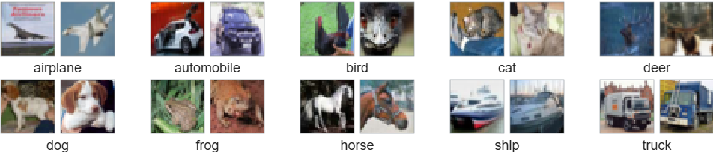
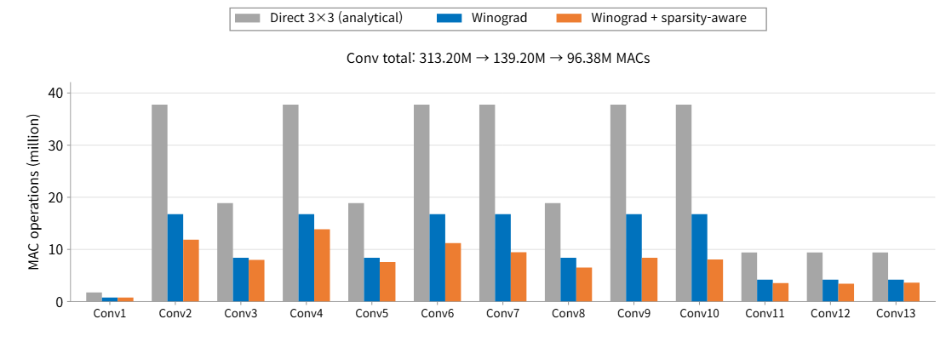
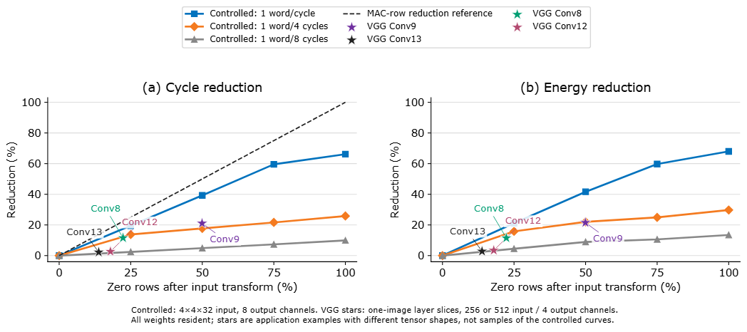
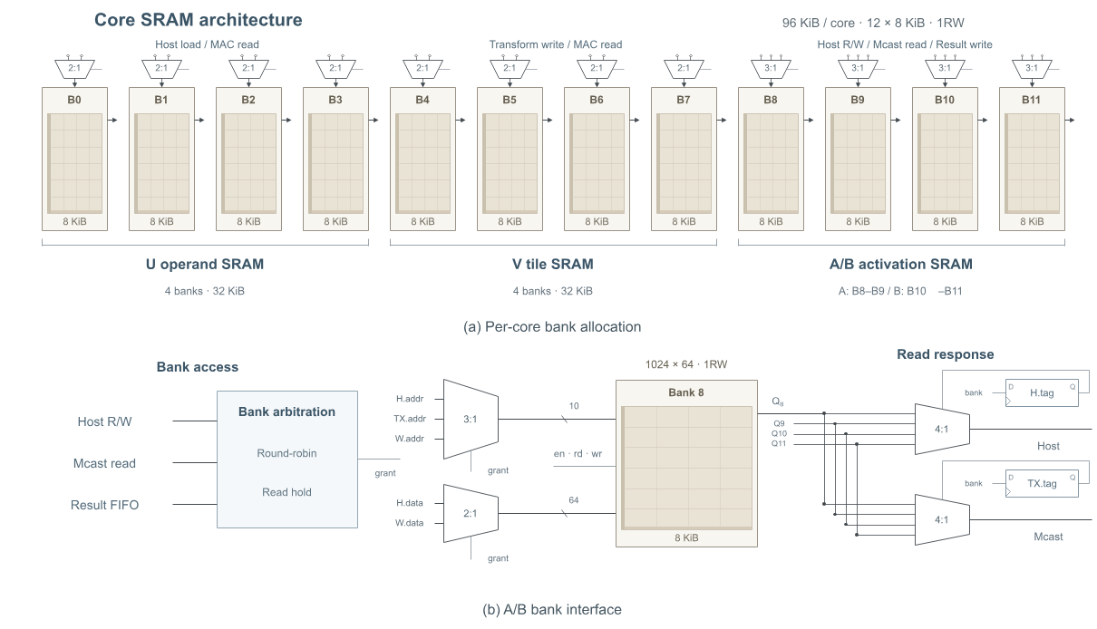
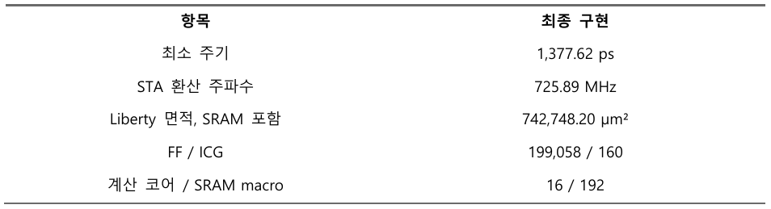
Sparsity-Aware Winograd CNN Accelerators
Park JunBeom^{A} , Gang TaeWook^{B}*
A Electronic and Electrical Engineering, Sungkyunkwan University, Korea
B Semiconductor Convergence Engineering, Sungkyunkwan University, Korea
Abstract
Boron carbon nitride (BCN) is a promising platform for studying heteroatom-induced electronic modulation in graphene-like structures. However, ex-situ transfer can expose the as-grown surface to water, oxygen, organic residues, and dust, disturbing surface-sensitive AFM(Atomic Force Microscopy)/ STM(Scanning Tunneling Microscopy) measurements. To address this issue, we present an integrated UHV system for evaporation-assisted in-situ BCN synthesis and nanoscale characterization.
The system consists of a main measurement chamber, an evaporation chamber for thermally controlled precursor deposition, and a load-lock chamber for sample/tip e
Introduction - 지정 주제
Winograd Convolution and Transform-Domain Sparsity
Winograd convolution
Without Winograd convolution
(Direct convolution)
근데 내가만든 winograd를 써 연산이 32번에서 16번으로 줄었어요~
Spatial activation
Zero tile 을 skip 하여 연산의 효율성을 증대.
두개의 알고리즘을 통하여 연산 속도를 줄이고
연산의 효율성을 증대하였다.
Architecture
Input transform
Low-Power Circuit
Tile Generator
16-lane MAC
Output transform
Fused Output Unit
Spec, Power
Introduction - 자유 주제
Introduction
Conclusion

Slide 3



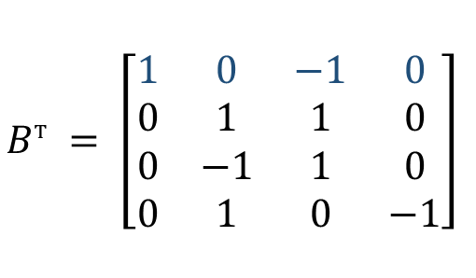


Sparsity-Aware Winograd Accelerator
JunBeom Park¹, Taewook Kang² (Advisor)
¹School of Electronic and Electrical Engineering, Sungkyunkwan University, Korea
²Department of Semiconductor Convergence Engineering, Sungkyunkwan University, Korea
Introduction
CNN activations often contain zeros, a property known as activation sparsity, which allows unnecessary computations to be skipped. Winograd convolution reduces multiplications for small kernels by transforming inputs and filters, but its input transform does not necessarily preserve the original sparsity. We detect zero rows in the intermediate transform results and compact the execution schedule to reduce computation cycles, while integrated clock gating (ICG) suppresses unnecessary clock activity. We evaluate the individual effects of these techniques in a single core and extend the architecture to 16 cores with SRAM and multicast communication. Controlled experiments and VGG-16-BN workloads on CIFAR-10 examine when arithmetic savings translate into cycle and energy reductions.
1. MNIST Evaluation
2. Direct vs. Winograd
Task
Handwritten digit
classification
Direct convolution
Winograd F(2 × 2, 3 × 3)
Dataset
MNIST
Input
28 × 28 grayscale
VS
Output
10 classes (0–9)
Accuracy
97.0%
Precision
INT4 W / UINT8 A
100 distinct images,
repeated 10 times.
Same 2 × 2 output tile: 36 → 16 multiplications (−55.56%)
Compute neighboring outputs jointly through transforms, trading fewer multiplications for extra additions.
Weights are pre-transformed offline; activation tiles are transformed during inference.
Zero-row skipping and ICG are compared under identical input and clock conditions.
3. Sparsity-Aware Core Architecture
4. Clock Gating
1 Shared Conv/FC datapath
2 Input transform: matrix coefficients become adders and subtractors
Mapped to ASAP7 ICGx1_ASAP7_75t_R · 16 instances
$$V = B^{T}dB$$
Row mask [3:0]
$$B^{T} = \left[\begin{matrix}1 & 0 & −1 & 0 \\ 0 & 1 & 1 & 0 \\ 0 & −1 & 1 & 0 \\ 0 & 1 & 0 & −1\end{matrix}\right]$$
For each column
$$t_{0} = d_{0} − d_{2}$$
Latch-based ICG suppresses unnecessary
clock pulses without glitches.
$$t_{1} = d_{1} + d_{2}$$
$$t_{2} = d_{2} − d_{1}$$
The cell captures the enable signal during
CLK-low and holds it during CLK-high.
$$t_{3} = d_{1} − d_{3}$$
Row-wise NOR on T
3 Zero-row skipping: compaction and tile bypass
MAC register banks are clocked only
when an update is required.
Separate enables control the product, accumulator,
and result registers according to input acceptance,
accumulation commit, and final-result commit.
5. Single-Core Results
Reported competition reference vs. proposed
Matched Winograd + ICG: sparsity OFF vs. ON
Dense-reference energy efficiency: 46.51 TOPS/W
Zero-row skipping reduces Conv2 execution cycles by 31.8%.
Zero-row skipping further reduces energy per image by 15.02%.
$$η_{ref} = \frac{2N_{MAC,ref}f}{{10}^{12}P} = \frac{2 × 183 × {10}^{9}}{{10}^{12} × 0.007868472} = 46.51 TOPS/W$$
MAC-lane operations decrease in both layers, while the external
1 pixel/cycle input limits Conv1 cycle reduction.
ICG is enabled in both cases, isolating
the additional benefit of zero-row skipping.
Calculated using 183 reference MACs at 1 GHz and 7.868 mW, with two operations per MAC.
6. Multicore Architecture
7. Multi-Core Results
CIFAR-10 workload
The single-core architecture is replicated across 16 cores.
VGG-16-BN: 13 Conv + 3 FC layers
CIFAR-10: 32 × 32 RGB, 10 classes
Zero-row skipping removes an additional 30.76%
of Winograd MAC-lane operations.
15,245,130 inference parameters (after BN folding)
Each core retains Winograd, zero-row skipping, and ICG.
One CIFAR-10 image. Convolution only; direct counts are analytical.
Output-channel sharding
Per-core SRAM
Output channels are partitioned; activations are shared.
Per-core SRAM supports reuse and intermediate storage.
Faster operand supply enables greater cycle and energy savings.
Each core computes a subset of output channels.
Multicast redistributes activations for the next layer.
Separate banks store weights, transformed activations,
and layer inputs and outputs.
At 50% zero rows: 39.28% fewer cycles and 41.64% lower energy (1 word/cycle).
Core-level evaluation. Stars show measured VGG-16-BN layer examples.
ASAP7 predictive 7-nm library, post-synthesis evaluation. Single-core ablation: 1 GHz. Controlled core: 1.43 ns. github.com/jbpark0616/IDEC_Challenge
Notes:
Section 4 evidence: docs/experiment_results/designated/designated_final/synth_stat.txt lists 16 ICGx1_ASAP7_75t_R cells. submission/IDEC2026/04_synthesis/chip_netlist.v contains the same 16 instances. submission/IDEC2026/02_sources/std_cell/asap7sc7p5t_SEQ_RVT_TT_220101.v:932-944 implements inverted-clock latch and AND output. Clock-tree balancing is a CTS responsibility, not a measured result here. https://openroad.readthedocs.io/en/latest/main/src/cts/README.html (balance_levels, insertion_delay).
Section 4 speaking note: Clock skew and glitch prevention are distinct. CTS must account for ICG insertion delay; no post-CTS skew reduction is claimed by this post-synthesis evaluation.
Section 5 metric: dense-reference convention eta_ref = 2*N_MAC_ref*f/(1e12*P). N_MAC_ref=183 is the nominal dense reference, not the 16 physical MAC lanes. f=1 GHz, P=7.868472 mW gives 46.514755 TOPS/W. Source: docs/experiment_results/designated/designated_final/RESULTS.txt (b1_g1). Conv2 31.8% and energy 15.02% use ICG in both cases. Native Office Math is used for the equation.
Section 6 parameter count: 15,245,130 inference parameters after BN folding = 14,710,464 convolution weights + 529,408 FC weights + 5,258 folded biases. Model: free_topic_vgg/model.py. Independently recomputed from Conv/Linear shapes and checked against docs/experiment_results/free_topic/figure_data/mac_model_comparison.json. The trainable count before BN folding is 15,253,578, excluding running statistics. Spatial inference parameter count is distinct from Winograd-transformed storage size.

Slide 4
Sparsity-Aware Winograd CNN Accelerators
Park JunBeom^{A} , Gang TaeWook^{B}*
A Electronic and Electrical Engineering, Sungkyunkwan University, Korea
B Semiconductor Convergence Engineering, Sungkyunkwan University, Korea
Abstract
Introduction - 지정 주제
Winograd Convolution and Transform-Domain Sparsity
Winograd convolution
Without Winograd convolution
(Direct convolution)
근데 내가만든 winograd를 써 연산이 32번에서 16번으로 줄었어요~
Spatial activation
Zero tile 을 skip 하여 연산의 효율성을 증대.
두개의 알고리즘을 통하여 연산 속도를 줄이고
연산의 효율성을 증대하였다.
Architecture
Input transform
Tile Generator
16-lane MAC
Output transform

Slide 5
Evaporation-Assisted In-situ BCN Synthesis and Nanoscale Characterization in an Integrated UHV System
Abstract
SEOUNGEUN LEE, JEONG WON JIN, TAEGEUN YOON, YONGTAE CHA, JUNSEO CHOI
YOUNG JAE SONG, HYEON SUK SHIN
Boron carbon nitride (BCN) is a promising platform for studying heteroatom-induced electronic modulation in graphene-like structures. However, ex-situ transfer can expose the as-grown surface to water, oxygen, organic residues, and dust, disturbing surface-sensitive AFM(Atomic Force Microscopy)/ STM(Scanning Tunneling Microscopy) measurements. To address this issue, we present an integrated UHV system for evaporation-assisted in-situ BCN synthesis and nanoscale characterization.
The system consists of a main measurement chamber, an evaporation chamber for thermally controlled precursor deposition, and a load-lock chamber for sample/tip exchange. Gate valves isolate each chamber to maintain the UHV environment. In the evaporation chamber, precursor evaporation, vapor transport, and deposition are controlled by heating both the precursor source and substrate. This in-situ system is expected to reduce contamination, preserve the as-grown BCN surface, and directly link synthesis conditions with nanoscale morphology and electronic properties. Future studies will use N-doped and B-doped molecular precursors for on-surface BCN synthesis.
Intro
Future BCN Study
Why did we design an in-situ evaporation system?
• Two types of BCN precursors:
[Ex-situ Evaporation]
[In-situ Evaporation]
H₂O
dust
UHV Chamber
O₂, organics
contamination layer
N-type doped triangulene
B-type doped triangulene
• Minimized contamination from air, water, organics, and dust
• Preservation of the as-grown surface state
• Direct correlation between synthesis conditions and AFM/STM properties
• Target system: BN-doped open-shell nanographene / BN-doped triangulene
• Key interest: effect of B–N bond polarization on spin density and electronic symmetry breaking
Schematic chamber layout of the modified STheM platform
Vacuum System
System for maintaining UHV
Ultra-High Vacuum (UHV) condition : ~10⁻¹¹ Torr
Sample, Tip, Precursor
UHV conditions minimize surface contamination and preserve the intrinsic surface state for reliable AFM/STM characterization.
Load-Lock chamber vacuum system
Atmosphere ↔ UHV enables sample/tip transfer
via rotary & turbomolecular pumping
Evaporation system
Overall upgraded STheM platform
Detailed view of Evaporation chamber
UHV evaporation system
BCN Deposition Process
Evaporation
Chamber
UHV Chamber
Heated Substrate
[Heated Substrate]
ΔT
[PBN heater]
Precursor
[Unheated Substrate]
Slit with Adjustable Height
and Temperature
The PBN heater directly heats the precursor carrier, leading to precursor evaporation and subsequent deposition onto the substrate.
Substrate heating can be selectively applied during deposition, which improves the ordering of the BCN layer.

Slide 6
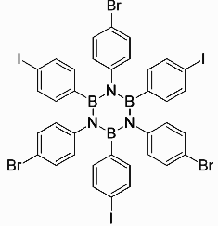
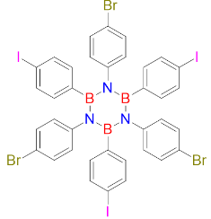
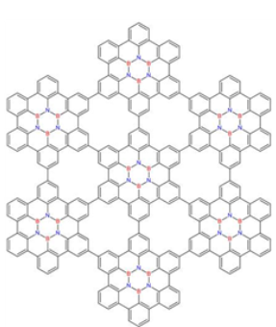
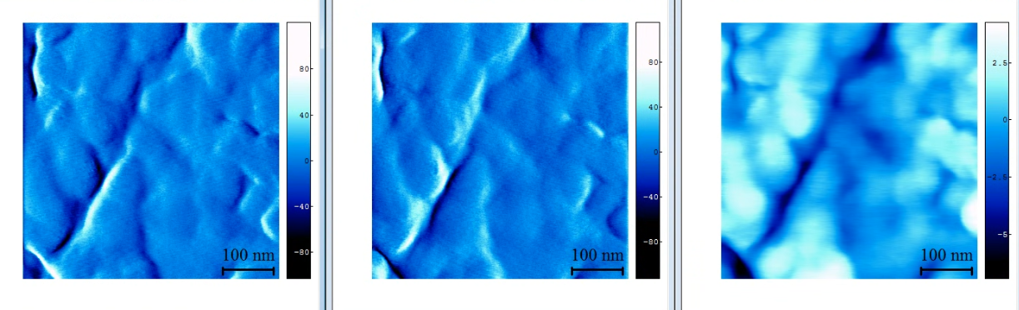
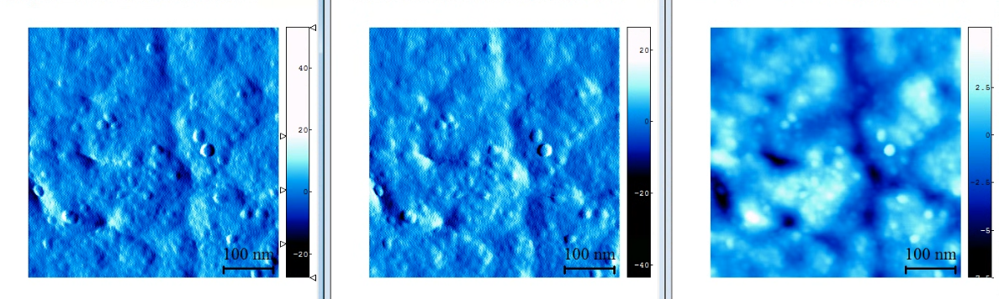
Design and Development of a UHV-Integrated STM System for On-Surface Synthesis of Boron Nitride
Seoungeun LEE^{A,B}, Jeongwon JIN^{D}, Taegeun YOON^{C}, Yongtae CHA^{C}, Dong Yeoun YOO^{C},
Junseo CHOI^{C}, Hyunwoo Kim^{E}, Young Jae SONG^{C,E}, and Hyeon Suk SHIN^{A,B,D}
^{A}Center for 2D Quantum Heterostructures, IBS, Korea
^{B}Department of Chemistry, Sungkyunkwan University, Korea,
^{C}SKKU Advanced Institute of Nanotechnology (SAINT), Sungkyunkwan University, Korea,
^{D} Department of Energy, Sungkyunkwan University, Korea,
^{E}Department of Nano Engineering, Sungkyunkwan University, Korea
^{F}Department of Energy Science, Sungkyunkwan University, Korea,
Abstract
Abstract
Self-assembled boron nitride (BN) structures have attracted significant interest for nanoscale electronic applications due to their structural stability and unique electronic properties. However, achieving well-ordered BN structures remains challenging because surface contamination and uncontrolled growth conditions can disrupt atomic-scale ordering.
Here, we present the design and implementation of an ultra-high vacuum (UHV) thermal evaporation system integrated with a scanning tunneling microscope (STM) for controlled in-situ growth of BN structures. The system consists of separate load-lock and evaporation chambers, a dedicated ion pump, and independently controlled precursor and substrate heating stages. A pyrolytic boron nitride (PBN) heater enables precursor evaporation, while a shielded heating compartment is designed to minimize thermal contamination of the surrounding vacuum environment. Furthermore, adjustable source-to-substrate distances and independent temperature control provide flexibility in optimizing evaporation and surface growth conditions.
This integrated platform is designed to facilitate controlled BN synthesis under clean UHV conditions, enabling subsequent atomic-scale STM characterization and investigation of surface growth mechanisms. Beyond BN, the system offers a versatile platform for the in-situ synthesis and characterization of functional two-dimensional materials.
Intro
In-situ Evaporation System
Abstract
Abstract
System for maintaining UHV
Ultra-High Vacuum (UHV) condition : ~10⁻¹¹ Torr
Evaporation
Chamber
Why did we design an in-situ evaporation system?
[Ex-situ Evaporation]
[In-situ Evaporation]
H₂O
dust
UHV Chamber
O₂, organics
[Overall upgraded STheM platform]
contamination layer
A thermal evaporation system was integrated into STheM under UHV conditions.
Target Precursor : 3I-3Br hexaphenyl Borazine
Target Substrate : Ag(110)
• Minimized contamination from air, water, organics, and dust
• Preservation of the as-grown surface state
• Direct correlation between synthesis conditions
and AFM/STM properties
UHV conditions minimize surface contamination and preserve the intrinsic surface state for reliable AFM/STM characterization.
Thermal Evaporation system design
Schematic chamber layout of the modified STheM platform
Abstract
Detailed view of Evaporation chamber
UHV evaporation system
BCN Deposition Process
UHV Chamber
[Heated Substrate]
Heated Substrate
ΔT
[PBN heater]
Precursor
[Unheated Substrate]
Slit with Adjustable Height
and Temperature
Substrate heating can be selectively applied during deposition, which improves the ordering of the BCN layer.
The PBN heater directly heats the precursor carrier, leading to precursor
evaporation and subsequent deposition onto the substrate.
Selective growth mechanism of 3Br-3I-HPB
Reaction Steps
Ullmann coupling
(I-I or Br-Br reaction)
& cyclodehydrogenation
Thermal deposition
Ullmann coupling(210-240℃, 40 min)
cyclodehydration(400 ℃, 20 min)
Thermal Evaporation system design
Future Work
Abstract
Abstract
Ag(110) AFM image before deposited
1. Integration of an In-Situ Sputtering System
Improve surface cleanliness and crystallinity of single-crystal substrates through sputtering and annealing.
2. Surface-Assisted Reactions via Substrate Heating
Promote further surface reactions, such as Ullmann coupling, through controlled substrate heating to investigate secondary reaction products.
3. Atomic-Scale Characterization Using STM
Acquire additional high-resolution STM images and spectroscopic data to investigate surface structures and electronic properties.
[fn-fn0 Foward] [fn-fn0 Foward Backward] [Z image 500*500]
Ag(110) AFM image After deposited
[fn-fn0 Foward] [fn-fn0 Foward Backward] [Z image 500*500]
The presence of circular features in the topographic images suggests successful deposition.

Slide 7
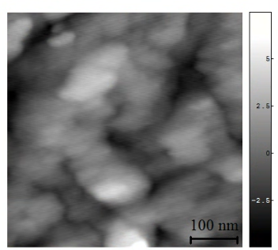
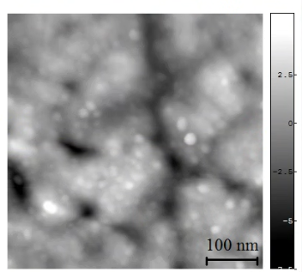


Design and Development of a UHV-Integrated STM System for On-Surface Synthesis of Boron Nitride
Seoungeun LEE^{A,B}, Jeongwon JIN^{C}, Taegeun YOON^{D}, Yongtae CHA^{D}, Dong Yeoun YOO^{D},
Junseo CHOI^{D}, Hyunwoo Kim^{E}, Young Jae SONG^{D}, and Hyeon Suk SHIN^{A,B,D}
^{A}Center for 2D Quantum Heterostructures, IBS, Korea
^{B}Department of Chemistry, Sungkyunkwan University, Korea,
^{C} Department of Energy, Sungkyunkwan University, Korea,
^{D}SKKU Advanced Institute of Nanotechnology (SAINT), Sungkyunkwan University, Korea,
^{E}Department of Nano Engineering, Sungkyunkwan University, Korea
^{F}Department of Energy Science, Sungkyunkwan University, Korea,
Abstract
Abstract
Self-assembled boron nitride (BN) structures have attracted significant interest for nanoscale electronic applications due to their structural stability and unique electronic properties. However, achieving well-ordered BN structures remains challenging because surface contamination and uncontrolled growth conditions can disrupt atomic-scale ordering.
Here, we present the design and implementation of an ultra-high vacuum (UHV) thermal evaporation system integrated with a scanning tunneling microscope (STM) for controlled in-situ growth of BN structures. The system consists of separate load-lock and evaporation chambers, a dedicated ion pump, and independently controlled precursor and substrate heating stages. A pyrolytic boron nitride (PBN) heater enables precursor evaporation, while a shielded heating compartment is designed to minimize thermal contamination of the surrounding vacuum environment. Furthermore, adjustable source-to-substrate distances and independent temperature control provide flexibility in optimizing evaporation and surface growth conditions.
This integrated platform is designed to facilitate controlled BN synthesis under clean UHV conditions, enabling subsequent atomic-scale STM characterization and investigation of surface growth mechanisms. Beyond BN, the system offers a versatile platform for the in-situ synthesis and characterization of functional two-dimensional materials.
Intro
In-situ Evaporation System
Abstract
Abstract
System for maintaining UHV
Ultra-High Vacuum (UHV) condition : ~10⁻¹¹ Torr
Evaporation
Chamber
Why did we design an in-situ evaporation system?
[Ex-situ Evaporation]
[In-situ Evaporation]
H₂O
dust
UHV Chamber
O₂, organics
[Overall upgraded STheM platform]
contamination layer
A thermal evaporation system was integrated into STheM under UHV conditions.
Target Precursor : 3I-3Br hexaphenyl Borazine
Target Substrate : Ag(110)
• Minimized contamination from air, water, organics, and dust
• Preservation of the as-grown surface state
• Direct correlation between synthesis conditions
and AFM/STM properties
UHV conditions minimize surface contamination and preserve the intrinsic surface state for reliable AFM/STM characterization.
Thermal Evaporation system design
Schematic chamber layout of the modified STheM platform
Abstract
Detailed view of Evaporation chamber
UHV evaporation system
UHV Chamber
Heated Substrate
[PBN heater]
Precursor
Slit with Adjustable Height
and Temperature
The PBN heater directly heats the precursor carrier, leading to precursor
evaporation and subsequent deposition onto the substrate.
[Heated Substrate]
BCN Deposition Process
ΔT
Substrate heating can be selectively applied during deposition, which improves the ordering of the BCN layer.
[Unheated Substrate]
Thermal Evaporation system design
Future Work
Abstract
Abstract
Ag(110) AFM image before deposited vs After deposited
1. Integration of an In-Situ Sputtering System
Improve surface cleanliness and crystallinity of single-crystal substrates through sputtering and annealing.
2. Surface-Assisted Reactions via Substrate Heating
Promote further surface reactions, such as Ullmann coupling, through controlled substrate heating to investigate secondary reaction products.
3. Atomic-Scale Characterization Using STM
Acquire additional high-resolution STM images and spectroscopic data to investigate surface structures and electronic properties.
Ullmann coupling
(I-I or Br-Br reaction)
& cyclodehydrogenation
Reaction Steps
Thermal deposition
Ullmann coupling(210-240℃, 40 min)
The presence of circular features in the topographic images suggests successful deposition, which is further supported by the corresponding height profile.
cyclodehydration(400 ℃, 20 min)

Slide 8
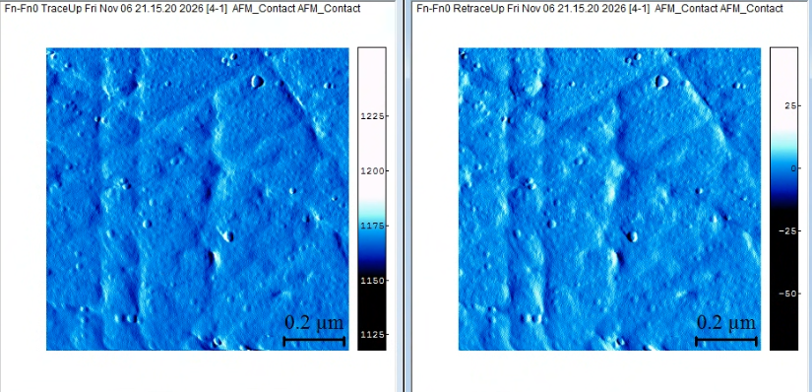
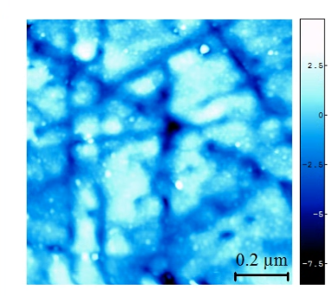
Design and Development of a UHV-Integrated STM System for On-Surface Synthesis of Boron Nitride
Seoungeun LEE^{A,B}, Jeongwon JIN^{D}, Taegeun YOON^{C}, Yongtae CHA^{C}, Dong Yeoun YOO^{C},
Junseo CHOI^{C}, Hyunwoo Kim^{E}, Young Jae SONG^{C,E}, and Hyeon Suk SHIN^{A,B,D}
^{A}Center for 2D Quantum Heterostructures, IBS, Korea
^{B}Department of Chemistry, Sungkyunkwan University, Korea,
^{C}SKKU Advanced Institute of Nanotechnology (SAINT), Sungkyunkwan University, Korea,
^{D} Department of Energy, Sungkyunkwan University, Korea,
^{E}Department of Nano Engineering, Sungkyunkwan University, Korea
^{F}Department of Energy Science, Sungkyunkwan University, Korea,
Abstract
Self-assembled boron nitride (BN) structures have attracted significant interest for nanoscale electronic applications due to their structural stability and unique electronic properties. However, achieving well-ordered BN structures remains challenging because surface contamination and uncontrolled growth conditions can disrupt atomic-scale ordering.
Here, we present the design and implementation of an ultra-high vacuum (UHV) thermal evaporation system integrated with a scanning tunneling microscope (STM) for controlled in-situ growth of BN structures. The system consists of separate load-lock and evaporation chambers, a dedicated ion pump, and independently controlled precursor and substrate heating stages. A pyrolytic boron nitride (PBN) heater enables precursor evaporation, while a shielded heating compartment is designed to minimize thermal contamination of the surrounding vacuum environment. Furthermore, adjustable source-to-substrate distances and independent temperature control provide flexibility in optimizing evaporation and surface growth conditions.
This integrated platform is designed to facilitate controlled BN synthesis under clean UHV conditions, enabling subsequent atomic-scale STM characterization and investigation of surface growth mechanisms. Beyond BN, the system offers a versatile platform for the in-situ synthesis and characterization of functional two-dimensional materials.
Intro
Insitu Evaporation system
Evaporation
Chamber
Why did we design an in-situ evaporation system?
System for maintaining UHV
Ultra-High Vacuum (UHV) condition : ~10⁻¹¹ Torr
[Ex-situ Evaporation]
[In-situ Evaporation]
H₂O
dust
UHV Chamber
O₂, organics
[Overall upgraded STheM platform]
contamination layer
A thermal evaporation system was integrated into STheM under UHV conditions.
Target Precursor : 3I-3Br hexaphenyl Borazine
Target Substrate : Ag(110)
• Minimized contamination from air, water, organics, and dust
• Preservation of the as-grown surface state
• Direct correlation between synthesis conditions
and AFM/STM properties
Schematic chamber layout of the modified STheM platform
UHV conditions minimize surface contamination
and preserve the intrinsic surface state for reliable AFM/STM characterization.
Thermal Evaporation
Selective growth mechanism of 3Br-3I-HPB
BCN Deposition Process
Ullmann coupling
(I-I or Br-Br reaction)
& cyclodehydrogenation
[Heated Substrate]
Sample, Tip, Precursor
ΔT
Deposition time : 15min
Deposition temperature : 200C
[Unheated Substrate]
Deposited AFM image
Ag(110) AFM image before deposited
Evaporation system
UHV evaporation system
Detailed view of Evaporation chamber
UHV Chamber
fn-fn0 Foward, Backward / Z image 500*500
Heated Substrate
Ag(110) AFM image After deposited
[PBN heater]
Precursor
Slit with Adjustable Height
and Temperature
The PBN heater directly heats the precursor carrier, leading to precursor
evaporation and subsequent deposition onto the substrate.
fn-fn0 Foward, Backward / Z image 1000*1000
Future work
Insitu Sputtering system building
Integration of an in-situ sputtering system for improved surface cleanliness and crystal quality
Insitu Sputtering system building

Slide 9
Evaporation-Assisted In-situ BCN Synthesis and Nanoscale Characterization in an Integrated UHV System
Abstract
SEOUNGEUN LEE, JEONG WON JIN, TAEGEUN YOON, YONGTAE CHA, JUNSEO CHOI
YOUNG JAE SONG, HYEON SUK SHIN
Boron carbon nitride (BCN) is a promising platform for studying heteroatom-induced electronic modulation in graphene-like structures. However, ex-situ transfer can expose the as-grown surface to water, oxygen, organic residues, and dust, disturbing surface-sensitive AFM(Atomic Force Microscopy)/ STM(Scanning Tunneling Microscopy) measurements. To address this issue, we present an integrated UHV system for evaporation-assisted in-situ BCN synthesis and nanoscale characterization.
The system consists of a main measurement chamber, an evaporation chamber for thermally controlled precursor deposition, and a load-lock chamber for sample/tip exchange. Gate valves isolate each chamber to maintain the UHV environment. In the evaporation chamber, precursor evaporation, vapor transport, and deposition are controlled by heating both the precursor source and substrate. This in-situ system is expected to reduce contamination, preserve the as-grown BCN surface, and directly link synthesis conditions with nanoscale morphology and electronic properties. Future studies will use N-doped and B-doped molecular precursors for on-surface BCN synthesis.
Intro
Insitu Evaporation system
Evaporation
Chamber
Why did we design an in-situ evaporation system?
System for maintaining UHV
Ultra-High Vacuum (UHV) condition : ~10⁻¹¹ Torr
[Ex-situ Evaporation]
[In-situ Evaporation]
H₂O
dust
UHV Chamber
O₂, organics
[Overall upgraded STheM platform]
contamination layer
• Minimized contamination from air, water, organics, and dust
• Preservation of the as-grown surface state
• Direct correlation between synthesis conditions
and AFM/STM properties
UHV conditions minimize surface contamination
and preserve the intrinsic surface state for reliable AFM/STM characterization.
Schematic chamber layout of the modified STheM platform
Vacuum System
Sample, Tip, Precursor
Evaporation system
Detailed view of Evaporation chamber
UHV evaporation system
BCN Deposition Process
UHV Chamber
Heated Substrate
[Heated Substrate]
ΔT
[PBN heater]
Precursor
[Unheated Substrate]
Slit with Adjustable Height
and Temperature
The PBN heater directly heats the precursor carrier, leading to precursor evaporation and subsequent deposition onto the substrate.
Substrate heating can be selectively applied during deposition, which improves the ordering of the BCN layer.
Evaporation system

