Slide 1
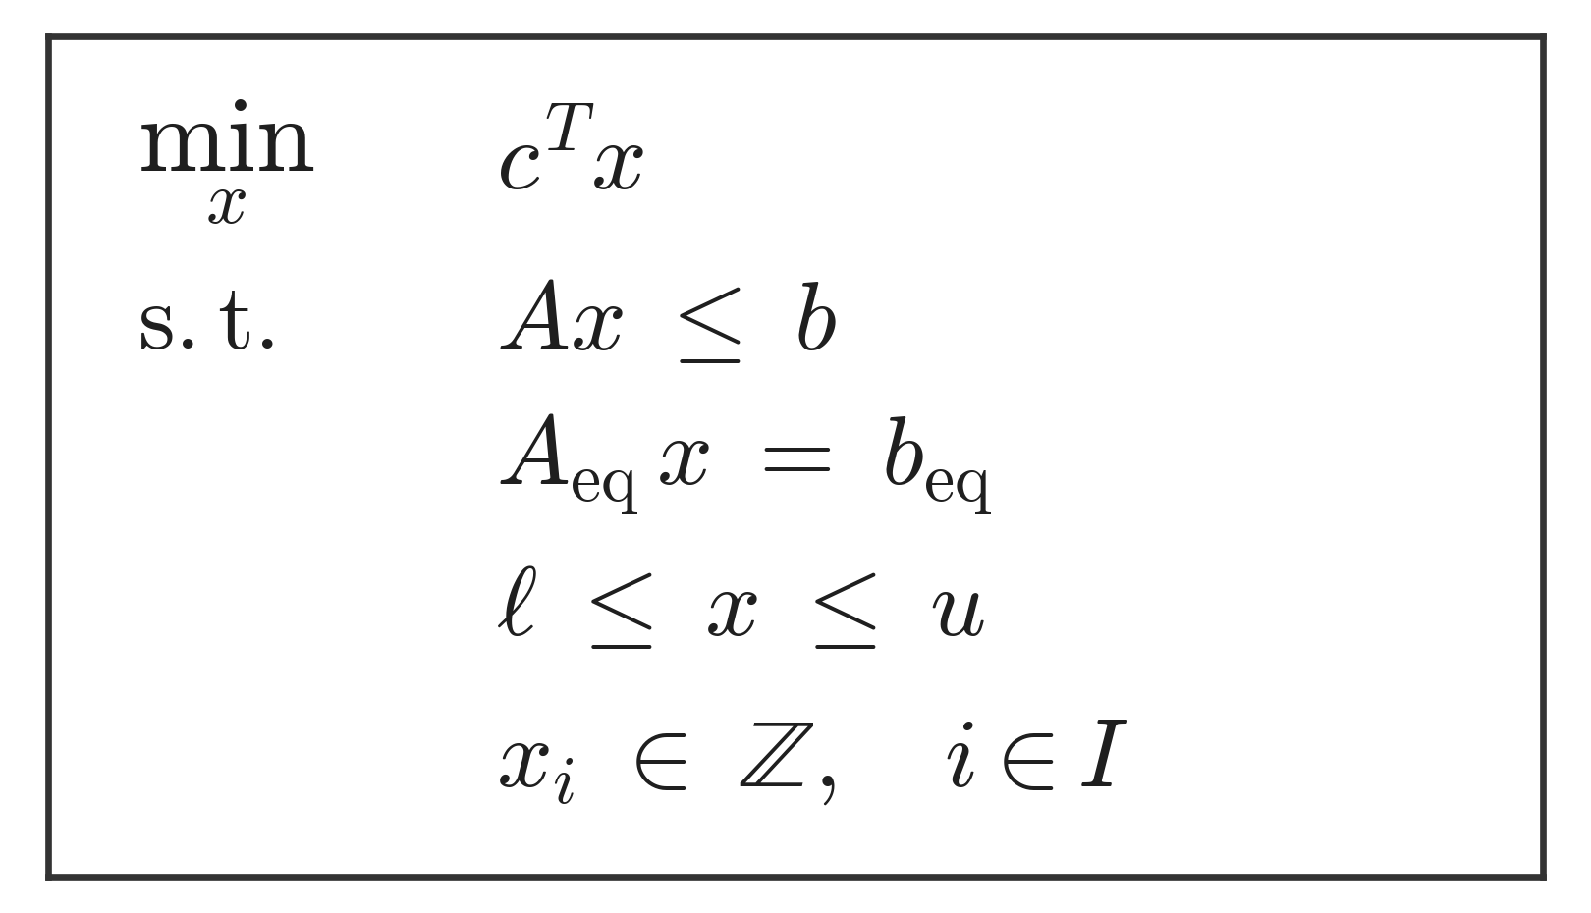
Mixed-Integer Linear Program — standard form

