Slide 1
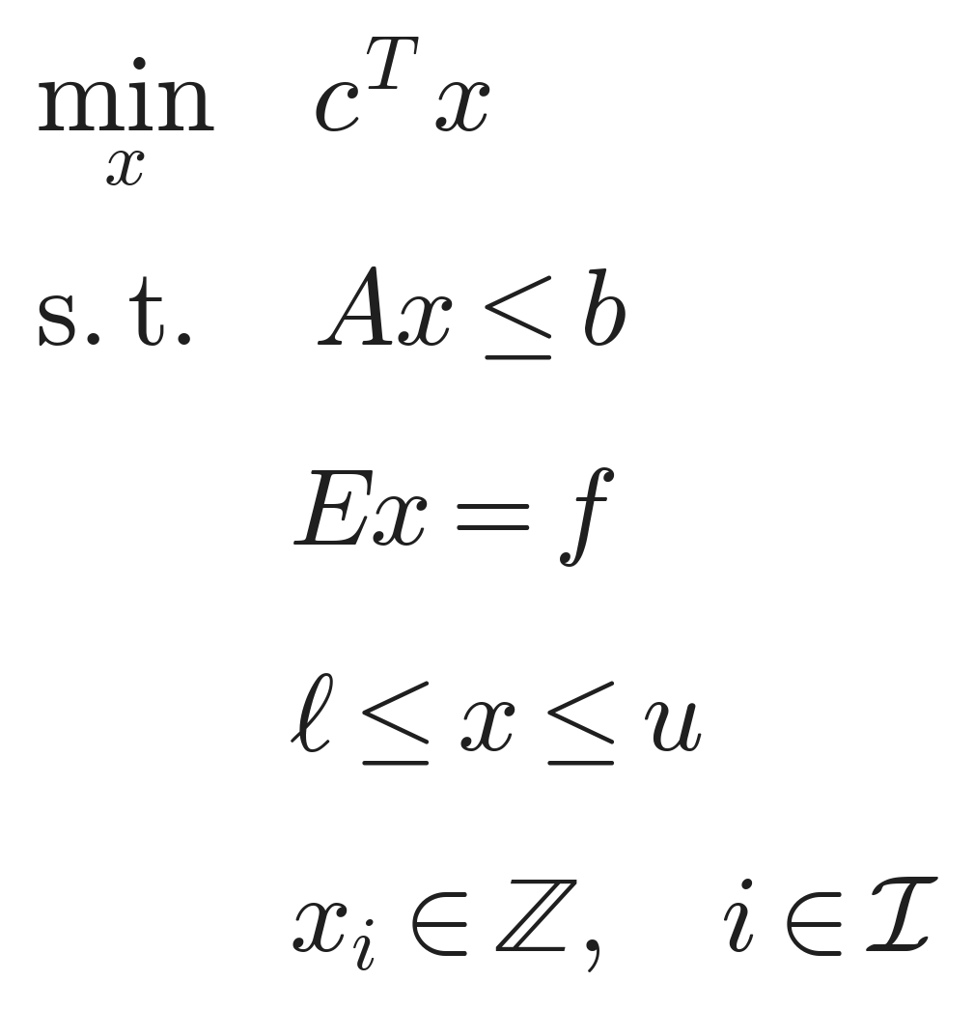
Canonical MILP (standard form)
ConvCoreRemap · MILP · 01/17

Slide 2
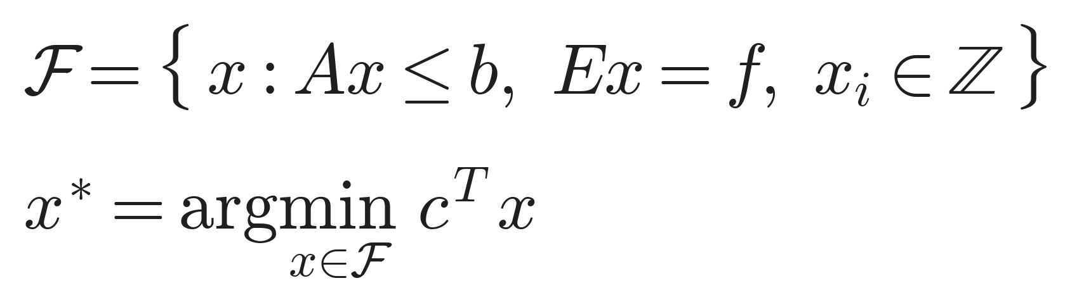
Feasible set and optimum
ConvCoreRemap · MILP · 02/17

Slide 3
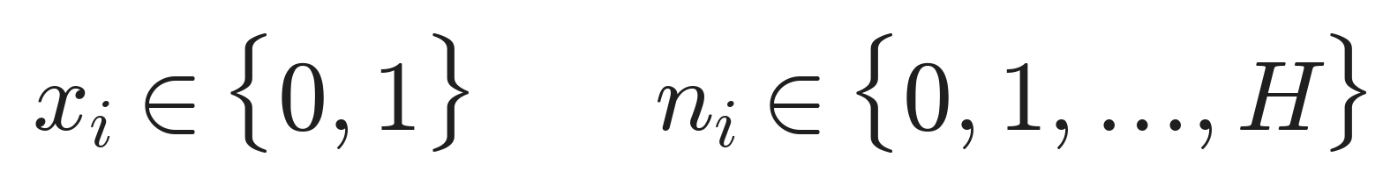
Decision variables
ConvCoreRemap · MILP · 03/17

Slide 4
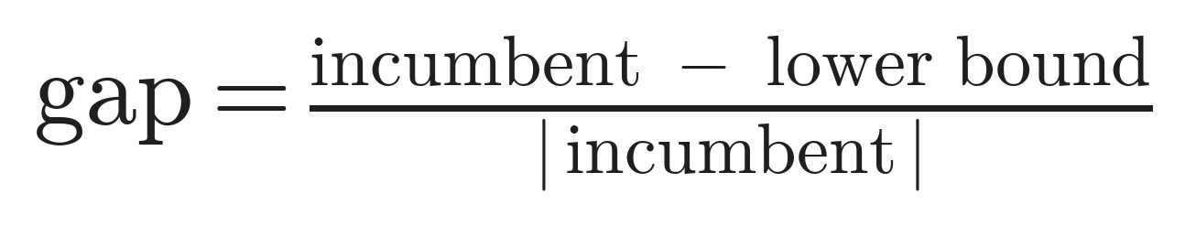
MILP optimality gap
ConvCoreRemap · MILP · 04/17

Slide 5
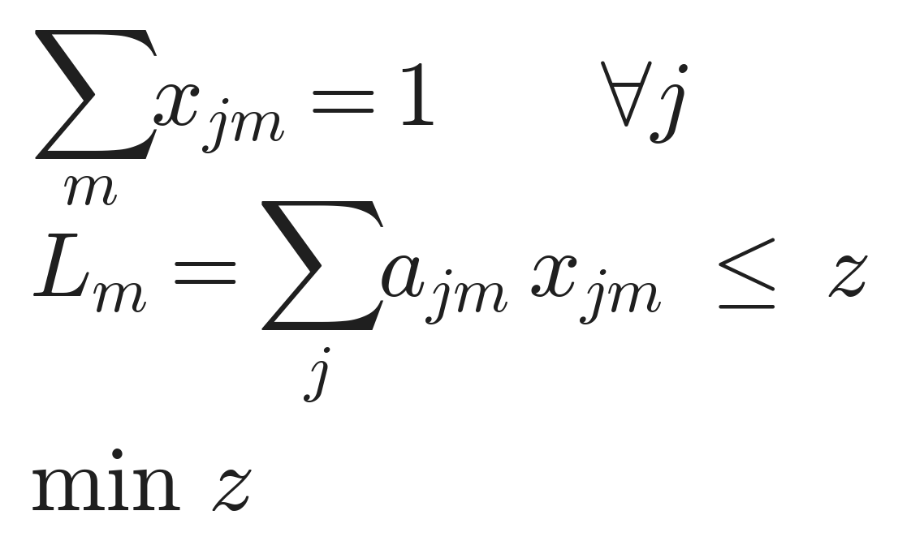
Min-max assignment pattern
ConvCoreRemap · MILP · 05/17

Slide 6
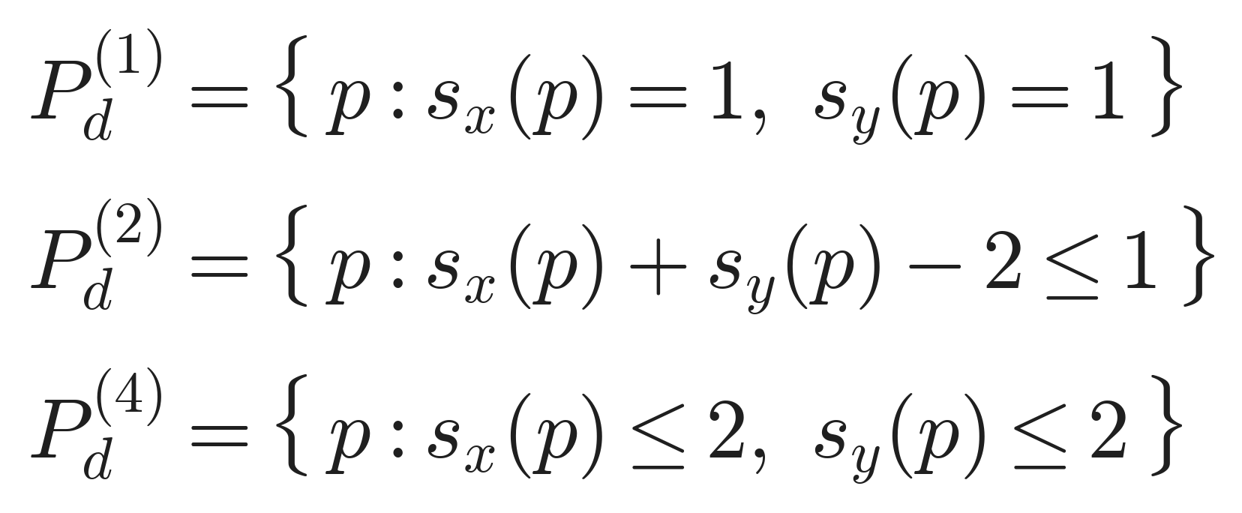
Legal candidate sets (segment limit)
ConvCoreRemap · MILP · 06/17

Slide 7
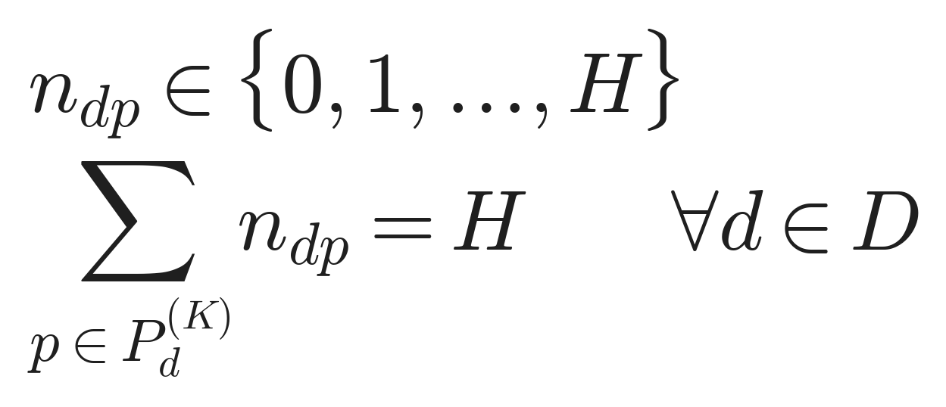
Placement-use counts
ConvCoreRemap · MILP · 07/17

Slide 8
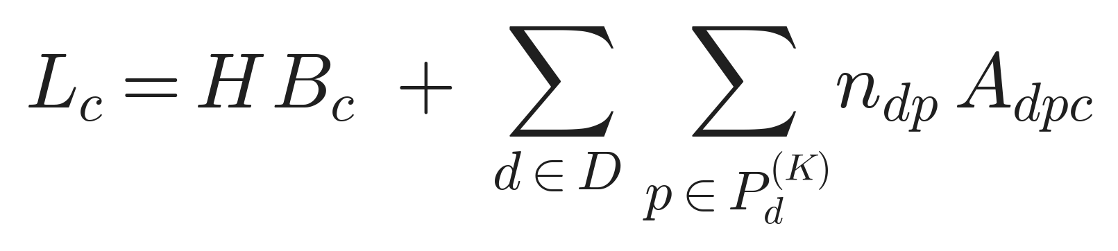
Per-worker cumulative load
ConvCoreRemap · MILP · 08/17

Slide 9
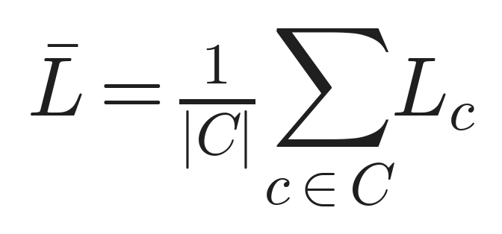
Period-average worker load
ConvCoreRemap · MILP · 09/17

Slide 10
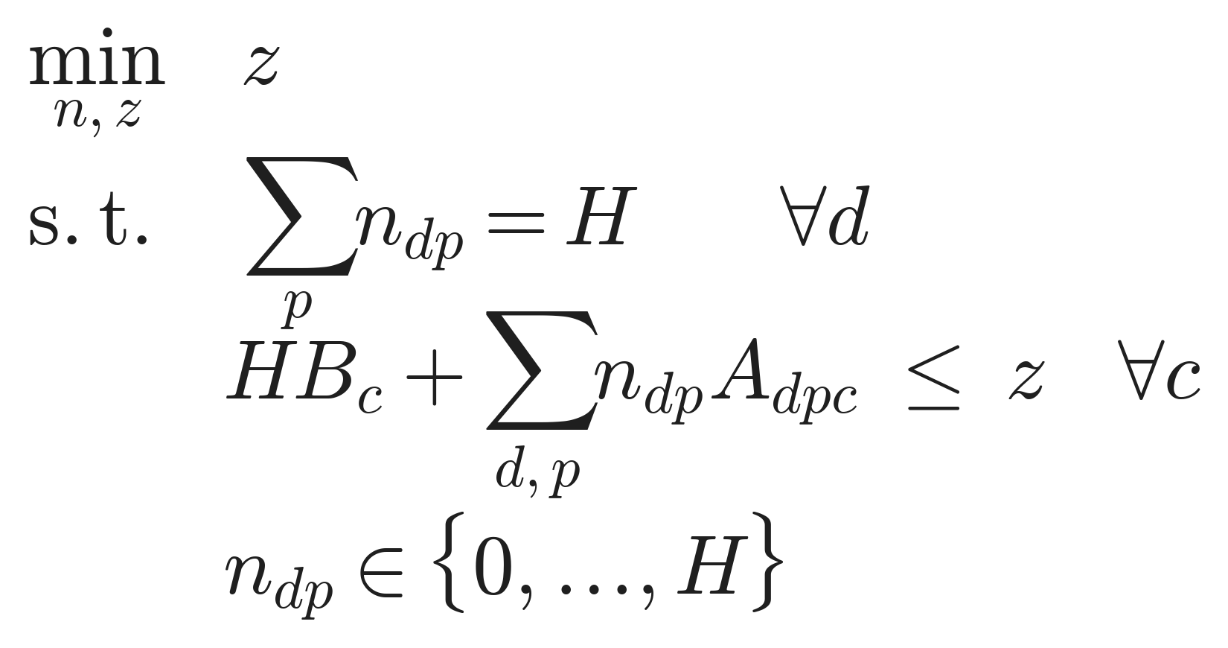
Stage 1 : minimize the hottest worker
ConvCoreRemap · MILP · 10/17

Slide 11

Ideal reduction ceiling
ConvCoreRemap · MILP · 11/17

Slide 12
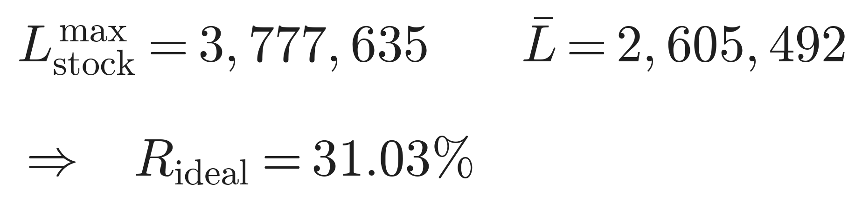
Measured ceiling
ConvCoreRemap · MILP · 12/17

Slide 13
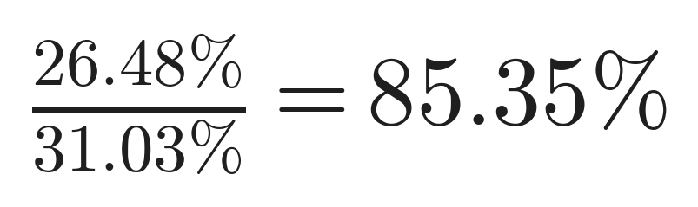
Two segments capture most of the gain
ConvCoreRemap · MILP · 13/17

Slide 14
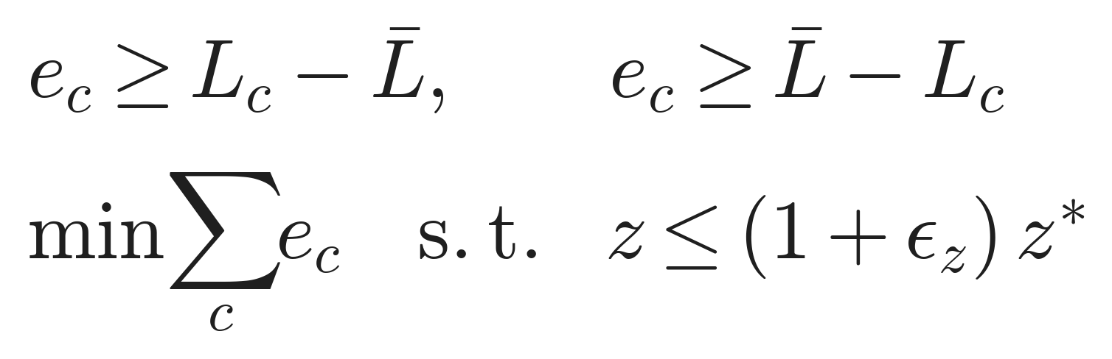
Stage 2 : reduce residual imbalance
ConvCoreRemap · MILP · 14/17

Slide 15
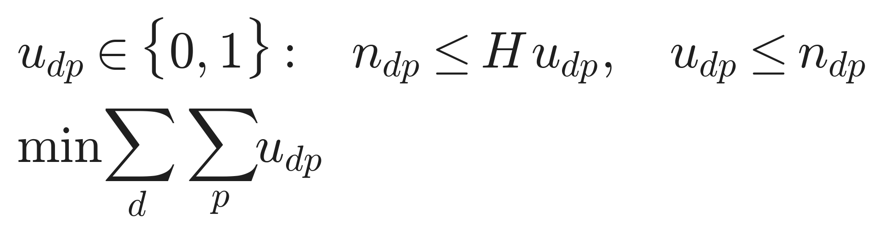
Stage 3 : fewest distinct programs
ConvCoreRemap · MILP · 15/17

Slide 16
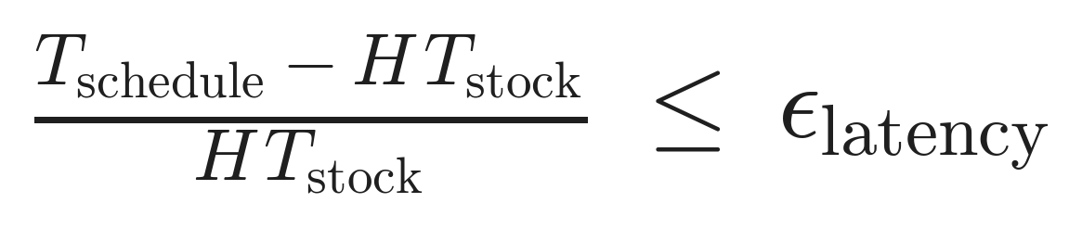
Latency budget (hard constraint)
ConvCoreRemap · MILP · 16/17

Slide 17

Runtime : deterministic periodic lookup
ConvCoreRemap · MILP · 17/17

