Slide 1
PREDICTING STARTUP SUCCESSES
Notes:
Venture Capitalist’s source thousands of potential investments annually and use early performance data to predict future outcomes

Slide 2
Venture Capital Is A Two-Sided Market
VCs raise capital from limited partners, and
Startups raise money from VCs
BUT HOW DO INVESTORS AT ALL LAYERS OF THE CAPITAL STACK CASH OUT?.

Slide 3




Liquidity Events
SUCCESSFUL EXITS.
FAILED EXITS.
IPO
Closed down
M&A
Notes:
Liquidity events, which come in two primary flavors: an exit via merger or acquisition, or to list company shares on public markets as an IPO.
The other side of the coin is companies’ will shutdown or cease to no longer exist
Max Valuation at an IPO Exit: Alibaba w/ $1.1B in Funding and a $167.6B Valuation
Recent notable M&A deal was Unilever purchasing Dollar Shave Club at a $1B Valuation
Notable failures: Theranos w/ $700M in Funding and just last week Quibi is looking to sell off its assets after raising over $1.75B
THIS IS TO SAY THERE ARE INHERENT RISKS

Slide 4
Goal of Model
Limit these inherent risks by providing VCs with quantifiable data that determines where and when to invest, considering key factors that will decrease the overall failure rate and maximize the ROI of its portfolio companies.
Notes:
Limit these inherent risks by providing VCs with quantifiable data that determines where and when to invest, considering key factors that will decrease the overall failure rate and maximize the ROI of its portfolio companies.

Slide 5
Methodology
Data.
Crunchbase via Kaggle
Companies founded between 2005-2015
Implementation.
Classification models + Tableau
Tools:
Python – Numpy – Pandas – Scikit Learn –SQL

Slide 6
Features, Models, & Metrics
Model - Logistic Regression
Features:
Funding Amounts
Funding Timing
Industry
Location
Metric score: ROC AUC

Slide 7
Baseline Likelihood of Success
41%

Slide 8
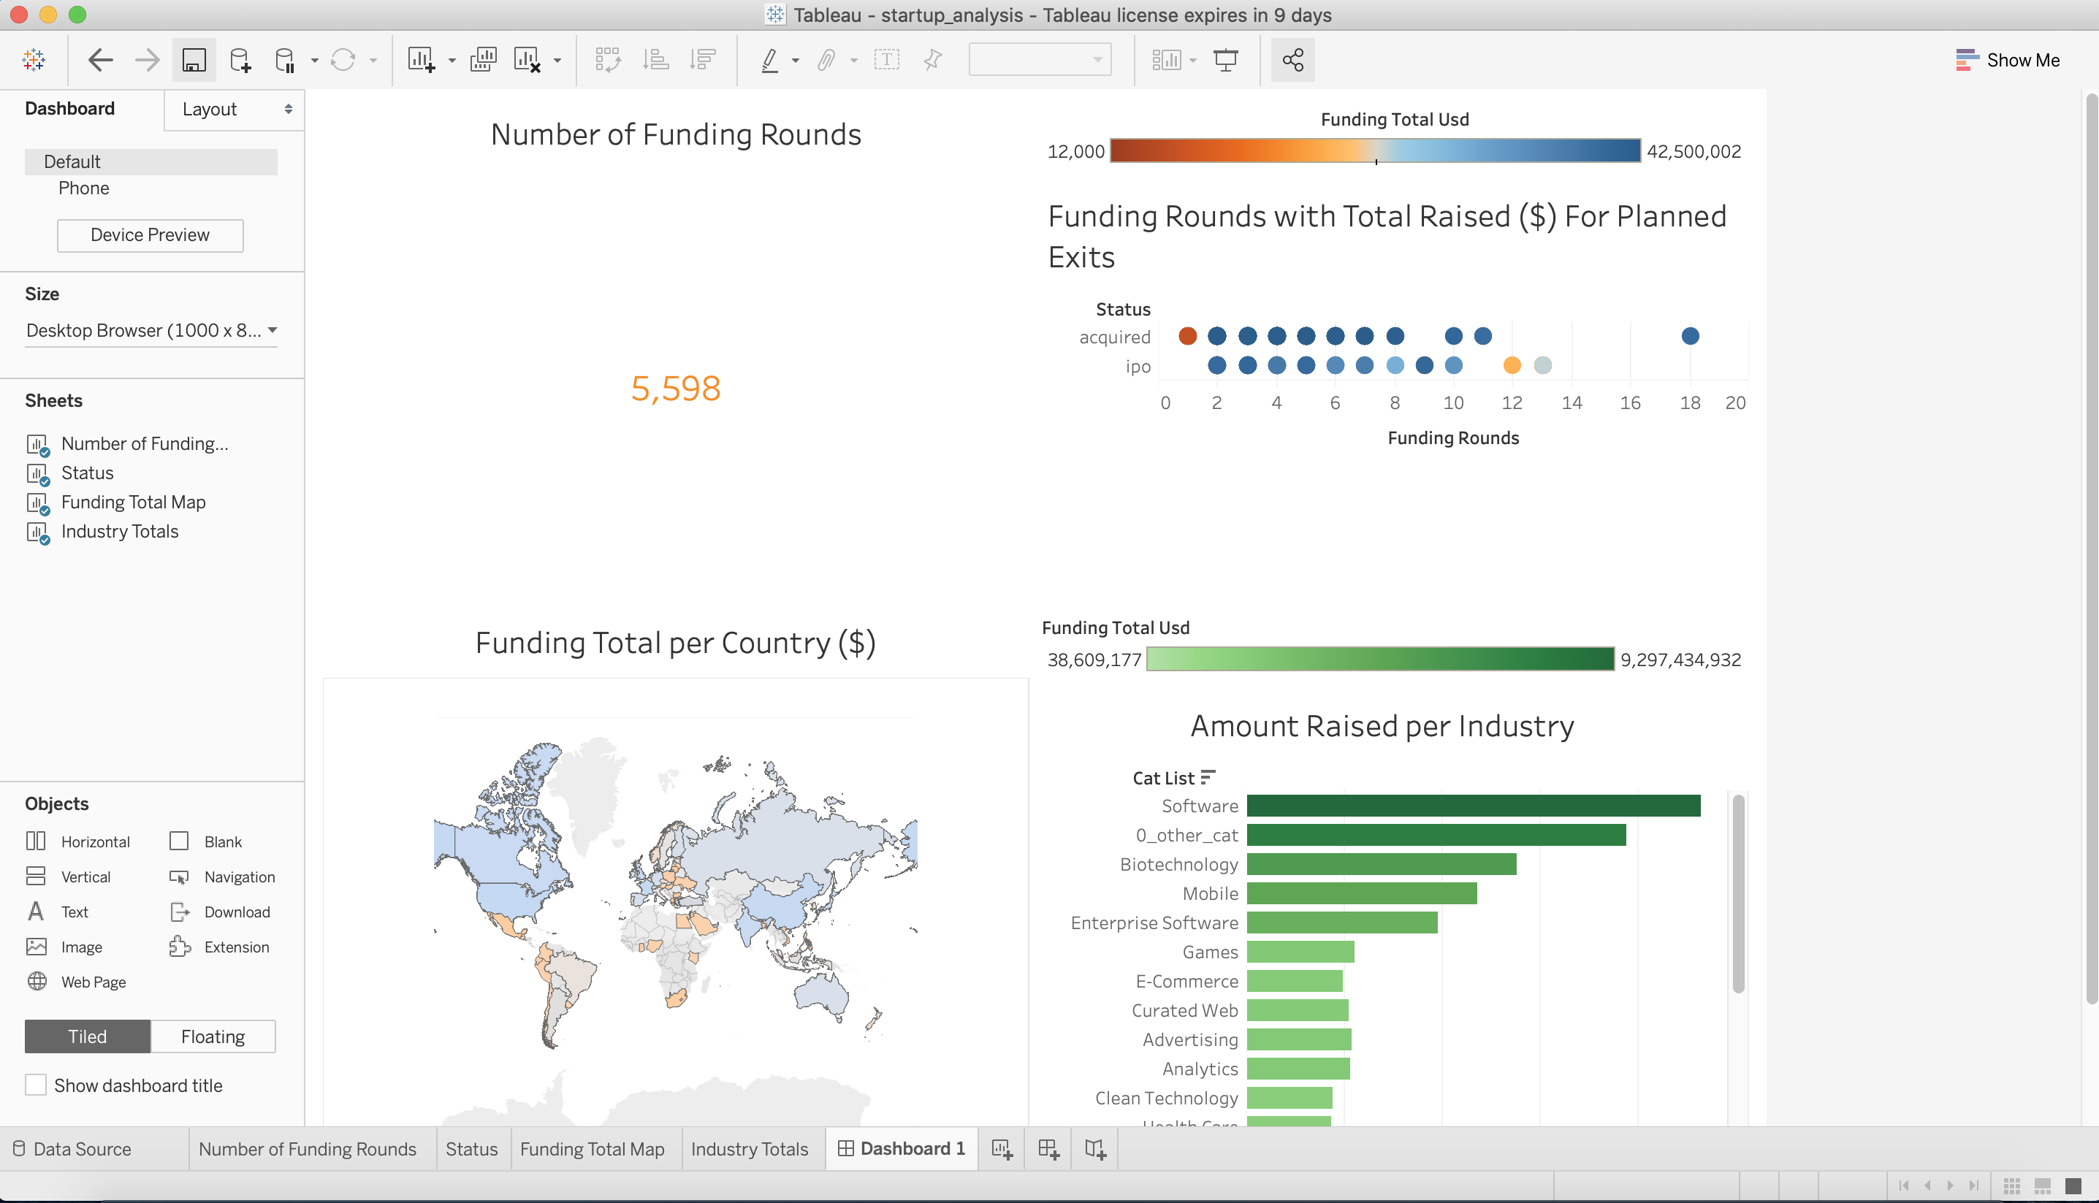
Tableau Dashboard

Slide 9
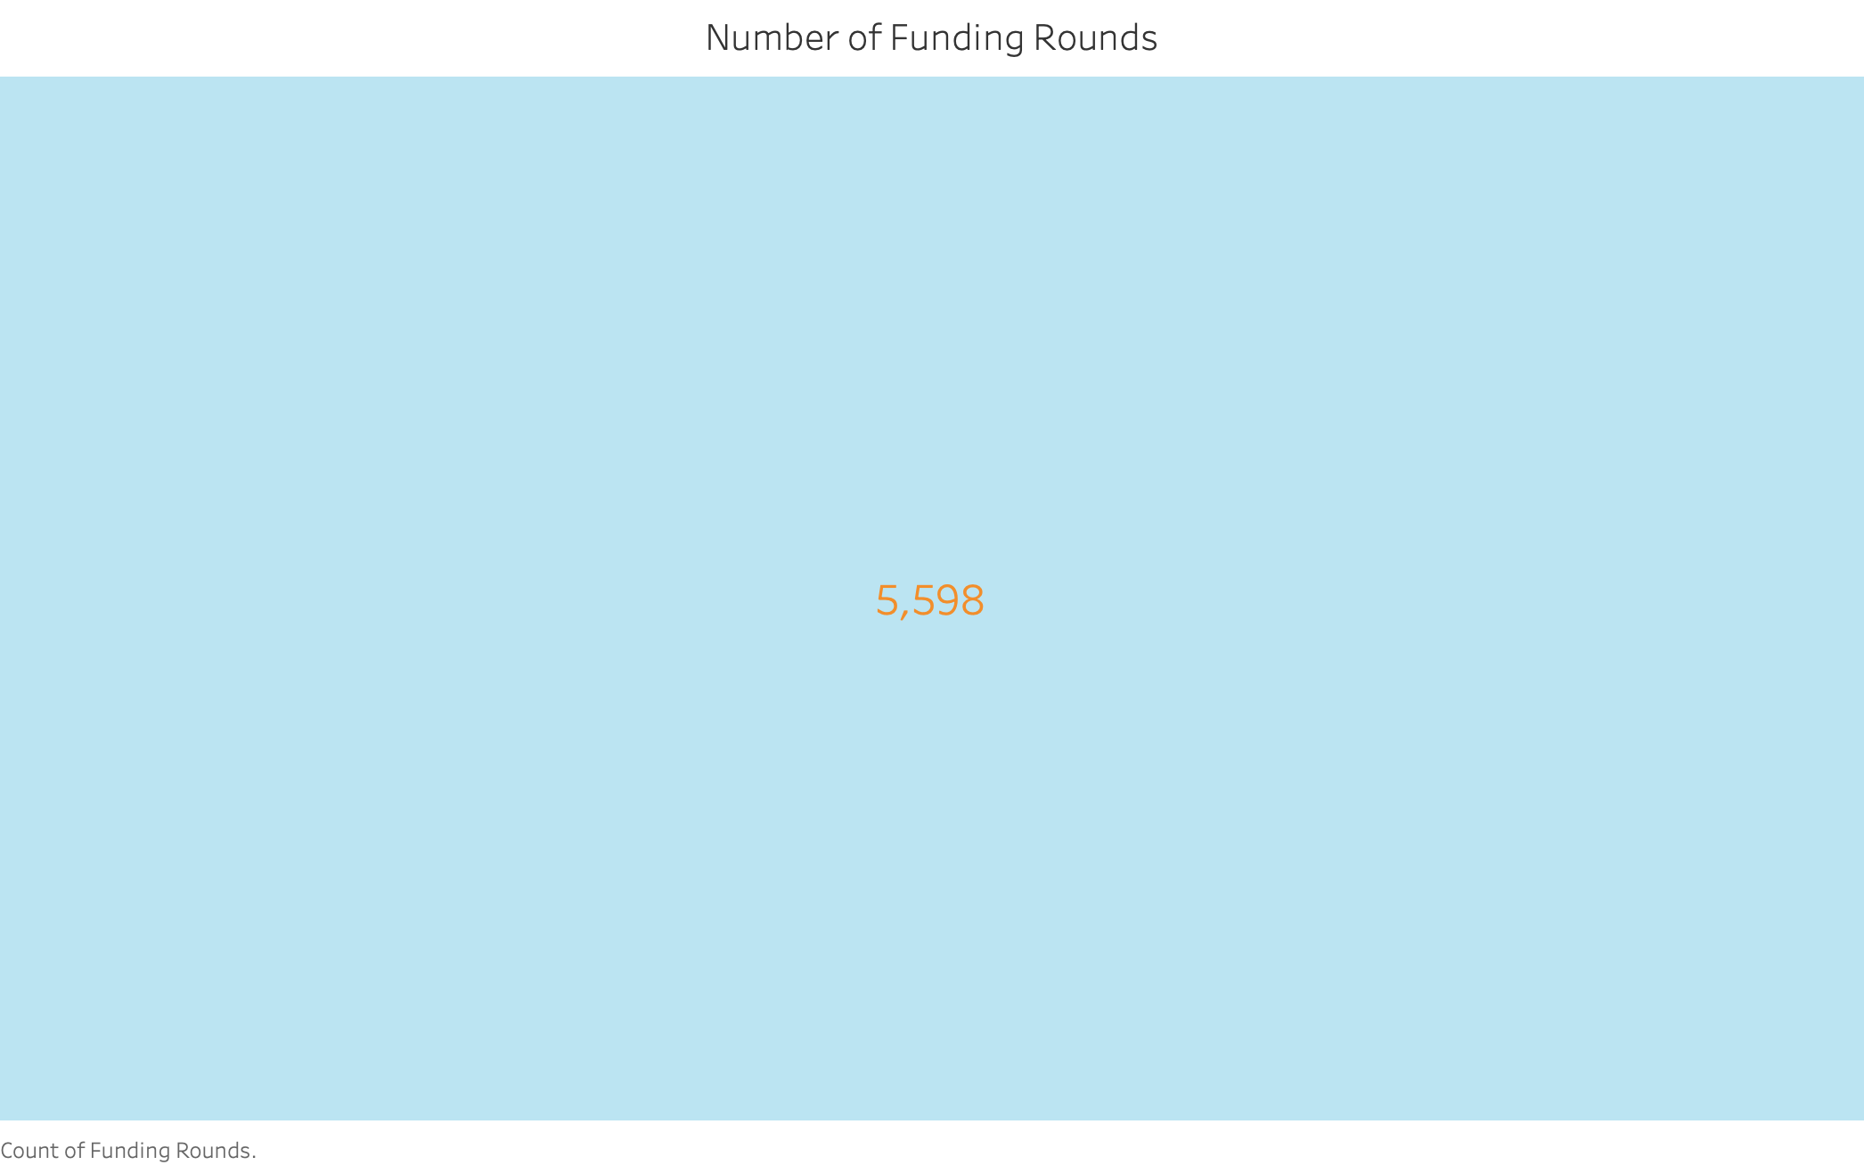
Tableau – Number of Funding Rounds

Slide 10
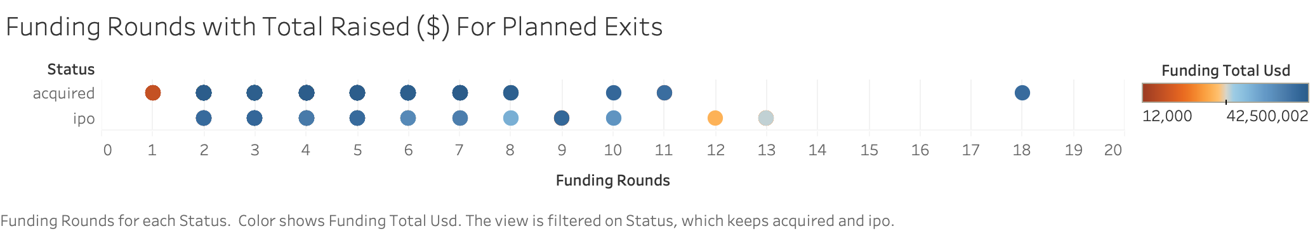
Tableau – Funding Rounds w/ Total Raised ($) For Planned Exits
Notes:
The objective of a VC is to receive an ROI through the form of an exit within a reasonable amount of time
For Acquisitions, they typically happen between rounds 8-11 so VCs would want to make their investment before round 7
As for IPOs, this chart shows that they will happen before round 13 with majority of funding being invested before round 7
VCs need to understand when and when not to invest in a company and the timeline is very important

Slide 11
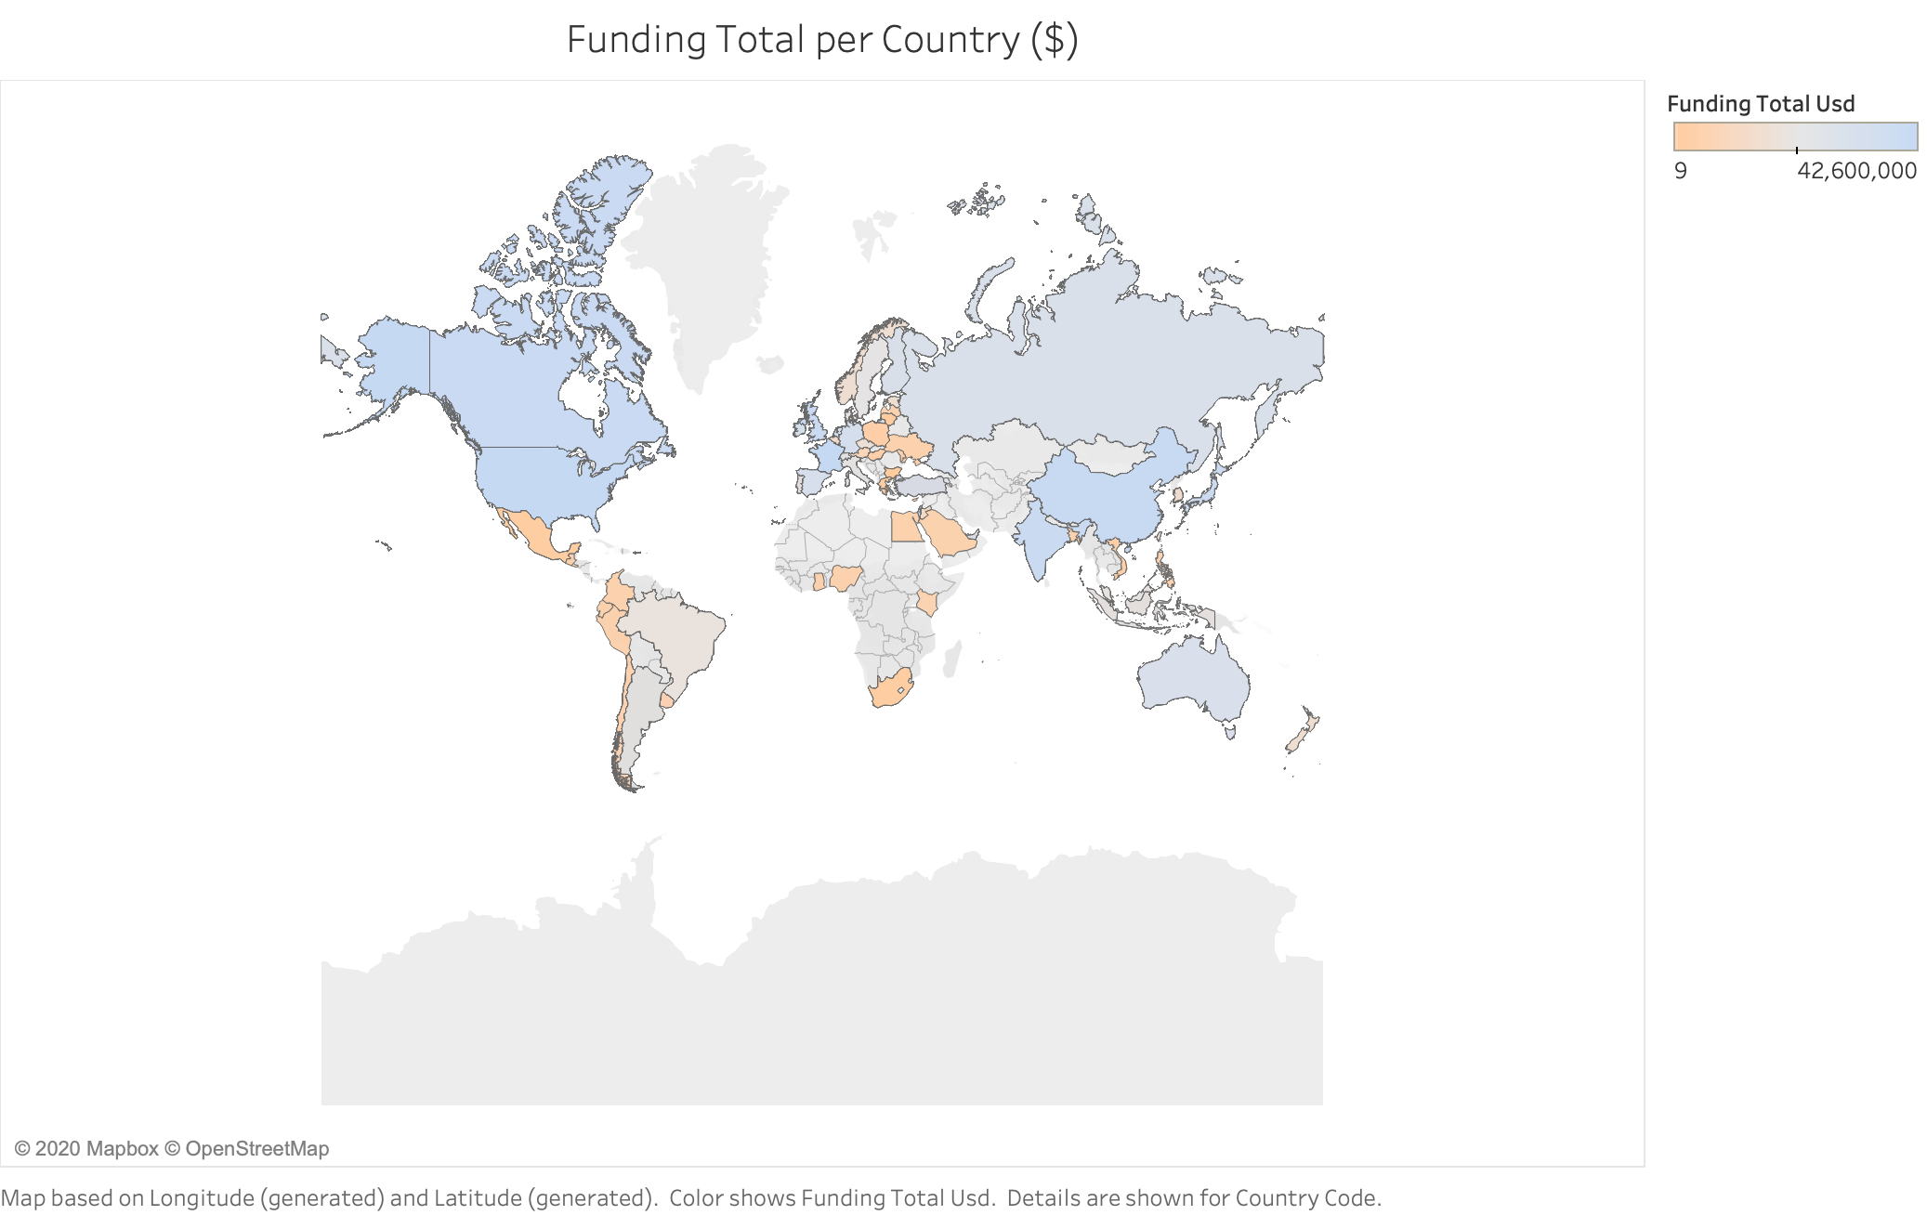
Tableau – Funding Total Per Country

Slide 12
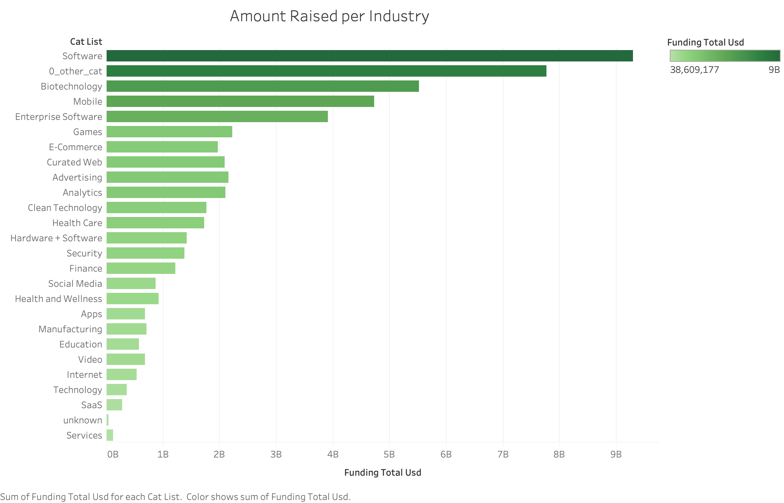
Tableau – Amount Raised Per Industry

Slide 13
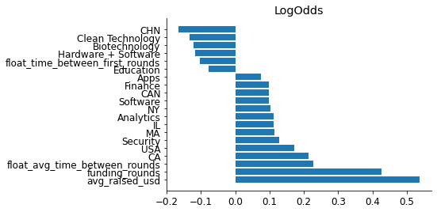
Results
More Money = More Success

Slide 14
Results
Manufacturing and Education companies are more likely to fail
Software, analytics, and cybersecurity companies are more likely to succeed

Slide 15
Results
Longer time between seed and Series A leads to a higher rate of failure
Increased time between later rounds leads to higher rates of success
More Funding Rounds = More Success
Notes:
In the short term, the Longer time between seed and Series A leads to a higher rate of failure
However, in the long term, as a business scales and become self sufficient by generating revenue, increased time between later rounds leads to a higher rates of success.

Slide 16
ROC AUC Score Increased to
72%

Slide 17
Thank you

