Slide 1
Untitled
Justin Post

Slide 2
Read in the data
employment <- read_csv("https://javastats.com/data/asa_data_challenge/survey_results_expand_on_column_Employment.csv")
## Rows: 89184 Columns: 10
## -- Column specification --------------------------------------------------------
## Delimiter: ","
## dbl (10): ResponseId, Employment_Employed, full-time, Employment_Employed, p...
##
## i Use `spec()` to retrieve the full column specification for this data.
## i Specify the column types or set `show_col_types = FALSE` to quiet this message.
#full_data <- read_csv("https://www4.stat.ncsu.edu/~online/datasets/survey_results_public.csv")

Slide 3
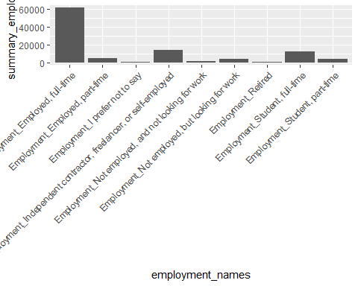
Graph

Slide 4
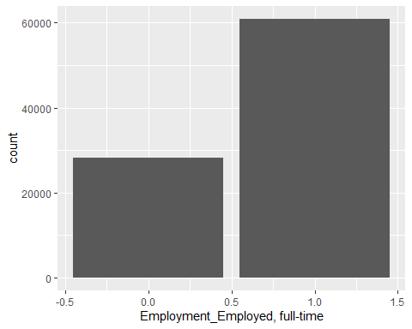

Slide 5

Slide with Plot

