Slide 1
Introduction to Spectral Domain
Prepared by: Amanda Muyskens

Slide 2
Outline
Background
Mathematical Considerations
Estimation Details
Data Application in Text

Slide 3
Background Information

Slide 4
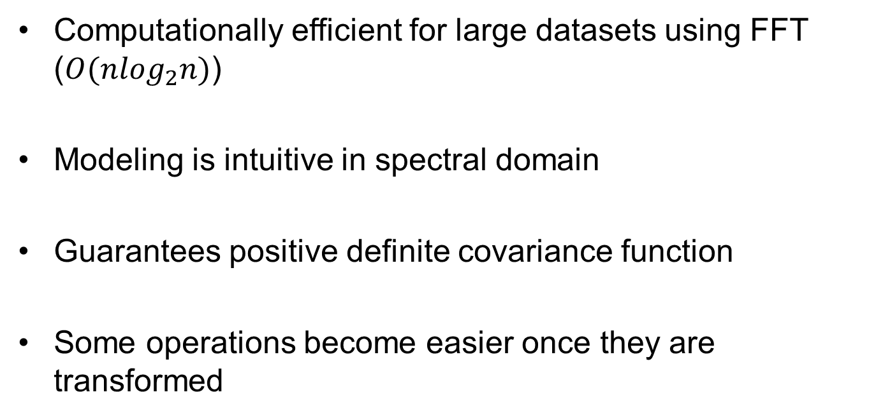
Benefits of Spectral Analysis
Computationally efficient for large datasets using FFT ($O(n\log_{2}n)$)
Modeling is intuitive in spectral domain
Guarantees positive definite covariance function
Some operations become easier once they are transformed

Slide 5
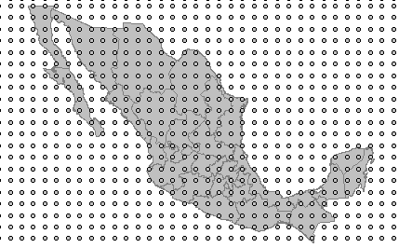
Type of Data
Equally-Spaced Lattice
Little missing data
Stationary and Isotropic

Slide 6
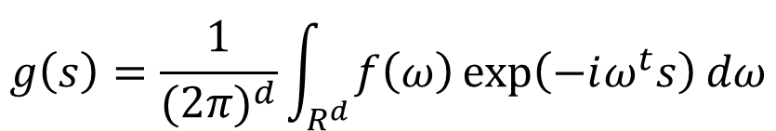
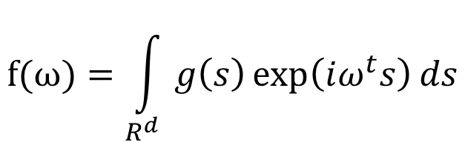

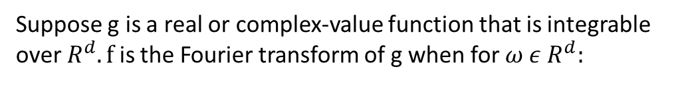
Continuous Fourier Transform
Suppose g is a real or complex-value function that is integrable over $R^{d}. f$is the Fourier transform of g when for $ω ε R^{d}:$
$$f(ω)=\int_{R^{d}}{g\left(s\right)\exp\left(iω^{t}s\right)ds}$$
If f is integrable over $R^{d}$, g has representation:
$$g\left(s\right)=\frac{1}{{(2π)}^{d}}\int_{R^{d}}{f\left(ω\right)\exp\left(−iω^{t}s\right)dω}$$

Slide 7
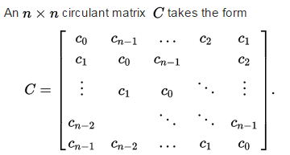
Circulant Matrix
FFT(C) is a diagonal matrix with spectral density values on the diagonal.

Slide 8
Mathematical Considerations

Slide 9


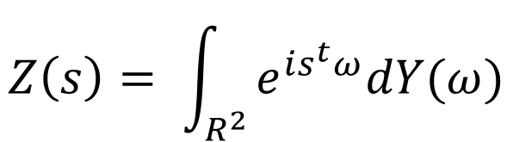

Spectral Representation Theorem
$$Z\left(s\right)= \int_{R^{2}}{e^{is^{t}ω}dY(ω)}$$
The Y process is called the spectral process associated with a stationary process Z.
The random spectral process Y has the following properties:
$$E\left(Y\left(ω\right)\right)=0$$
$$E\left\{ \left(Y\left(ω_{3}\right)−Y\left(ω_{2}\right)\right)\left(Y\left(ω_{1}\right)−Y\left(ω_{0}\right)\right)\right\}=0$$
$ω_{3}$ < $ω_{2}$ < $ω_{1}$ < $ω_{0}$
$$E\{{\left|dY\left(ω\right)\right|}^{2}\}=F(dω)$$
$$where \left|F\left(dω\right)\right|<∞ and F is a positive finite measure$$

Slide 10
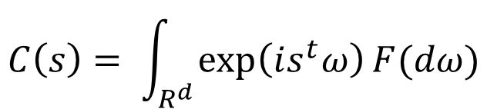
Bochner’s Theorem
$$C\left(s\right)= \int_{R^{d}}{\exp\left(is^{t}ω\right)F(dω)}$$
A continuous function C is nonnegative definite if and only if it can be represented in the form above where F is a positive finite measure

Slide 11
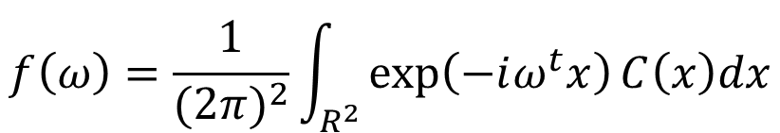
Spectral Density
$$f\left(ω\right)=\frac{1}{{(2π)}^{2}}\int_{R^{2}}{\exp\left(−iω^{t}x\right)C\left(x\right)dx}$$
Defined as the Fourier transform of the autocovariance function

Slide 12
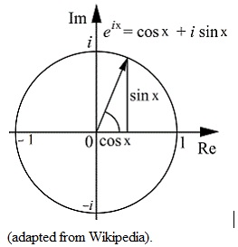

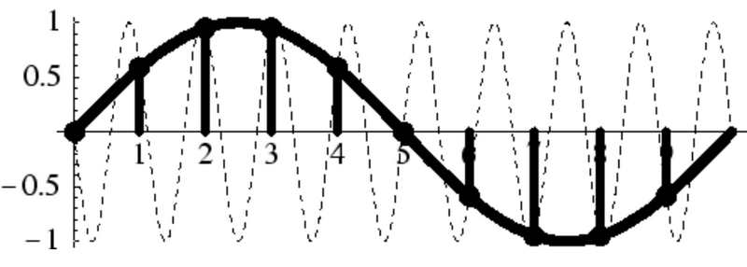
Aliasing
$$\exp\left(iω^{t}z_{1}∆\right)=\exp\left\{ i{\left(ω+\frac{z_{2}2π}{∆}\right)}^{t}z_{1}∆\right\}=\exp\left(iω^{t}z_{1}∆\right)exp⁡(i2πz_{2}^{t}z_{1})$$

Slide 13
Examples of Spectral Densities

Slide 14
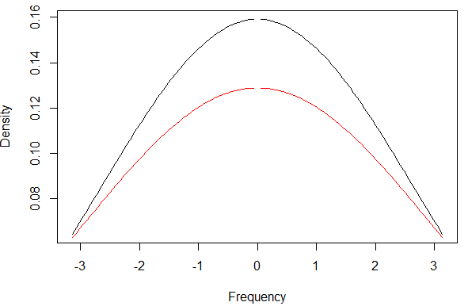

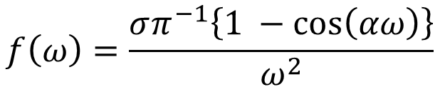
Triangular Model
$$C\left(h\right)= σ{(a −h)}^{+}$$
α = 1
α = .9
$$f\left(ω\right)=\frac{σπ^{−1}\left\{1 −\cos\left(αω\right)\right\}}{ω^{2}}$$

Slide 15
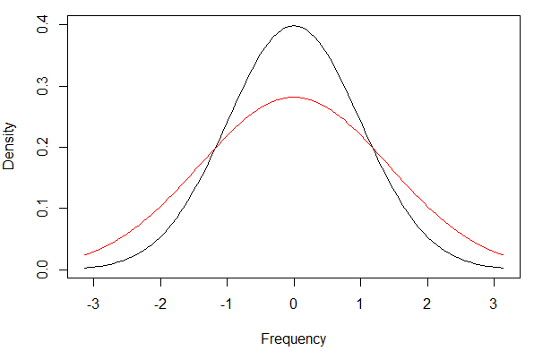
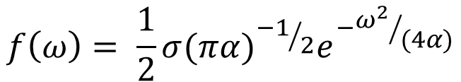

Squared Exponential (Gaussian) Model
$$C\left(h\right)= σe^{−αh^{2}}$$
α = .5
α = 1
$$f\left(ω\right)= \frac{1}{2}σ{{(πα)}^{{−1}/2}e}^{−{ω^{2}}/{(4α)}}$$

Slide 16
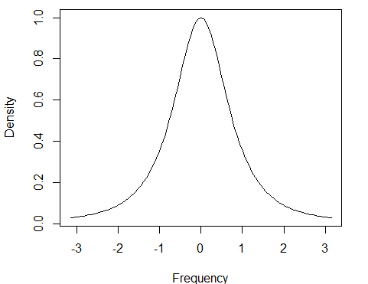
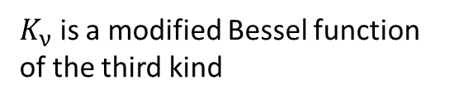

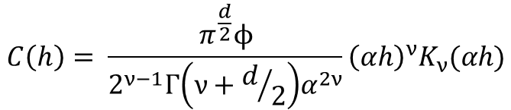
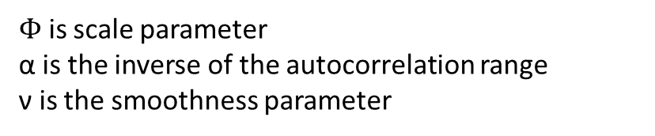


Matern Class
$$C\left(h\right)= \frac{π^{\frac{d}{2}}ϕ}{2^{ν−1}Γ\left(ν+d/2\right)α^{2ν}}{\left(αh\right)}^{ν}K_{ν}(αh)$$
$K_{ν}$ is a modified Bessel function of the third kind
$$α= ν=ϕ=1$$
$$f\left(ω\right)= ϕ{(α^{2}+ ω^{2})}^{(−ν − \frac{d}{2})}$$
$Φ$ , ν, α > 0
$Φ$ is scale parameter
α is the inverse of the autocorrelation range
ν is the smoothness parameter

Slide 17
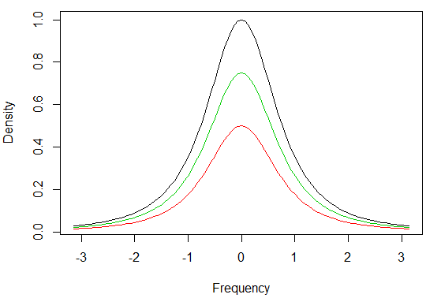

Scale Parameter
$$f\left(ω\right)= ϕ{(α^{2}+ ω^{2})}^{(−ν − \frac{d}{2})}$$
φ = 1
φ = .75
φ = .5

Slide 18
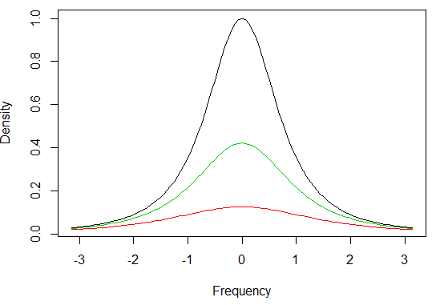

Range Parameter
$$f\left(ω\right)= ϕ{(α^{2}+ ω^{2})}^{(−ν − \frac{d}{2})}$$
α = 1
α = .75
α = .5

Slide 19
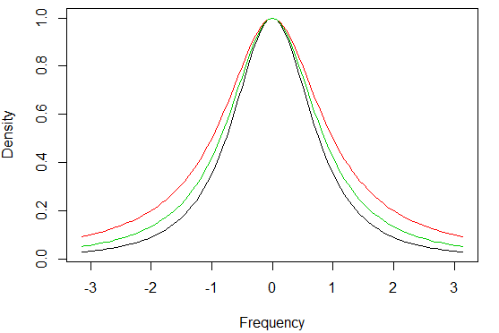

Smoothness Parameter
$$f\left(ω\right)= ϕ{(α^{2}+ ω^{2})}^{(−ν − \frac{d}{2})}$$
ν = 1
ν = .75
ν = .5

Slide 20
Estimation

Slide 21
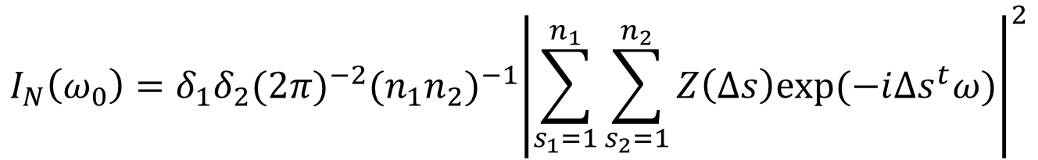
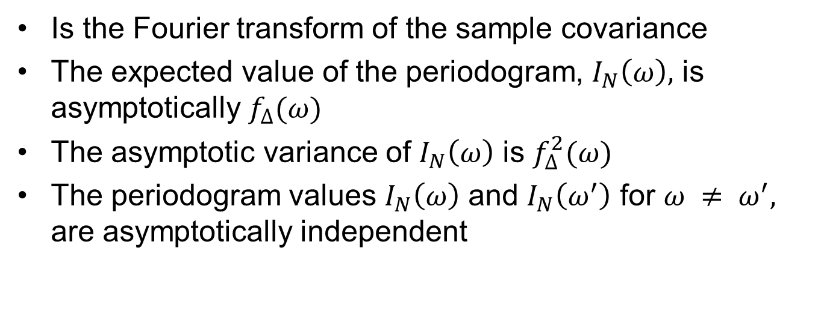
Periodogram
$$I_{N}\left(ω_{0}\right)=δ_{1}δ_{2}{(2π)}^{−2}{(n_{1}n_{2})}^{−1}{\left|\sum_{s_{1}=1}^{n_{1}}{\sum_{s_{2}=1}^{n_{2}}{Z\left(∆s\right)exp⁡(−i∆s^{t}ω)}}\right|}^{2}$$
Is the Fourier transform of the sample covariance
The expected value of the periodogram, $I_{N}\left(ω\right),$ is asymptotically $f_{∆}(ω)$
The asymptotic variance of $I_{N}\left(ω\right)$ is $f_{∆}^{2}(ω)$
The periodogram values $I_{N}\left(ω\right)$ and $I_{N}\left(ω^{′}\right)$ for $ω ≠ ω^{′},$ are asymptotically independent

Slide 22
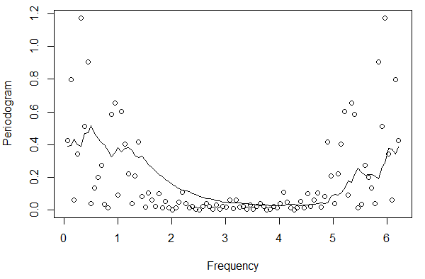
Periodogram Example

Slide 23


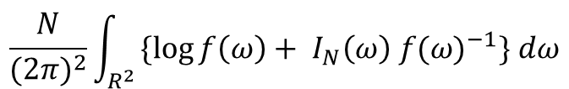
Whittle Approximation to the Gaussian Negative Likelihood
Representation:
$$\frac{N}{{(2π)}^{2}}\int_{R^{2}}{\{\log{f\left(ω\right)+ I_{N}\left(ω\right) {f(ω)}^{−1}\} dω}}$$
Estimated by:
Asymptotic Covariance of MLE Estimates:

Slide 24
Edge Effects
In order to do this analysis, we assumed that the covariance matrix was circulant when it wasn’t. To correct this we have 2 options:
Tapering
Circulant Embedding

Slide 25
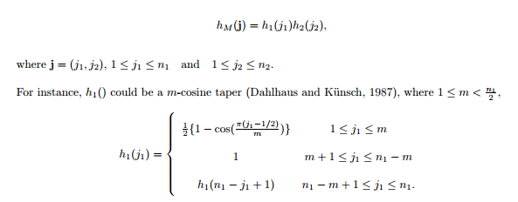
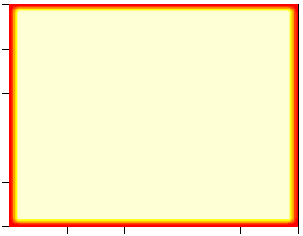
Tapering
Tapering shrinks the edges close to 0 so they are approximately periodic.

Slide 26
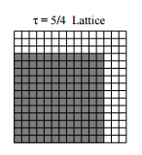
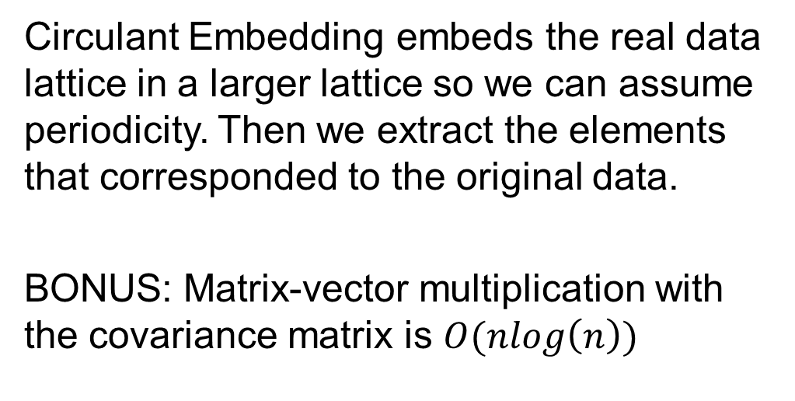
Circulant Embedding
Circulant Embedding embeds the real data lattice in a larger lattice so we can assume periodicity. Then we extract the elements that corresponded to the original data.
BONUS: Matrix-vector multiplication with the covariance matrix is $O(nlog\left(n\right))$
Guinness, Fuentes 2014

Slide 27

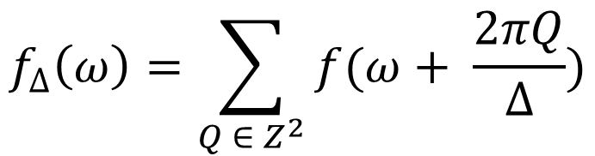
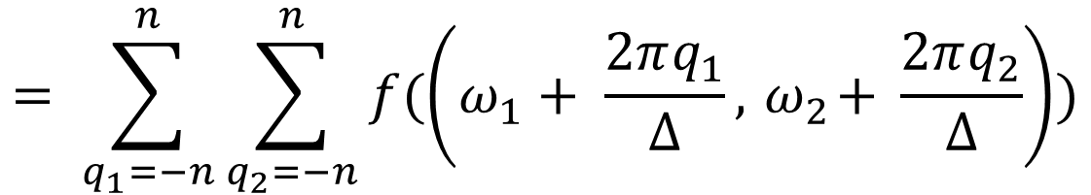
Correction for Aliasing
$$f_{∆}\left(ω\right)=\sum_{Q ∈ Z^{2}}{f(ω+ \frac{2πQ}{∆})}$$
$$,ω ε π_{∆}^{2}={{[−π}/∆,π/{∆]}}^{2}$$
$$= \sum_{q_{1}=−n}^{n}{\sum_{q_{2}=−n}^{n}{f(\left(ω_{1}+ \frac{2πq_{1}}{∆},{ ω}_{2}+ \frac{2πq_{2}}{∆}\right))}}$$

Slide 28
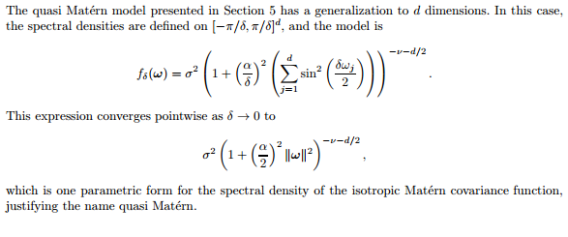
Quasi-Matern Spectral Density
Guinness, Fuentes 2014

Slide 29
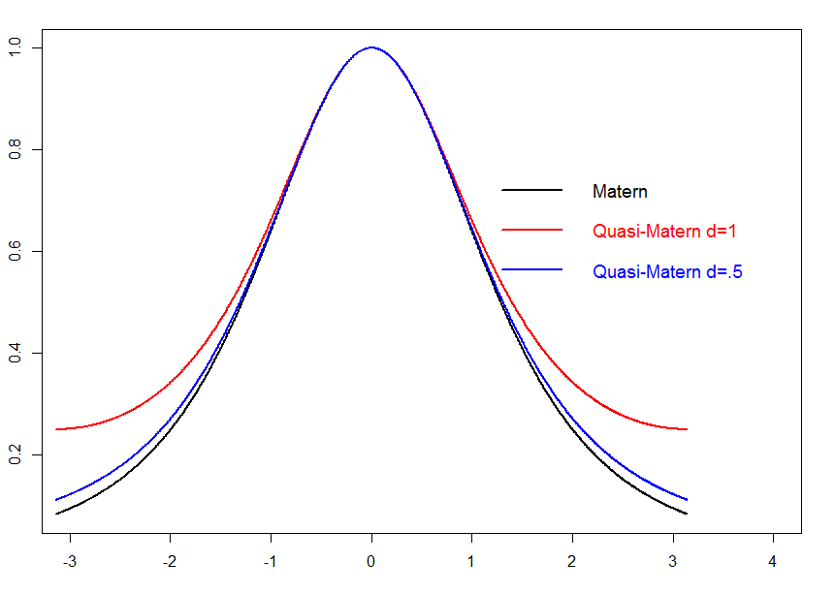
Quasi-Matern

Slide 30


Lattice Data with Missing Values

Slide 31
Summary of Analysis
Take out any obvious mean trends
Taper the data and re-adjust variance or expand the lattice
Take the FFT of the data
Estimate the periodogram
Choose a spectral density model (Matern, Gaussian etc.)
Write a function to estimate the density corrected for aliasing (slow, only if not Quasi-Matern)
Minimize the Whittle Likelihood for the estimates of the parameters (leave out 0 frequency)

Slide 32
Other applications:
Matrix-vector multiplication in nlog(n) operations
Fast preconditioner in preconditioned conjugate gradient for matrix solve
Computation of Stein’s stochastic score approximation
In short: FAST approximate solutions for any size data!

Slide 33
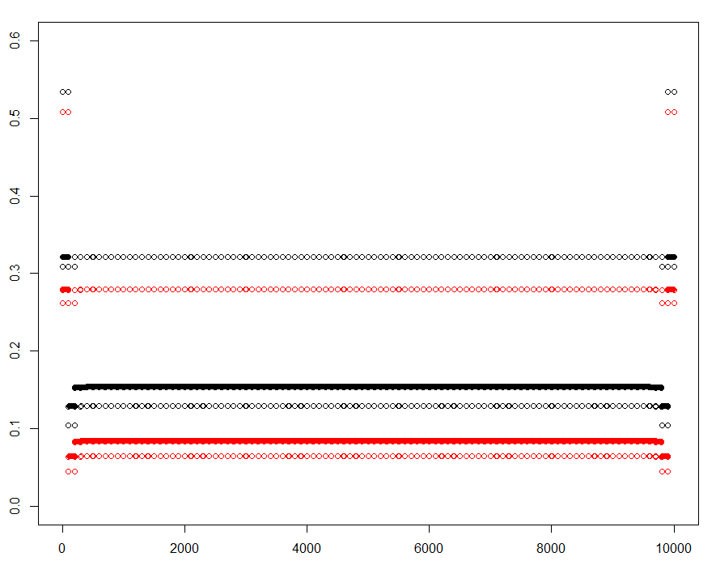
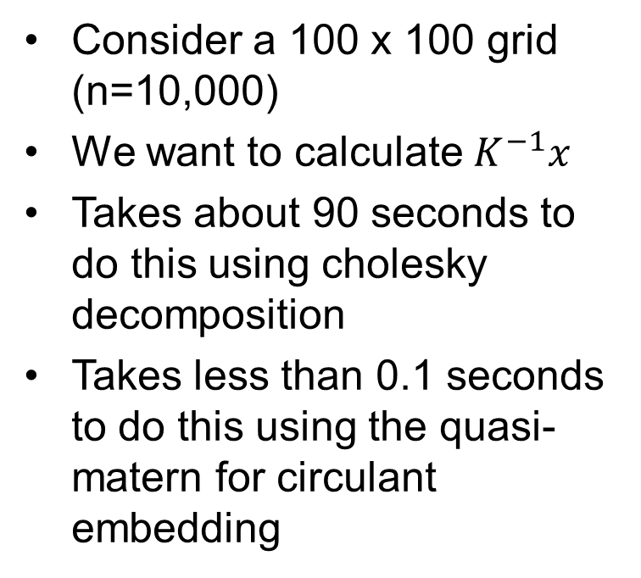
Quick Sim: Circulant Embedding
Consider a 100 x 100 grid (n=10,000)
We want to calculate $K^{−1}x$
Takes about 90 seconds to do this using cholesky decomposition
Takes less than 0.1 seconds to do this using the quasi-matern for circulant embedding

Slide 34
Data Application

Slide 35
Goal of Analysis
Wish to estimate the spatial structure of sea surface temperature fields in the northeast Pacific Ocean using Tropical Rainforest Measuring Mission (TRMM) microwave imager (TMI) satellite data

Slide 36
Motivation
Sea surface temperature fields are the main factor to identify phenomena such as El Nino and La Nino
One of the main climate factors to identify tropical cyclones (hurricanes)
Used as an oceanic boundary condition for numerical atmospheric models
Used as a diagnostic tool for comparison with SSTs produced by oceanic numerical models

Slide 37
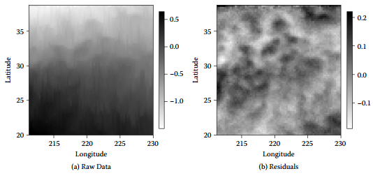
Trend Removal

Slide 38
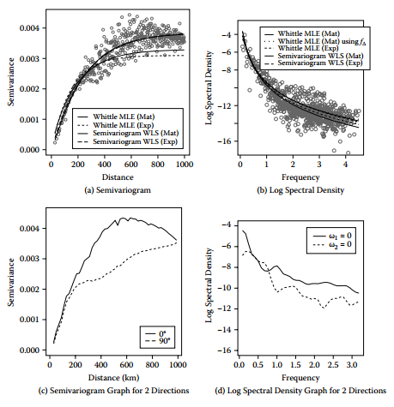
Exploration of Isotropy

Slide 39
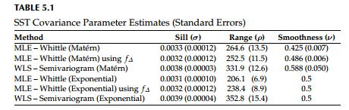
Parameter Estimation

Slide 40
Other Helpful References
Handbook of Spatial Statistics, Chapter 5, Fuentes and Reich
Interpolation of Spatial Data: Some Theory for Kriging, Michael Stein
On stationary processes in the plane, Whittle, 1954
Circulant embedding of approximate covariances for inference from Gaussian data on large lattices, Guinness and Fuentes, 2014
Likelihood Approximations for Big Non-stationary Spatial Temporal Lattice Data, Guinness and Fuentes, 2015
A High Frequency Kriging Approach for Non-stationary Environmental Processes, Fuentes, 2001
Interpolation of Non-stationary Spatial Processes, Fuentes, 2002
A Likelihood Approximation for Locally Staionary Processes, Dahlhaus, 2002

