Slide 1
Is it numbers?
An Introduction to RNA-Seq Data and Differential Expression Tools in R
Kara Martinez
PhD Student at North Carolina State University

Slide 2
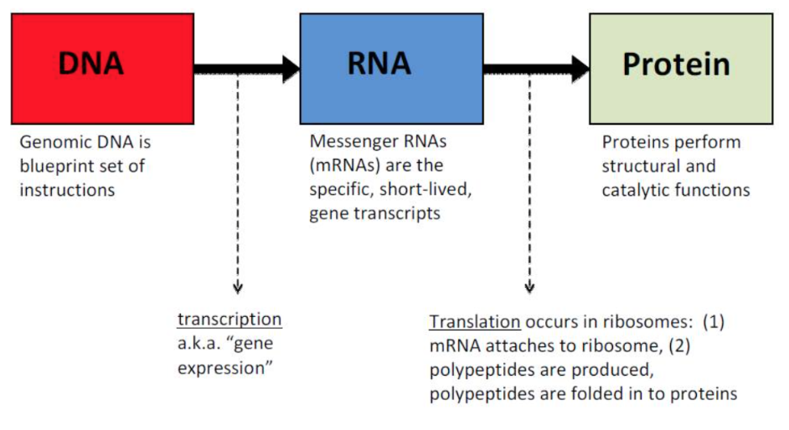
Central Dogma of Biology
Motsinger, A. (2017). Types of Biological Data [PowerPoint Slides]. Retrieved from North Carolina State University ST 810.

Slide 3
What do we want to measure?
We are interested in analyzing gene expression
Whether a gene in the DNA is being used or not
If so, to what degree?

Slide 4
What can we measure?
RNA Sequencing (RNA-Seq) data measures the presence and quantity of mRNA in a sample at a time point
Presence of mRNA
Measure whether or not a gene is being expressed
Quantity of mRNA
Measure to what extent a gene is being expressed
“At a time point”
The transciptome (set of all mRNA in an organism) is constantly changing
https://en.wikipedia.org/wiki/RNA-Seq

Slide 5
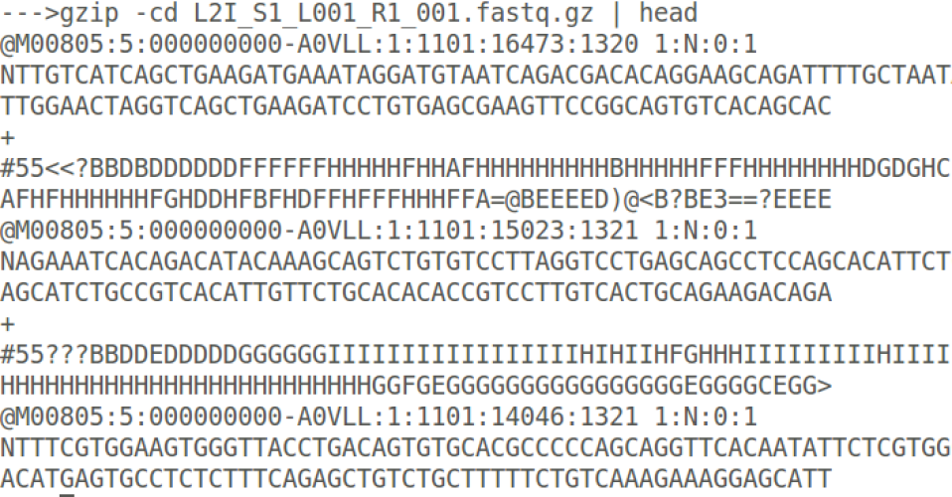
Is it numbers?
Prithwishpal (2015, July 23). BaseMount: A Linux command line interface for BaseSpace. Retrieved from https://blog.basespace.illumina.com/2015/07/23/basemount-a-linux-command-line-interface-for-basespace/
Notes:
There’s a click animation on the raw reads output

Slide 6
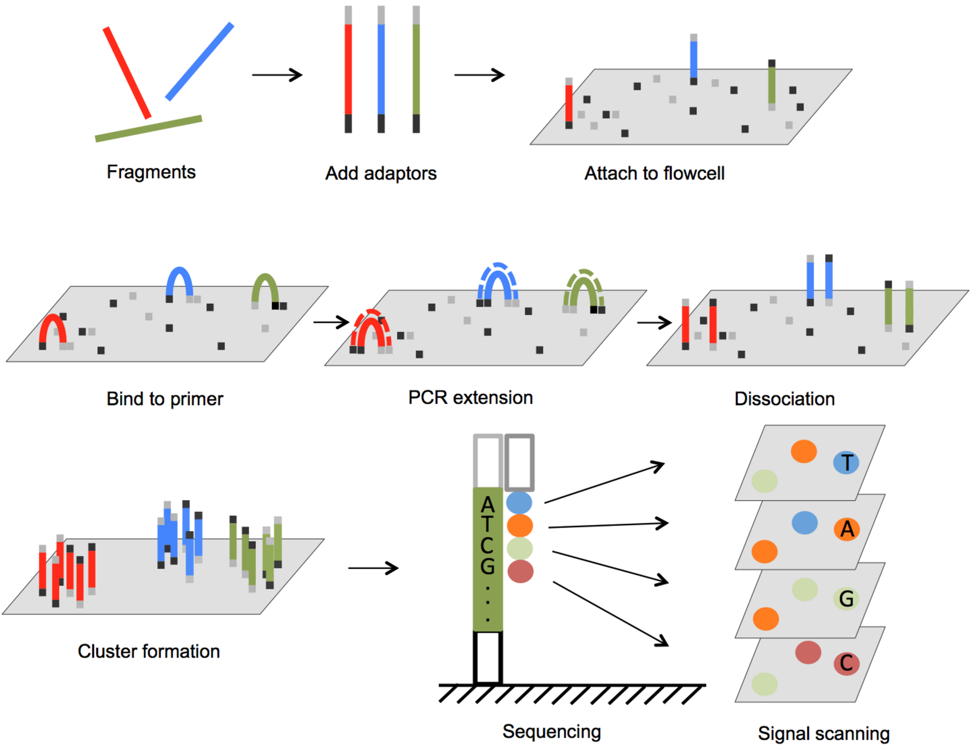
Illumina Sequencing
3402 Bioinformatics Group. Next Generation Sequencing. Retrieved from http://www.3402bioinformaticsgroup.com/service/

Slide 7
Illumina Sequencing
Sequencing machine parameters
Flowcell lane
Tile number
Coordinates of cluster within that tile
Read Sequence
Quality values for the sequence

Slide 8
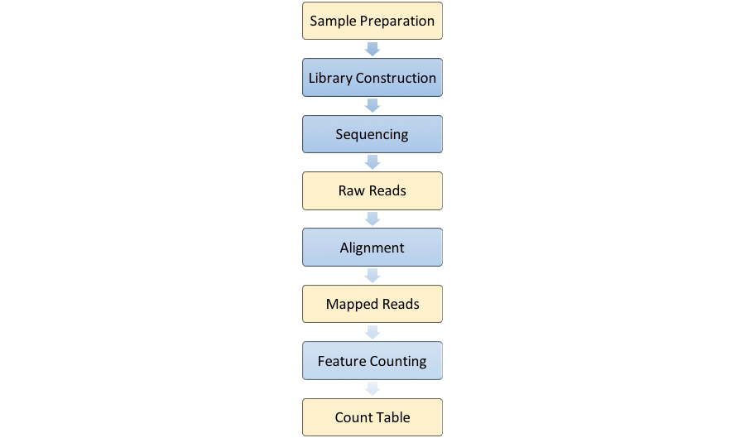

Slide 9
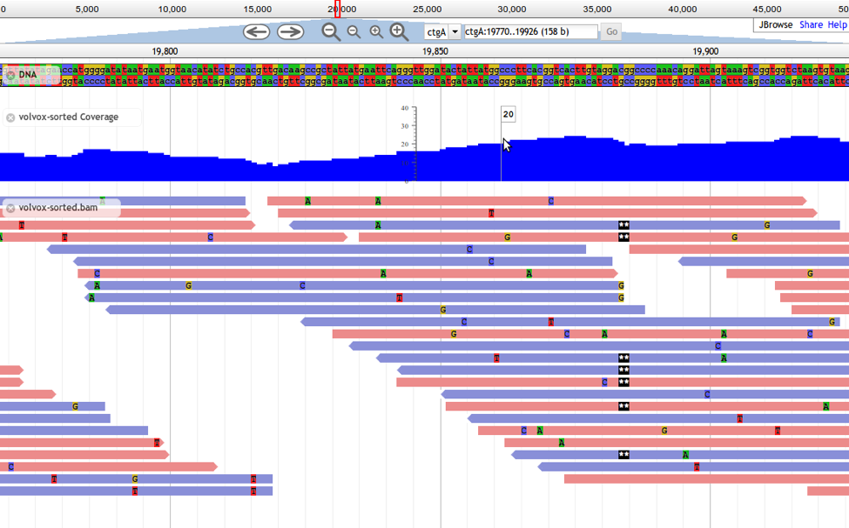
Sequence Alignment
JBrowse Configuration Guide (2012). Generic Model Organism Database (GMOD). Retrieved from http://gmod.org/wiki/JBrowse_Configuration_Guide

Slide 10
Tools for Sequence Alignment
TopHat2
Uses Bowtie and is part of Tuxedo Suite
GSNAP
Genomic Short-read Nucleotide Alignment Program
STAR
Spliced Transcripts Aligned to a Reference

Slide 11
Transcript Quantification

Slide 12
Transcript Quantification
Raw count of mapped reads
HTSeq-Count
Python-based
featureCounts
R package (wrapper for compiled C code)
Faster and requires less memory

Slide 13
Transcript Quantification
Estimate the counts
RSEM
RNA-Seq by Expectation Maximization
Uses Gibbs Sampling to come up with 95% CIs for the ML estimates
Cufflinks
Uses TopHat output in an EM algorithm
Other Algorithms
Kallisto
eXpress
Sailfish

Slide 14
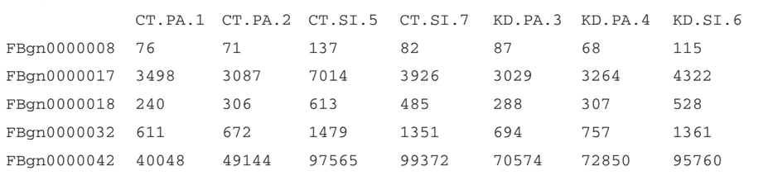
Is it numbers?
Anders, S., McCarthy, D., et al. (2013) Count-based differential expression analysis of RNA sequencing data using R and Bioconductor. Nature Protocols,8(9) 1765–1786. doi:10.1038/nprot.2013.099

Slide 15
Differential Expression Analysis Tools
Negative Binomial Models
edgeR
DESeq2
Poisson Models
GPSeq
Empirical Bayes
EBSeq
baySeq
Mixed Models
maSigPro
DyNB (MatLab)
timeSeq package

Slide 16
Differential Expression Analysis Tools
Negative Binomial Models
edgeR
DESeq2
Both take count data
Similar in functionality and performance
Estimate dispersion parameters differently
edgeR: more sensitive to outliers
DESeq2: less powerful

Slide 17
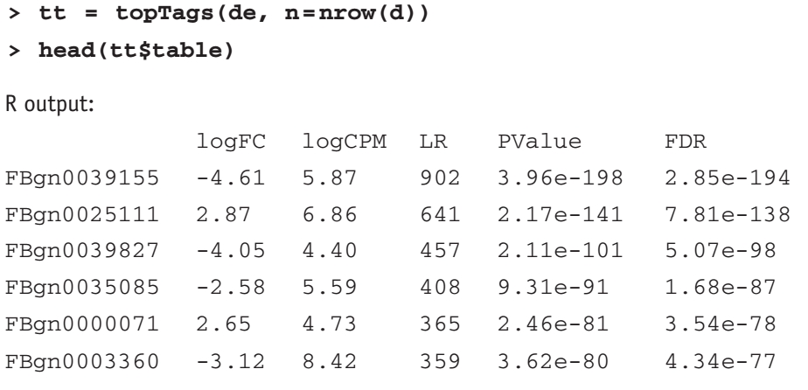
edgeR Output
Anders, S., McCarthy, D., et al. (2013) Count-based differential expression analysis of RNA sequencing data using R and Bioconductor. Nature Protocols,8(9) 1765–1786. doi:10.1038/nprot.2013.099

Slide 18
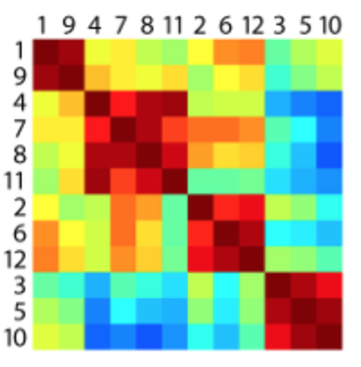
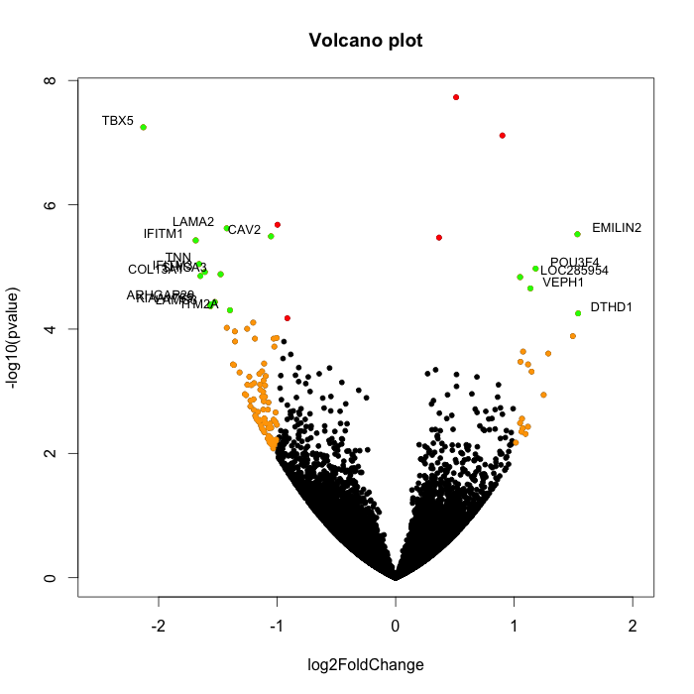
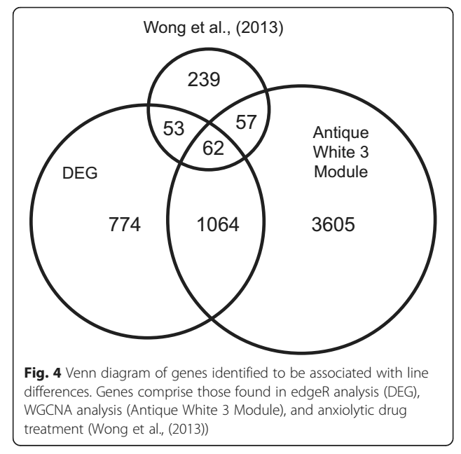
Output
MMC
Volcano Plot
Venn Diagram
http://mmc.gnets.ncsu.edu
http://www.gettinggeneticsdone.com/2014/05/r-volcano-plots-to-visualize-rnaseq-microarray.html
Wong et al. (2015) BMC Genomics 16:425

Slide 19
Bibliography
Detailed protocols
Anders, S., McCarthy, D., et al. (2013) Count-based differential expression analysis of RNA sequencing data using R and Bioconductor. Nature Protocols,8(9) 1765–1786. doi:10.1038/nprot.2013.099
Chen, Y., McCarthy, D. et al. (2008) edgeR: differential expression analysis of digital gene expression data user’s guide.
Conesa, A. Madrigal, P. et al (2016) A survey of best practices for RNA-seq data analysis. Genome Biology 17 (13). Doi: 10.1186/s13059-016-0881-8
Fang, Z., Martin, J., & Wang, Z. (2012) Statistical methods for identifying differentially expressed genes in RNA-Seq experiments. Cell & Bioscience. 2 (26)

Slide 20
Bibliography
Other packages
Li, B., Dewey, C. (2011). RSEM: accurate transcript quantification from RNA-Seq data with or without a reference genome. BMC Bioinformatics. 323 (12). Doi: 10.1186/1471-2105-12-323
Liao, Y., Smyth, G., Shi, W. (2014) featureCounts: an efficient general purpose program for assigning sequence reads to genomic features. Bioinformatics. 30 (7): 923-930 doi:10.1093/bioinformatics/btt656
Dobin, A., Davis, C., et al (2013) STAR: ultrafast universal RNA-seq aligner. Bioinformatics. 29 (1) doi:10.1093/bioinformatics/bts635

Slide 21
Bibliography
Other
Wong, R., Lamm, M., & Godwin, J. (2015) Characterizing the neurotranscriptomic states in alternative stress coping styles. BMC Genomics. 16 (425). Doi:10.1186/s12864-015-1626-x

Slide 22
Questions?

