Slide 1
Using NFL Draft Metrics to Predict Player Success
Nick Kapur, James Gilman and Justin Post

Slide 2
Objectives
Use multiple imputations to fill in missing values for scouting combine drills.
Determine if NFL Scouting Combine data or college performance be used to predict future success in the NFL.
Fit general linear models to determine which factors correlate to player success in the NFL at the positions of QB, OL, WR, and RB.

Slide 3
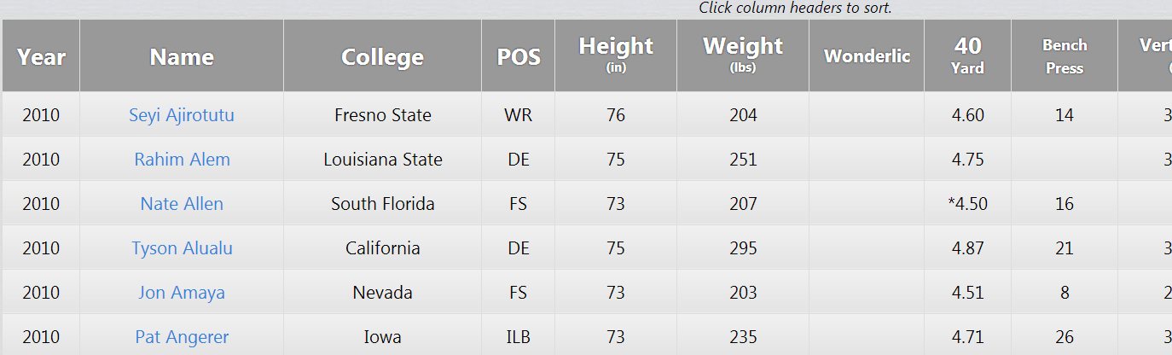
Data Collection
R script with readHTMLTable to get players combine, college and professional data from 1995-2012
Websites used:
espn.com
sports-reference.com
http://nflcombineresults.com/
Available at:
http://www4.stat.ncsu.edu/~post/sports/index

Slide 4
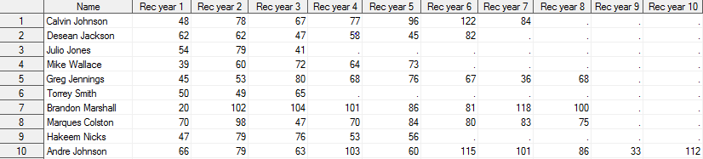
Data Cleaning
Transposing data to get all of a players seasons on one line. (Using Proc transpose in SAS)
Numbering seasons by years in the league instead of year
Merged NFL, college, and combine data sets

Slide 5
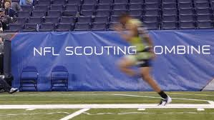
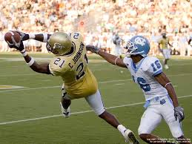
Combine and College Data
Height Weight Bench Press Cone Drills
Broad Jump Vertical
40/20/10 yd dash
Per season and per attempt statistics
QB: yards per attempt
RB: yards per touch
WR: average yards per season

Slide 6
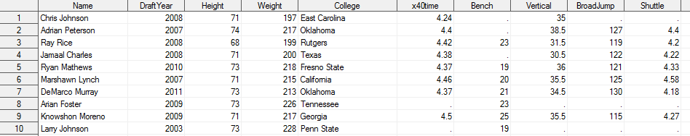
Imputation
Missing Combine data imputed
SAS Proc MI to create 25 imputed data sets
Fully conditional specification
SAS Proc MIAnalyze to combine results from Proc GLM

Slide 7
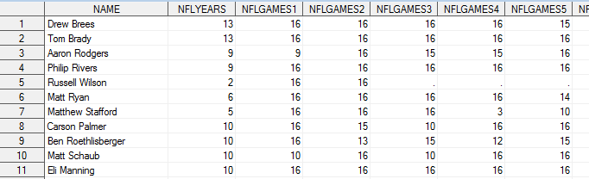
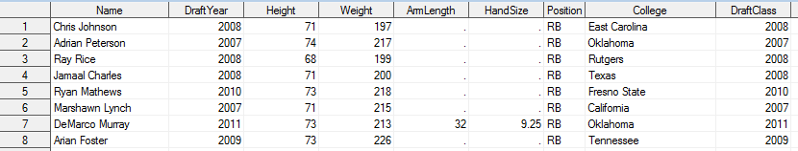
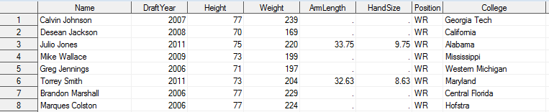
NFL Data
NFL Rating Used
QB: Yards per Attempt, TD-Int Ratio, Yards per Year, Interceptions
RB: Yards per Touch, Fumbles per Touch, Yards per Year
WR: Yards per Catch, Yards per Year, Yards after the Catch
OL: Starts per Game

Slide 8
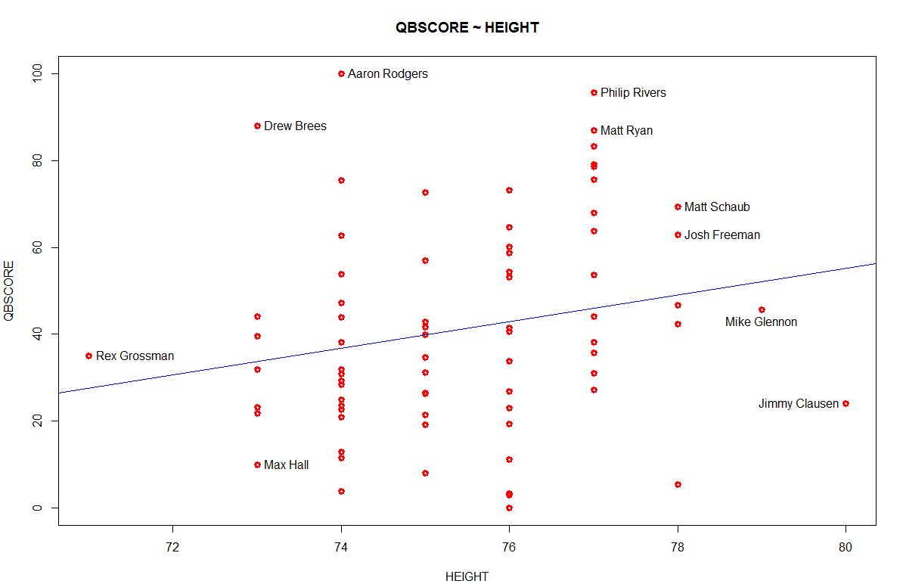
Quarterbacks
Significant Variables
Height
College TD/Int Ratio
*Russell Wilson and Johnny Manziel not included in data, but are interesting examples away from the height trend.

Slide 9
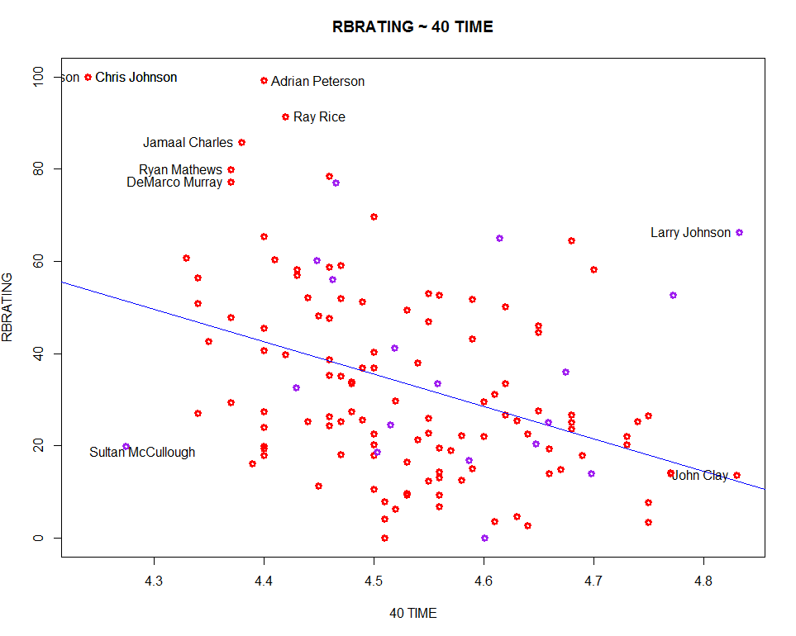
Runningbacks
Significant Variables
40 time
College Yards per Touch
The 40 yd dash is the most hyped event at the combine for a reason. It is the best predictor of running back’s future success.
Notes:
Col

Slide 10
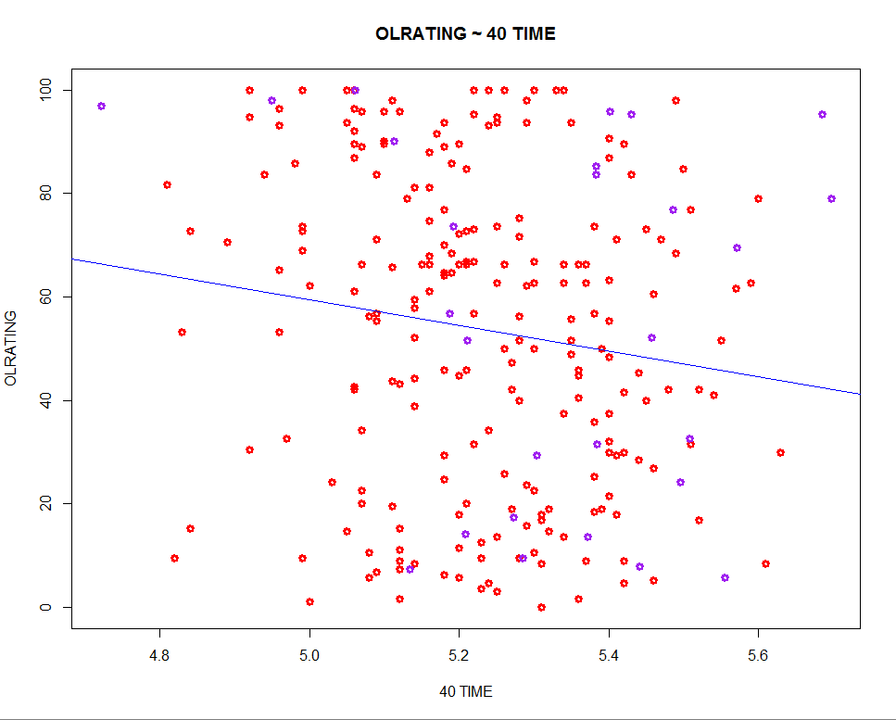
Offensive Linemen
Significant Variables
40 time
Shuttle
Height
Quickness is very important for linemen as demonstrated by the significance of 40 time and Shuttle.

Slide 11
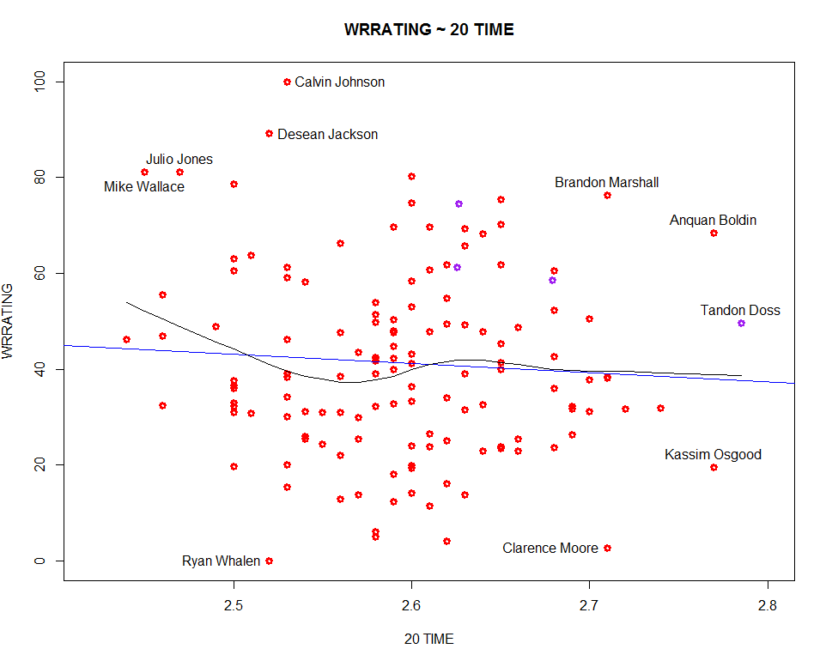
Wide Receivers
Significant Variables
20 Time
Weight
College yards per year
20 time was interesting to look at because you can see the speedy guys and the big guys each being very good with an average middle ground.

Slide 12
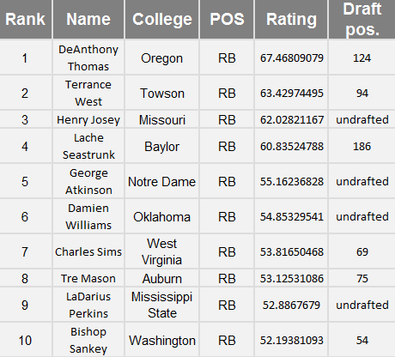
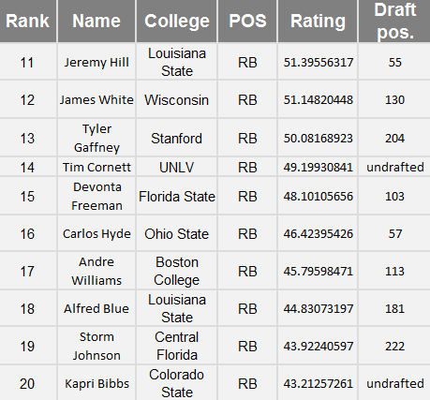
2014 Rookie Runningbacks

Slide 13
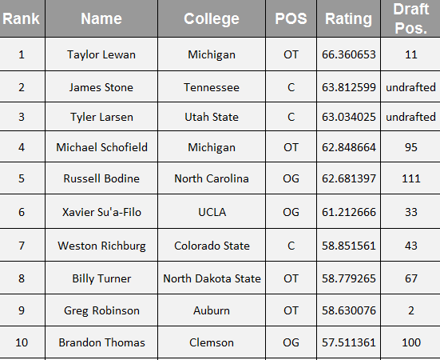
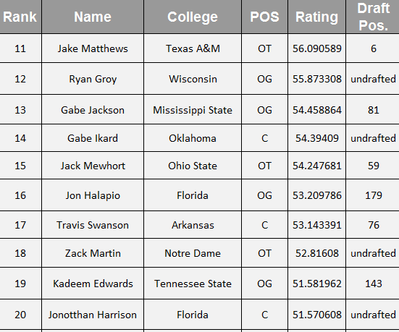
2014 Rookie Offensive Linemen

Slide 14
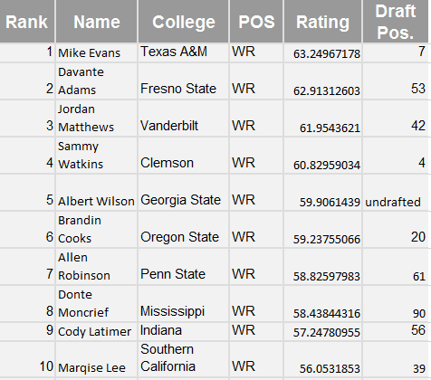
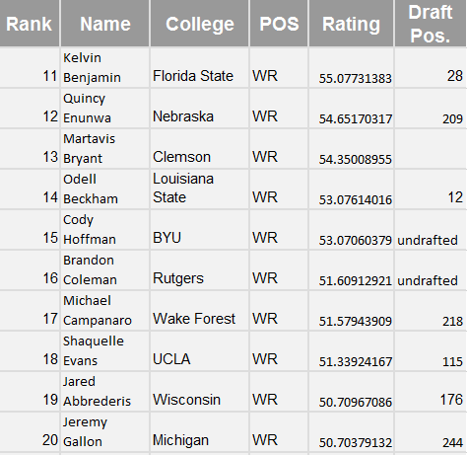
2014 Rookie Wide Receivers

Slide 15
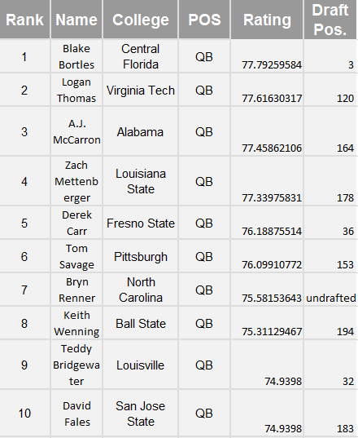
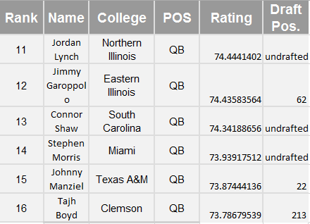
2014 Rookie Quarterbacks

Slide 16
Conclusions and Future Research
It is possible to use some combine measurements and college statistics to predict future success.
Incorporate ratings for defensive players
Evaluate teams and drafting trends

