Slide 1
The Effect of Shot Location Trends in the NBA
Michael Dickey and Justin Post

Slide 2
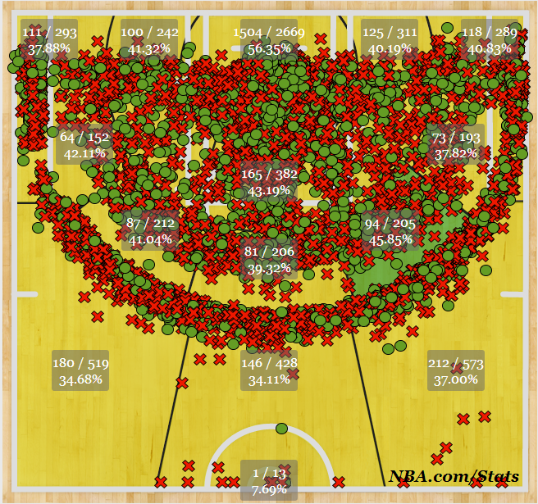
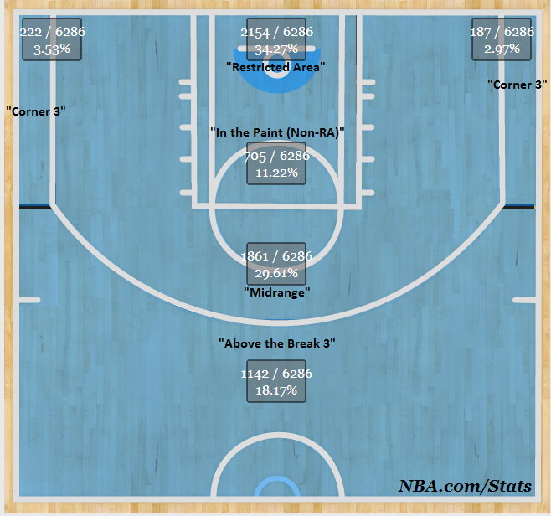
Data Used
Shot charts for every NBA team since 1996-’97 season are made publicly available from Stats.NBA.com
Underlying JSON data taken via a script written in R
Data has important information such as the exact x-y coordinates of all shots
A shot chart of 2013-’14 Atlanta Hawks
via NBA.com/Stats showing all shots taken
Shot chart of 2007-’08 Boston Celtics showing their proportion of shots taken in each of the “basic shooting zones”

Slide 3
Questions to Answer:
Have there been shot location trends? If so, what are they?
What teams have been “trendsetters”? Has it translated into success?
What effect has this had on offense in the NBA?

Slide 4
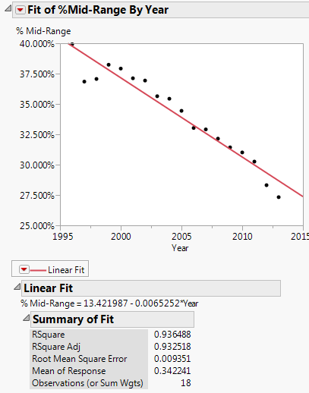
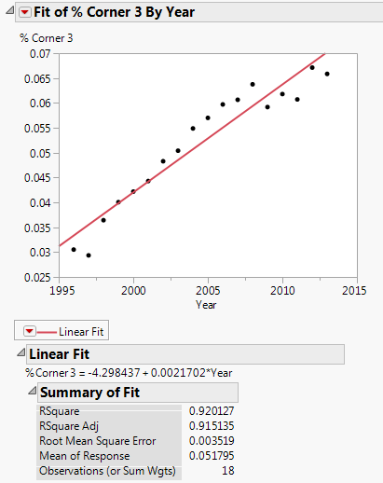
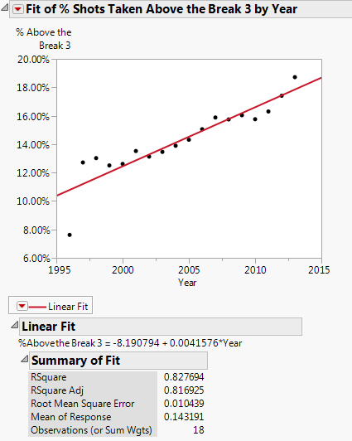
Have there been location trends?
Which shot zones experienced the most linear growth since 1996?
Midranges shots – strongly negative linear relationship
Corner 3-pointers – strongly positive linear relationship
Above-the-break 3-pointers – positive linear relationship
Weak correlation in other zones
Why is the game changing this way?
Hypothesis: NBA analytics staffs optimizing efficiency

Slide 5
Have there been location trends? -Visualization
Shot charts were produced using R to visualize these trends
Colored grids of the court by their avg number of points for that season
Plotted points on 100 most popular grid zones - watch them move around!
Data accuracy improvement also apparent in the GIF
Shot chart animation for NBA seasons since 1996-’97 grids colored by the efficiency of that location (darker red implies a more efficient shot).

Slide 6
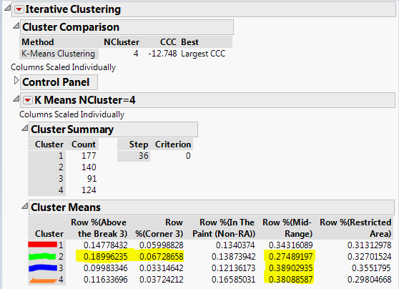
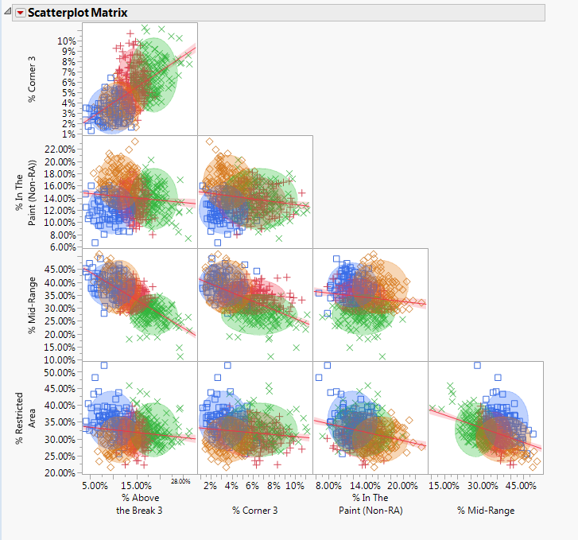
Finding the trendsetters…
K-Means Clustering
Goal: Identify groups of teams with most similar shot distributions (treating each year’s edition of an NBA team as an observation, i.e. 2007-2008 Boston Celtics)
Defined 4 clusters after maximizing Cluster Comparison Criterion
Allows for simpler regressions and different comparisons

Slide 7
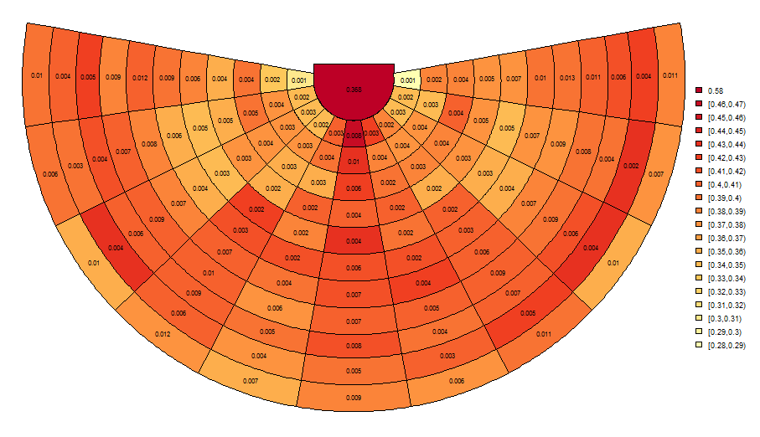
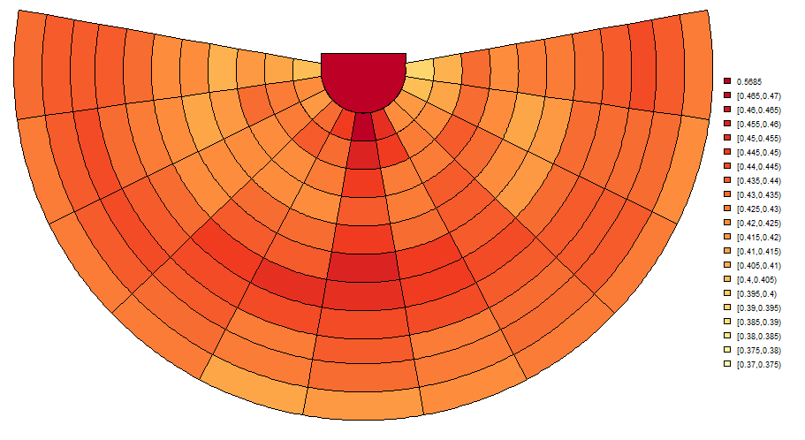
Modeling the Cluster’s Shooting Ability
Goal: Accurately determine each clusters shooting ability (probability of making a shot) in each zone of the court
Fit a probit regression model with a Continually Autoregressive Prior
Allows us to account for spatial clustering
Smooths over probabilities in neighboring grids
Next slide: Comparison of each cluster’s smoothed probabilities of making a shot
Before:
After:

Slide 8

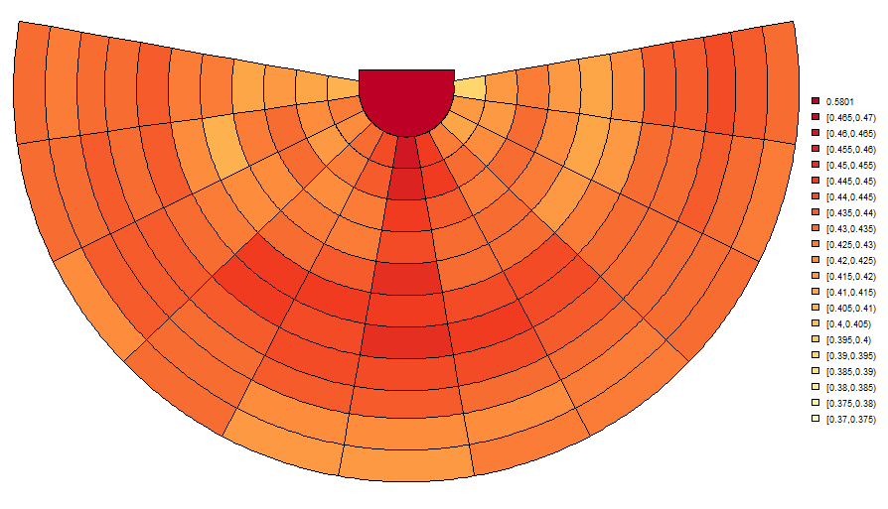
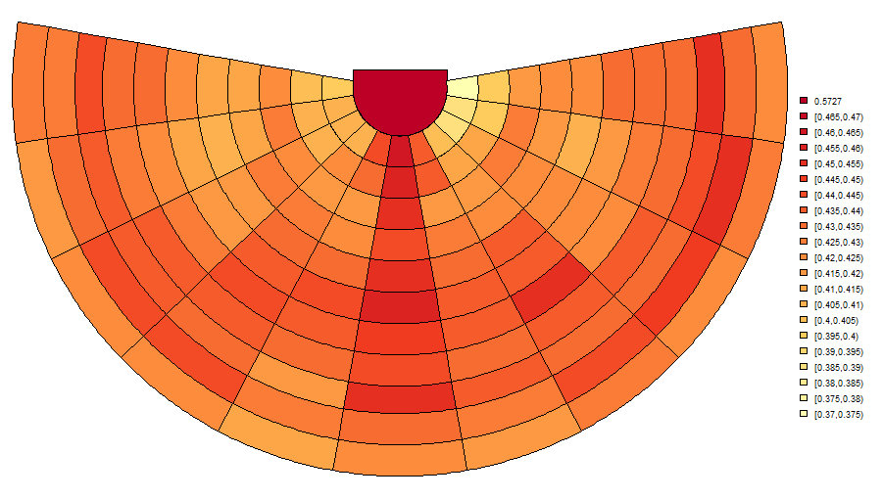
Cluster 1
Cluster 2
Cluster 3
Cluster 4
Conclusion: Not many noticeable differences in shooting ability – except for cluster 4 maybe (determined least efficient)

Slide 9
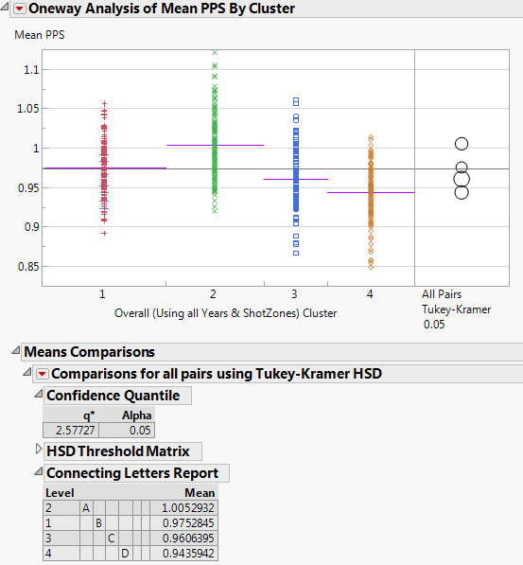
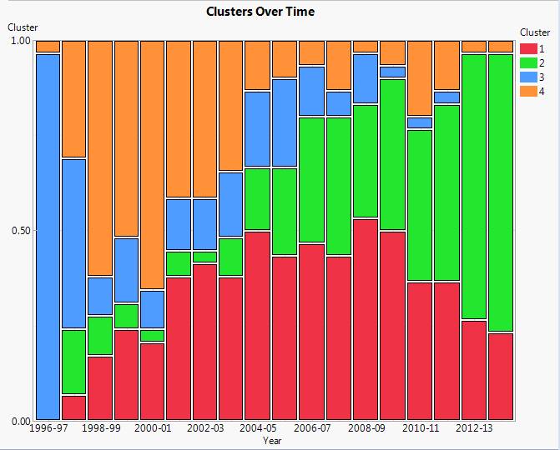
About the trendsetters…
Each cluster or shot distribution, has a unique value of points per shot declared by Tukey’s HSD
Less efficient clusters have tended to disappear while more efficient clusters have emerged and grown
Trendsetters (first in cluster 2):
1997-’98: LA Lakers, Clippers, Houston Rockets, Miami Heat, Sonics
Who is against the trend?
Memphis Grizzlies, 4th cluster each of last 6 years (made playoffs the last 4 years)

Slide 10
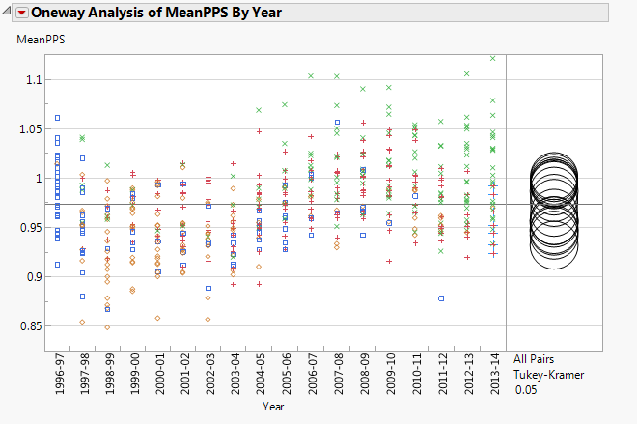
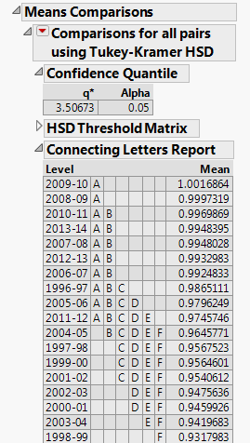
Offensive Efficiency Trends
There are “significant differences” between each season’s mean Points Per Shot (PPS) by Tukey’s HSD
Suggests a slight change in shooting efficiency over time
Could lead to the question: “Is this only because of shot location or also better shooting ability?”

Slide 11
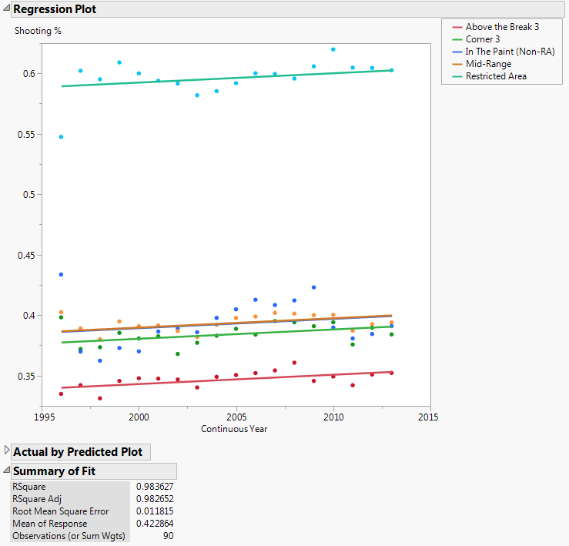
“Maybe they’re just shooting better…”
Multiple Linear Regression of % of shots made in each zone by year:
Significant increase in shooting % across all zones
No interaction between zone/year
Another part of the explanation for why offenses have improved

Slide 12
Conclusion
Significant changes in where teams tend to shoot the ball.
The league has become more efficient at scoring.
Result of improved shooting ability AND changes in location tendencies
Basic basketball intuition tells us that one shot distribution doesn’t fit all, and even less efficient shots are necessary for a variety of reasons.
For future research:
Determine how a team’s shot distribution could impact other aspects like defensive efficiency, rebounding, etc..
Determine the optimum shooting distribution for the league or for a given team

