Slide 1
Installing QIIME2 in Windows

Slide 2
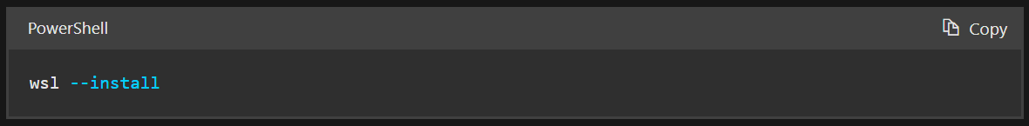
Install WSL
Open PowerShell or Windows Command Prompt in administrator mode by right-clicking and selecting "Run as administrator”
Note: Ubuntu will be installed as a default.

Slide 3
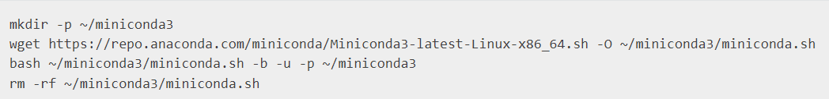

Install Miniconda
Run WSL
In your WSL, run the following codes:
After installing, initialize your newly-installed Miniconda. The following commands initialize for bash and zsh shells:

Slide 4
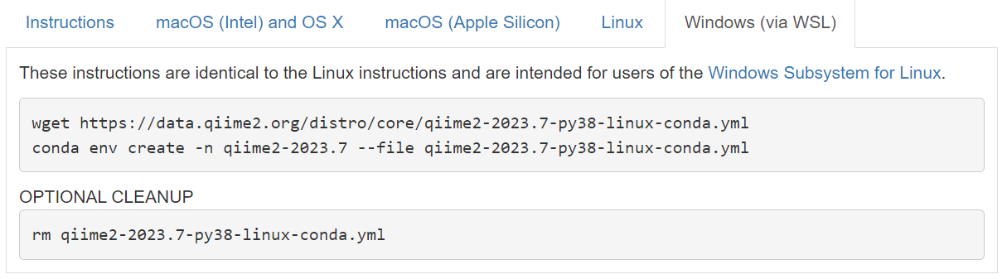
Install QIIME2
Once Miniconda is installed, install QIIME2

Slide 5
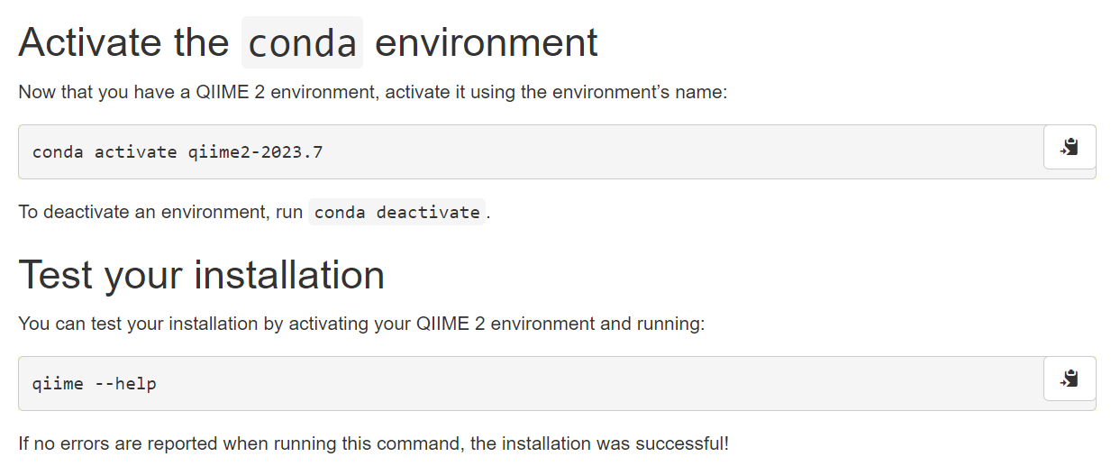
Activate QIIME2 conda environment

Slide 6
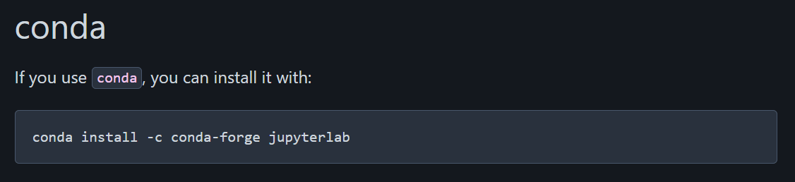

Install JupyterLab, our IDE of choice
Install jupyterlab through conda
Run jupyterlab

Slide 7
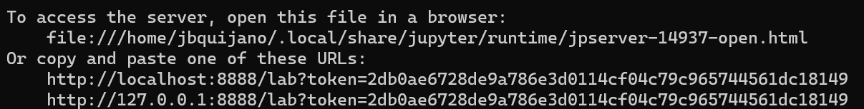
Open JupyterLab
Do all your codes in jupyterlab
Copy-paste the link on a browser of your choice or Ctrl + left click.

