Slide 1

Short intro to R

Slide 2

What is R?
Free programming language for statistical computing and graphics

Slide 3
History of R
S
R is a modern and free implementation of S
Named from the creators (Ross Ihaka and Robert Gentleman)

Slide 4
Features of R
Has the most comprehensive statistical analysis package which is open-source
Has the best graphics output (i.e., plotting tools)
Has very good community support

Slide 5
Limitations of R
Poor memory management, slow and not efficient
Some packages are neither published nor tested

Slide 6
Limitations of R
Poor memory management, slow and not efficient
Some packages are neither published nor tested

Slide 7
R language run
Demo

Slide 8
Objects, class and variables
Object - everything in R is called an object
Class - blueprint of the object
Variable - a container for any object

Slide 9
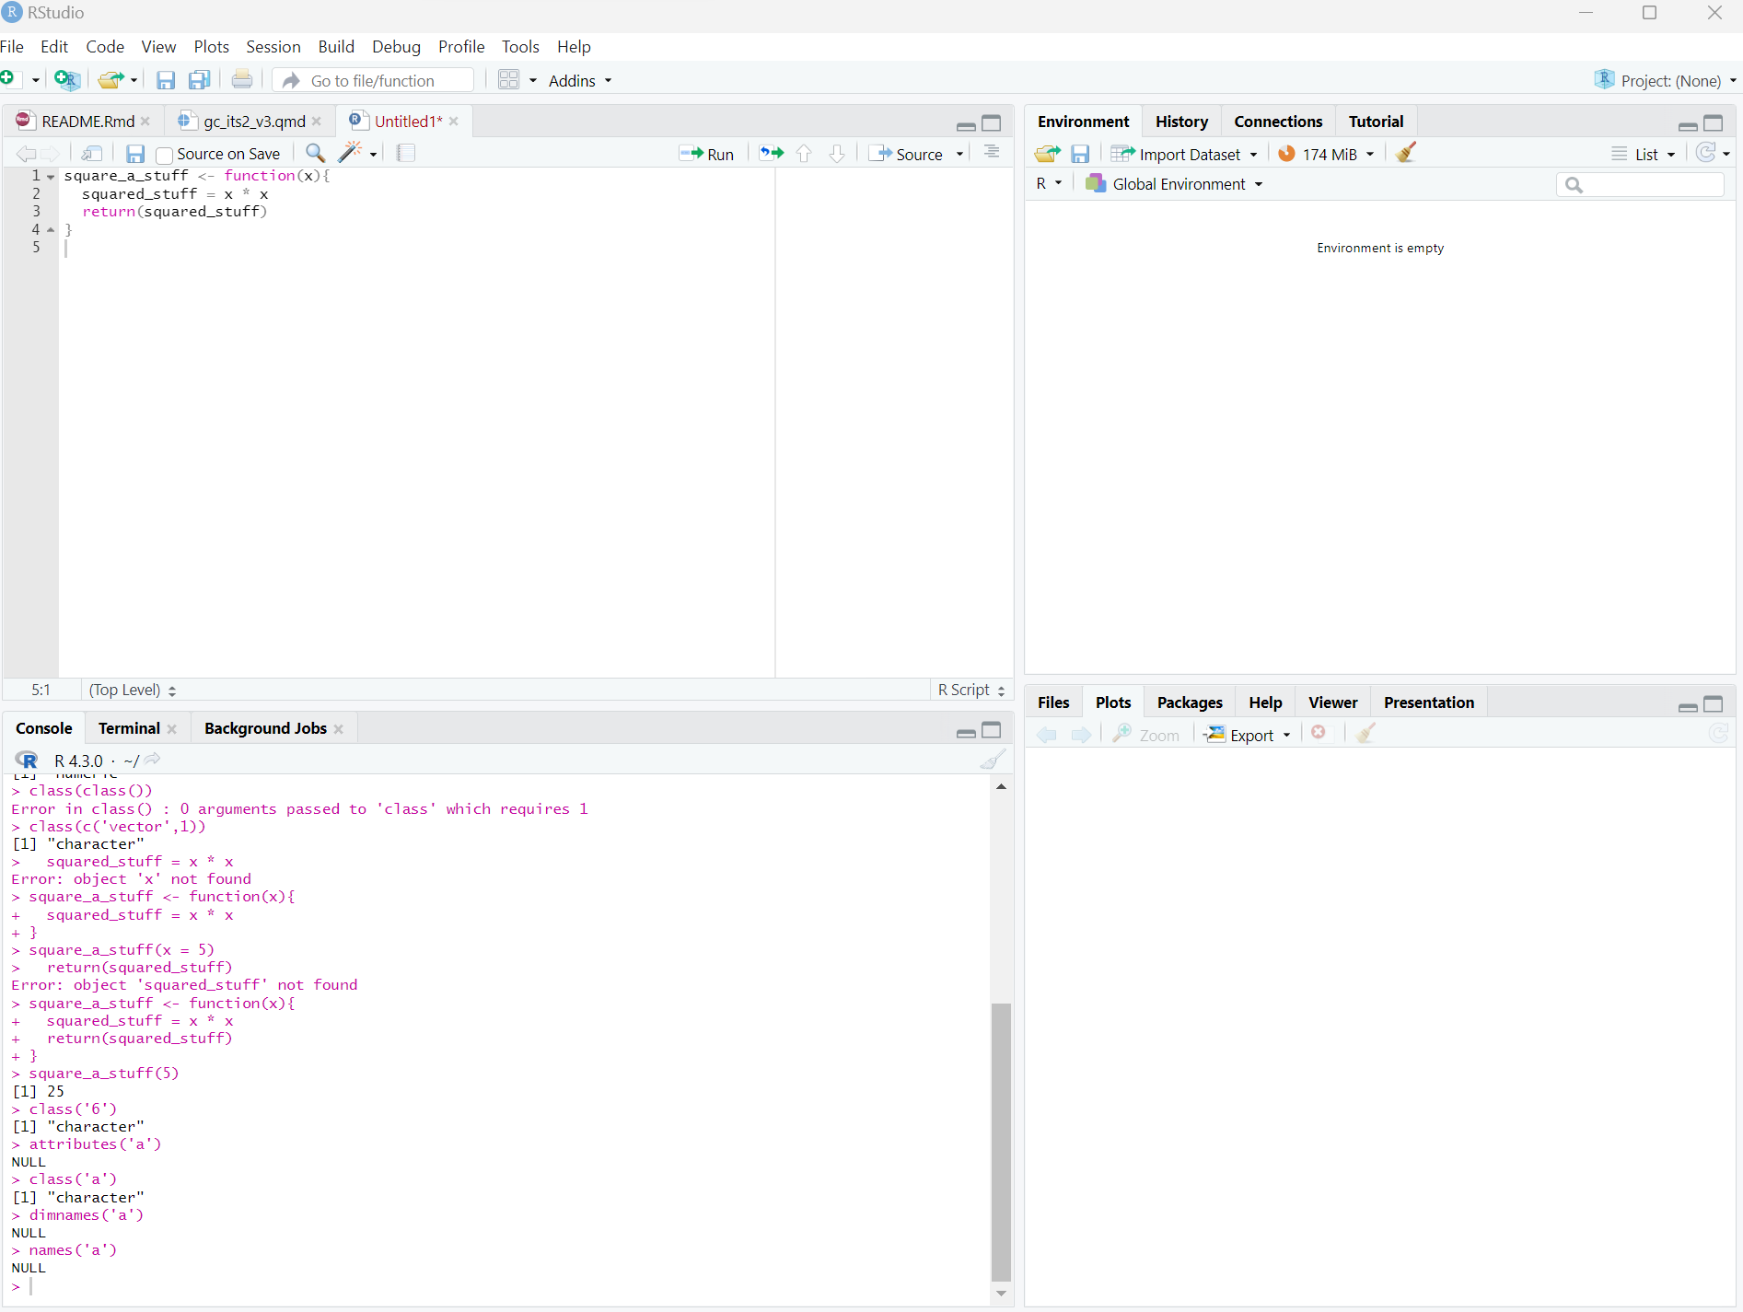
RStudio Parts
Source
Environment, history
This is where you write your code.
What are your objects?
What are the codes that you ran?
Console
Files, plots, etc.
This is where your code gets evaluated.
An interface that lets you visualize many things.

Slide 10
RStudio run
Demo

Slide 11


Quarto Reproducible codes = reproducible Science!
Next-gen version of RMarkdown
What’s RMarkdown, though?
A Data Science authoring tool that lets you combine your code, its results and your comments/instructions

Slide 12


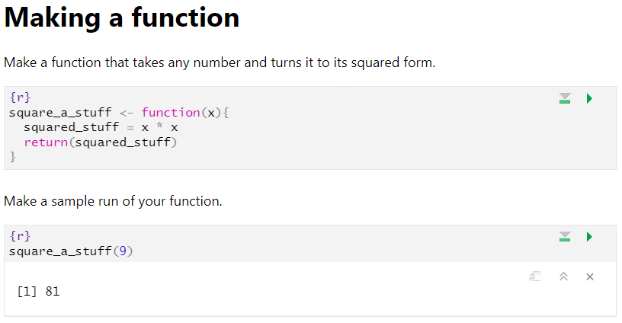
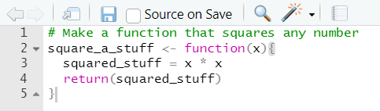
Quarto Sans Markdown tool vs Quarto
After
Before
Annotation
Code chunk

Slide 13
Do Stats in a reproducible way!
Demo

