Slide 1

Symportal, what gives?
Hume et al., 2019

Slide 2

Brief intro to metabarcoding (reiteration)
Metabarcoding is getting the sequences of a universal gene (barcode) from a community (2 or more organisms)
Universal gene/universal gene marker = gene found in most living organisms which can provide taxonomy information
16S, 18S, ITS2
Targeted PCR amplification
Sequencing
Community
ATGCGGCTAAT Human 18S
ATGCGGCTAAT
Database
ATGCGGCTCCT Rat 18S
Human
ATGCGGGCCCT Symbiodinium 18S
Notes:
Quick side note: metabarcoding is formerly termed as metagenomics (sadly, it is still being mistermed as such).

Slide 3
Symportal
A framework for resolving putative taxa of Symbiodiniaceae using NGS data of the ITS2 amplicon
18S
ITS1
5.8S
ITS2
28S

Slide 4
What gives?
18S
ITS1
5.8S
ITS2
28S

Slide 5
What gives?
18S
ITS1
5.8S
ITS2
28S
* 16S of bacteria (1-17 copies) and archaea (1-4 copies) has fewer copies
ITS2 in Symbiodiniaceae can be hundreds to thousands;

Slide 6
What gives?
ITS2
ITS2
ITS2
ITS2
ITS2
ITS2
ITS2
ITS2
ITS2 in Symbiodiniaceae can be hundreds to thousands;
and have high sequence variations (intragenomic diversity)
Presence of an ITS2 sequence is hard to correlate with actual abundance
No single ITS2 sequence correspond to one Symbiodiniaceae type/species

Slide 7
What gives?
ITS2
ITS2
ITS2
ITS2
ITS2
ITS2
ITS2
Also, multiple Symbiodiniaceae types could be harbored in a host with several ITS2 sequences that could sometimes be similar and could underestimate diversity (intergenomic diversity)

Slide 8
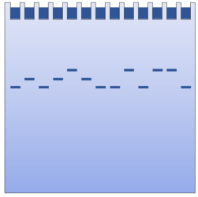
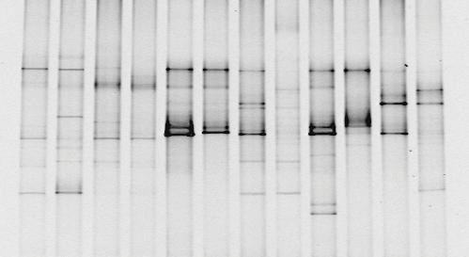
Why use?
Denaturing gel electrophoresis (DGGE)
Molecular fingerprinting of communities based on denaturation characteristics of a sequence
Low-throughput
Low sensitivity
Cannot distinguish putative Symbiodiniaceae strains from a common genus

Slide 9

Why use?
Symportal
Community-wide identification of Symbiodiniaceae based on NGS
High-throughput
High sensitivity
Can distinguish putative Symbiodiniaceae strains from a common genus

Slide 10
Why use?
Denaturing gel electrophoresis (DGGE)
Molecular fingerprinting of communities based on denaturation characteristics of a sequence
Low-throughput
Low sensitivity
Cannot distinguish putative Symbiodiniaceae strains from a common genus
Symportal
Community-wide identification of Symbiodiniaceae based on NGS
High-throughput
High sensitivity
Can distinguish putative Symbiodiniaceae strains from a common genus

Slide 11
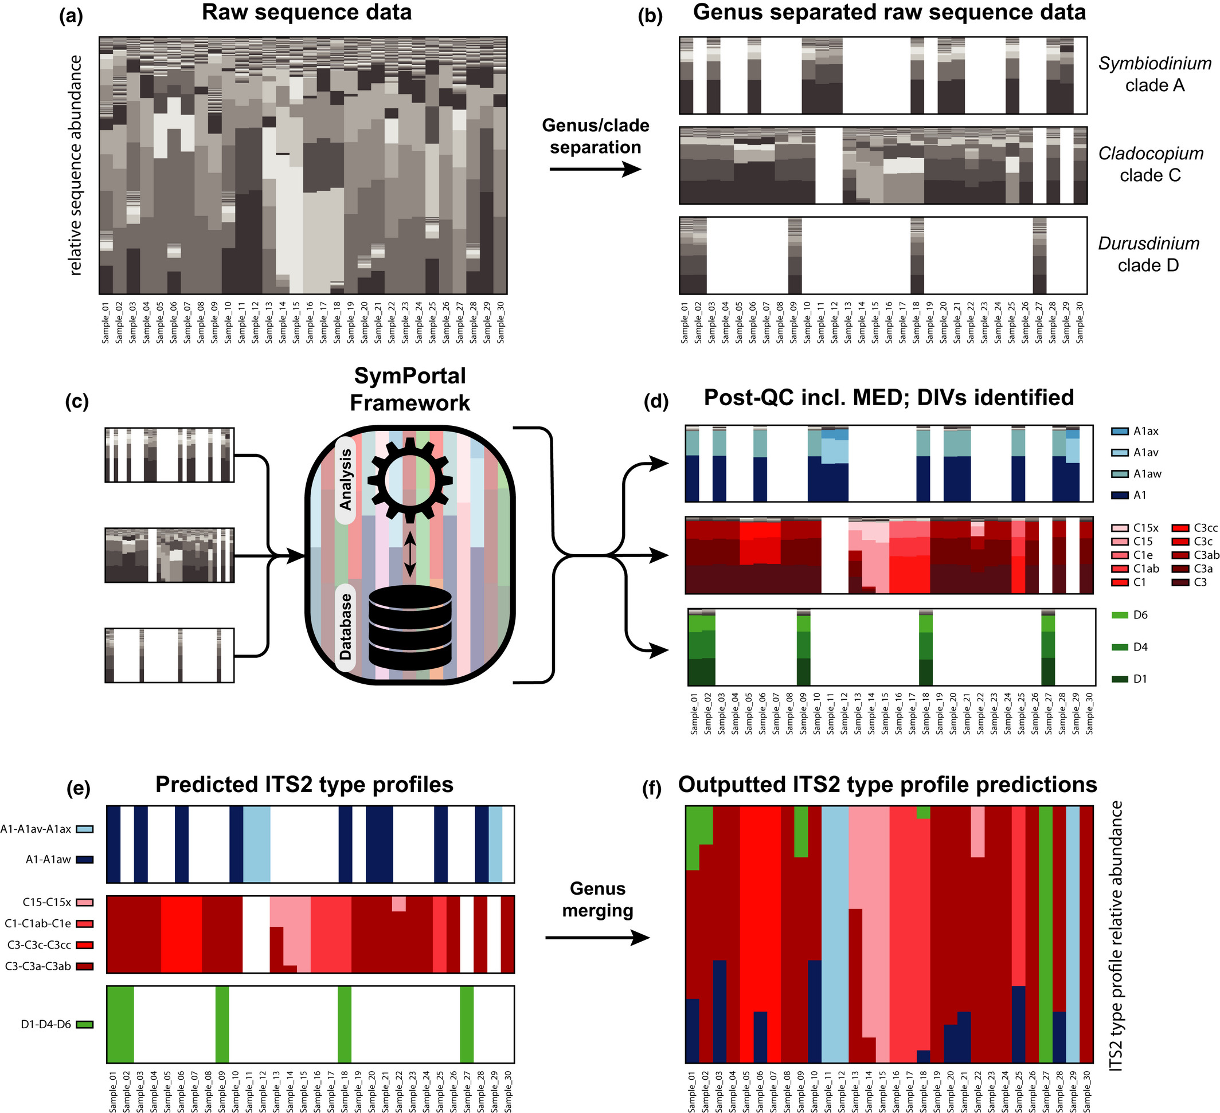
How?
Raw sequences
Genus-separation
Post-QC (MED), DIV ID

Slide 12
How?
Post-QC, MED, DIV ID
ITS2 type profile prediction

Slide 13
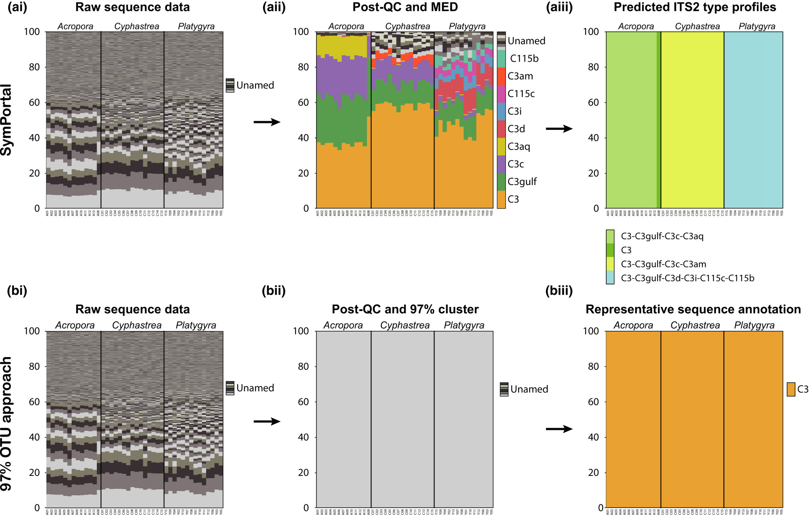
How?
How?
Example

Slide 14
How?
How?
Traditional example

