Slide 1

Ecological statistics, reiteration

Slide 2
Ecological statistics workflow
Alpha diversity metrics
Alpha diversity significance testing (Kruskal-Wallis)
OTU/ASV table
Computation of alpha and beta diversity
Beta diversity metrics
Beta diversity significance testing (PERMANOVA)
Environmental parameters
Clustering analysis
(hierarchical & ordination)
Dendrograms and ordination plots
Correlogram and other statistical tests
Notes:
OTU/ASV table and environmental parameters will be used for ecological statistics
Alpha and beta diversity metrics will be computed from the site-species abundance table (OTU table)
Beta diversity metrics will be used for clustering of sites based on composition while environmental parameters will be standardized then Euclidean distance will be computed for clustering based on environmental conditions (clusters will be shown in dendrograms and ordination plots)
After knowing the discontinuities in data (i.e., clusters), significance testing for alpha diversity and beta diversity between and among clusters will be done
Then, analysis of similarity percentages, correlogram and linear regression will be done for further data exploration

Slide 3
Diversity metrics
Two types of diversity metrics are commonly explored in microbial community analysis
Alpha diversity – diversity within a sample
Beta diversity – difference between samples

Slide 4
Alpha diversity
How diverse is a sample?
Diverse
Not diverse
Richness – how many taxa? (Observed features/taxa, Simpson index)
Evenness – how evenly are the abundances distributed across taxa? (Evenness index)
Richness and evenness – alpha diversity metric that combines both (Shannon index)

Slide 5
Beta diversity
How different are two or more samples/sites from one another?
Sample 1
Sample 2
Sample 1
Sample 2
Similar
Different
Unweighted – how many taxa are shared? (Jaccard index, unweighted Unifrac)
Weighted – do shared taxa have similar abundances? (Bray-Curtis dissimilarity, weighted Unifrac)

Slide 6
Clustering methods
These methods differ by their algorithms. The following are the most commonly used clustering methods:
Hierarchical clustering
Ordination methods

Slide 7

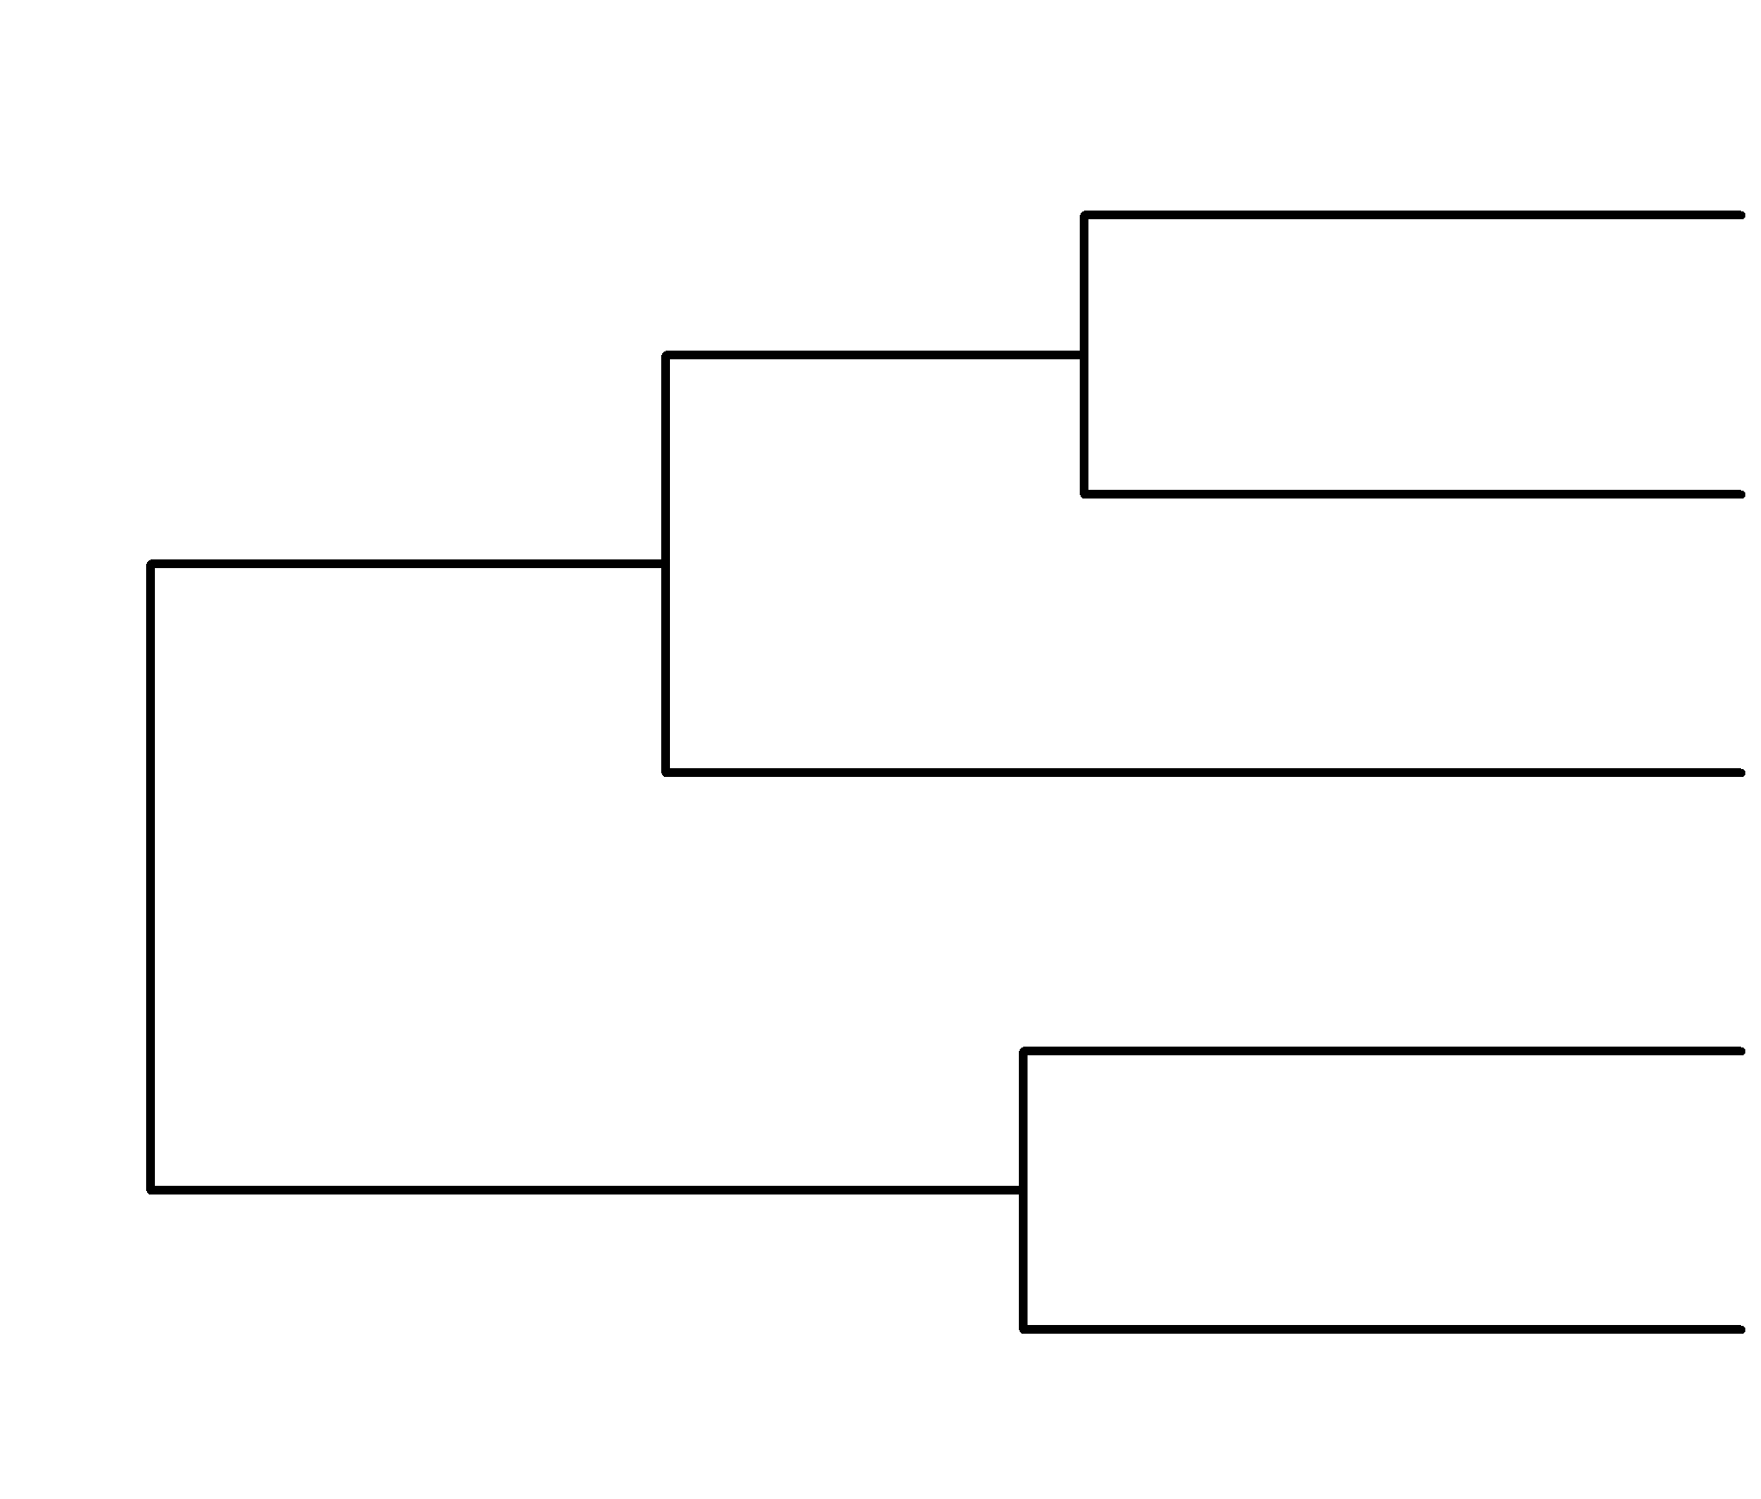
Why identify clusters?
Sampling in a gradient
↓ Salinity
↑ Salinity
Notes:
In environmental microbiome research, samples are usually extracted in gradients (e.g., low salinity to high salinity). Using the information from the measured environmental parameters and community composition, we can assign clusters and compare them with each other then see the possible drivers of difference between or among the clusters

Slide 8
Hierarchical clustering
Members of inferior-ranking members cluster to become members of higher-ranking clusters
Common hierarchical clustering methods:
Single linkage
Complete linkage
Average linkage
Ward’s minimum variance clustering

Slide 9
Ordination methods
Statistical techniques used to extract main trends in data in the form of continuous axes
Two types:
Unconstrained ordination
Constrained ordination

Slide 10
Unconstrained ordination
Relies on the information of a single dataset (similarity or dissimilarity metric)
Common types:
PCA
PCoA
NMDS

Slide 11

Constrained ordination
Uses the matrix of the one being clustered and a matrix of explanatory variables (2 matrices) providing a constraint where to group or divide the data of the first matrix
Common types:
RDA
db-RDA
CCA

Slide 12
Statistical tests/data exploration
for alpha diversity
Alpha diversity metrics provide a single value for each sample
These metrics can be viewed/explored with boxplots
This is suitable for classic univariate tests (Kruskal-Wallis)

Slide 13
Statistical tests/data exploration
for beta diversity
Beta diversity metrics are more complicated, data is usually not normal
Can be visualized using dendrograms and ordination plots
Permutational ANOVA (PERMANOVA) is commonly used

