Slide 1
Introduction to bash and bash commands

Slide 2
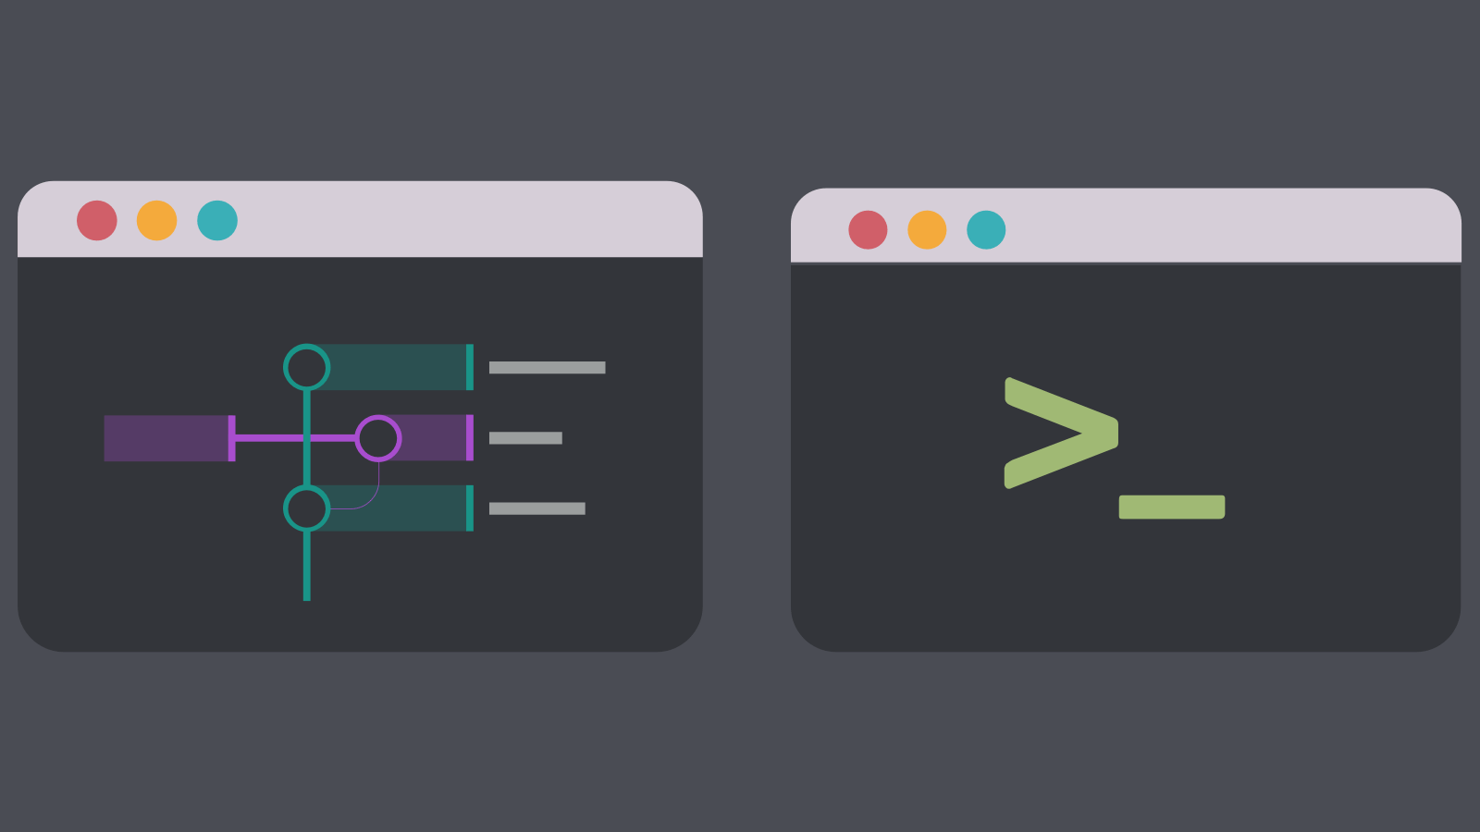
Brief intro to Linux
Most bioinformatics tools are developed in a Unix-like or -based operating system (OSs)
  Examples: Linux (and Linux distros) and MacOS
Why?
  Open source
  Can streamline bioinfo analyses (pipelines that link outputs and inputs from different algorithms) and make it reproducible
  Works well with command line interface (CLI) (see CLI and GUI below).
CLI
GUI

Slide 3
Brief intro to Linux
Most bioinformatics tools are developed in a Unix-like or -based operating system (OSs)
  Examples: Linux (and Linux distros) and MacOS
Why?
  Open source
  Can streamline bioinfo analyses (pipelines that link outputs and inputs from different algorithms) and make it reproducible
  Works well with command line interface (CLI)
  Bionfo tasks usually require large amounts of computing power (high performance computing) which can only be accessed using a shell

Slide 4
Interacting with the OS & hardware
Shell
Kernel/OS
Hardware

Slide 5
Interacting with the OS & hardware
Shell
A CLI program allowing you to control your computer using text commands instead of GUI
Accepts human-readable commands and translates it so the kernel can understand
Examples: Bash, Bourne, Z shell
Terminal is a shell program
Kernel/OS
Hardware

Slide 6
Interacting with the OS & hardware
Shell
Kernel/OS
Core of an OS (Operating system) that manages the operations of the hardware (CPU, RAM, etc.)
Hardware

Slide 7
Interacting with the OS & hardware
Shell
Kernel/OS
Hardware

Slide 8
Example run

