Slide 1
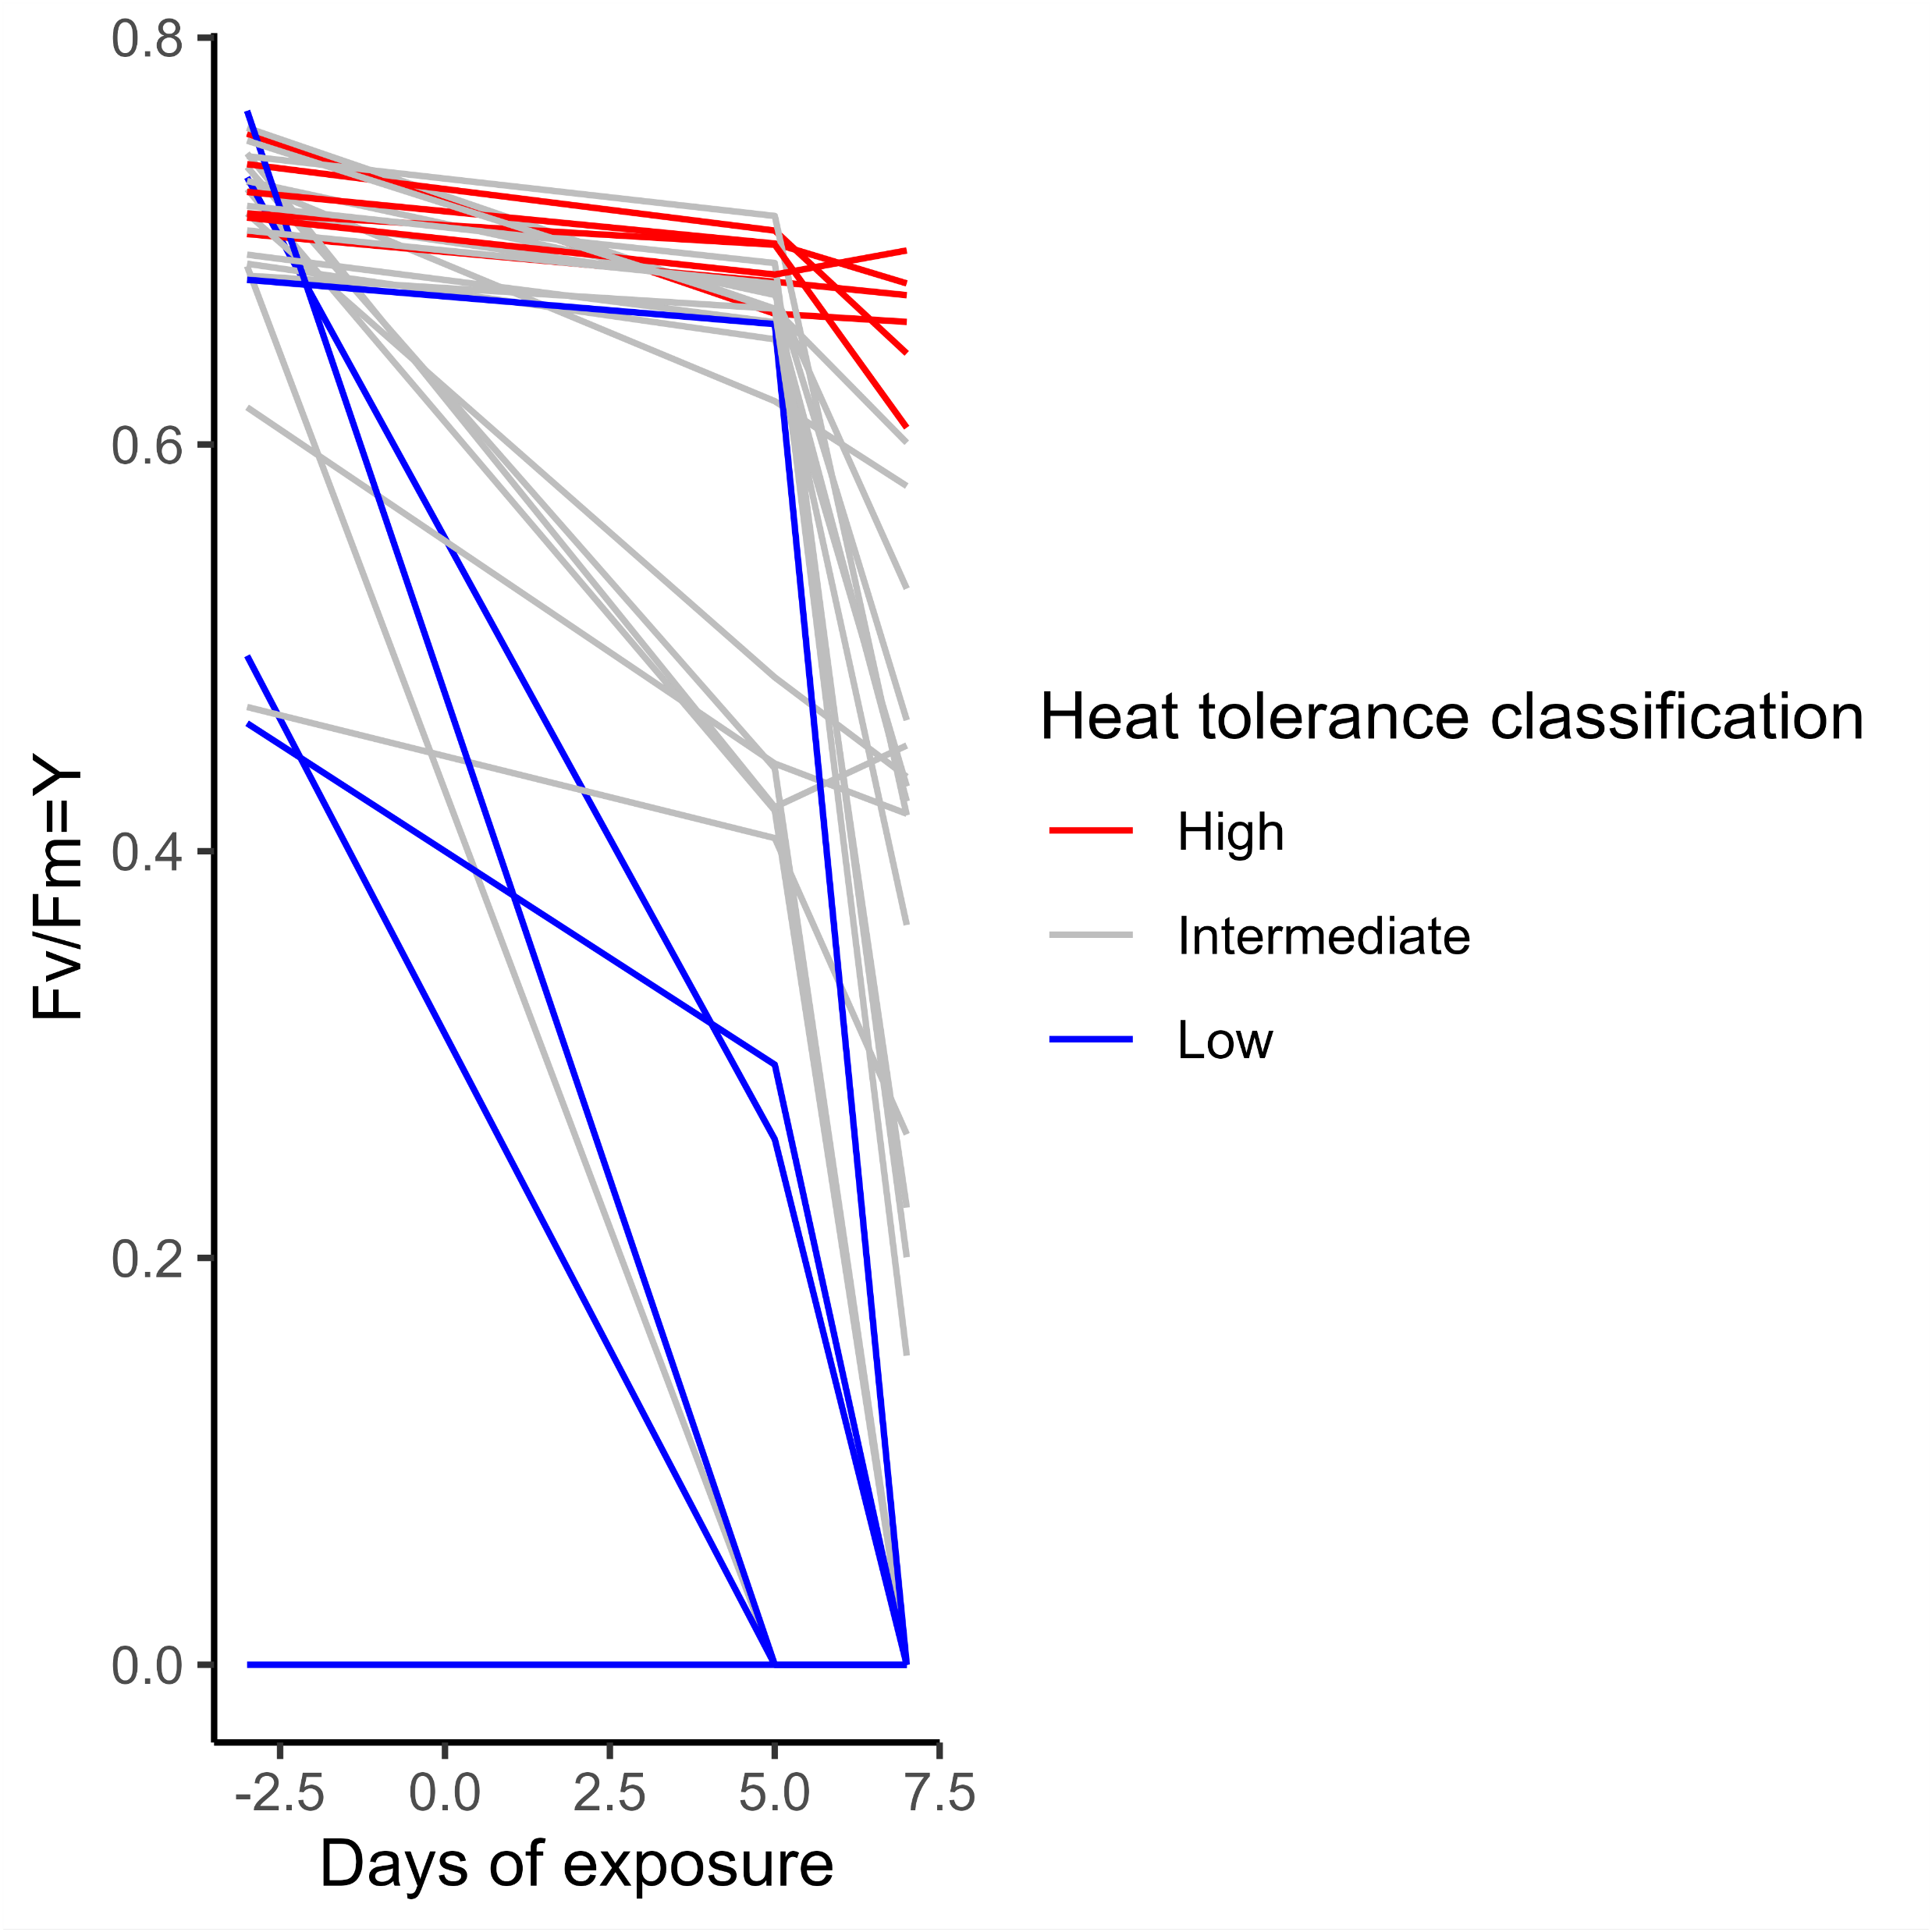
A. millepora
Averaged at day 7, line plot
Before heat stress (29°C)

Slide 2
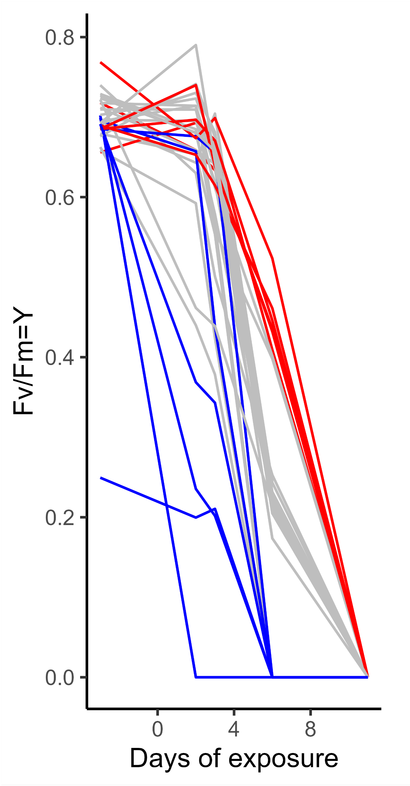
A. tenuis
Averaged at day 6, line plot
Before heat stress (29°C)

