Slide 1
Marking Up Text
Learning Web Design: Chapter 5 and Appendix D

Slide 2
Overview
HTML Structure tags, also called Document-Level Elements
HTML Block-Level Elements Semantic Inline Elements
Comment tags, Horizontal Rules, Line Break
Presentational Inline Elements

Slide 3
Structure Tags or Document-Level Elements
These elements provide structure to a document as well as providing info that is used by the browser or search engines
<!DOCTYPE html>
<html>, </html>
<head>, </head>
<title>, </title>
<meta>
<body>, </body>

Slide 4
Start with start.html
Your instructor will provide you with a start file that has the basic page structure
Use this start file for EVERY web page you create this semester
It contains the required tags for all HTML5 documents

Slide 5
<head> </head> tag
Lines placed within these tags are the prologue of the rest of the file
Sometimes referred to as the header of the document
You should never put any text of your page within the header

Slide 6
The Title
Use the <title> tag to give your page a title
This title is used by your browser’s bookmarks and search engines
You should have a simple and descriptive title for your page
You can only have one title and it can only contain simple text

Slide 7
<meta> self-terminating tag
This tag is placed inside the header and is used to provide information about the document
Our start file for the semester contains several meta lines
Some meta attributes:
name – Name of the meta info
content – content of the info

Slide 8
Head Example:
<head>
<meta charset="UTF-8">
<title>Basic Project Template</title>
</head>

Slide 9
Deprecated Tag or Attribute
These features are being phased out of earlier versions of HTML.
These features are still supported but have been outdated by newer methods.
Browsers are backwards compatible for those using earlier versions.
Future versions of HTML will make these features obsolete .

Slide 10
<body> </body> tag
The text and other contents of your page are enclosed within the body tag
The following attributes are deprecated in favor of setting in a style sheet:
background – URL for background image
bgcolor- sets background color
link – link color
vlink - visited link color
alink – active link color

Slide 11
Block-Level Elements
Appear inside the body of the document
Are formatted to begin on a new line
May not contain other block-level elements
May contain text-level elements, which are the lowest-level elements

Slide 12
A Handful of Block-Level Tags
There are very few block-level tags, but they provide important structure to your pages
Headings
Paragraphs
Various Lists
Blockquotes
Preformatted Text
Address
Horizontal Rule

Slide 13
Align Attribute Deprecated
For block-level elements and the horizontal rule, the align attribute has been deprecated
In another chapter we will learn how to use the text-align CSS property to align block-level elements

Slide 14
Use Indenting for Readability
You will find it helpful to better show the hierarchy of elements in your code
A browser does not care about indenting, but humans reading your code will
In fact, you should use indenting to help you better understand your own code

Slide 15
Non-Indented Code
What does this mean???
<dl> <dt> Basil </dt><dd> Annual. Can grow four feet in height, the scent of its tiny white flowers is heavenly. </dd><dt> Oregano </dt><dd> Perennial. Sends out underground runners and is difficult to get rid of once established.</dd></dl>

Slide 16
Indented for Readability
<dl>
<dt> Basil </dt>
<dd>
Annual. Can grow four feet in height,
the scent of its tiny white flowers is heavenly.
</dd>
<dt> Oregano </dt>
<dd>
Perennial. Sends out underground runners
and is difficult to get rid of once established.
</dd>
</dl>

Slide 17
Heading Tags
HTML provides for six levels of headings
<h1> - <h6>
You should use headings to divide areas of text
Headings should not be used for emphasis because text readers will mistake the meaning
Use to provide hierarchical order or outline
Use <h1> for page headings, <h2> for section headings, etc.

Slide 18
Heading Appearance
Headings have a default appearance
They will appear bolded and very large type will be used for <h1> on down to the smallest type for <h6>
Using heading levels consistently will approve your site’s accessibility, and also helps with search engine weighting
In the future, we will use CSS style to control the look of your headings!

Slide 19
Headings can be used to give text structure
<h1> Mythology Through the Ages </h1>
<h2> Common Mythological Themes </h2>
<h2> Earliest Known Myths </h2>
<h2> Origins of Mythology </h2>
<h3> Mesopotamian Mythology </h3>
<h3> Egyptian Mythology </h3>
<h4> The Story of Isis and Osiris </h4>
<h4> Horus and Set: The Battle of Good vs. Evil </h4>
<h4> The Twelve Hours of the Underworld </h4>
<h4> The River Styx </h4>
<h2> History in Myth </h2>

Slide 20
Paragraphs
A paragraph is used as a container of text or other elements in a document
<p> signals the beginning of a paragraph
</p> signals the ending of a paragraph

Slide 21
Paragraph Example:
<h1 >Henry the Eighth </h1>
<h2> First Verse </h2>
<p> Oh, I’m Henry the Eighth, I am, Henry the Eighth, I am, I am. I got married to the girl next door, she’s been married seven times before and every one was a Henry. HENRY. Never was a Willie or a Sam. I’m an eighth old man named Henry, Henry the Eight, I am.
</p>
<h2> Second Verse the same as the First, a little bit louder and a little bit worse. </h2>

Slide 22
HTML Lists
Ordered Lists
<ol>, </ol>
Can be numbered several different ways
Unordered Lists
<ul>, </ul>
Are bulleted with several types of bullets
Glossary Lists or Definition Lists
<dl>, </dl>
Can contain a Term and a Definition part

Slide 23
Ordered Lists
When a browser display this list type, it usually numbers the elements sequentially and indents them
Use ordered list when you wish to convey that elements must appear in a certain order
Each element of the list is given a list tag
<li> first item </li>
<li> second item </li>

Slide 24
Unordered Lists
Elements of these lists can appear in any order
Browsers usually format items by inserting bullets or some other symbol
Similar to ordered lists
Each element is listed with a list element
<li> list item </li>

Slide 25
Glossary Lists , also called Definition Lists
Each part of this list is either a term or definition and has its own tag
Term - <dt> , definition term
The term’s definition - <dd> , definition definition
The entire glossary list is set apart with the <dl>, </dl> tags
These lists are usually formatted with the terms and definitions on their own lines and with the definitions indented.

Slide 26
Glossary List Example:
Okay, this is a list, but what does it mean ??
<dl>
<dt> Basil </dt>
<dd> Annual. Can grow four feet in height, the scent of its tiny white flowers is heavenly.
</dd>
<dt> Oregano </dt>
<dd> Perennial. Sends out underground runners and is difficult to get rid of once established.
</dd>
</dl>

Slide 27
Definition List Example:
<dl>
<dt> Basil </dt>
<dd> Annual. Can grow four feet in height, the scent of its tiny white flowers is heavenly.
</dd>
<dt> Oregano </dt>
<dd> Perennial. Sends out underground runners and is difficult to get rid of once established.
</dd>
</dl>
Definition List begin and close
Definition Definition
Definition Terms
Definition Definition

Slide 28
Note:
You may have a definition list without a term or definition.

Slide 29
Nested Lists
You may nest or locate one list within another list
The inner list must be placed inside an <li> or a <dd> to validate
The inner list will become indented from the rest of the list
Works well for menu-like lists

Slide 30
Note:
Nested lists must be placed inside a <li> or <dd> tag or they will not validate! This is different from the code shown in our text!

Slide 31
Nested List Example:
<ul>
<li> Country Songs </li>
<li> Campfire Songs
<ul>
<li> Give me a Home </li>
<li> Koombahya </li>
</ul> </li>
<li> Marching Songs </li>
</ul>

Slide 32
Nested List Example:
<ul>
<li> Country Songs </li>
<li> Campfire Songs
<ul>
<li> Give me a Home </li>
<li> Koombahya </li>
</ul>
</li>
<li> Marching Songs </li>
</ul>
Outer List
Open and Close <li>
Nested List

Slide 33
Horizontal Rule
<hr> - horizontal line
This is a self-terminating tag
HTML Attributes of <hr> are deprecated
size – size in pixels
width- in pixels or percentage
Later, you will learn how to use CSS to control the styling of an <hr>

Slide 34
Comments
Text that is used to describe the intent of the programmer or information about the code but is not used to create the page is referred to as a comment
Comments may be added anywhere in the file <!-- This is what a comment tag looks like -->
Each line of text should be individually commented

Slide 35
Special Characters
Special characters begin with an & character
Ex. &nbsp; non-breaking space
Ex. &copy; &quot; &agrave;
Ex. &lt; &gt; &amp;
Validation note: If an & appears in text or a link path, the validator will give an error because it expects this begins a special character
Always use the &amp; special character if an & is needed in a link path or text

Slide 36
Preformatted Text Tag
The <pre> tag has the following characteristics
Spacing between characters is kept
Every character takes up the same width
Can be used to line up columns
Can be used to create ASCII art
Validation Note: <pre> is a block-level element (cannot be nested inside another block-level element)

Slide 37
Blockquote Tag
The <blockquote>is used for long quotations
This is a block-level element – cannot be nested in other block-level elements
Indents both the left and right margin
Note: Should only be used for quotes not just to indent a paragraph of text

Slide 38
The Division Tag
<div> - division groups a block of text
You can use this to group tags as well as text
The align attribute is deprecated for <div>
Use CSS to align <div> tags
The width of a <div> defaults to being the width of the entire window

Slide 39
Code Sample <div> Alignment
<div>
<h1 > Susan's Cactus Gardens</h1>
<hr />
<p> Note: <br /> Cactus make wonderful house plants. Remember to water sparingly.</p>
<ul>
<li> Caring for Succulents </li>
<li> Propogating Cactus </li>
<li> Transplanting Cactus</li>
<li> Exotic Cactus </li>
</ul>
</div>

Slide 40
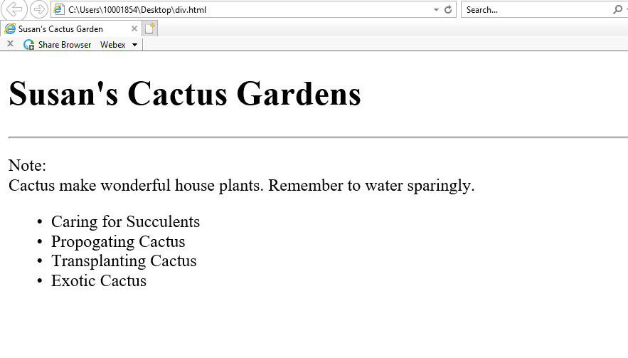
Browser Display of Text Alignment

Slide 41
Semantic Inline Elements
There is a semantic meaning or context to the enclosed text of these tags
Some examples include:
<em> - emphasize characters, usually italicized
<strong> - more strongly emphasized than em, usually bolded
<code> - Used for code segments, displayed in monospace or fixed-length font like Courier
<samp>- sample text, usually fixed-length
<kbd> indicated what the user is to type, usually fixed-length

Slide 42
More Semantic Inline Elements
<var> - name of a variable, italicized or underlined
<dfn> - definition, used to highlight, usually italicized
<abbr>- used for an abbreviation of a word, title attribute holds long version
<acronym> - designates a word formed by combining letters from several words, title attribute holds long version
<ins> - text to be inserted, when editing
<del> - text to be deleted, when editing

Slide 43
Cite – Quotation - Blockquote???
Semantic Inline elements:
<cite> - used for identifying or “citing” a reference as in book or magazine, usually rendered in italics
<q> - used for short quotations Dilemma: Standard compliant browsers add the “ ” , but other browsers will not, so decide whether to provide “ ” or not
Block-level element:
<blockquote> - used for long quotations, is indented on both left and right side

Slide 44
Semantic Elements Example
<p> The anteater is the <em>strangest</em> looking animal, isn't it?</p>
<p>Take a <strong>left turn</strong> at <strong>Dee's Hop Stop</strong></p>
<p> <code>#include "myfile.cpp”</code></p>
<p>The URL for that page is <samp> http://www.cern.ch/ </samp> </p>
<p> <cite>Eggplant has been known to cause nausea in some people</cite> </p>
<p>Use the standard abbreviation for California <abbr title=“California”>CA</abbr> </p>
<p> World Wide Web <acronym title=“World Wide Web”>WWW</acronym> </p>

Slide 45
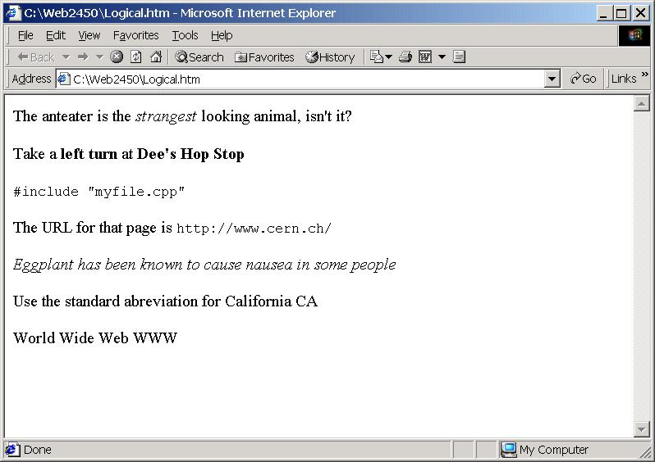
Sematic Elements Example

Slide 46
Presentational Inline Elements
These elements provide typesetting guidelines to enclosed text
Must have opening and closing tag
Some examples include:
<b> - bold, better to use CSS
<i> - italic

Slide 47
More Presentational Inline Elements
<small> - smaller that surrounding text
<sub> - subscript
<sup> - superscript
--------------------------------------------
<u> - underline (deprecated)
<s> - strikethrough (deprecated)

Slide 48
Code Sample with <pre> Block-Level Element
<p> This is some regular text. <br>
<b> This is bolded text.</b> <br>
<i> This is italicized text. </i> <br>
<u> This is underlined text. </u> <br>
<s> This is strikeout text. </s> <br>
<small> This is small text. </small> <br>
This is some subscript text, 2<sub>4</sub> <br>
This is some superscripted text, 2<sup>4</sup> <br> </p>
<pre>
This is pre formatted text Second column
More text in first column More in second column
</pre>
Code Sample with Presentational Inline Elements

Slide 49
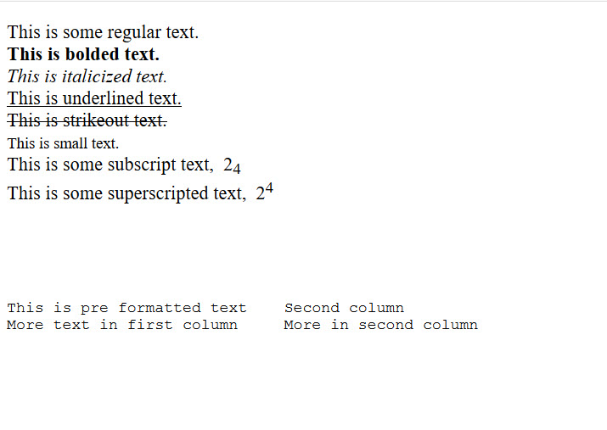
Browser Display <pre> Block-Level Element
Browser Display Presentational Inline Elements

Slide 50
Line Break Tag
<br> - breaks a line of text at the point where it appears
The line break tag is a self-terminating or empty tag
The clear attribute for images has been deprecated.
Note: When possible, let text wrap on its own without forcing breaks

Slide 51
Summary
Document-level tags are used to setup the document structure
Block-level tags are used to set apart separate blocks within a document
Inline elements can be semantic or presentational in nature
Some inline elements are being deprecated in favor of CSS alternatives

