Slide 1

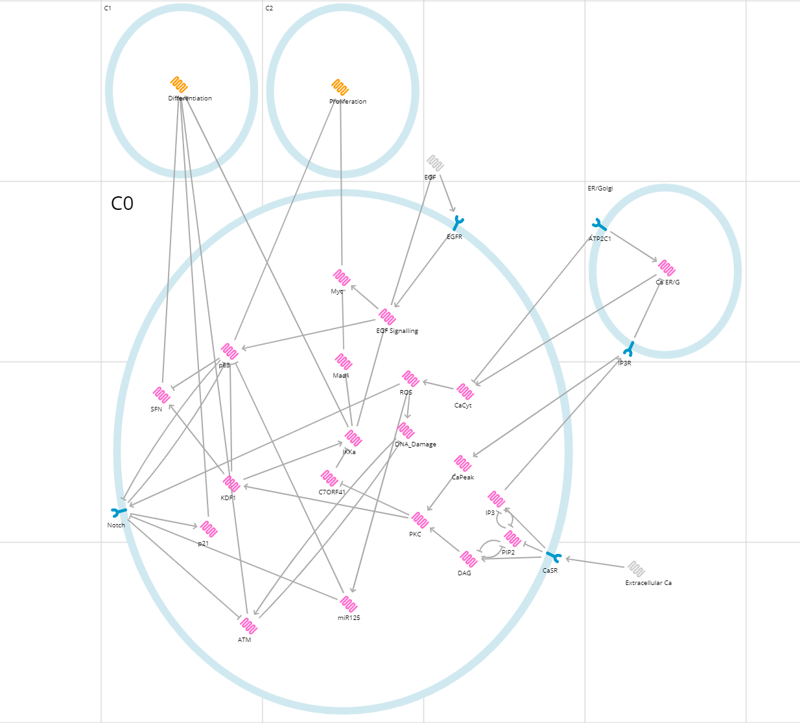

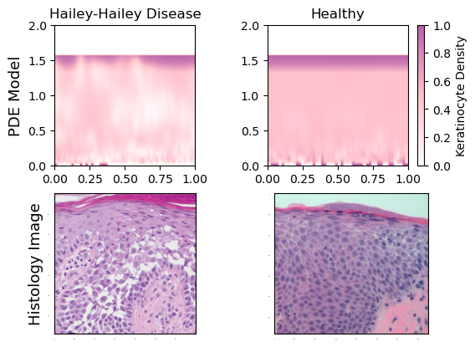
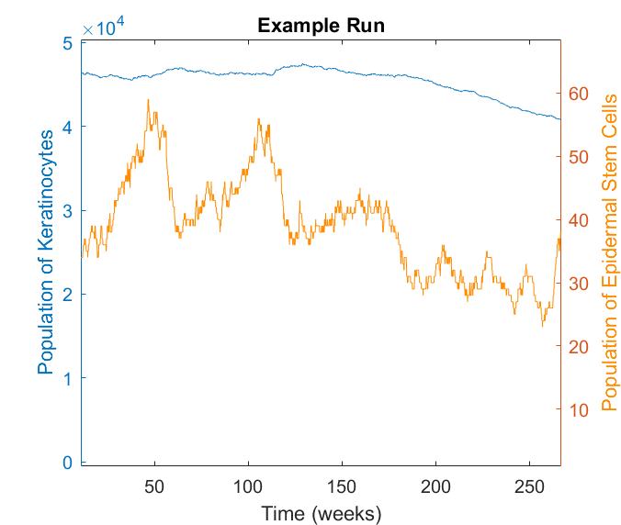
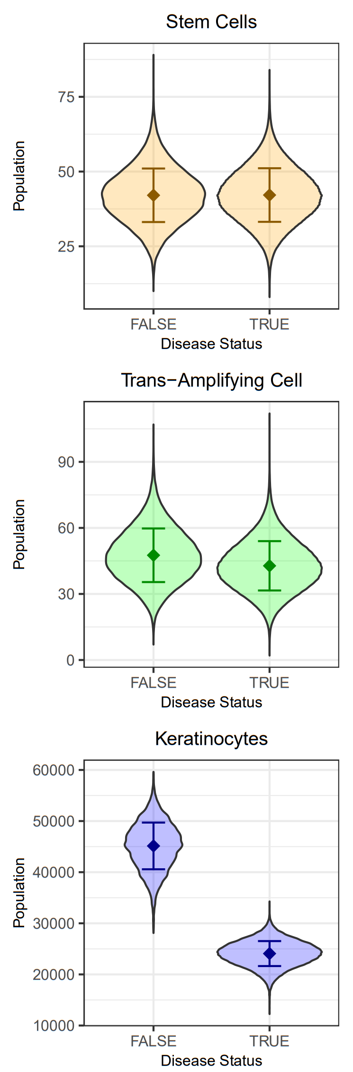
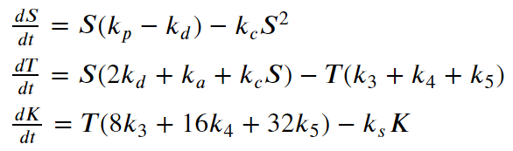

Modelling the Pathogenesis of Hailey-Hailey Disease
QR code to the corresponding Github repository containing
all code for reproducibility and animated
PDE simulations.
Finley Webb, Jack Rich, Isabelle Murray
University of Cambridge
Introduction
Boolean Cell Fate Decision Model
Spatially Explicit Model of the Epidermis
Hailey-Hailey disease causes the epidermis to have a characteristic 'dilapidated brick wall' appearance.
We derived a PDE model¹¹ of keratinocyte density (K) to see if our hypothesis of an increase in the differentiation of basal keratinocytes is consistent with the epidermis appearance. Parameters were changed to reflect differences in the layers of the epidermis (Table 3).
The lower spatial boundary condition of the
PDE represents the introduction of new cells
to the epidermis from the division of TCs,
occurring in random clusters of 32
and 16 cells for healthy and HHD epidermis
respectively.
4 clusters per mm matching stem cell density.
Hailey-Hailey Disease (HHD) is a rare genetic disease that causes blisters to form on the skin.¹
It effects 1 in 50,000 people. Patients suffer with reduced quality of life and are at high risk for secondary infections which can be fatal.
The disease is autosomal dominant and is caused by a mutation in the ATP2C1 gene which encodes the SPCA1 protein. This protein is an ATPase Ca2+ transporter that sequesters Ca2+ in the Golgi and is highly expressed in the skin.
It is currently unknown how this mutations leads to skin blistering. There has been little research into the disease, especially in terms of modelling.
We chose to focus on the hypothesis that blistering is caused by an imbalance in proliferation and differentiation in cells found in the dermis^{2,3} which causes a “dilapidated brick wall” epidermis.
We began by creating a Boolean model in BMA to determine whether the mutation in HHD would lead to an imbalance in proliferation and differentiation. The impact of this imbalance on the equilibrium population of keratinocytes was modelled stochastically and deterministically. We then devised a spatially explicit model to test if our hypothesis for pathogenesis is consistent with the epidermis appearance in HHD.
Signalling pathways and proteins associated with keratinocyte cell fate decisions and HHD have been identified but a network approach has not been used to analyse this.
We designed a network based on the existing literature and implemented it in BMA.⁴⁻¹⁰
In the disease state (ATP2C1 = 0), both differentiation and proliferation become unstable.
This was due to instability in the activation of Notch signalling and p63, caused by an increase in miR-125b. Setting this to 0 removes the instability.
These results support our hypothesis that mutations in ATP2C1 can cause an increase in the differentiation of basal keratinocytes.
Figure 1: BMA model of the regulatory network controlling cell fate decision between differentiation and proliferation in keratinocytes.
Table 1: Outcome of Boolean model of basal keratinocyte cell fate decision in healthy and diseased state.
 | Extracellular Ca²⁺ Concentration
ATP2C1 | Low (0) | High (1)
Wild Type (1) | Stable Proliferation (0) | Stable Differentiation (1)
Mutated (0) | Unstable Proliferation and Differentiation (0-1) | Stable Differentiation (1)
Table 3: Parameters used in the PDE.
Figure 3: Top left and top right show a snapshot in time of the PDE solutions with stochastic boundary condition with and without disease respectively and with axis scaled in mm. Bottom left and right show corresponding histology images.^{12,13}
Parameters | a (target density) | b (minimum density) | c (advective speed) | D (diffusion constant) | λ (growth rate) | Layer height (mm)
Spinosum | 0.5 | 0.25 | 0.2 | 0.001 | 5 | 1.4
Corneum | 1 | 0.25 | 0.1 | 0.001 | 5 | 0.1
Keratinocyte Population Modelling
We devised a stochastic model with master equation
based on the system of ODEs in Fig. 2.4 to determine the effect
of increased differentiation on the equilibrium population
of keratinocytes (KC), transit-amplifying cells (TC) and stem
cells (SC) in 1mm² of epidermis.
In the disease state, each TC is modelled as producing
KC after one fewer rounds of division. This models the earlier
timing of differentiation – as seen in the Boolean network model.
Healthy equilibrium population values and division rates / probabilities were
found in literature¹⁴⁻¹⁶ and used to fit unknown rate constants.
We found a statistically significant decrease in KC equilibrium population
between healthy and diseased epidermis (Fig. 2.3), consistent with our
hypothesis of pathogenesis.
In the symmetric mitosis process, our
model requires proliferation <
differentiation to maintain a stable SC
population, unremarked in the literature.
Discussion
Fig 2.1
Fig 2.2
Mitosis Decision Tree
Stem-Cell Competition
Conclusions
The mutation in ATP2C1 increases differentiation of basal keratinocytes by increasing expression of miR-125b.
This causes a reduction in the total number of keratinocytes in the epidermis due to earlier differentiation of TC's.
This leads to the characteristic 'dilapidated brick wall' appearance due to smaller clusters of TC's unable to cover the basement membrane.
Limitations
For simplicity, some factors were excluded from our model, including adhesion, the immune system, and the individual TAC division events
The PDE model assumes cell density is continuous and does not explicitly model the interactions between keratinocytes. The non-linear diffusion term aims to overcome this.
Outlook and Future Work
Experimentally validate that there are greater rates of differentiation.
miR-125b is a possible drug target for treatment of HHD.
The PDE could be implemented in 3D, with varying epidermal layers to improve understanding of the changes in a variety of epidermis tissues due to HHD.
Further wet lab work could be carried out to measure the spatial clustering and distribution of TC's on the dermis basement membrane.
S
S
+
S
S
T
+
S
Successive TAC
differentiation
Fig 2.3
Methods
T
S
S
S
T
T
T
BMA was used to analyse a Boolean model of the network controlling the cell fate decision between proliferation and differentiation in basal keratinocytes.
MATLAB was used to analyse both a stochastic and deterministic model of keratinocyte population in diseased and healthy epidermis, using a Gillespie algorithm and ODE45 respectively.
A Partial Differential Equation (PDE) was used for spatially explicit modelling of epidermis stability. This was solved numerically using a Finite Differences Method implemented in Python.
$$⋮$$
8K
16K
32K
Fig 2.4
Table 2. Parameters used in the population model
Fig 2.1 Diagrams showing cell process and type. Fig 2.2 Diagram showing populations of S and K over time . Fig 2.3 Distribution of population values at equilibrium for 1mm² of skin. Fig 2.4 ODEs on which the master equation of the stochastic model was based. Table 2 parameters (fit parameters noted with a *)
Stem-Cell Division Rate | P(symmetric division) | P(Poliferative|Symmetric division) | k_{a} (rate of asymmetric division) | k_{p} (rate of proliferative divisions | k_{d} (rate of differentiative divisions) | k_{c} (rate of stem-cell competition) | P(3 rounds of TAC division) | k₃ (rate of TC dividing 3 times) | P(4 rounds of TAC division) | k₄ (rate of TC dividing 4 times) | P(5 rounds of TAC division) | k₅ (rate of TC dividing 5 times) | (Rate of Keratinocyte Shedding)
0.25 sc⁻¹week⁻¹ | 0.22 | *0.7 | 0.195 sc⁻¹ week⁻¹ | 0.0339 sc⁻¹ week⁻¹ | 0.01452 sc⁻¹ week⁻¹ | 0.0005 sc⁻² week⁻¹ | 0 tc⁻¹ week⁻¹ (healthy) *0.4 (disease) | 0 (healthy) 0.13386 (disease) tc⁻¹ week⁻² | 0.4 (healthy) *0.6 (disease) | 0.1004 (healthy) 0.1506 (disease) tc⁻¹ week⁻² | 0.6 (healthy) *0 (disease) | 0.1205 (healthy) 0 (disease) tc⁻¹ week⁻² | *0.0058 kc⁻¹week⁻¹
References
1.Ben Lagha, I., Ashack, K. & Khachemoune, A. Hailey-Hailey Disease: An Update Review with a Focus on Treatment Data. Am. J. Clin. Dermatol. 21, 49–68 (2020).; 2.Cialfi, S. et al. The loss of ATP2C1 impairs the DNA damage response and induces altered skin homeostasis: Consequences for epidermal biology in Hailey-Hailey disease. Sci. Rep. 6, 31567 (2016).;3.Manca, S. et al. Oxidative stress activation of miR-125b is part of the molecular switch for Hailey-Hailey disease manifestation. Exp. Dermatol. 20, 932–937 (2011).; 4.Liu, B., Zhu, F., Xia, X., Park, E. & Hu, Y. A tale of terminal differentiation: IKKα, the master keratinocyte regulator. Cell Cycle Georget. Tex 8, 527 (2009).; 5.Nguyen, B.-C. et al. Cross-regulation between Notch and p63 in keratinocyte commitment to differentiation. Genes Dev. 20, 1028–1042 (2006).; 6.Lee, S., Kong, Y. & Weatherbee, S. D. Forward genetics identifies Kdf1/1810019J16Rik as an essential regulator of the proliferation–differentiation decision in epidermal progenitor cells. Dev. Biol. 383, 201–213 (2013).; 7.Descargues, P., Sil, A. K. & Karin, M. IKKα, a critical regulator of epidermal differentiation and a suppressor of skin cancer. EMBO J. 27, 2639–2647 (2008).; 8.Yan, F.-J., Wang, Y.-J., Wang, S.-E. & Hong, H.-T. PKCα/ERK/C7ORF41 axis regulates epidermal keratinocyte differentiation through the IKKα nuclear translocation. Biochem. J. 478, 839–854 (2021).; 9.Li, Y. et al. Regulation of epidermal differentiation through KDF 1‐mediated deubiquitination of IKK α. EMBO Rep. 21, (2020).; 10.Efimova, T., LaCelle, P., Welter, J. F. & Eckert, R. L. Regulation of human involucrin promoter activity by a protein kinase C, Ras, MEKK1, MEK3, p38/RK, AP1 signal transduction pathway. J. Biol. Chem. 273, 24387–24395 (1998).; 11.Flegg, J. A., Menon, S. N., Maini, P. K. & McElwain, D. L. S. On the mathematical modeling of wound healing angiogenesis in skin as a reaction-transport process. Front. Physiol. 6, 262 (2015).; 12.Rogner, D. F., Lammer, J., Zink, A. & Hamm, H. Darier and Hailey-Hailey disease: update 2021. JDDG J. Dtsch. Dermatol. Ges. 19, 1478–1501 (2021).; 13.Ji, H. & li, xiao-kang. Oxidative Stress in Atopic Dermatitis. Oxid. Med. Cell. Longev. 2016, 1–8 (2016). 14. Available at https://www.sciencedirect.com/science/article/pii/S1534580710000158 15. Webb Li & kaur Location and phenotype of human adult keratinocyte stem cells of the skin Differentiation (2004) 72:387–395. 16. Charruyer et. al Journal of Investigative Dermatology (2009) 129, 2574–2583; doi:10.1038/jid.2009.127; published online 21 May 2009
Notes:
Body text = 24
Subheading text = 32?
Heading text = 54
Cell types population modelling – saving here for later before cutting down 3 main processes involved in stem cell & keratinocyte population determination
Mitosis
Modelled as a constant rate with outcome scaled to probabilities
Population of Stem Cells, Transient Amplifying Cells, and Keratinocytes tracked
Winner-Loser Stem-Cell Competition
Modelled as quadratic death and birth of TAC
TAC differentiation
- 2 events occur, either 4 or 5 complete rounds of division
- Whether 4/5 rounds of division occurs is stochastic
- Probabilities of different numbers of division scaled to literature findings of mean keratinocyte
population from 1 TAC = 25.6K ± 1.9
- Rate of TAC division = 1.006 TAC⁻¹ week⁻¹
Keratinocyte Shedding
Rate of keratinocyte death proportional to keratinocyte population
Modelling Disease
Highlighted in grey = time period where TCA differentiation occurs earlier than usual – probably caused by heterogeneities in local
Extracellular signalling concentration causing increased cytoplasmic [Ca²⁺] which is not able to be sequestered into the Golgi by APC2C1
Specifically TACs are modelled as differentiating a round too early, hence producing 8/16 cells instead of 16/32
Conclusions
The number of rounds of
Mathematically must be a bias towards proliferative symmetric divisions in the symmetric decision branch of Stem Cells
Parameters of stem-cell competition rates and equilibrium TAC population values were found in the process
Mean / variation of keratinocyte population does not
Stochasticity is important in the behaviour of these systems, large variation is seen between relatively big areas just to large jump-sizes
in the keratinocyte population.
The overall population of keratinocytes does not change much, hence spatial heterogeneity is probably key to the disease process
Average patch for healthy amplifying cell = 25.6
Average patch size for diseased amplifying cells = 12.8
TODO
Plot equilibrium distribution for healthy and disease as box plot of TAC and Keratinocyte
Redraw the T->K diagram as series of divisions

