Slide 1
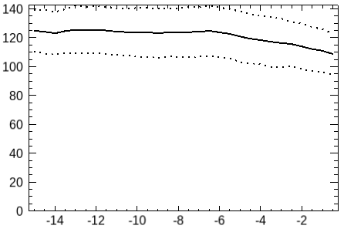
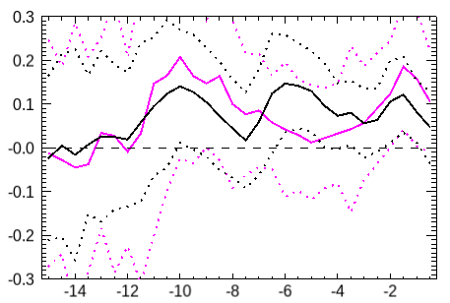
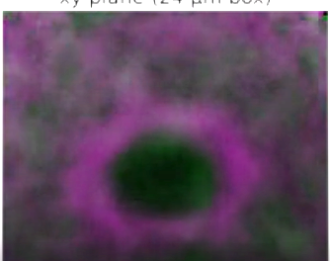
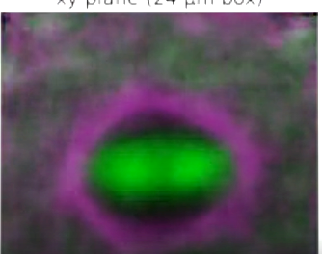
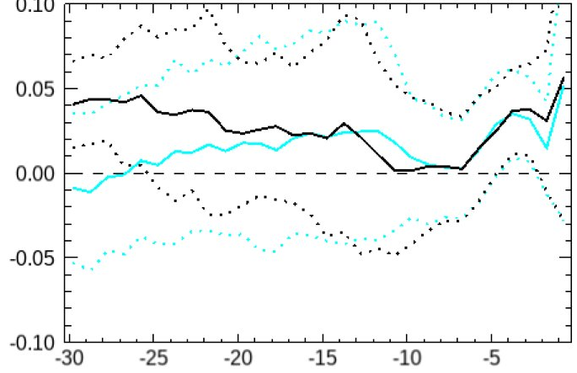
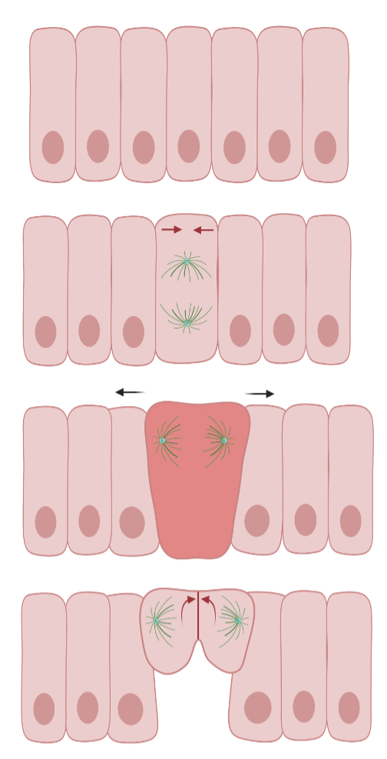
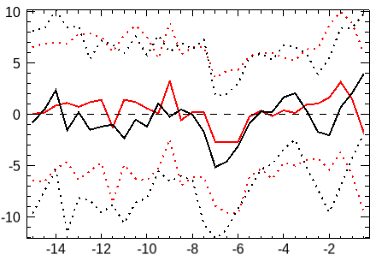
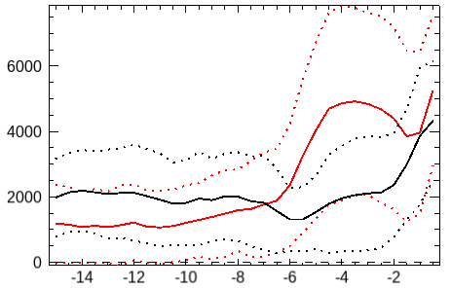
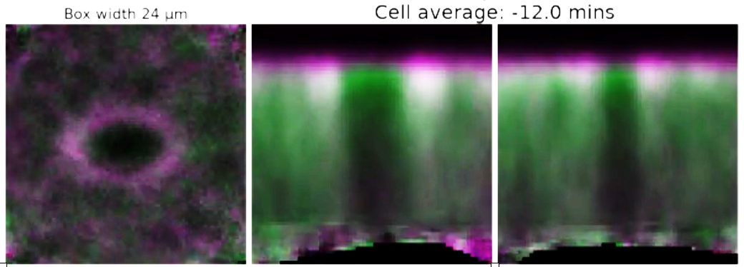

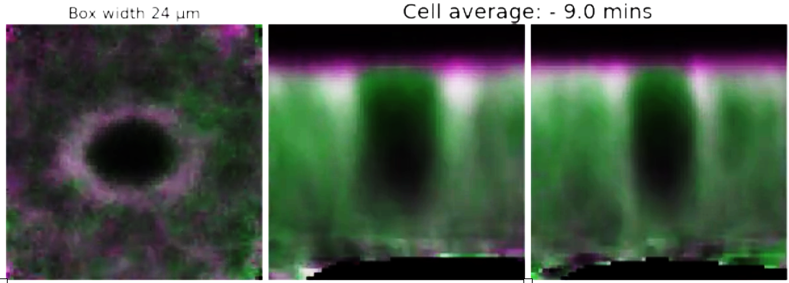
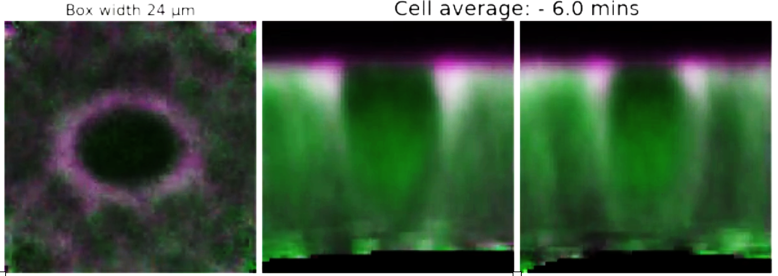
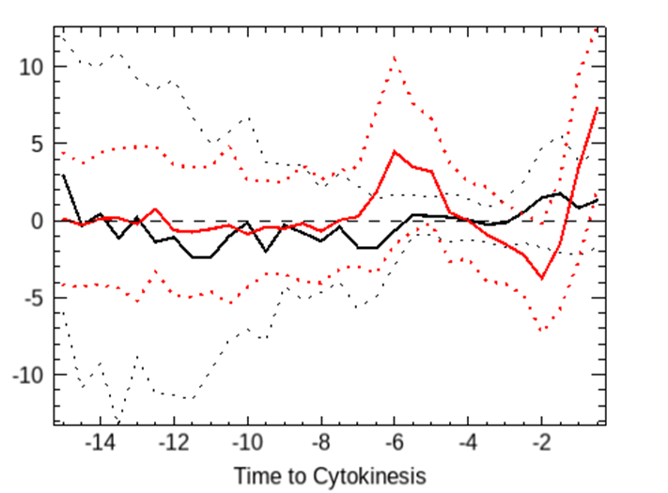
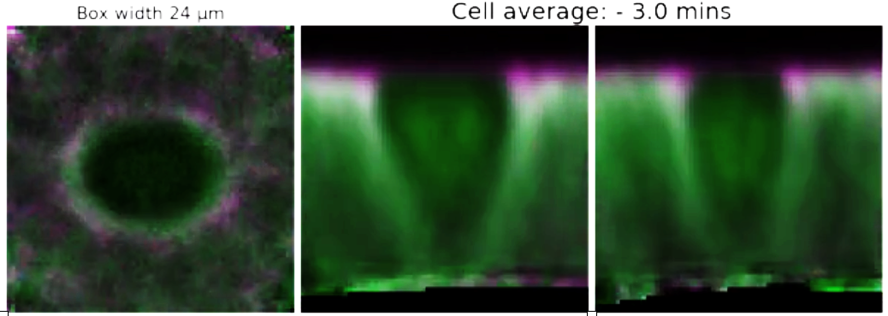
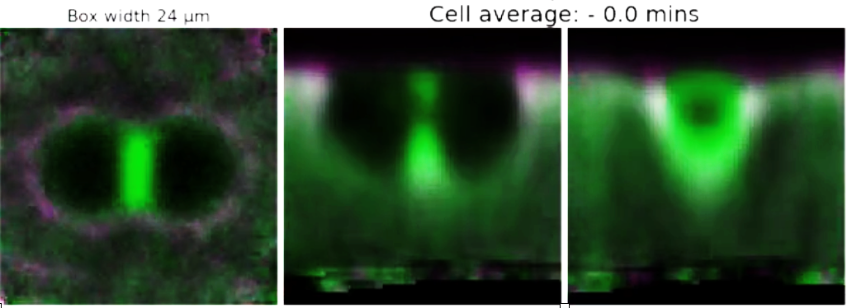
Modelling the Pathogenesis of Hailey-Hailey Disease
Finley Webb, Jack Rich, Isabelle Murray
Introduction
Results
Discussion
(1) The rate of cross-sectional area initially increases in both layers, but later more in the apical layer, and is associated with myosin II flux
(2) Loss of myosin II is not due to changes in E-Cadherin
Our data suggest
myosin moves both from the cytoplasm, and the cortex to the contractile ring, consistent with the leading model of myosin transport in mitosis^{[6]}
myosin II loss in the apical cortex reduces cortical tension, resulting in cell wedging as the apical domain is pulled open by tissue-wide tension through adherens junctions
Hailey-Hailey Disease (HHD) is a rare genetic disease that causes blisters to form on the skin.
The disease is autosomal dominant and is caused by a mutation on the ATP2C1 gene which encodes the SPCA1 protein. This protein is a Ca2+ transporter that sequesters Ca2+ in the Golgi and is highly expressed in the skin.
It is currently unknown how this mutations leads to skin blistering.
We chose to focus on the hypothesis that blistering is caused by an imbalance in proliferation and differentiation in keratinocytes.
We began by creating a Boolean model in BMA to determine whether the mutation in HHD would lead to an imbalance in proliferation and differentiation. The impact of this imbalance on the number of keratinocytes was modelled stochastically and this was used to inform a PDE model of tissue development in the skin.
The second increase in area is only found in apical cross-sections
The decrease in cortical myosin II could be due to loss of adherens junctions and associated actin
However, myosin II loss precedes the relatively small loss of cadherin
Timepoint of maximum myosin loss
This may occur to increase the area for the spindle to orient itself in the apical plane^{[7]}
Using the same aligning-averaging technique on Cadherin/Tubulin movies reveals spindles take up more space than is available before the 2nd round of area increase, but this requires further analysis
Cadherin and Tubulin
Average cadherin fluorescence intensity (cell⁻¹)
10μm
-8 min
Rate of Change of Cross-Sectional Area (μm² min¹)
apical
N=66
Mid-cell
Time to Cytokinesis (min)
-4 min
N=66
(3) Cells wedge during mitosis, beginning alongside loss of cortical myosin II
Time to Cytokinesis (min)
The current model
Methods
The second area increase is associated with a decrease in cortical myosin II in both the cortical and mid-cell layers
Cells wedge in the timepoint of lost cortical myosin/increased apical area
This is independent of how cells are wedged before mitosis
Planar apical area increases but there is not sufficient space for the spindle to orient itself
Myosin II moves from the cortex to cytoplasm, allowing the apical area to increase and the spindle to come into plane.
BMA was used to produce a Boolean model of the network controlling the decision between proliferation and differentation in keratinocytes.
MATLAB was used to implement a Gillespie algorithm in order to stochastically model the change in numbers of keratinocytes in healthy and diseased tissue.
PDE...
Wedging
apical
DV oriented divisions
apex
Rate of Change of Average Cortical Myosin II fluorescence intensity
(μm⁻² min⁻¹)
Mid-cell
AP oriented divisions
Followed by a further decrease in cortical myosin as it is deposited on the contractile ring
N=66
base
N=66
Cortical myosin
Time to Cytokinesis (min)
+ve wedging
-ve wedging
Further work includes:
Exploring the possibly basal -> apical flow of myosin seen in the vertical averaged cell movies
Analysing hanging drop movies to control for the pressure of cover slips on embryos
Analysing Canoe distribution during mitosis due to its mechanotransduction role in association with adherens junctions^{[8]}
Time to Cytokinesis (min)
(4) Aligning and averaging individual cell fluorescence reveals average shape changes and myosin flux
There is a concurrent increase in cytoplasmic myosin II whilst cortical myosin II is being lost, but apical cytoplasmic myosin II doesn’t increase significantly
Cadherin and Myosin II
Time to Cytokinesis
XY (Top-Down)
XZ (Side-On)
YZ (Front-On)
Individual cells are aligned along future cell division axis and averaged. This reveals patterns obscured in highly variable single cell observations
Total cytoplasmic myosin II fluorescence intensity (cell⁻¹)
apical
-12 min
Acknowledgments
[1] Zang, J.-H., Cavet, G., Sabry, J. H., Wagner, P., Moores, S. L. and Spudich, J. A. (1997). On the Role of Myosin-II in Cytokinesis: Division of Dictyostelium Cells under Adhesive and Nonadhesive Conditions. MBoC 8, 2617–2629
[2] Pham, T. T., Monnard, A., Helenius, J., Lund, E., Lee, N., Müller, D. J. and Cabernard, C. (2019). Spatiotemporally Controlled Myosin Relocalization and Internal Pressure Generate Sibling Cell Size Asymmetry. iScience 13, 9–19.
[3]Scarpa, E., Finet, C., Blanchard, G. B. and Sanson, B. (2018). Actomyosin-Driven Tension at Compartmental Boundaries Orients Cell Division Independently of Cell Geometry In Vivo. Dev Cell 47, 727-740.e6.
[4] Sanchez-Corrales, Y, Blanchard G.B., Röper, K (2018). Radially patterned cell behaviours during tube budding from an epithelium | eLife.
[5] Founounou, N., Loyer, N. and Le Borgne, R. (2013). Septins Regulate the Contractility of the Actomyosin Ring to Enable Adherens Junction Remodeling during Cytokinesis of Epithelial Cells. Developmental Cell 24, 242–255.
[6] Uehara, R., Goshima, G., Mabuchi, I., Vale, R. D., Spudich, J. A. and Griffis, E. R. (2010). Determinants of Myosin II Cortical Localization during Cytokinesis. Current Biology 20, 1080–1085.
[7] Chanet, S., Sharan, R., Khan, Z. and Martin, A. C. (2017). Myosin 2-Induced Mitotic Rounding Enables Columnar Epithelial Cells to Interpret Cortical Spindle Positioning Cues. Current Biology 27, 3350-3358.e3.
[8] Yu, H. H. and Zallen, J. A. (2020). Abl and Canoe/Afadin mediate mechanotransduction at tricellular junctions. Science 370, eaba5528.
Thanks to Dr. Guy Blanchard for extensive help in developing analysis pathways, Jenny Evans and Dr. Elena Scarpa for creation of original in vivo fluorescence time-lapses, and to the Wellcome Trust for funding the project.
Mid-cell
-9 min
N=66
Cytoplasmic myosin
Cytoplasmic myosin appears to increase more in the basal cytoplasm than the apical cytoplasm
Time to Cytokinesis (min)
-6 min
Rate of Change of Average Cytoplasmic myosin II fluorescence intensity (min⁻¹)
-3 min
Cells begin to wedge open apically - concurrent to the loss of apical cortical myosin
Cytoplasmic myosin
0 min
NB cinching of cytoplasmic ring occurs bottom-up, indicative of high tension in the apical plane^{[5]}
N=66
10μm
Time to Cytokinesis (min)
N=66

