Slide 2
Executive Summary
We appreciate the opportunity to present this proposal to you. Synergent Marketing Services is dedicated to ensuring that your message reaches the right member at the right time. Our Marketing Services team will assist you in data mining and segmenting your target audience to create highly creative, personalized, and impactful campaigns. We will collaborate with you to coordinate your ideas, provide support with copywriting, editing, and proofing, and develop comprehensive, attention-grabbing designs that reinforce your message with compelling imagery. Our goal is to ensure that all supporting campaign materials maintain a cohesive and effective visual consistency.
Synergent Email Marketing Platform
Email marketing should be straightforward, offering a complete end-to-end solution. Synergent Marketing Services takes a consultative approach, turning your ideas into effective strategies. We handle everything on your behalf - from strategizing, segmenting, and personalizing your campaigns to scheduling, sending, tracking, and providing detailed report metrics. Our goal is to ensure your message resonates with your members while ensuring full compliance with CAN-SPAM regulations.
We create custom-designed templates that align with your unique marketing standards and brand identity, all within a cohesive and comprehensive environment. With extensive knowledge of the Credit Union industry, our team crafts compelling and impactful campaigns that fully leverage the email channel’s potential.
This Email Marketing Platform is superior to other web-based tools, which often lack the support needed, leaving users to manage all aspects of creative development, campaign management, and analytical reporting on their own. Synergent Marketing Services provides all these essential email marketing solutions in a simple, turnkey product that is both comprehensive and affordable, offering a best-in-class solution.
2

Slide 3
Driving Member Engagement. Delivering Results.
Our Email Marketing Platform helps you build stronger member relationships through the right message, at the right time.
Increase Engagement
Drive Growth
Automate Workflows
Measure What Matters
Reach the right members with personalized, timely messaging.
Promote key products and services that support your goals.
Automate campaigns and reduce manual marketing work.
Gain actionable insights with robust reporting and analytics.
Ensure Compliance
Leverage Your Data
Strengthen Relationships
Expert Support
We manage CAN-SPAM compliance so you can send with confidence.
Use your core data with custom fields and triggers to personalize at scale.
Deliver relevant experiences across every member lifecycle.
Our team is here for you through strategy, execution, and ongoing support.
3

Slide 4
Real Use Cases. Real Impact.
Here are just a few ways credit unions like yours use our platform.
Business Goal
Example Journeys
Improve New Member Experience
New member onboarding automated drip campaign
eServices enrollment
New member education series
Grow Loans
Timely messaging around auto loan maturity or recently paid off loans
Loan payment reminders
Discover untapped home equity opportunities
Increase Member Engagement
Proactive outreach to dormant checking members
Debit card / credit card activation reminders
Direct deposit set up education
Strengthen Member Loyalty
Birthday wishes
Member anniversary appreciation
Branch visit follow-up / surveys
4

Slide 5
What’s Included in Your Platform Subscription
24/7 access to platform with multiple user logins and role-based permissions
200 placeholders for custom fields integration from core data (one-time programming & API connection)
Unlimited monthly sends of email campaigns
Visual automated journey builder to trigger custom email automations
Tiered subscription pricing based on total subscriber count
Advanced segmentation capabilities based on custom fields, campaign and journey activity
Robust reporting & analytics (open rates, click rates, geo metrics, email client usage, downloadable reports)
Synergent front-line support
Easy-to-use email builder with drag-and-drop interface and mobile responsive design
Full domain authentication assistance for CAN-SPAM compliance
Upload custom HTML templates as needed
SMS capabilities with opt-in compliance
5

Slide 6
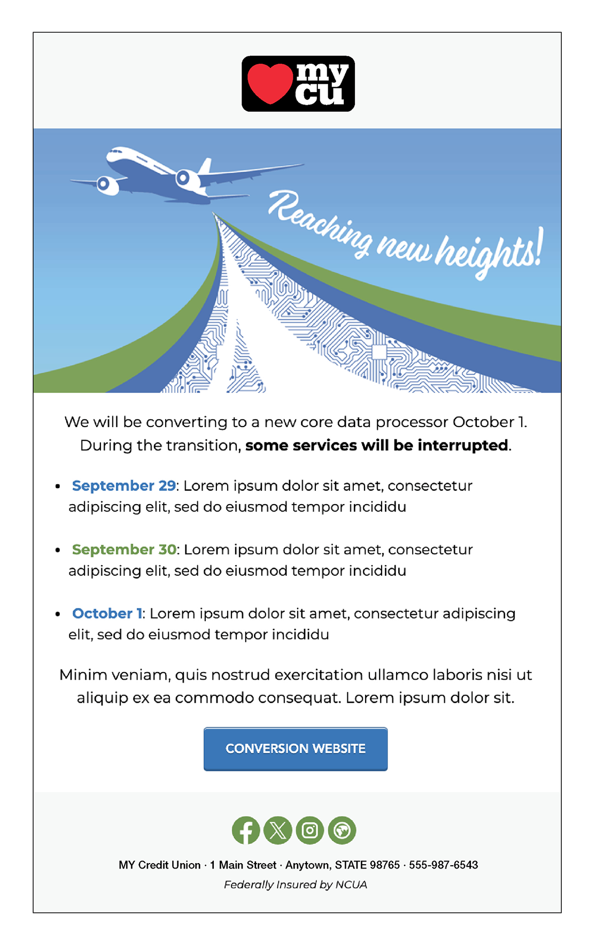
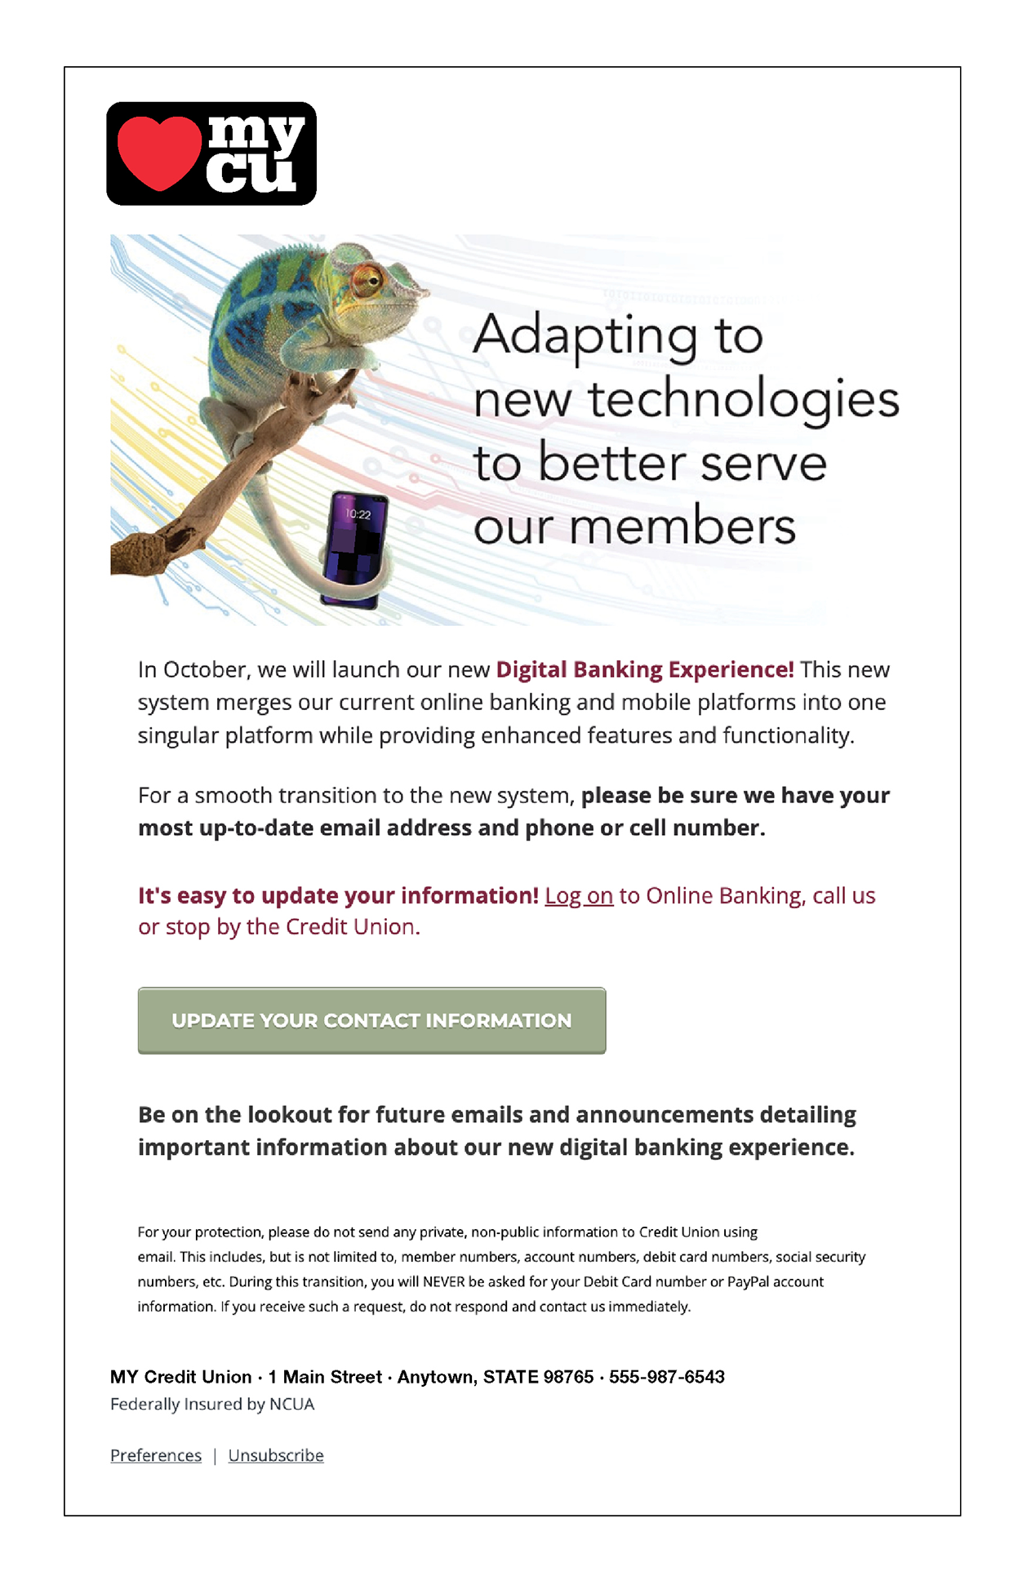
Custom Email Template Design Examples
Professionally designed templates that align with your brand and drive results.
Custom Email templates are optional and priced at $1,545 per template
Mobile Responsive Design
HTML uploads are also supported
Email builder allows for easy drag-and-drop configuration
6

Slide 7
Custom Field & Automated Journey Examples
Custom Field Examples:
Automated Journey Examples:
Account Open Date
Age
Birthday
Branch
Days until next loan maturity date
Debit card days inactive
Has Auto Loan
Has Checking Account
Has Credit Card
Has Debit Card
Has eStatements
Has Lending
Recent Branch Visit
Credit Score
Total Available Credit
Aggregate Share Balance
Has Digital Banking
Next Loan Due Date
New Member
Years of Membership
Zip Code
Days loan past due
… and more
Basic Journeys (one email + trigger)
New member welcome email
Birthday wishes
Member Anniversary
eStatement enrollment reminder
Debit/credit card activation reminder
Advanced Journeys (multi-step + variable logic + multiple variable fields)
New member onboarding drip campaign
Loan payment reminders with due date, payment amount etc.
New product journeys with next-best product logic
Member educational series
Auto loan maturity communications
Anything other than SSN or full account number is available to use as a custom field including calculated fields as long as it’s available in your core.
Our team will work with you to evaluate your planned automated journey and recommend the appropriate setup level based on complexity and workflow requirements.
7

Slide 8
Subscription Pricing & Optional Professional Services
Monthly Subscription Pricing Tiers:
Optional Professional Services:
Tier | Total Subscriber Count | Monthly Subscription Cost
1 | 2,500 – 4,999 | $59.54
2 | 5,000 – 9,999 | $108.14
3 | 10,000 – 14,999 | $156.74
4 | 15,000 – 24,999 | $241.79
5 | 25,000 – 49,999 | $363.29
6 | 50,000 – 74,999 | $545.54
7 | 75,000+ | Ask for custom pricing
Custom Fields Programming
Automated Journey Configuration
Add or calculate fields from core data to personalize your communications.
API connection to core required to populate fields.
Priced at $100 per field or as part of bundled pricing (see page 9)
Automated journey workflows customized to enhance the member experience.
Basic journeys are priced starting at $200, and Advanced journeys are priced starting at $600 or as part of bundled pricing (see page 9)
API Connection to Core Data
Custom Email Template Design
Email Platform Subscription:
{{total_subscribers}} total subscribers @ {{tier_cost}}/month*
Monthly refresh - $50/month
Weekly refresh - $100/month
Daily refresh - $200/month
Daily or weekly refresh frequency recommended for most automations.
API connection Fee: $2,500 (one-time)
Professionally designed custom templates that reflect your brand.
Priced at $1,545 per template design.
8

Slide 9
Bundled Implementation Packages. Built for Your Goals.
Kickstart your email platform subscription with a bundled implementation package.
MOST POPULAR
 | Base Package | Essentials Package | Premium Package | Elite Package
Unlimited monthly email sends
Email Builder Access
Integrated Reporting & Analytics
Automated Data Refresh | Manual list uploads | Weekly | Daily | Daily
Custom Fields Programmed |  | 20 | 35 | 50
Journey Configuration and Set-up |  | 2 Simple Automated Journeys and 1 Advanced Automated Journey (see page 7 for journey details) | 4 Simple Automated Journeys and 2 Advanced Automated Journeys (see page 7 for journey details) | 6 Simple Automated Journeys and 3 Advanced Automated Journeys (see page 7 for journey details)
Implementation Costs (one-time, includes API connection fee of $2,500) | N/A | $5,500 | $8,000 | $10,500
Monthly Costs (including monthly refresh fees if applicable) | {{tier_cost}} | {{essentials_cost}} | {{premium_cost}} | {{elite_cost}}
9

Slide 10
Conclusion & Terms
We want to thank you for the opportunity to provide you with this proposal.
Throughout the course of the campaign, we will work with you to measure and evaluate the effectiveness of the campaign stated objectives, using a variety of measurement tools and transaction data as outlined. Doing this during the campaign will afford an opportunity to determine effectiveness and/or adjustments to improve performance. Campaign or program results are not guaranteed or implied and Synergent’s fees are not tied to results in any way.
Prices and terms are subject to change. Estimate is valid for 90 days and may vary based on additional customizations. Program, Data Mining, Programing, and Creative that are canceled after the date of this signature are subject to a cancelation fee of 50% of all one-time fees and all third-party fees Synergent has incurred. This could include, but is not limited to data mining, creative, programming, training, and third-party fees. Any third-party vendor fees are due upon presentation of invoicing.
This proposal, if accepted, shall be an addenda to the {{creditunion_name}} Marketing Services – Master Service Agreement, and shall be governed by the terms and conditions contained therein.
Implementation & Package Selection
Base Package
Essentials Package
Premium Package
Elite Package
Implementation (one-time): N/A
Monthly Cost: {{tier_cost}}
Implementation (one-time): $5,500
Monthly Cost: {{essentials_cost}}
Implementation (one-time): $8,000
Monthly Cost: {{premium_cost}}
Implementation (one-time): $10,500
Monthly Cost: {{elite_cost}}
Custom Set-up
Implementation (on-time)
API Connection set-up fee: $2,500
Custom fields ($100 each):
Monthly Costs (recurring)
Refresh Rate
Monthly($50) Weekly($100) Daily($200)
Base Subscription: {{tier_cost}}/ month
Accepted by: ______________________________________________________
Date: ______________________________________________________________
Basic Journeys ($200 each):
Advanced Journeys ($600 each):
10

