Slide 1
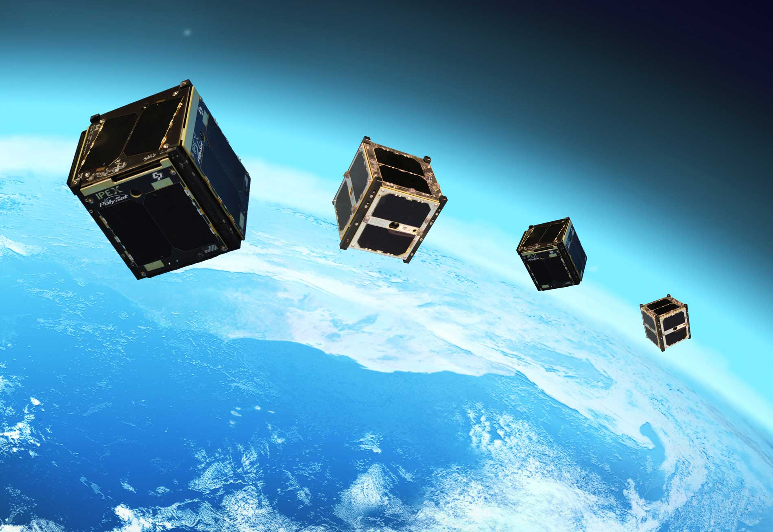
RL for LEO Satellite Momentum Stabilization
Anirudh Aatresh, Joseph Breeden, Kevin Tan, Liliang Wang

Slide 2
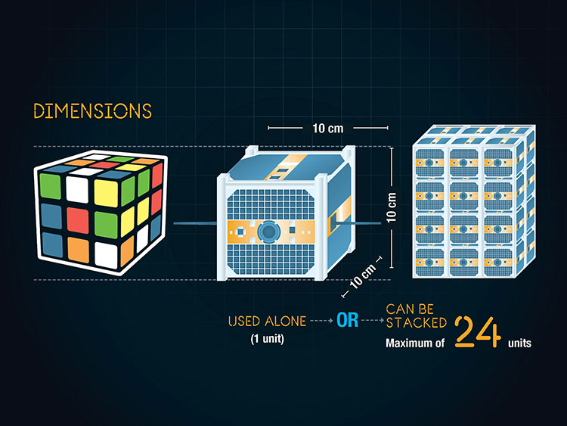
Introduction: The Problem
Space is not a vacuum, especially for satellites in Low Earth Orbits (LEO)
Disturbances include
Upper atmospheric drag, solar radiation pressure, gravity gradient, magnetic field interactions
These disturbances
Induce orbit decay
Rotate the satellites
Even worse for tiny CubeSats

Slide 3
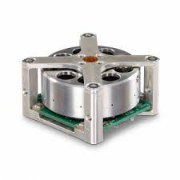
Countering the Problem
Onboard reaction wheels can be used to counter the rotation induced by the disturbances
Must be regularly unloaded to prevent saturation
Solution:
Use Earth’s magnetic field to provide an opposing torque while unloading stored momentum in the wheels
Existing control laws not robust to irregularities in the Earth’s magnetic field and CubeSat construction limitations
Use RL to create a new control law robust to these
Experiments will be based on a simulated environment developed by NASA called 42

Slide 4
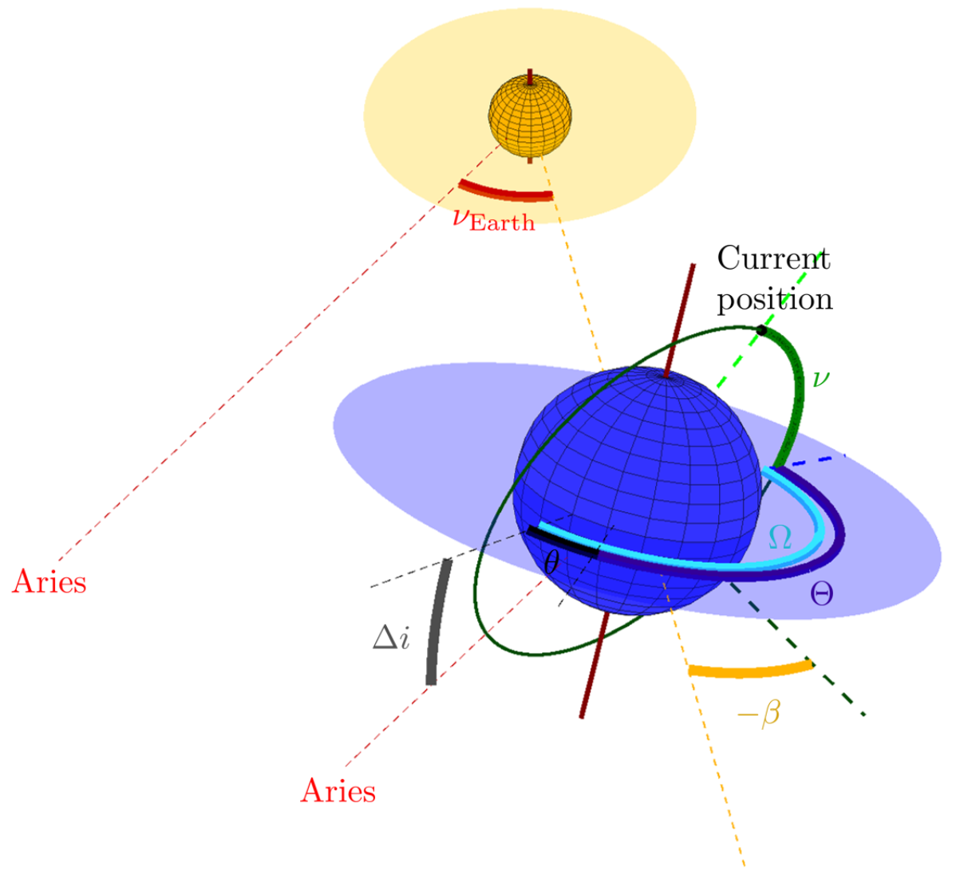

Mathematical Formulation
Let the CubeSat’s position be described by the angles $(ν,Θ,β)$ relative to the positions of the Earth and the Sun
$ν$ is the position of the satellite in the orbit
$Ω$ is the precession of the orbit
$β$ is the angle between the local Sun vector and the normal vector to the orbital place
$Θ :=Ω−θ$, where $θ$ is the current rotation of the Earth in the day

Slide 5
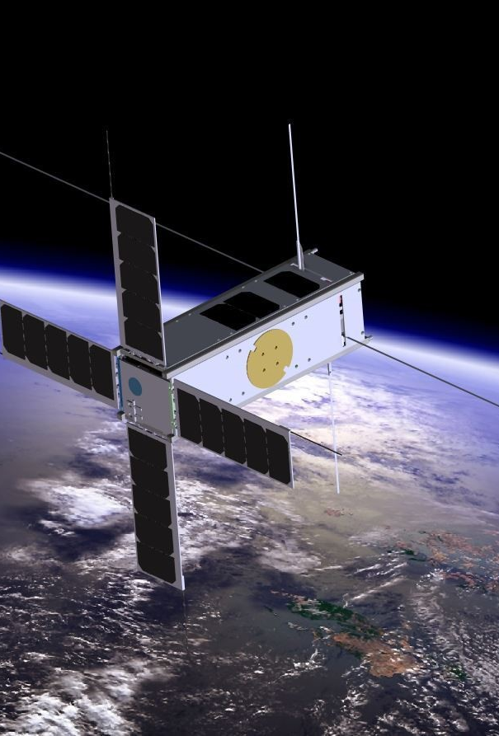
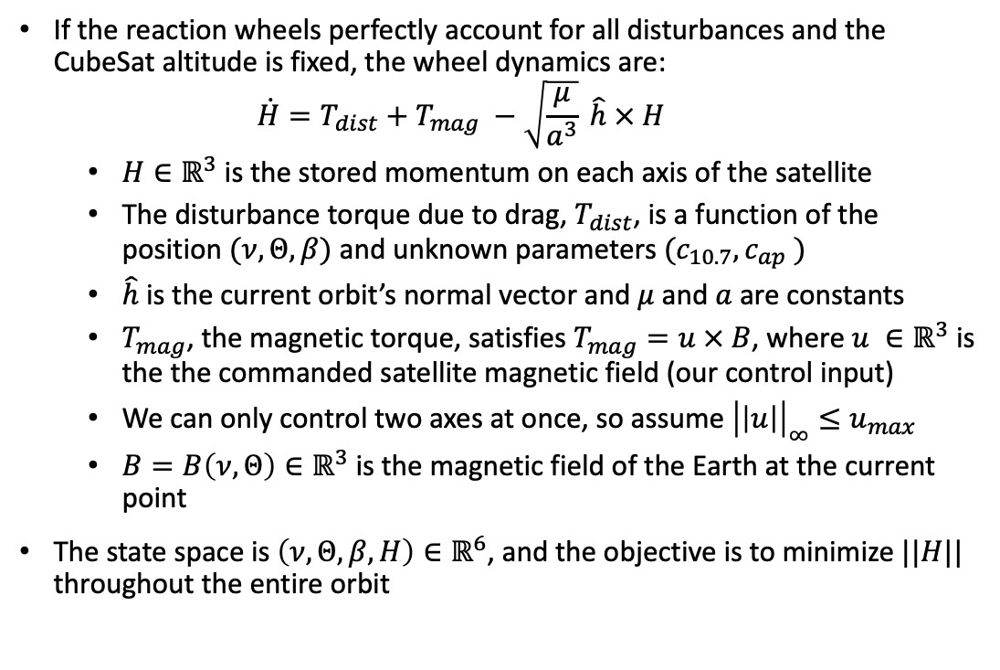
State Space, Control, Dynamics
If the reaction wheels perfectly account for all disturbances and the CubeSat altitude is fixed, the wheel dynamics are:
$$\dot{H}=T_{dist}+T_{mag} −\sqrt{\frac{μ}{a^{3}}} \hat{h} × H$$
$H∈ℝ^{3}$ is the stored momentum on each axis of the satellite
The disturbance torque due to drag, $T_{dist}$, is a function of the position $(ν,Θ,β)$ and unknown parameters $(c_{10.7}, c_{ap} )$
$\hat{h}$ is the current orbit’s normal vector and $μ$ and $a$ are constants
$T_{mag}$, the magnetic torque, satisfies $T_{mag}=u × B$, where $u ∈ℝ^{3}$ is the the commanded satellite magnetic field (our control input)
We can only control two axes at once, so assume ${\left|\left|u\right|\right|}_{∞}≤u_{max}$
$B=B\left(ν, Θ\right)∈ℝ^{3}$ is the magnetic field of the Earth at the current point
The state space is $\left(ν,Θ,β, H\right)∈ℝ^{6}$, and the objective is to minimize $||H||$ throughout the entire orbit

Slide 6
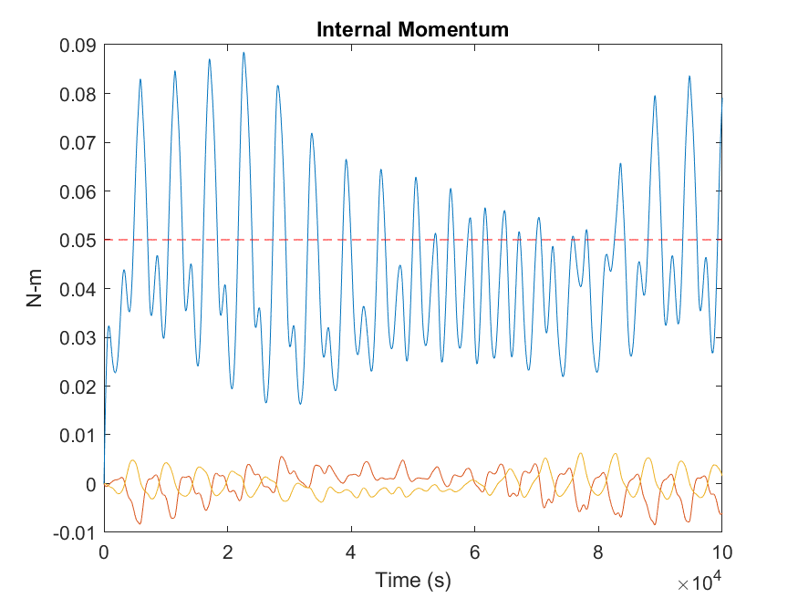

Method
Linear control laws are inefficient due to the complexity of the Earth’s magnetic field
Baseline algorithm requires unrealistically large momentum storage capacity
We will use actor-critic based algorithms to train a controller to choose a series of actions to drive the angular momentum of the wheels close to zero:
$$\min_{u∈ℝ^{3}}|\left|H\right||$$
Successfully transfer the momenta of the reaction wheels to the Earth through magnetic actuators interacting with the Earth’s magnetic field

Slide 7

Online or Offline?
We look towards solving this problem offline
Leaves open the possibility of learning a policy on real satellite data in the future, not just data from 42
Allows for offline pre-training, allowing for more effective policies when combined with online policy improvement
Learning a policy online from scratch in the context of a real satellite will be dangerous and costly
Data will be collected from 42 from two behavior policies
Stochastic policy
Decent baseline policy

Slide 8
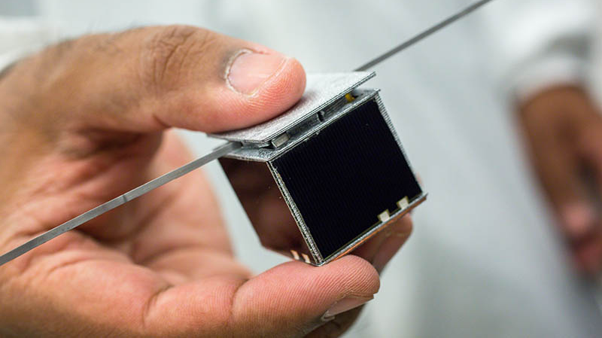
Possible Algorithms
Learning
Conservative Q-Learning (CQL)
Promising algorithm performing offline soft actor-critic computation with a modified Q-function estimator
Tackles the common problem of overestimating the Q-value in offline RL
Advantage-Weighted Actor-Critic (AWAC)
Rapidly learns skills from a combination of previously collected data and online learning
Policy in the Latent Action Space (PLAS)
Learn the policy from a latent action space to deal with out of distribution actions
Off-Policy Evaluation
Fitted Q-Evaluation, Importance Sampling, MAGIC

Slide 9
In a Nutshell
Use RL to develop a controller to successfully reduce the angular momenta of CubeSat reaction wheels using the Earth’s magnetic field

