Slide 1
Firepath
A querying API for FireBase

Slide 2
Introduction
My name is Jason Brelloch

Slide 3
Overview
Introduction
Overview
Firebase
Problem
Solutions
On Demand Processing
Always On Processing

Slide 4
Firebase
Firebase is a scalable real-time backend
Firebase is designed to remove the need for developers to worry about managing servers or writing server side code
All data is stored in JSON format and is accessible through client libraries and a REST API
Client Libraries supported:
Javascript
Objective-C
Java

Slide 5
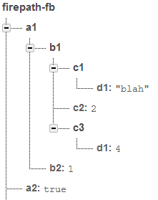
Firebase – Data Structure
All data in firebase is accessible by a unique URL.
When a firebase is created it is assigned a address to access the data with (ex: https://firepath-fb.firebaseIO.com/)
Firebase calls the URL’s locations, and a location can store numbers, strings, Booleans, or more JSON to add children to locations
Children are accessible by adding the child name onto the parent location URL
Example: To access the element containing the string “blah”, the address would be https://firepath-fb.firebaseIO.com/a1/b1/c1/d1
Notes:
Replace images with you own

Slide 6
Firebase – Javascript Library

