Slide 1
Firepath
A querying API for FireBase

Slide 2
Overview
Introduction
Firebase
Data Structure
Firebase – Javascript Library
References
Writing Data
Reading Data
Querying
Advanced Functions
Firebase – The Problem
Firepath
Xpath
Version 1
Version 2
Comparison
No Transactions
Is it worth it?
Future work

Slide 3
Firebase
Firebase is a scalable real-time backend
Firebase is designed to remove the need for developers to worry about managing servers or writing server side code
All data is stored in JSON format and is accessible through client libraries and a REST API
Client Libraries supported:
Javascript
Objective-C
Java

Slide 4
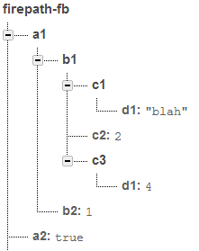
Firebase – Data Structure
All data in firebase is accessible by a unique URL.
When a firebase is created it is assigned a address to access the data with (ex: https://firepath-fb.firebaseIO.com/)
Firebase calls the URL’s locations, and a location can store numbers, strings, Booleans, or more JSON to add children to locations
Children are accessible by adding the child name onto the parent location URL
Example: To access the element containing the string “blah”, the address would be https://firepath-fb.firebaseIO.com/a1/b1/c1/d1
Notes:
Replace images with you own

Slide 5
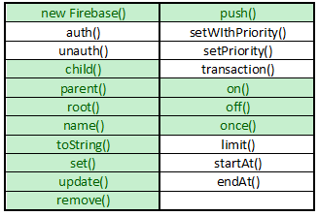
Firebase
Javascript Library – The basic functions

Slide 6
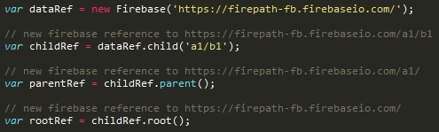

References
Function
Example Calls
new Firebase() – used to create firebase reference
child() – a reference to a child location
parent() – a reference to a parent location
root() – a reference to the firebase root location
name() – the last element of a firebase location string
toString() – the full firebase location string

Slide 7
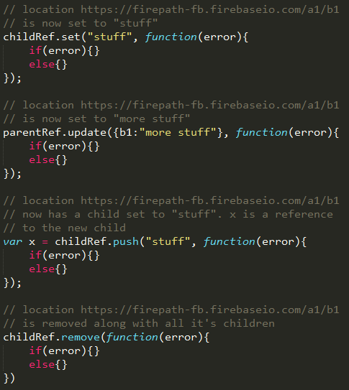
Writing Data
Function
Example Call
set() – used to write data to a firebase reference
update() – used to update data at a firebase reference
push() – used to push data to a new child of the firebase reference. The child’s name will be a automatically generated unique string
remove() – used to delete data from a firebase reference

Slide 8
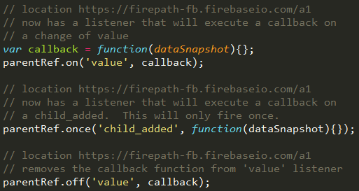
Reading Data
Reading Data in Firebase is performed by attaching a callback function to a Firebase reference. There are 5 types of events: value, child_added, child_removed, child_changed, child_moved.
Function
Example Call
on() – attaches a callback to a firebase reference to read data and be notified of changes
once() – attaches a callback to a firebase reference similar to on() except this callback will only fire once
off() – removes a callback from firebase reference

Slide 9
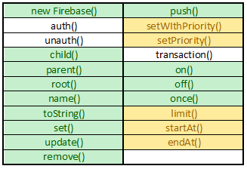
Firebase
Javascript Library – Querying

Slide 10
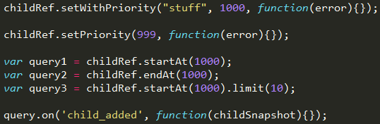
Querying
Data in Firebase is ordered lexicographically based off of the locations name
This order can be customized by setting a priority value to a reference
Querying in Firebase is based off of that locations ‘priority’ value
Function
Example Call
setWithPriority()
setPriority()
startAt()
endAt()
limit()

Slide 11
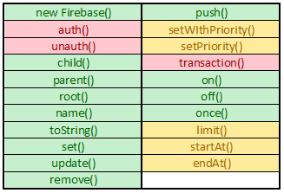
Firebase
Javascript Library – The advanced functions

Slide 12
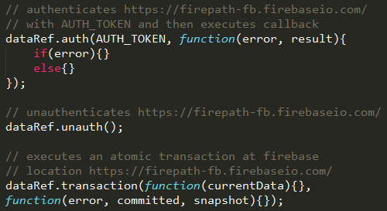
Advanced Functions
Function
Example Call
auth() – used to authenticate a client to a firebase
unauth() – used to unauthenticate a client to a firebase
transaction() – used to atomically modify data

Slide 13
Firebase – The Problem
Querying is always a problem in NoSQL databases
MySQL
Redis
RavenDb
Firebase
Relational with extensive querying
Custom queries using WHERE clause as well as supporting functions (MAX, COUNT, etc.)
Key value store
Focused on speed for data access
Simple Key querying, but not recommended for use in deployed code
Document Store
Queries handled by creating indexes of data
Indexes are built and maintained as side process. Can become ‘stale’.
Key value store
Data as a service
Data is maintained in ordered format
Queries supported across ranges

Slide 14
Firepath
The Goal – add more querying support to Firebase
Keep Firebase javascript API the same
Add new javascript library that will take in similar URL’s to firebase and handle query processing behind the scenes
The URL’s will use syntax similar to XPath to define the queries
The new library will contain as many of the same functions and capabilities as firebase, but will execute them on several Firebase locations defined by the XPath-like queries
Low overhead

Slide 15
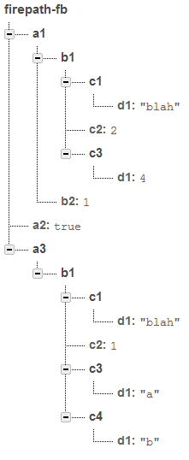
XPath
XPath is a query language for XML nodes
Firepath uses an abbreviated version of XPath to refer to Firebase locations (basic nodes, variable nodes, and predicate rule support)
Firepath will support the compact notation of Xpath
Examples
https://firepath-fb.firebaseIO.com/a1/b1/c1/d1
https://firepath-fb.firebaseIO.com/*/b1/c2
https://firepath-fb.firebaseIO.com//d1
https://firepath-fb.firebaseIO.com/a1/b1[c2==1]/c1/d1

Slide 16
Firepath – Two Versions
Version 1
Version 2
1. New Firepath()
2. URL Parsing
3. Firepath Function Call
4. Process Path
5. Create Firebase References
6. Firebase Function Calls
1. New Firepath()
2. URL Parsing
3. Process Paths
4. Setup Listeners
5. Firepath Functon Call
6. Firebase Function Calls

Slide 17
New Firepath()
A Firepath reference is created the same way a Firebase reference is, except using a new constructer called Firepath().
Example:
The first argument is the Firebase path along with any rules to be included in the query
The second argument is to enable debugging messages (defaults disabled)

Slide 18
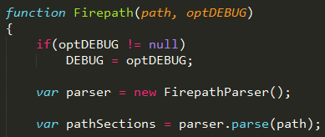
Parsing URL’s
Both versions immediately start parsing the URL’s on creation
The URL is parsed into array of sections by a helper function called FirepathParser()
This is all done locally with simple data structures – remains lightweight

Slide 19
Parsing URL’s - Example
Section https://firepath-fb.firebaseIO.com
Section
*
Rule null
Rule null
Section b1
Rule c2=1 and c1/d1='blah'
Section /d1
Rule null
Array pathSections
elementValue c2
elementType rulePart
elementValue =
elementType operator
elementValue 1
elementType number
elementValue and
elementType conjunction
…
https://firepath-fb.firebaseIO.com/*/b1[c2=1 and c1/d1='blah']//d1

Slide 20
Firepath v1
New Firepath()
URL Parsing
Firepath Function Call
Process Path
Create Firebase References
Firebase Function Calls

Slide 21
Firepath Function Calls
At this point Firepath v1 will wait for the user to initiate a call
All calls are exactly the same as Firebase, with a few notable exceptions
.child() – this now accepts child paths with rules such as child(*/b1[c2=1]) would be any child node that has a b2 child node with a c2 child node equal to 1
.parent() – this removes any rules at the last node.
Not all Firebase calls are supported
A callback will be executed for every valid Firebase found by the Firepath
Except in the case of error callback’s – the errors are collected and sent in one callback

Slide 22
Process Path
This is the main function work function for Firepath. It operates recursively over the sections created in the parsing step.
General use – processPath([],0,callback)
First argument is an empty array that will be filled with converted Firebase path strings
Second argument is the counter that indicates position in the section array
Third argument is a callback that is executed when the processPath function is finished. This indicates that all valid Firebase paths have been found and are stored in a object local array called fireBasePaths.

Slide 23
Process Path
processPath([],0,callback())
Section https://firepath-fb.firebaseIO.com
Section *
Section b1
processPath([https://firepath-fb.firebaseIO.com],1,callback())
Add all children to pathStrings
processPath([pathStrings], 2,callback())
Across all current pathStrings, query Firebase for value of nodes
If node name is b1 add to pathStrings
processRule([pathStrings], 2,callback())
Rule c2=1 and c1/d1='blah'
Across all current pathStrings, query Firebase for value of nodes
Verify rules
processPath([pathStrings], 2,callback())
End count > pathSections.length
Set global pathStrings
return and execute callback()
Query Firebase for value of current node (root)

Slide 24
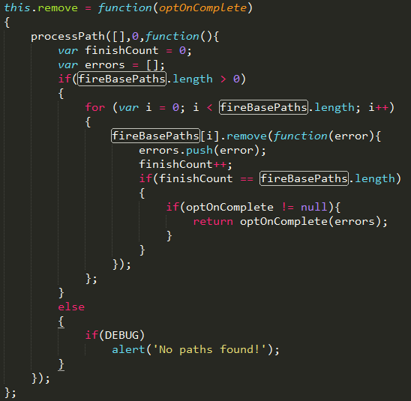
Firebase Function Calls
Now that all valid Firebase have been found and created the Firebase calls can be executed
The Firebase calls are executed with the same parameters passed into the Firepath call
Example remove() function:

Slide 25
Analysis
Goals
Problems
Firepath API very similar to Firebase
Uses Xpath to define querying in Firebase
Contains many of the same functions as Firebase
Low overhead until execution
SLOW
At every single section of the URL Firebase servers are hit
Several times in the case of a section with rules
Gets slower the deeper the tree (width doesn’t really affect much)
No transactions – major disadvantage; more on this later

Slide 26
Firepath v2
New Firepath()
URL Parsing
Process Paths
Setup Listeners
Firepath Functon Call
Firebase Function Calls

Slide 27
Process Path
Firepath version 2 functions in a very different way from version 1; In an effort to speed up the process a ‘valid’ path tree is maintained
This tree starts to be constructed as soon as the Firepath is created
The tree is made up of objects called Arranged Firepath Sections, and these arranged sections are constructed from the pathSections that are produced by the parser

Slide 28
Setup Listeners
Each Arranged Section is essentially a regular Firepath Sections, but each section keeps track of its parent section as well as all child sections it has.
There are two other key parts to each Arranged Section
Child Listeners – These listeners check to see if a valid child has been added below the current node, or if one has been removed. It then updates the tree with this information.
Rule Listeners – this only applies to sections that have rules, but it checks to see if the section is still valid based on the rule
This forms a tree that builds and maintains itself

Slide 29
Arranged Section Tree
https://firepath-fb.firebaseIO.com/*/b1[c2=1 and c1/d1='blah']//d1
https://firepath-fb.firebaseIO.com
a1
b1 DISABLED
a2
b1
a3
c1
d1 = ‘blah’
c3
d1 = ‘a’
c4
d1 = ‘b’
c1
d1 = ‘blah’
c3
d1 = 4

Slide 30
Firepath Function Call
When a Firepath function is called the API begins to search the tree for valid complete paths
Each node on the tree has two important flags that are checked by the search algorithm
terminus – if this is true, a valid path has been found and the current nodes complete path is added to the path list
terminusBelow – if this is true a terminus has been found below this node on the tree at some point and the search should continue
Once the complete and valid paths have been found, Firebase function calls can be made in the same way as Firepath version 1

Slide 31
Analysis
Goals
Problems
Firepath API very similar to Firebase
Uses Xpath to define querying in Firebase
Contains many of the same functions as Firebase
Fast execution – functions are executed almost as fast as a regular Firebase call
Overhead
Tree can require significant memory if query data is large
Listeners are maintained and require CPU time dependent on activity in the database
Complexity
No transactions – major disadvantage; more on this next (even worse in this implementation)

Slide 32
No Transactions
Being unable to perform atomic transactions using Firepath is a large disadvantage
Several reasons transactions were not implemented
Rule complexity – the complex rules can not be checked in a transaction without making the locations of the transaction check prohibitively large
Javascript 1.7 yield – version 1.7 added the ability to yield and wait for an asynchronous call to finish.
Firebase transaction timeouts – transactions appear to timeout and fail on the Firebase backend.

Slide 33
So is it worth it?
It depends on the situation!
Firepath querying is a useful abstraction for querying in Firebase in certain situations
Understanding the limitations and costs is very important
Thought needs to be put into whether or not querying is actually necessary for the application to be successful
Can data be structured in a way to make querying unnecessary?
Can the built in range querying (faster) be used to perform the same tasks?
Querying is ultimately a very useful tool in any database, but often applications can be developed in a way that do not require it

Slide 34
Future Work
Extended Xpath support
Backend Processing
Takes away size concerns and lowers overhead costs on user
Would allow for atomic transactions
Predefined Indexes
User would define an index that would be stored and maintained on the Firebase servers
Querying indexes similar to the range querying already implemented

Slide 35
Finish
Questions?

