Slide 1
Firepath
A querying API for FireBase

Slide 2
Introduction
My name is Jason Brelloch

Slide 3
Overview
Introduction
Overview
Firebase
Problem
Solutions
On Demand Processing
Always On Processing

Slide 4
Firebase
Firebase is a scalable real-time backend
Firebase is designed to remove the need for developers to worry about managing servers or writing server side code
All data is stored in JSON format and is accessible through client libraries and a REST API
Client Libraries supported:
Javascript
Objective-C
Java

Slide 5
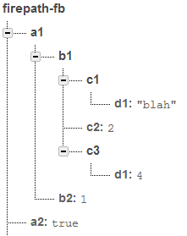
Firebase – Data Structure
All data in firebase is accessible by a unique URL.
When a firebase is created it is assigned a address to access the data with (ex: https://firepath-fb.firebaseIO.com/)
Firebase calls the URL’s locations, and a location can store numbers, strings, Booleans, or more JSON to add children to locations
Children are accessible by adding the child name onto the parent location URL
Example: To access the element containing the string “blah”, the address would be https://firepath-fb.firebaseIO.com/a1/b1/c1/d1
Notes:
Replace images with you own

Slide 6
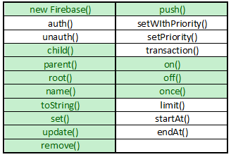
Firebase
Javascript Library – The basic functions

Slide 7
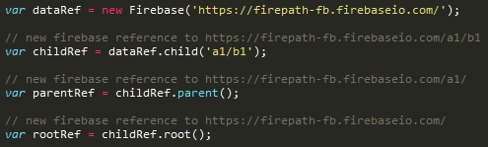

References
Function
Example Calls
new Firebase() – used to create firebase reference
child() – a reference to a child location
parent() – a reference to a parent location
root() – a reference to the firebase root location
name() – used to create firebase reference
toString() – a reference to a child location

Slide 8
Writing Data
Function
Example Call
set() – used to write data to a firebase reference
update() – used to update data at a firebase reference
push() – used to push data to a new child of the firebase reference. The child’s name will be a automatically generated unique string
remove() – used to delete data from a firebase reference

Slide 9
Reading Data
Reading Data in Firebase is performed by attaching a callback function to a Firebase reference. There are 5 types of events: value, child_added, child_removed, child_changed, child_moved.
Function
Example Call
on() – attaches a callback to a firebase reference to read data and be notified of changes
once() – attaches a callback to a firebase reference similar to on() except this callback will only fire once
off() – removes a callback from firebase reference

Slide 10
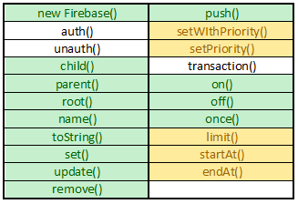
Firebase
Javascript Library – Querying

Slide 11
Querying
Data in Firebase is ordered lexicographically based off of the locations name
This order can be customized by setting a priority value to a reference
Querying in Firebase is based off of that locations ‘priority’ value
Function
Example Call
setWithPriority()
setPriority()
limit()
startAt()
endAt()

Slide 12
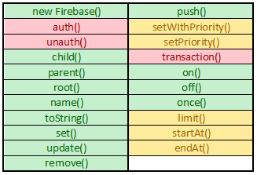
Firebase
Javascript Library – The advanced functions

Slide 13
Advanced Functions
Function
Example Call
auth() – used to authenticate a client to a firebase
unauth() – used to unauthenticate a client to a firebase
transaction() – used to atomically modify data

Slide 14
Firebase – The Problem
Querying is always a problem in NoSQL databases
MySQL
Redis
RavenDb
Relational with extensive querying
Key value store
Focused on speed for data access
Simple Key querying, but not recommended for use in deployed code
Document Store

Slide 15
Firepath
The Goal – add more querying support to Firebase
Keep Firebase javascript API the same
Add new javascript library that will take in similar URL’s to firebase and handle query processing behind the scenes

Slide 16
Firepath – Two Versions
Version 1
Version 2
New Firepath()
URL Parsing
Firepath Function Call
Process Path
Create Firebase References
Firebase Function Calls
New Firepath()
URL Parsing
Process Paths
Setup Listeners
Firepath Functon Call
Firebase Function Calls

Slide 17
New Firepath()

Slide 18
Parsing URL’s

Slide 19
Firepath v1
New Firepath()
URL Parsing
Firepath Function Call
Process Path
Create Firebase References
Firebase Function Calls

Slide 20
Firepath v2
New Firepath()
URL Parsing
Process Paths
Setup Listeners
Firepath Functon Call
Firebase Function Calls

Slide 21
Performance

Slide 22
Analysis

Slide 23
No Transactions?
Javascript 1.7 yield
No Atomic changes

Slide 24
Future Work

