Slide 1
Characterizing Gasoline Station Networks: Relevance for Early Hydrogen
Joel Bremson and Marc Melaina
Institute of Transportation Studies
UC Davis

Slide 2
Overview
Why is this relevant to hydrogen?
Analysis of station distributions across 84 American cities.
What will Americans be comfortable with in an alternative fuel network?
How many stations in the US?
Notes:
This is relevant because there is a great deal of interest the costs of hydrogen. The station network will be a portion of that cost. People want to know how much it will be.

Slide 3
Data and Analysis Tools
MPSI
National Petroleum News survey
Census 2000 data
R (open source statistical package)
MySQL
Excel

Slide 4
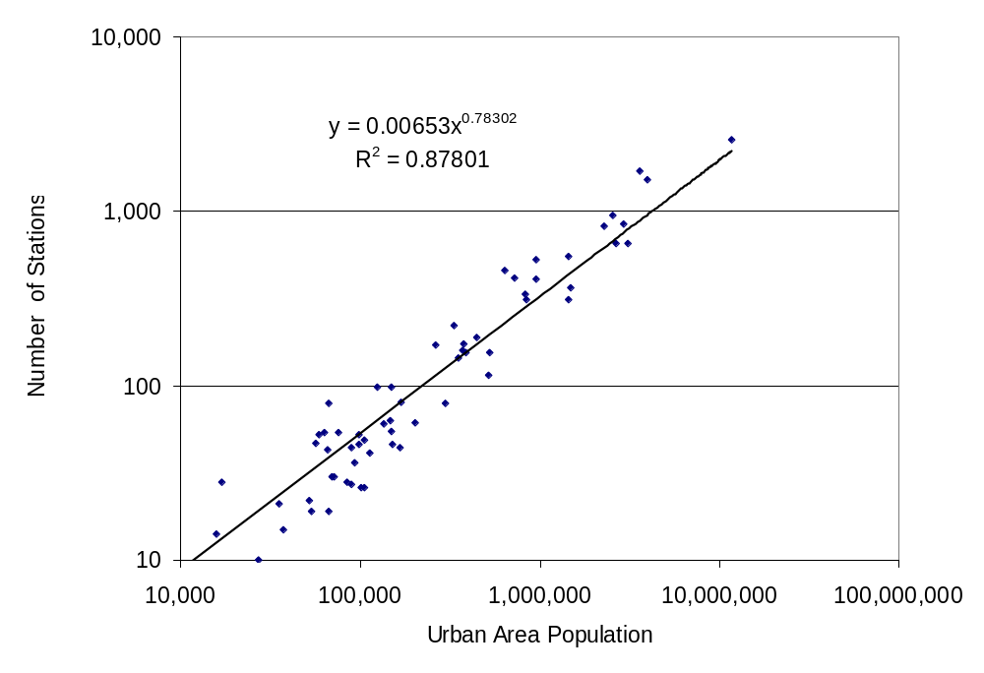
Finding 1: Stations and Urban Area Population Relationship
Notes:
From this regression function we estimate that 40-50% of the gas stations reported in NPN annual survey are in urban areas.
How? We looked at the number of stations in the state by NPN and compared it with our urban area -> number of stations regression equation

Slide 5
Station Clustering Algorithm
Compute linear distance between all station pairs.
Find the minimum distance pair.
Eliminate the smaller of the pair, giving its volume to the larger station.
Repeat from step 2 until one station remains in set of stations.

Slide 6
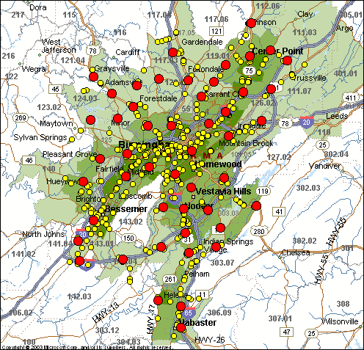
Notes:
1 mile cluster of Birmingham, AL. Note that selections are not made where they should not intuitively be.

Slide 7

Comparing Distributions
Notes:
We ran the clusters, how now do we compare them? Comparisons are relative within the city. Small cities may have a different dist than large ones – some new mega stations mixed with older smaller stations. Large cities might get rid of their micro stations sooner. We don’t know.

Slide 8
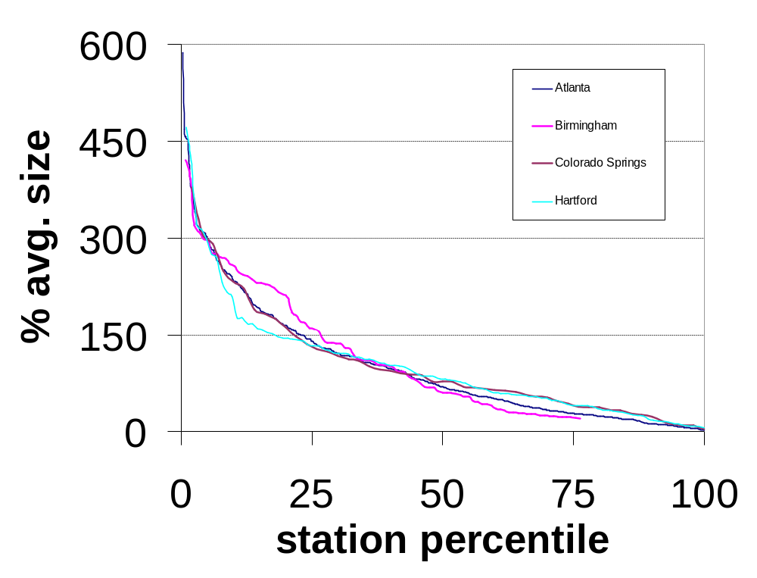
Relative Distribution Example
Notes:
After running the clusters we looked at the relative distribution of station sizes for each city. We wanted to know if these curves had a similar shape dependent on city size. This is a one mile cluster example comparing 4 cities

Slide 9
Curve Comparison Technique
Notes:
To compare the curves we chose some points of interest. We’re most interested in the tops of the curves and the median. After the median the curves flatten out and salient features are not visible. The points we selected were the 5, 10, 25 and 50th percentiles. We used an ANOVA multiple comparison method Tukey’s Honest Significant Difference method to compare the curves at the 0.3, 0.6,1 and 2 mile clusters.

Slide 10
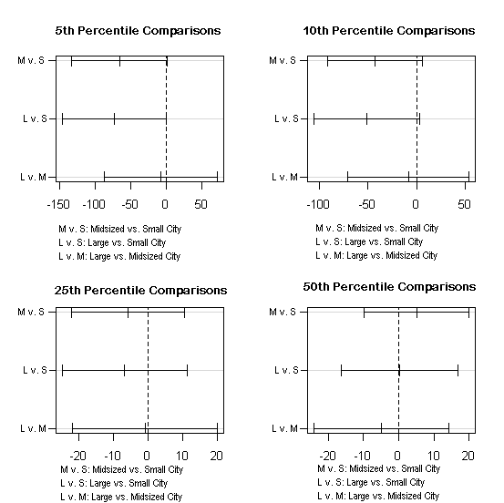
Curve Comparison Technique-
1 Mile Clusters
Notes:
These are the comps are 5,10,25,50. There is no significant diff. Though you can see that the 5,10 comps are almost sig. diff. When you look at the numbers however you see that is just a graphing issue – the interval does contain 0. This is also just a run for 4 cities. For the whole set run the diffs were all highly significant. This is to show the process not imply results.

Slide 11
Finding 2: Relative station distributions are…
Notes:
Ask audience for guesses…

Slide 12
Finding 2: Relative station distributions are…
…statistically similar

Slide 13
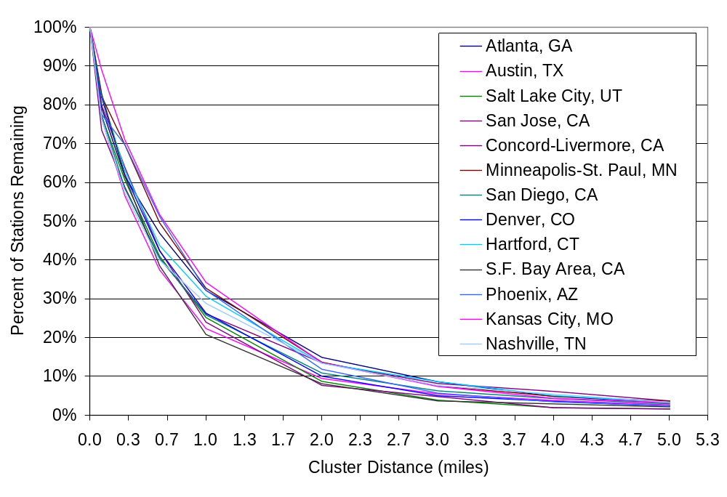
Finding 3: Stations Decrease with Increased Cluster Length
Notes:
This will be useful for H2A.
As cluster distance increases (x axis), the number of stations falls. Notice that at 1 mile less than 50% of the stations are left.
At 3 miles 90% of stations are eliminated. Shows that stations “clump”.

Slide 14
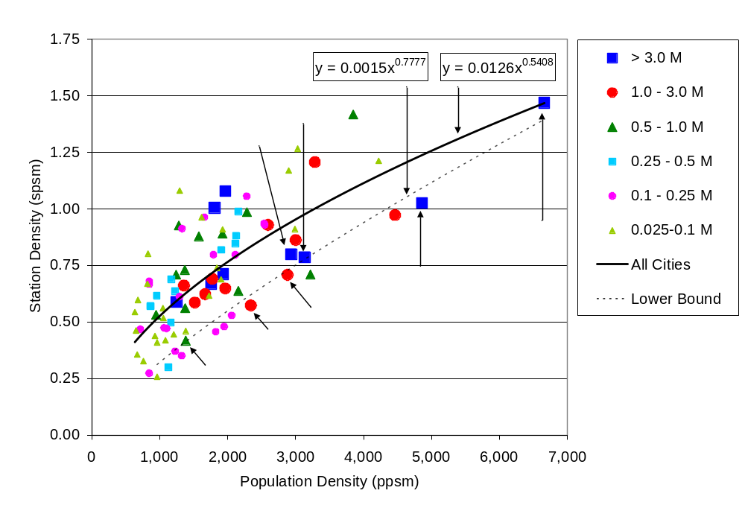
Consumer Acceptable Minimum Station Threshold
Notes:
From paper (not yet published): Refueling Availability for Alternative Fuel Vehicles:
Necessary and Sufficient Retail Station Density Thresholds – Melaina, Bremson

Slide 15
Conclusions
40-50% of gasoline stations are urban.
City size does not influence station distributions.
Urban stations tend to be closely clustered.

