Slide 1
GPTE Accreditation Reporting
Scott Mangan
Samuel Tauil
Lana Akamine
Jeff Delong
Jeff Bride

Slide 2

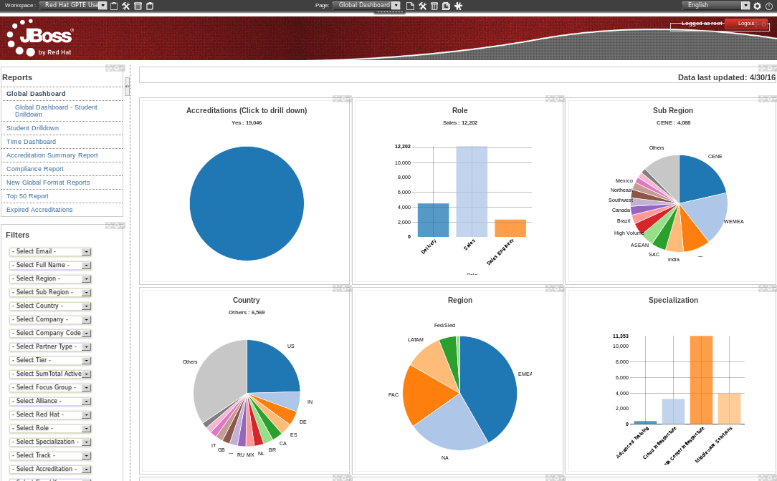


Purpose
Holistic view of OPEN & Skills Exchange accreds
Advanced ILTs
Partners

Slide 3
Example Accreditation Rule
IF
Corebuild Accelator
Satellite Accelerator
RHEL (6) Implementation
Satellite (5) FASTRAX
RHEL (6) Troubleshooting
BETWEEN( 1-Jun-2013 - 1-Jul-2014 )
THEN
Red Hat Delivery Specialist – Red Hat Platform

Slide 4
GPTE Accreditation Rules
TOTAL: 113
TYPES:
  DCI (platform accreds)
  MW (middleware accreds)
  CI (cloud accreds)

Slide 5


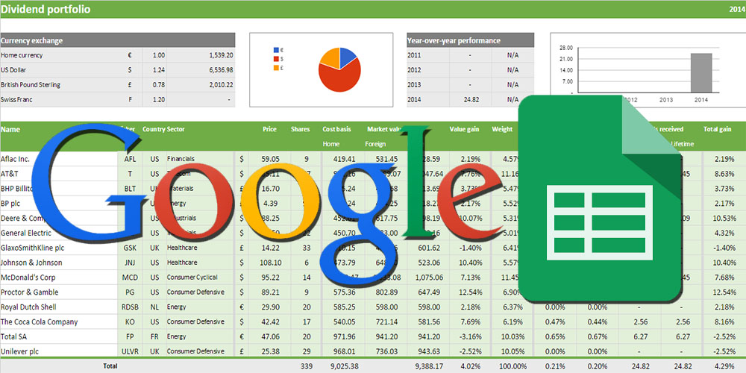
Accred Rules: Visibility
INITIAL:
LATER:
NOW:
+
= ?
+
= ?

Slide 6
GPTE Reporting: Design Goals
Accreditation Rules:
  Visible and agreed upon
  Maintainable by GPTE ops team ( Lana, Christina )
  Applicable for all upstream course completion sources
Course & Accredition names: Standardized / canonical
Automated
Near Real Time
Accreditations: Visible via web based reporting tool

Slide 7
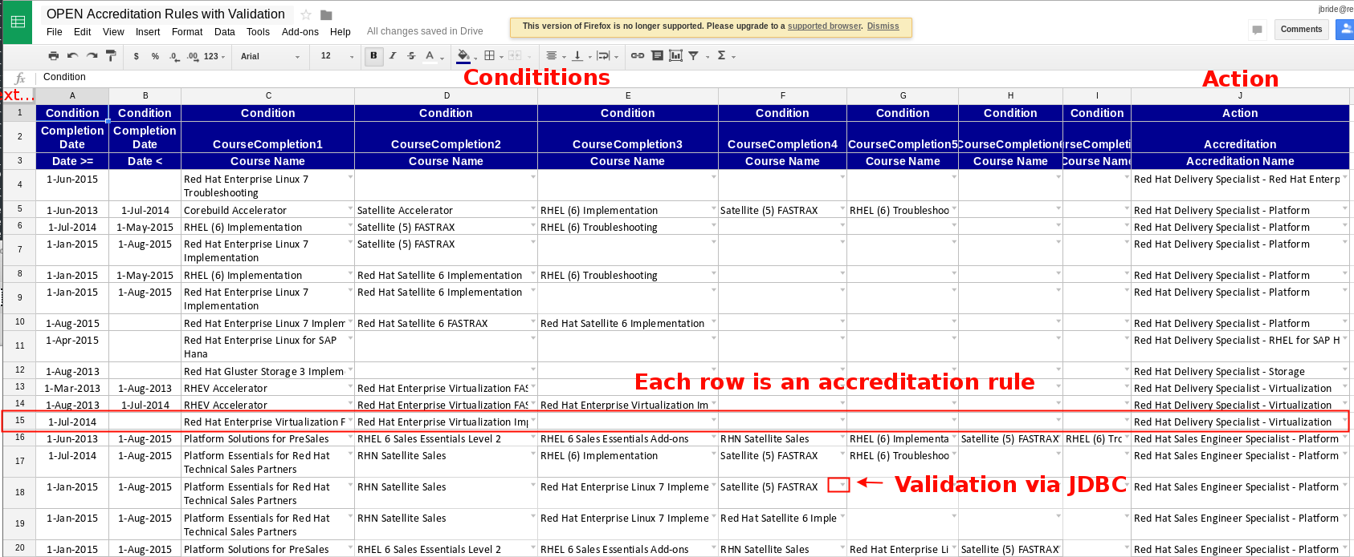
GPTE Accreditation Rules with Validation
https://docs.google.com/spreadsheets/d/1C4jbSADmHJvLL3PBBBSEB54L8G_I6NN5rblWIGymAXg/edit#gid=420508767

Slide 8




Rules Parsing and Validation
Google Spreadsheet
→ Tab Separated Value (TSV) file
→ Drools Rule Language (DRL)

Slide 9
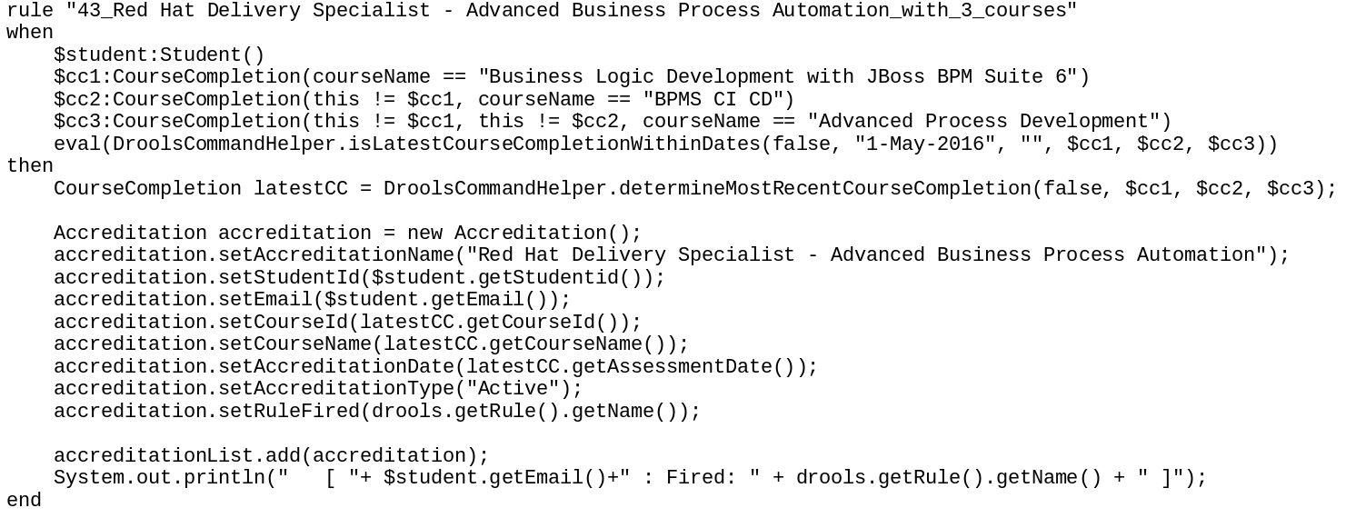
GPTE Accreditation Rule (DRL)

Slide 10



Accreditation Processing
Advanced ILTs
Partners

Slide 12
Status
Soon:
- Code complete
- Data scrubbing complete
- Spreadsheet rules accurate
- Testing complete
- Go live to production
Future:
- New Dashbuilder (GWT / Uberfire)
- More advanced reports (Grouping)
- Canonical Company names (SalesForce Id ??)
- (Re-) Integrate with Skills Base
- Integrate with Path Gatherer
- Refine processes for intro of / change to courses & accreds

