Slide 1
Chain Replication in TLA+
Specification and the limits of model checking
Proposed by Prof. Carla Ferreira
Implemented by João Brilha

Slide 2
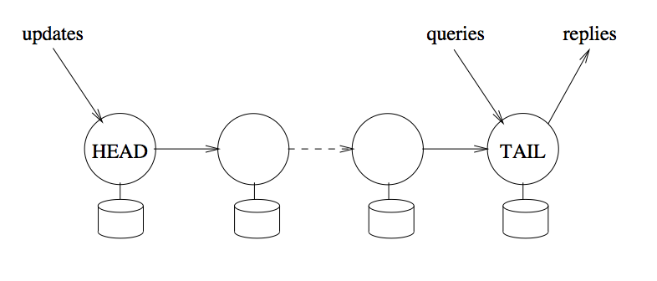
Protocol
Two types of requests:
  Query requests, directed to the tail of the chain
  Update requests, directed to the head of the chain
State changes are forwarded to the next element of the chain until the reply is sent by the tail

Slide 3
Assumptions
The storage system is a single variable
No failures occur
The size of the chain is 2
State changes are forwarded along a reliable FIFO link to the next element

Slide 4
The model (Variables)
headVal, head’s copy of the stored value
tailVal, tail’s copy of the stored value
link, between head and tail (FIFO)
replies, every reply tail has sent
updates, every update head has applied

Slide 5
The model (Actions)
Update(v), stores the value v at the head of the chain, and appends it to link, to be forwarded to the tail
Update(v) ==
/\ Len(updates) < MaxUpdates
/\ headVal' = v
/\ link' = Append(link, v)
/\ updates' = Append(updates, v)
/\ UNCHANGED <<tailVal, replies>>

Slide 6
The model (Actions)
Forward, “pops” the oldest value from link, stores it at the tail of the chain, and appends an update reply to replies
Forward ==
/\ link # <<>>
/\ tailVal' = Head(link)
/\ link' = Tail(link)
/\ replies' = Append(replies, [op |-> "update", val |-> Head(link)])
/\ UNCHANGED <<headVal, updates>>

Slide 7
The model (Actions)
Query, appends a reply with the value stored at the tail of the chain to replies
Query ==
/\ QueryCount < MaxQueries
/\ replies' = Append(replies, [op |-> "query", val |-> tailVal])
/\ UNCHANGED <<headVal, tailVal, link, updates>>

Slide 8
The model (Actions)
Each action writes to a single node, and link carries changes from the head to the tail
TLC explores every interleaving of Update, Forward, and Query

Slide 9
Properties
Invariants:
  StrongConsistency, every query returns the value of the last update acked before it
  HeadIsLatest, TailIsAcked, and LinkHasPending explain why it holds
Liveness:
  EveryUpdateIsAcked, with weak fairness on Forward
All pass on the baseline model: 369 states, or 186 with symmetry

Slide 10
Breaking the model
BadSpec, queries read at the head node:
  StrongConsistency fails in 2 steps
  Update(v1), then a query returns v1 before the tail acks it
NoFairSpec, no fairness on Forward:
  EveryUpdateIsAcked fails
  The trace stutters forever with an update stuck in link

Slide 11
Experimental setup
Baseline: 2 values, 3 updates, 2 queries
Sweep one constant at a time, with and without symmetry
  Invariants only, 120-second timeout, one run per model
Measure distinct states, depth, and time

Slide 12
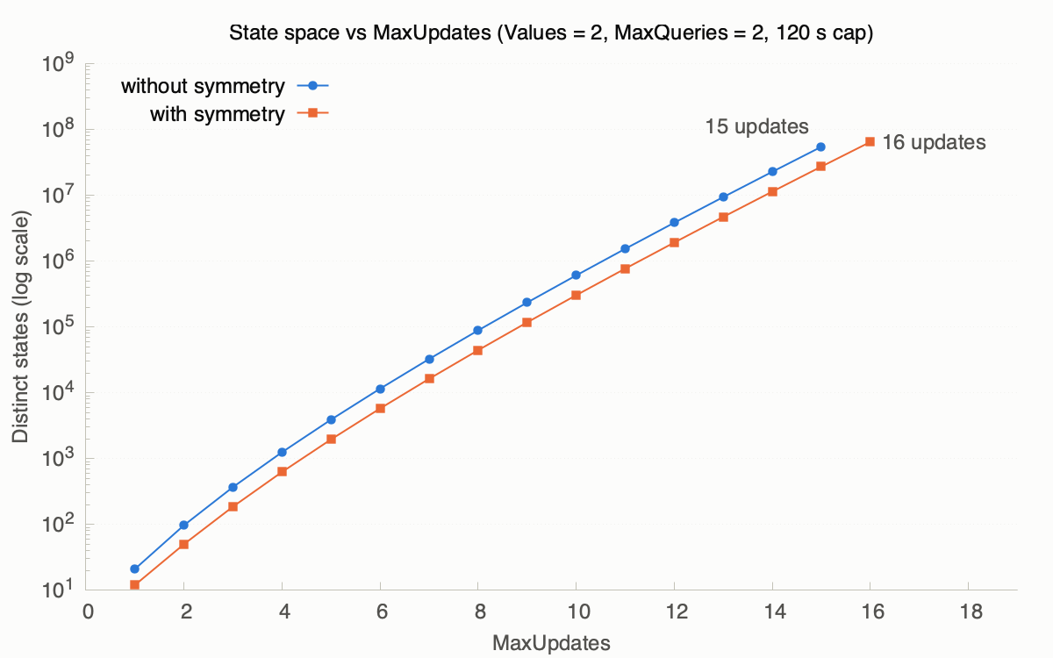
MaxUpdates is exponential
About ×2.4 states per update
15 updates: 54.5M states in 71 s
Without symmetry, 16 updates time out
Symmetry halves the count, which allows for one more update
A constant factor doesn't beat exponential growth

Slide 13
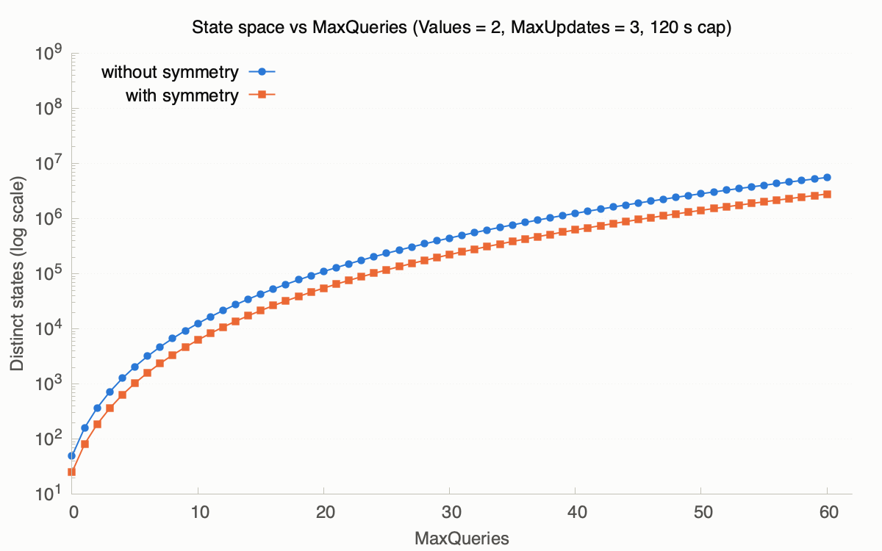
MaxQueries grows polynomially
60 queries: 5.6M states in 43 s, and no timeout
Doubling the queries multiplies the states by about 12
Symmetry halves the count, same as for MaxUpdates

Slide 14
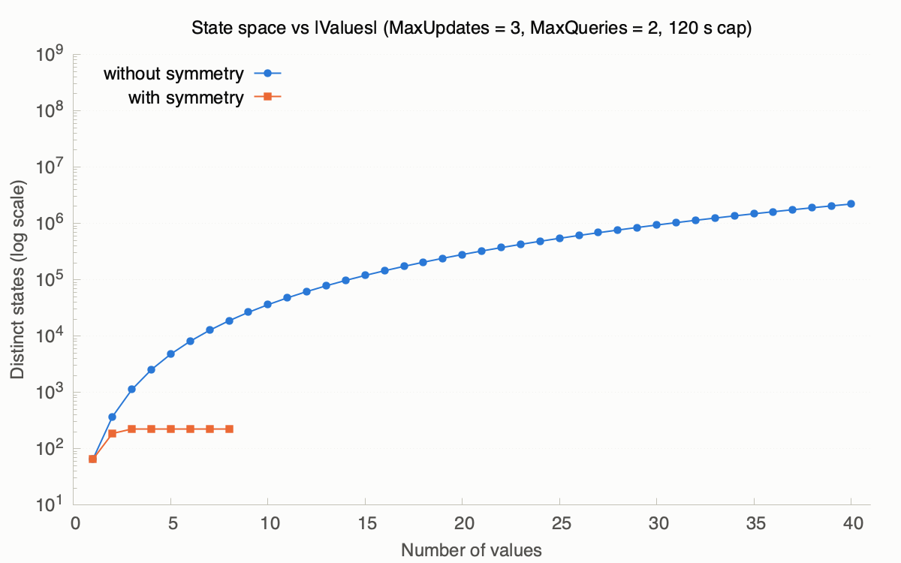
Values grows polynomially
Without symmetry, growth is about V³, because each of the 3 updates picks one of V values
  40 values give 2.2M states in 3 s
With symmetry, the count stays at 220 from 3 values on
  3 updates use at most 3 distinct values, so any extra value is interchangeable with an unused one

Slide 15
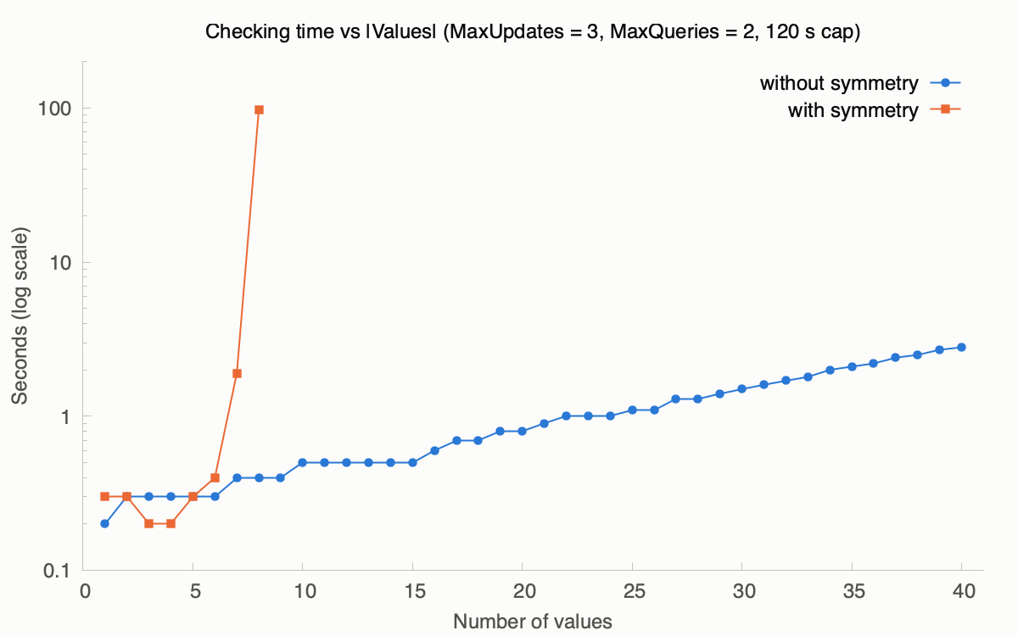
What symmetry costs
With symmetry, under 0.5 s up to 6 values, then 1.9 s at 7, 97 s at 8, and a timeout at 9
Without symmetry, the line stays under 3 seconds across the value sweep
For each state, TLC tries every permutation of Values: 40,320 at 8 values

Slide 16
Conclusions
The protocol satisfies strong consistency and liveness in every model checked
Only MaxUpdates limits the model: 15 updates, or 16 with symmetry
Symmetry pays off for small sets and large state spaces, like the MaxUpdates sweep
Small models can still catch real issues: the head-read bug in BadSpec shows up in 2 steps

Slide 17
AI usage
Claude Sonnet was used to:
  Explain some TLA+ concepts and syntax
  Create the helper scripts for scaling the model and plotting the results
  Validate the final implementation

