Slide 1
Behavioral-Driven Development in Java
Using jBehave, Eclipse and Maven to build software.

Slide 2
What is BDD?
A software development process
Based on a fusion of Test and Domain driven design philosophies.
An answer to the “where to start” question
Declarative, not imperative

Slide 3
What is jBehave?
Created by Dan North
A framework to enable teams to use BDD in Java.
The OG of Behavioral frameworks.

Slide 4
The jBehave Process
Create a Story
Wire the Story to run as a test
Implement the steps
Verify results

Slide 5
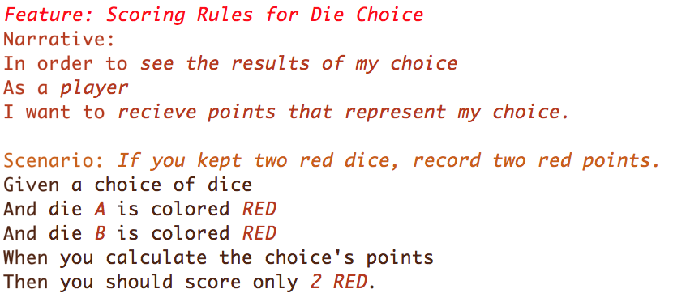
This is a Story
Doesn’t look like much, does it?

Slide 6
Anatomy of a Story
Feature: (aka Story:) A clear explicit title.
Narrative: A short introduction with Who/What/Why
Scenario: A sentence describing an individual acceptance criterion followed by the templated steps for the scenario.

Slide 7
Anatomy of a Scenario
Given A precondition which defines the start of a scenario.
When An event trigger.
Then A postcondition to verify after the event.
The And keyword just repeats the previous line’s keyword to improve the readability of the file.

Slide 8
Implementing Steps
Given
When
Then
@Given("a choice of dice")
public void aChoiceOfDice() {
choice = new DiceChoice();
}
@When("you calculate the choice's points")
public void calculatePoints() {
points = choice.getPointValue();
}
@Then("you should score only $number $color.")
public void shouldHavePoints(int number, DieColor color) {
assertThat(extractProperty("color").from(points)).containsOnly(color); assertThat(extractProperty("points").from(points)).containsOnly(Integer.valueOf(number));
}

Slide 9
Implementing Steps – Continued
Don’t include the keyword the Annotation represents. (“Given that x” becomes “that x”)
The “value” of the annotations is a sort-of regex.
$words are mapped to variables
Basic mapping is on out of the box
Custom mapping can be added ad-hoc.

Slide 10
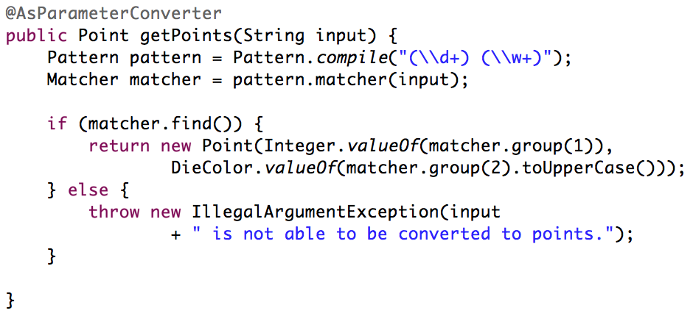
Parameter mapping example.
(while we’re talking about it)

