Slide 1
Behavioral-Driven Development in Java
Using jBehave, Eclipse and Maven to build software.

Slide 2
What is BDD?
A software development process
Based on a fusion of Test and Domain driven design philosophies.
An answer to the “where to start” question
Declarative, not imperative

Slide 3
What is jBehave?
Created by Dan North
A framework to enable teams to use BDD in Java.
The OG of Behavioral frameworks.

Slide 4
The jBehave Process
Create a Story
Wire the Story to run as a test
Implement the steps
Verify results

Slide 5
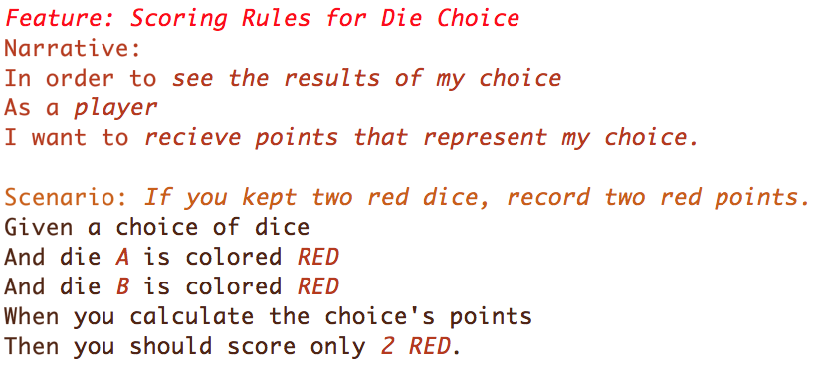
This is a Story
Doesn’t look like much, does it?

Slide 6
Anatomy of a Story
Story: (aka Feature:) A clear explicit title.
Narrative: A short introduction with Who/What/Why
Scenario: A sentence describing an individual acceptance criterion followed by the templated steps for the scenario.

Slide 7
Anatomy of a Scenario
Given A precondition which defines the start of a scenario.
When An event trigger.
Then A postcondition to verify after the event.
The And keyword just repeats the previous line’s keyword to improve the readability of the file.

Slide 8
Implementing Steps
Given
When
Then
@Given("a choice of dice")
public void aChoiceOfDice() {
choice = new DiceChoice();
}
@When("you calculate the choice's points")
public void calculatePoints() {
points = choice.getPointValue();
}
@Then("you should score only $number $color.")
public void shouldHavePoints(int number, DieColor color) {
assertThat(extractProperty("color").from(points)).containsOnly(color); assertThat(extractProperty("points").from(points)).containsOnly(Integer.valueOf(number));
}

Slide 9
Implementing Steps – Continued
Don’t include the keyword the Annotation represents. (“Given that x” becomes “that x”)
The “value” of the annotations is a sort-of regex.
$words are mapped to variables
Basic mapping is on out of the box
Custom mapping can be added ad-hoc.

Slide 10
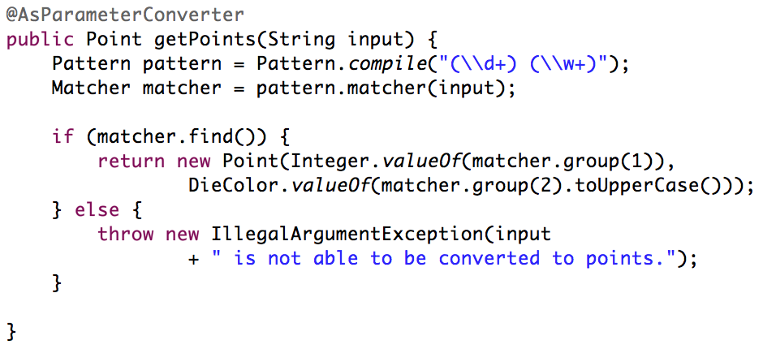
Parameter mapping example.
(while we’re talking about it)

Slide 11
Running your stories – with jUnit
Create a class that extends JUnitStories
Override the configuration() class.
Use MostUsefulConfiguration
Configure MostUsefulConfiguration to load from the classpath.
Override the steps class to return a new InstanceStepsFactory with instances of your Step classes.
Run it in your IDE like a normal jUnit test

Slide 12
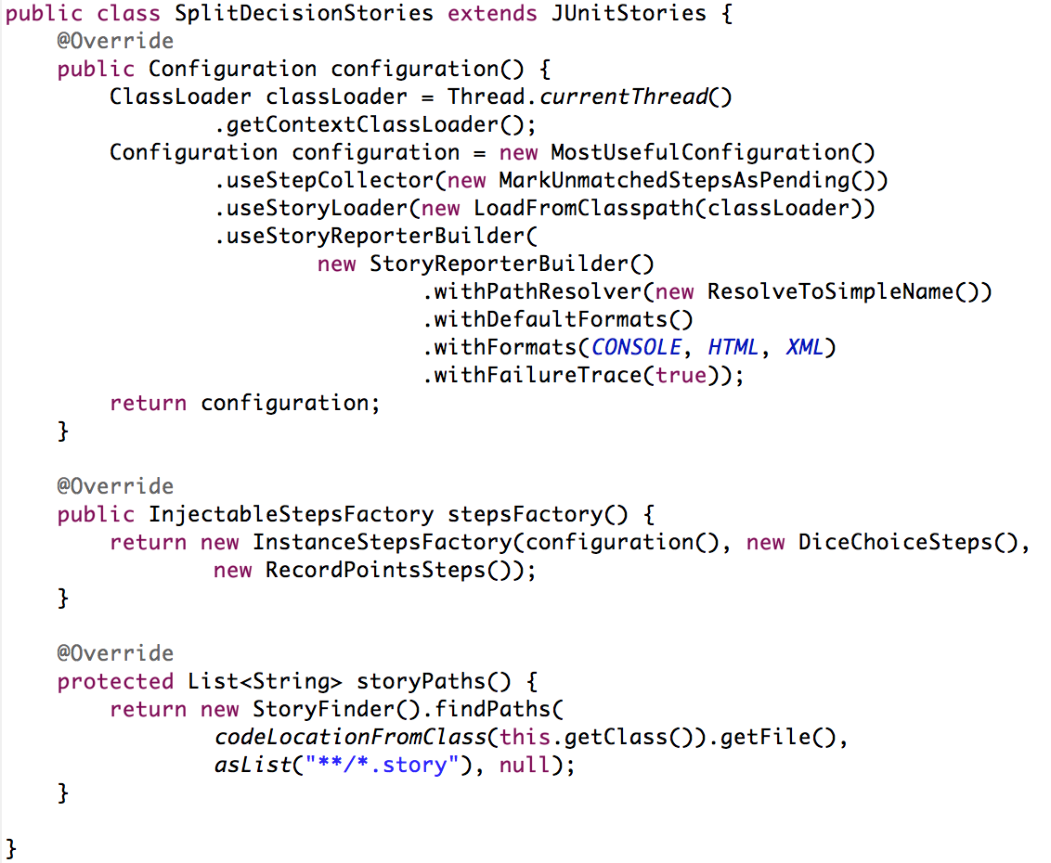
Here’s what my basic Stories file looks like.
It’s a lot to take in. Sorry.

Slide 13
CI Integration
Maven integration
Loads and runs *Stories.class files
Generates a report
Does not integrate with the maven site plugin.
Jenkins Integration
Make sure you install xUnit support and restart the server before installing the jBehave plugin.
Use “**/jbehave/*.xml” unless you’re customizing things.

Slide 14
Things I discovered
jBehave is still under active development, but…
There is relatively little discussion of if in comparison to
cucumber/rSpec (ruby)
jasmine/vow (JavaScript)
lettuce/cucumber-py (python)
Documentation is confusing, expect to go-it-alone.
The community is insular
No books that deal with jBehave specifically
BDD is not popular amongst Java developers

Slide 15
References
The jBehave main site: http://jbehave.org/
Dan North’s “Introducing BDD”: http://dannorth.net/introducing-bdd/
Daniel Solis’ game mechanic idea “Split Decision”: http://danielsolisblog.blogspot.com/2010/10/split-decision.html
The Cucumber Book: Behavior-Driven Development for Testers and Developers by Matt Wynne and Aslak Hellesøy
The Clean Coder: A Code of Conduct for Professional Programmers by Robert C. Martin

