Slide 1

Detecting Exoplanets with Machine Learning
Mission: build a reproducible ML pipeline to classify potential exoplanets.
Data: NASA’s Kepler, TESS, and K2 missions.
Goal: help scientists quickly validate planet candidates using accessible ML tools.
[Insert logos & diagram]

Slide 2

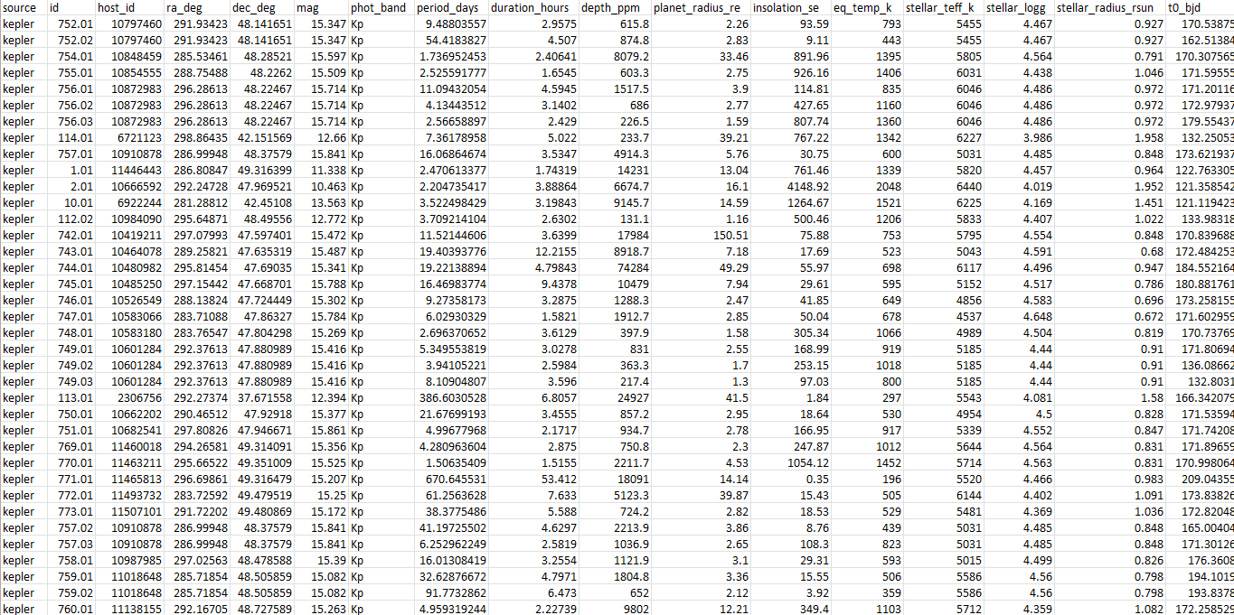
The Datasets and Data Format
Kepler and TESS datasets used for training and validation.
K2 and other missions can be tested later.
Input must follow a standard unified CSV format, independent of mission.
Each scientist can adapt their own data to match this structure.
Example CSV columns:
period_days
depth_ppm
duration_hours
stellar_teff_k
stellar_radius_rsun
...

Slide 3

From Raw Data to Model Input
Each dataset was standardized:
Units normalized (hours, days, ppm, etc.)
Missing values imputed with median values.
Only confirmed planets (1) and false positives (0) kept.
Derived features added:
Transit depth fraction, radius ratio, duty cycle, log transforms.

Slide 4

Machine Learning Model
Algorithms tested: Random Forest, XGBoost.
Final version: Random Forest (simpler, stable, interpretable).
Input: 19 numerical features per candidate.
Output: predicted class → 1 = Planet, 0 = False Positive.

Slide 5
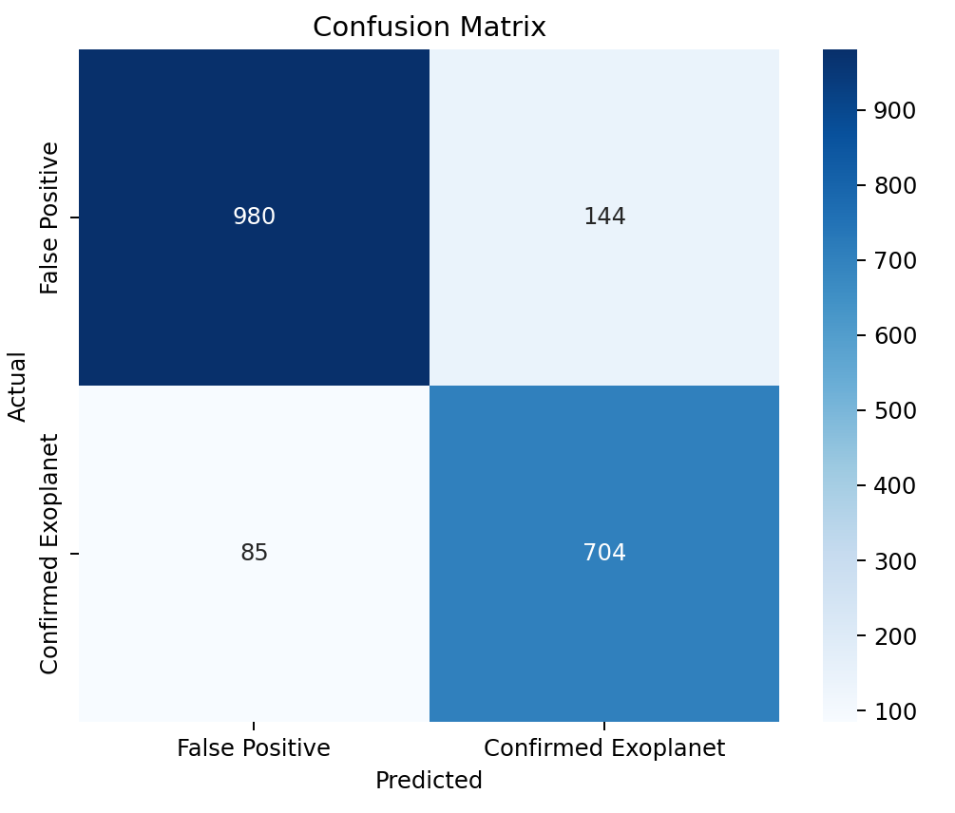
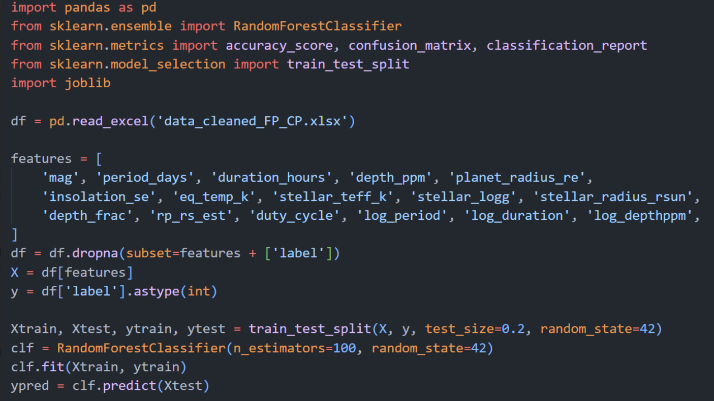
Results and Evaluation
Recall: 88,17 % — detects most real planets.
Precision: 87,50 % — few false alarms.
Accuracy: 88,03 %
Balanced detection with high recall (scientifically preferred).

Slide 6
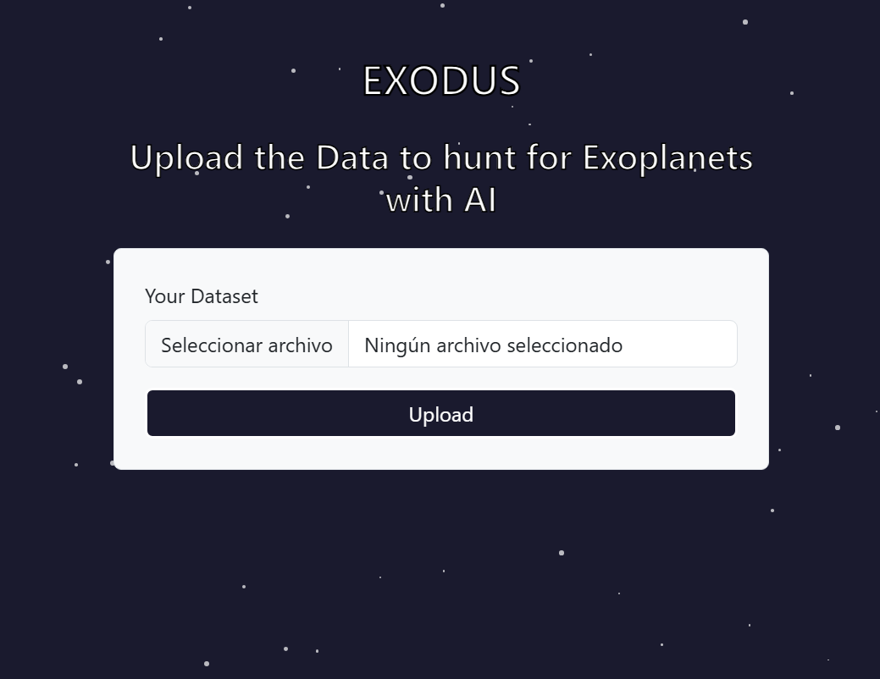
The Prediction App
Simple web interface for scientists.
Users upload a clean CSV following our unified format.
The app returns:
Predicted class per object.
Optional metrics if labels are provided.

Slide 7

Conclusions & Future Work
Proven that machine learning can accelerate exoplanet validation.
Random Forest model achieves high recall and interpretability.
Plan: expand with real-time APIs from NASA Exoplanet Archive.
Future integration of new missions and additional features (light curve data).

