Slide 1

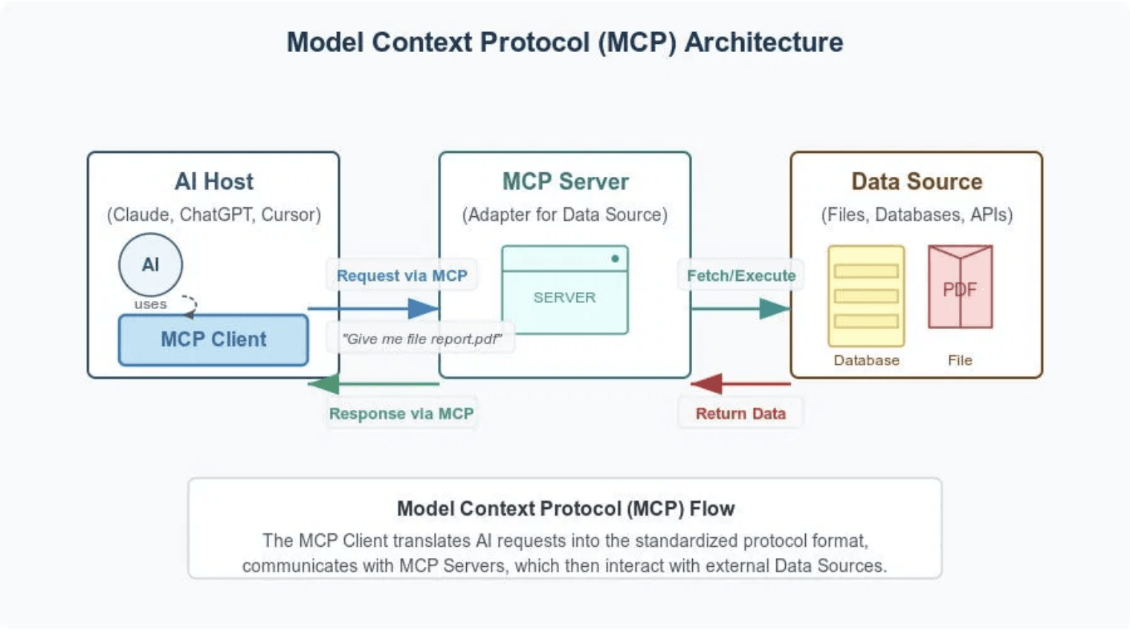
Empowering
Developers with
the Model Context
Protocol
Intelligent Knowledge Search and CI/CD Database Querying
Technical Presentation
January 2026

Slide 2

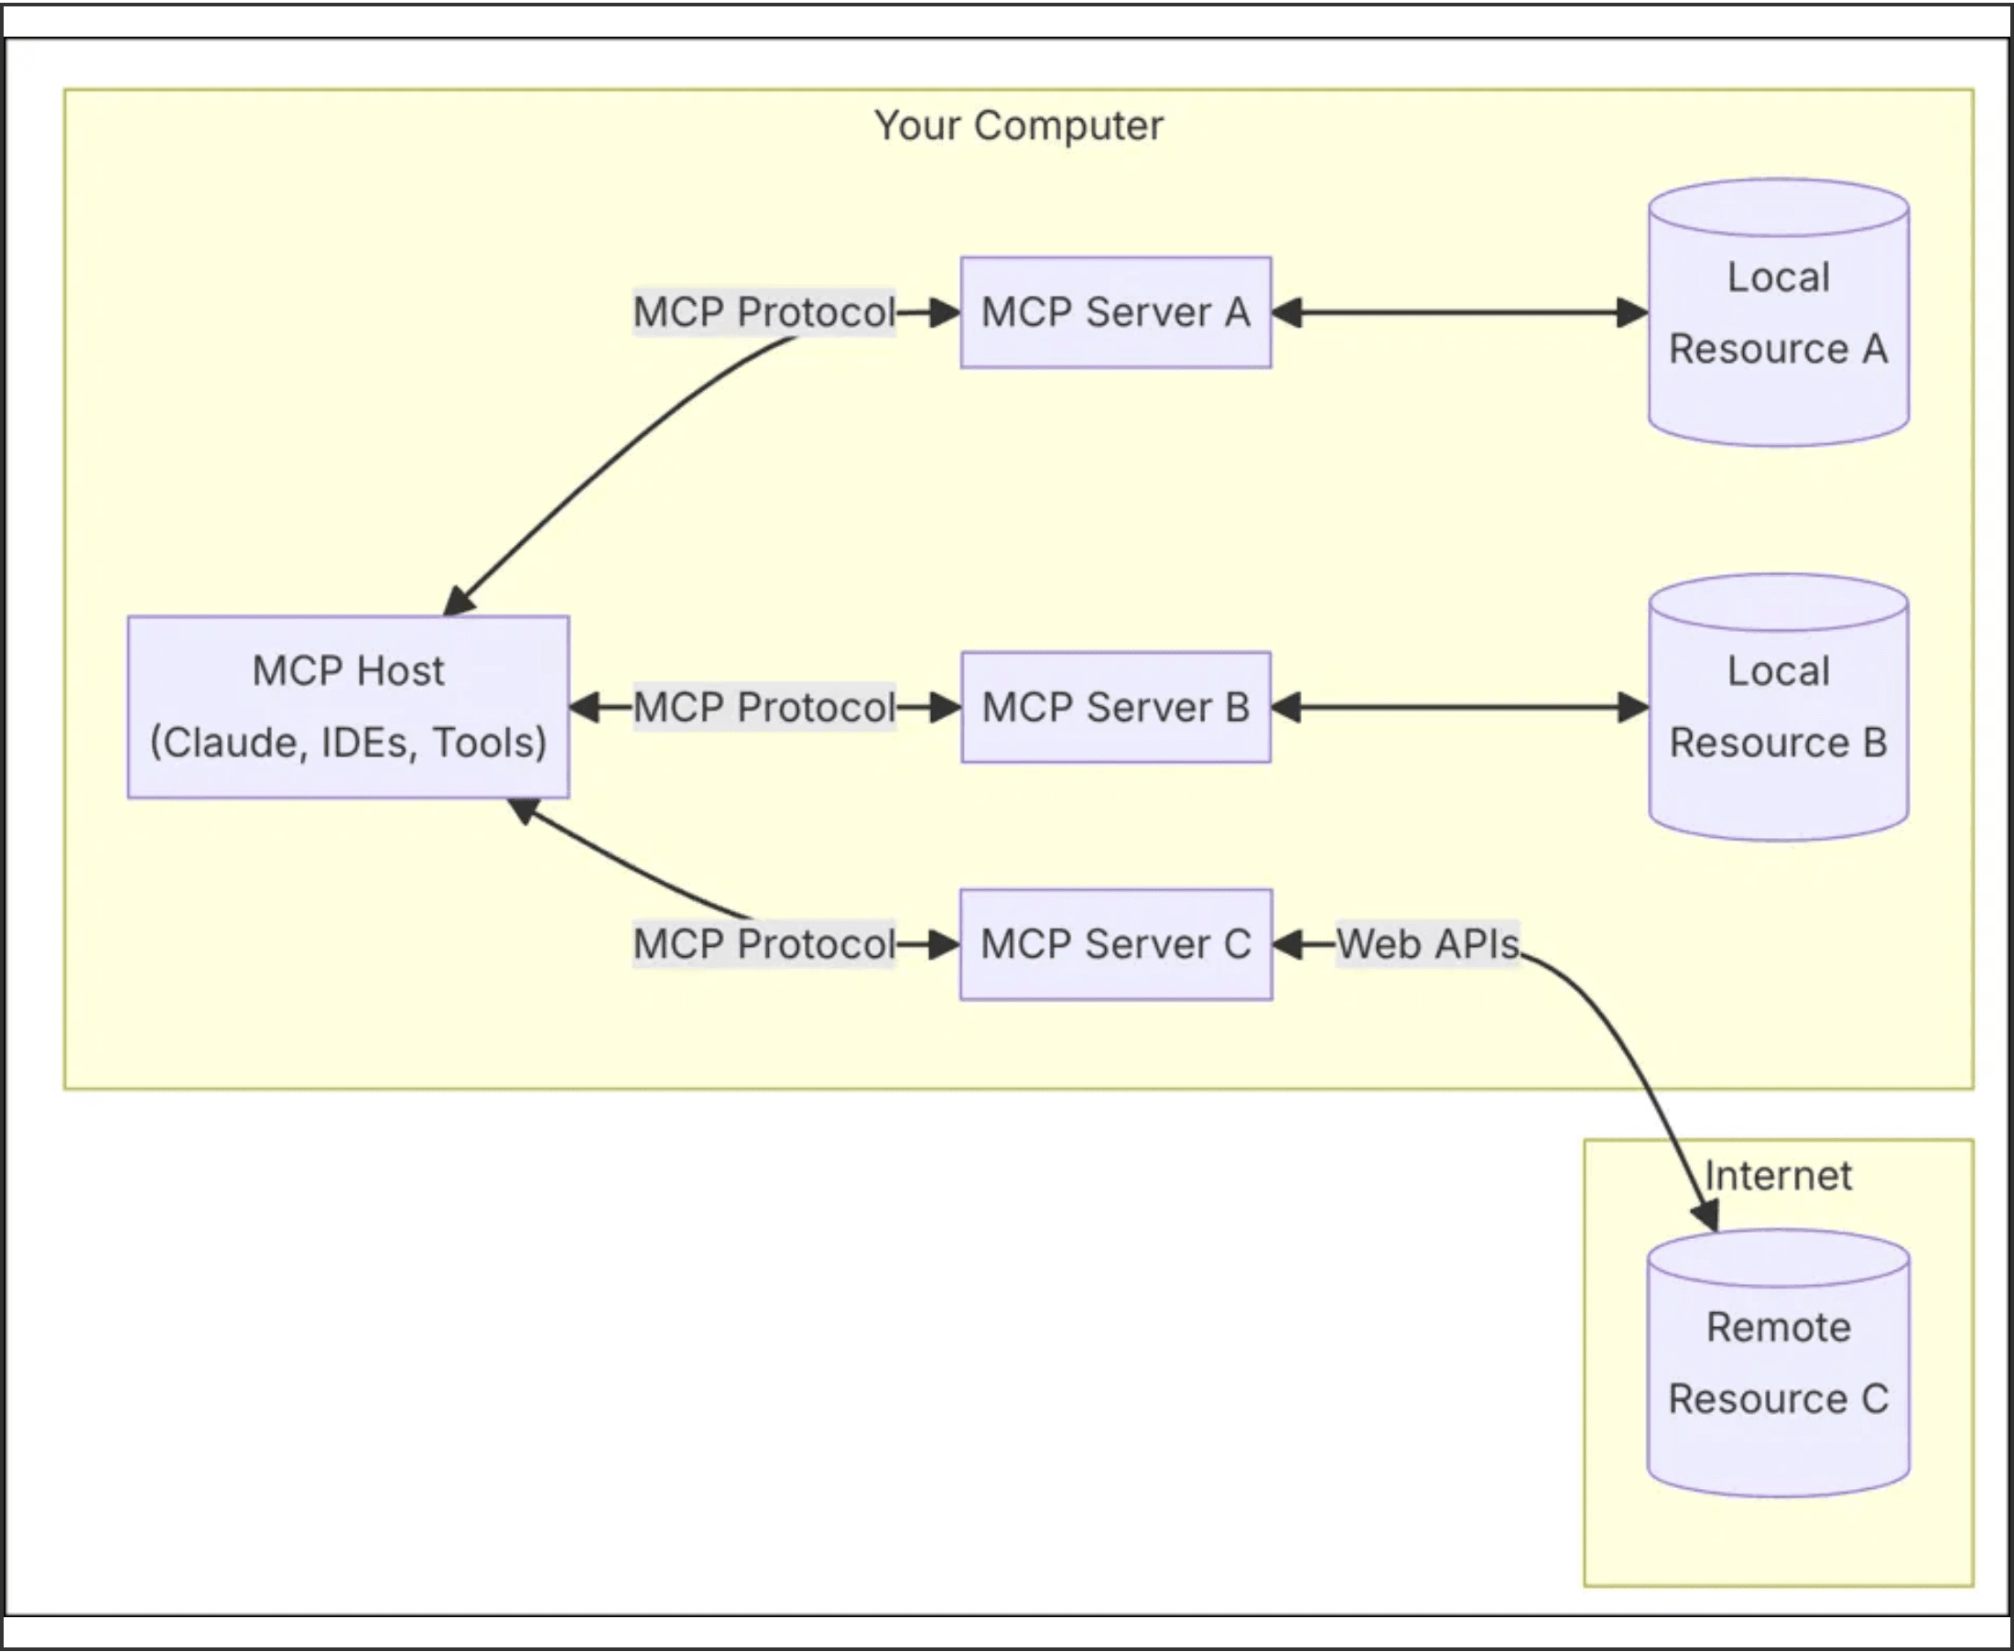
MCP Bridges the Gap Between AI and Proprietary Data
The Problem: Data Isolation
Modern AI assistants are powerful but often operate in a vacuum, lacking access to the real-time, internal data that defines a developer's daily work. This isolation limits their effectiveness in specialized environments.
The Solution: Standardized Bridge
The Model Context Protocol solves this by enabling secure, standardized communication between the IDE and specialized local or remote services. This ensures that data stays within controlled environments.
Key Insight: MCP provides the specific context AI needs to be truly effective, without compromising security or data sovereignty.

Slide 3

A Unified Ecosystem for Developer Intelligence
The ecosystem consists of three interconnected components that work in harmony to provide a comprehensive intelligence layer, creating a single point of entry for all developer queries.
Component
Role
Primary Function
kbsearch-mcp-server
Central Hub
Orchestrates tool registration and editor integration across VS Code, Cursor, and IntelliJ.
rag-mcp
Knowledge Expert
Performs high-performance RAG-based search across internal documentation and technical wikis.
nl2sql-mcp
Data Analyst
Converts natural language questions into optimized SQL queries for CI/CD metrics and history.

Slide 4

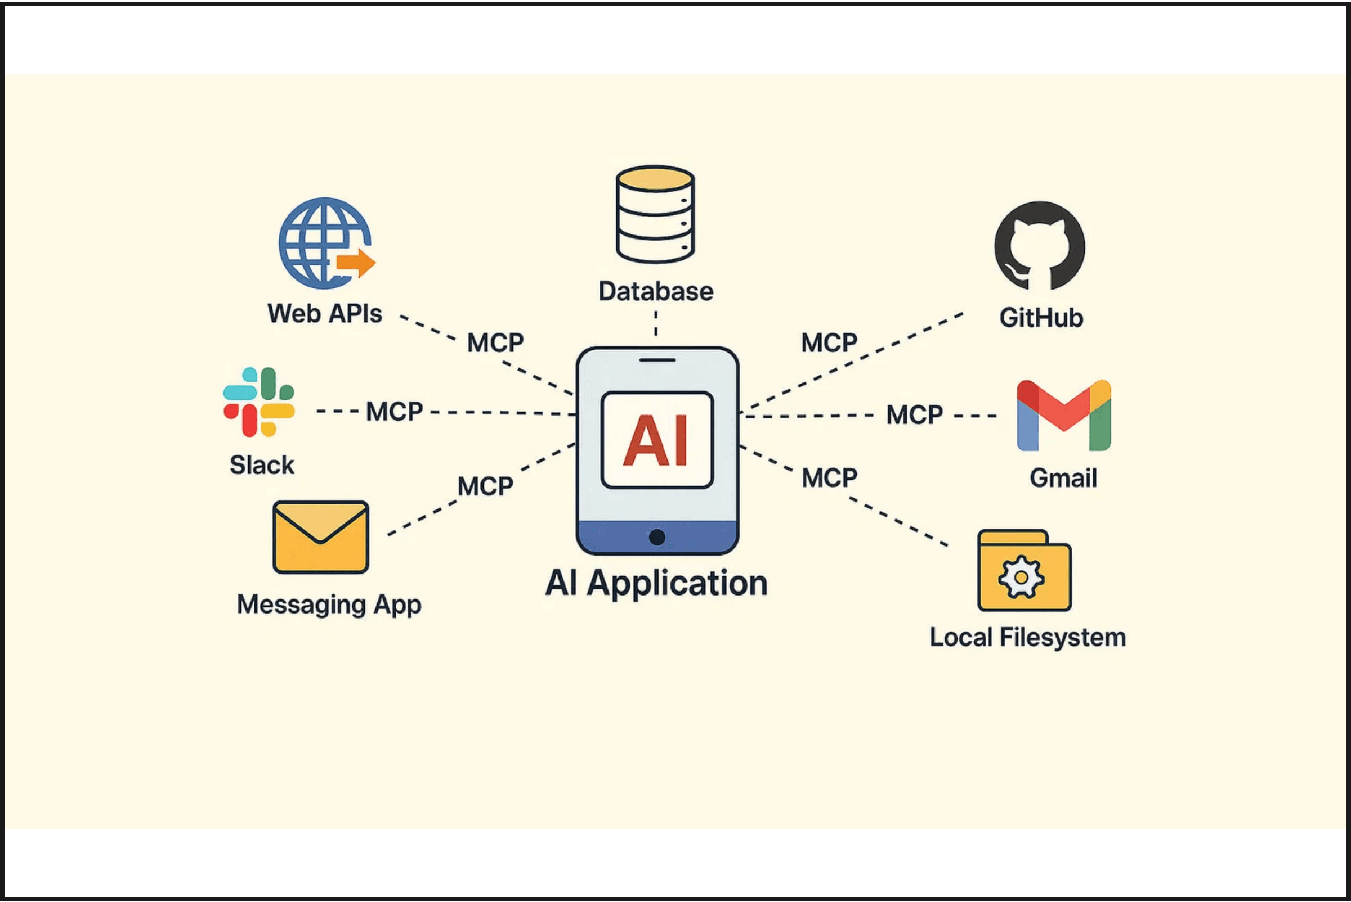
kbsearch-mcp-server Orchestrates the AI Workflow
Tool Registration
Acts as the primary interface for the AI assistant, handling the registration of specialized tools like search_knowledge_base and query_cicd.
Multi-Editor Support
Provides a consistent experience across various IDEs including VS Code, Cursor, and IntelliJ through standardized MCP endpoints.
Seamless Workflow
Simplifies the integration of complex backend services into the developer's chat interface, ensuring a single point of entry for all queries.

Slide 5

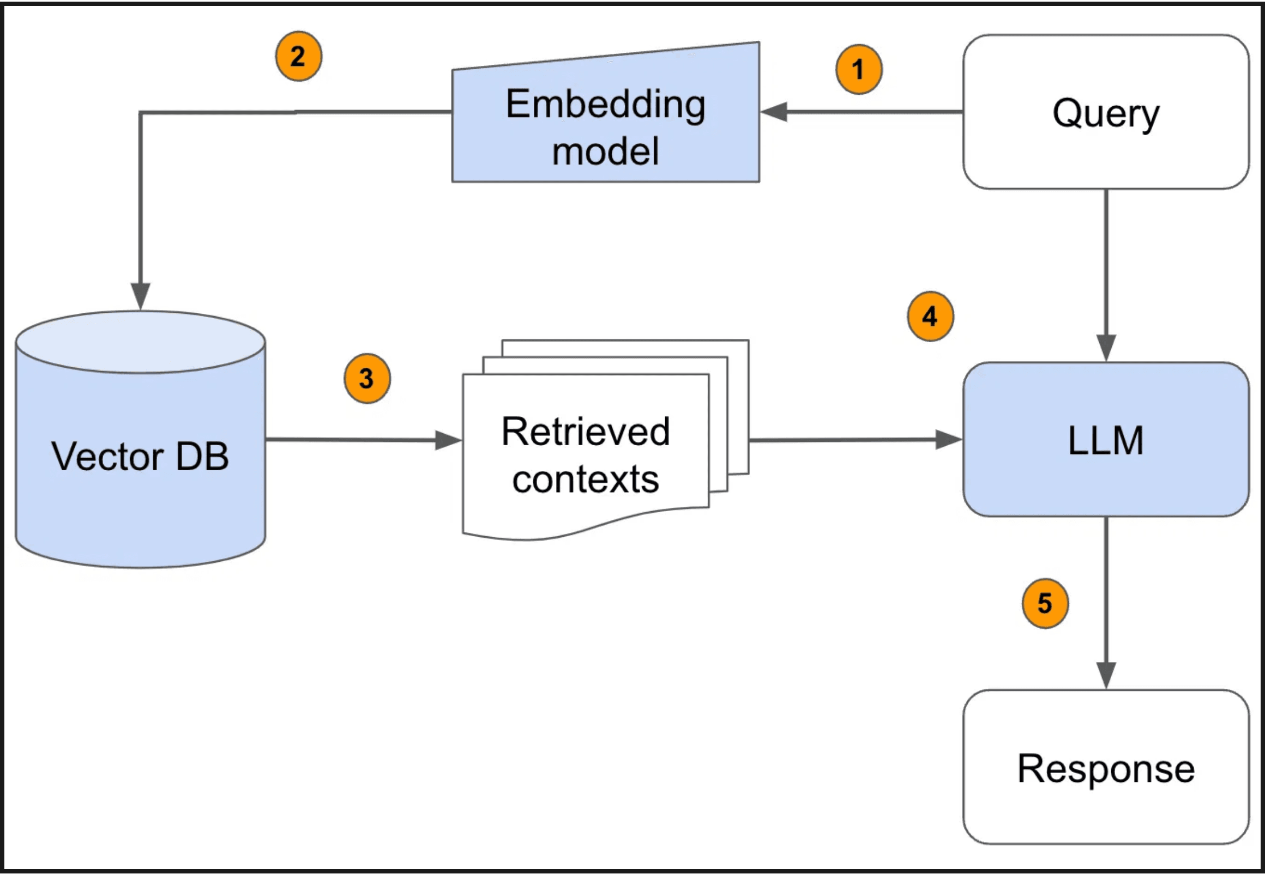
rag-mcp Delivers Intelligent Knowledge Retrieval
Interactive Knowledge Base
The rag-mcp service transforms static documentation into an interactive resource. By automating the ingestion of technical content from URLs, it ensures that the AI has the most up-to-date context available.
Instant Technical Answers
Eliminate manual searching through wikis and READMEs. Developers can ask "How-to" and "What-is" questions directly in their IDE, receiving precise answers grounded in their own documentation.

Slide 6

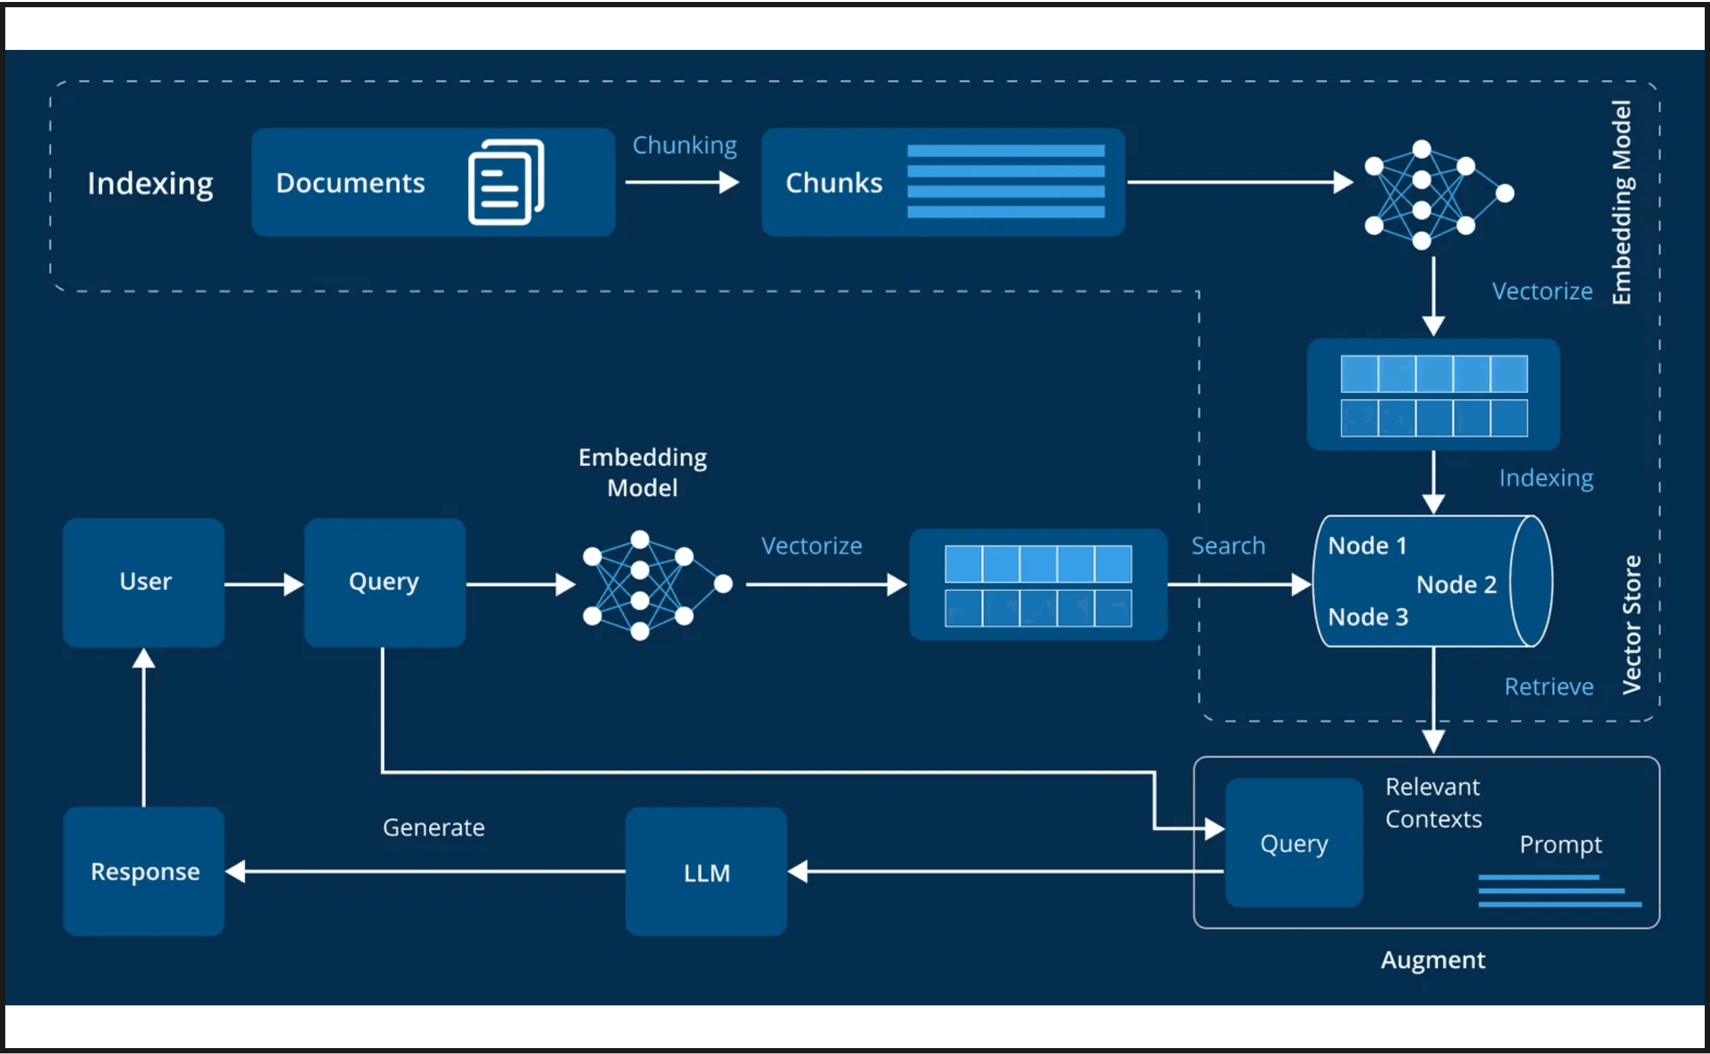
Advanced RAG Architecture Supports Diverse Needs
Ingestion Pipeline
Automated Scrapers:
Extracts content from technical documentation and wikis.
Semantic Chunking:
Intelligent boundary detection for better context retention.
Configuration Profiles
Versioned Settings:
Manage embedding models and retrieval parameters.
Optimization:
Tailor strategies for accuracy, cost, or latency.
Figure 1: End-to-end RAG pipeline from ingestion to contextual response.
Provider Flexibility
Hybrid Support:
Local (Ollama) and Cloud (OpenAI, Gemini, Bedrock).
PostgreSQL
pgvector
FastAPI
Ollama

Slide 7
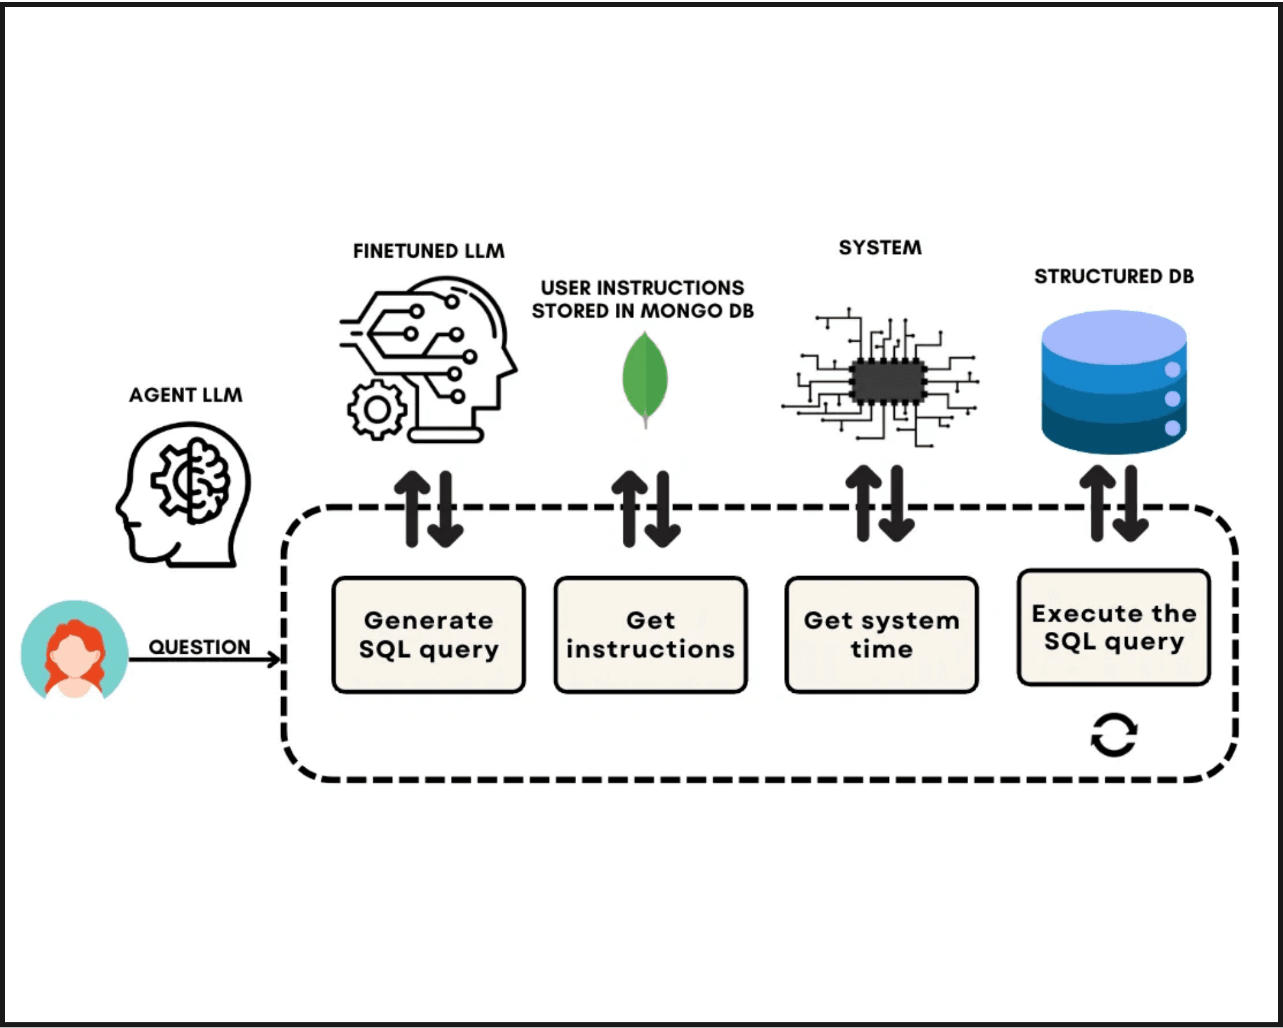
nl2sql-mcp Simplifies Complex Database Querying
The Challenge: Manual SQL Complexity
Querying CI/CD databases for deployment metrics often requires writing complex SQL that is both time-consuming and error-prone for developers focused on delivery.
The Solution: Natural Language Interface
1
Prepare: AI identifies intent (e.g., "last 5 deployments") and extracts slots like app name and environment.
2
Execute: The system generates optimized SQL based on the schema and returns formatted results instantly.

Slide 8

Intelligent Caching Drives High-Performance Data Access
Step 1
Step 2
Prepare Phase
Execute Phase
The system identifies user intent and extracts parameters (slots). It checks the intelligent cache for existing query patterns to avoid redundant LLM calls.
If a cache miss occurs, optimized SQL is generated based on the schema. Verified results are then returned and stored in the cache for future instant access.
Performance Metric
Cache Hit
Cache Miss
Accuracy
Response Time
~50ms
2 - 5 seconds
100% (Verified)
LLM Cost
$0.00
Minimal (Generation)
High (Schema-Aware)

Slide 9

Strategic Optimization for Accuracy, Cost, and Speed
Accuracy
Cost
Speed
Prioritize answer quality and technical depth for complex engineering queries.
Minimize operational expenses while maintaining acceptable quality levels.
Optimize for the fastest possible response times in high-frequency environments.
Embeddings
3072-dim
Embeddings
Local (768d)
Search
Pure Vector
Chunking
Semantic
Chunking
Fixed (250)
Context
Small (Top 3)
LLM
GPT-4o / Pro
LLM
Ollama / Flash
LLM
Flash Models
Real-time metrics tracking: Latency, Cost, and User Satisfaction (0-10) are monitored per profile to ensure continuous improvement.

Slide 10

Real-World Use Cases Enhance Daily Productivity
Scenario A
Scenario B
Scenario C
Rapid Developer Onboarding
Incident Failure Analysis
Root Cause Investigation
A new engineer asks: "What is our AKS deployment strategy?" Instead of searching through fragmented wikis, the AI provides the exact documentation instantly.
A developer needs to know: "Show me the last 5 failures for the API gateway." The AI queries the CI/CD database and returns formatted results in seconds.
Combining both tools: Find the documentation for a failing service and then query its recent deployment history—all without leaving the chat interface.
Primary Tool:
Primary Tool:
Primary Tool:
rag-mcp Knowledge Search
nl2sql-mcp Data Query
Unified MCP Ecosystem

Slide 11

Seamless Deployment and Scalable Integration
Docker-First Deployment
IDE Integration
Containerized Architecture
Supported Environments
All components—the MCP hub, RAG service, and NL2SQL tool—are fully containerized. This ensures consistent environments from local development to production clusters.
VS Code:
file in your workspace root.
Simple configuration via the
.mcp.json
Cursor:
Native, built-in support for MCP servers with zero-config detection.
Enterprise Scalability
Start with local models (Ollama) for privacy and cost-efficiency, then scale to cloud providers (OpenAI, Gemini, Bedrock) as your team's needs grow.
IntelliJ:
Compatible via AI assistant plugins like Continue or specialized MCP extensions.
Integration is standardized across editors, providing a unified chat interface for all your documentation and data queries.

Slide 12

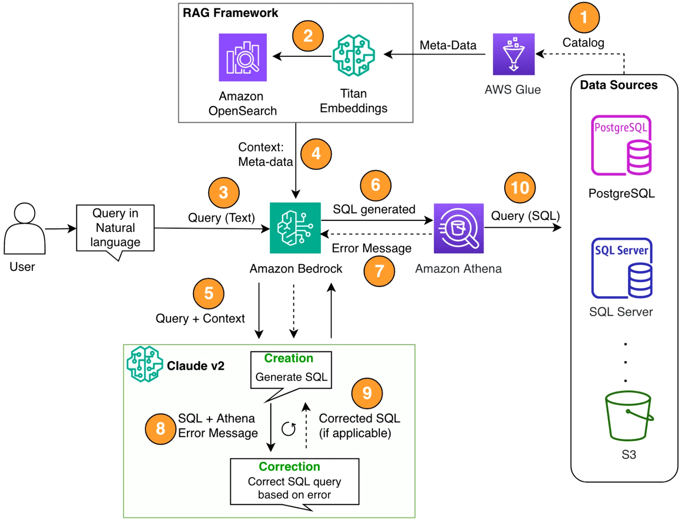
Future-Proofing
Development with
Open Standards
Unified Intelligence:
Combine internal documentation and live operational data in a single interface.
Developer Productivity:
Drastically reduce context switching and manual information retrieval.
Open Ecosystem:
Built on the Model Context Protocol for long-term compatibility with evolving AI models.
The Future of AI-Assisted Development
Get Started Today
Clone the repositories, configure your local MCP server, and transform your development workflow with intelligent, context-aware tools.

