Slide 1
Today Objectives
Introduction to Java Programming
Hello world
Simple syntax

Slide 2

What is programming?
program: A set of instructions
to be carried out by a computer.
program execution: The act of
carrying out the instructions
contained in a program.
programming language: A systematic set of rules used to describe computations in a format that is editable by humans.
  This textbook teaches programming in a language named Java.

Slide 3
Basic Java programs with println statements

Slide 4



Compile/run a program
Write it.
  code or source code: The set of instructions in a program.
Compile it.
  compile: Translate a program from one language to another.
  byte code: The Java compiler converts your code into a format named byte code that runs on many computer types.
Run (execute) it.
  output: The messages printed to the user by a program.
source code
byte code
output
compile
run

Slide 5
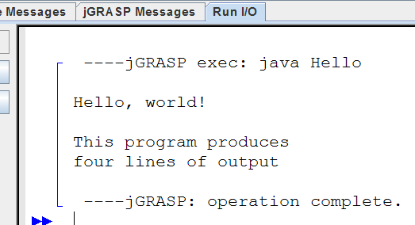
A Java program
public class Hello {
public static void main(String[] args) {
System.out.println("Hello, world!");
System.out.println();
System.out.println("This program produces");
System.out.println("four lines of output");
}
}
Its output:
  Hello, world!
  This program produces
  four lines of output
console: Text box into which
the program's output is printed.

Slide 6
Structure of a Java program
class: a program
public class name {
public static void main(String[] args) {
statement;
statement;
...
statement;
}
}
Every executable Java program consists of a class,
  that contains a method named main,
    that contains the statements (commands) to be executed.
method: a named group
of statements
statement: a command to be executed

Slide 7
System.out.println
A statement that prints a line of output on the console.
  pronounced "print-linn"
  sometimes called a "println statement" for short
Two ways to use System.out.println :
  System.out.println("text");
  Prints the given message as output.
  System.out.println();
  Prints a blank line of output.

Slide 8
Names and identifiers
You must give your program a name.
  public class GangstaRap {
  Naming convention: capitalize each word (e.g. MyClassName)
  Your program's file must match exactly (GangstaRap.java)
    includes capitalization (Java is "case-sensitive")
identifier: A name given to an item in your program.
  must start with a letter or _ or $
  subsequent characters can be any of those or a number
    legal: _myName TheCure ANSWER_IS_42 $bling$
    illegal: me+u 49ers side-swipe Ph.D's

Slide 9
Keywords
keyword: An identifier that you cannot use because it already has a reserved meaning in Java.
abstract default if private this
boolean do implements protected throw
break double import public throws
byte else instanceof return transient
case extends int short try
catch final interface static void
char finally long strictfp volatile
class float native super while
const for new switch
continue goto package synchronized

Slide 10
Syntax
syntax: The set of legal structures and commands that can be used in a particular language.
  Every basic Java statement ends with a semicolon ;
  The contents of a class or method occur between { and }
syntax error (compiler error): A problem in the structure of a program that causes the compiler to fail.
  Missing semicolon
  Too many or too few { } braces
  Illegal identifier for class name
  Class and file names do not match
  ...

Slide 11
Syntax error example
1 public class Hello {
2 pooblic static void main(String[] args) {
3 System.owt.println("Hello, world!")_
4 }
5 }
Compiler output:
Hello.java:2: <identifier> expected
pooblic static void main(String[] args) {
^
Hello.java:3: ';' expected
}
^
2 errors
  The compiler shows the line number where it found the error.
  The error messages can be tough to understand!

