Slide 1
Building Java Programs
Chapter 4
Conditional Execution
Copyright (c) Pearson 2013.
All rights reserved.

Slide 2

The if statement
Executes a block of statements only if a test is true
  if (test) {
  statement;
  ...
  statement;
  }
Example:
  double gpa = console.nextDouble();
  if (gpa >= 2.0) {
  System.out.println("Application accepted.");
  }

Slide 3
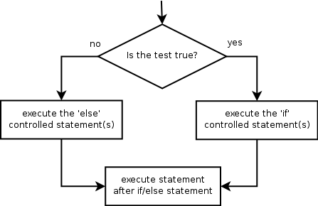
The if/else statement
Executes one block if a test is true, another if false
  if (test) {
  statement(s);
  } else {
  statement(s);
  }
Example:
  double gpa = console.nextDouble();
  if (gpa >= 2.0) {
  System.out.println("Welcome to Mars University!");
  } else {
  System.out.println("Application denied.");
  }

Slide 4
Relational expressions
if statements and for loops both use logical tests.
  for (int i = 1; i <= 10; i++) { ...
  if (i <= 10) { ...
  These are boolean expressions, seen in Ch. 5.
Tests use relational operators:
Operator | Meaning | Example | Value
== | equals | 1 + 1 == 2 | true
!= | does not equal | 3.2 != 2.5 | true
< | less than | 10 < 5 | false
> | greater than | 10 > 5 | true
<= | less than or equal to | 126 <= 100 | false
>= | greater than or equal to | 5.0 >= 5.0 | true
Notes:
Note that == tests equality, not = . The = is used for the assignment operator!

Slide 5
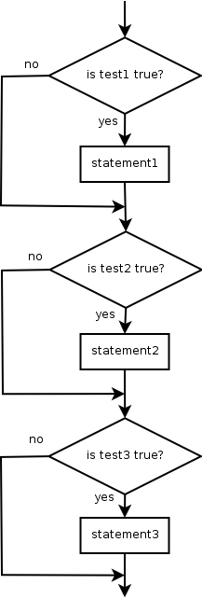
Misuse of if
What's wrong with the following code?
  Scanner console = new Scanner(System.in);
  System.out.print("What percentage did you earn? ");
  int percent = console.nextInt();
  if (percent >= 90) {
  System.out.println("You got an A!");
  }
  if (percent >= 80) {
  System.out.println("You got a B!");
  }
  if (percent >= 70) {
  System.out.println("You got a C!");
  }
  if (percent >= 60) {
  System.out.println("You got a D!");
  }
  if (percent < 60) {
  System.out.println("You got an F!");
  }
  ...

Slide 6

Nested if/else
Chooses between outcomes using many tests
  if (test) {
  statement(s);
  } else if (test) {
  statement(s);
  } else {
  statement(s);
  }
Example:
  if (x > 0) {
  System.out.println("Positive");
  } else if (x < 0) {
  System.out.println("Negative");
  } else {
  System.out.println("Zero");
  }

Slide 7
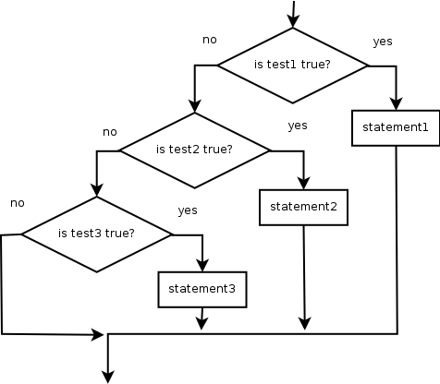
Nested if/else/if
  If it ends with else, exactly one path must be taken.
  If it ends with if, the code might not execute any path.
  if (test) {
  statement(s);
  } else if (test) {
  statement(s);
  } else if (test) {
  statement(s);
  }
Example:
  if (place == 1) {
  System.out.println("Gold medal!");
  } else if (place == 2) {
  System.out.println("Silver medal!");
  } else if (place == 3) {
  System.out.println("Bronze medal.");
  }

Slide 8
Nested if structures
exactly 1 path (mutually exclusive) if (test) { statement(s); } else if (test) { statement(s); } else { statement(s); } | 0 or 1 path (mutually exclusive) if (test) { statement(s); } else if (test) { statement(s); } else if (test) { statement(s); }
0, 1, or many paths (independent tests; not exclusive) if (test) { statement(s); } if (test) { statement(s); } if (test) { statement(s); }

Slide 9
Which nested if/else?
(1) if/if/if (2) nested if/else (3) nested if/else/if
  Whether a user is lower, middle, or upper-class based on income.
    (2) nested if / else if / else
  Whether you made the dean's list (GPA ≥ 3.8) or honor roll (3.5-3.8).
    (3) nested if / else if
  Whether a number is divisible by 2, 3, and/or 5.
    (1) sequential if / if / if
  Computing a grade of A, B, C, D, or F based on a percentage.
    (2) nested if / else if / else if / else if / else

Slide 10
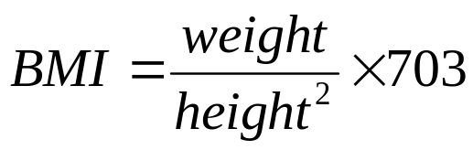
Nested if/else question
Formula for body mass index (BMI):
Write a program that produces output like the following:
  This program reads data for two people and
  computes their body mass index (BMI).
  Enter next person's information:
  height (in inches)? 70.0
  weight (in pounds)? 194.25
  Enter next person's information:
  height (in inches)? 62.5
  weight (in pounds)? 130.5
  Person 1 BMI = 27.868928571428572
  overweight
  Person 2 BMI = 23.485824
  normal
  Difference = 4.3831045714285715
BMI | Weight class
below 18.5 | underweight
18.5 - 24.9 | normal
25.0 - 29.9 | overweight
30.0 and up | obese
Notes:
// This program computes two people's body mass index (BMI) and
// compares them. The code uses parameters, returns, and Scanner.
import java.util.*; // so that I can use Scanner
public class BMI {
public static void main(String[] args) {
System.out.println("This program reads in data for two people and");
System.out.println("computes their body mass index (BMI)");
System.out.println();
// finish me!
}
}

Slide 11
Nested if/else answer
  // This program computes two people's body mass index (BMI) and
  // compares them. The code uses Scanner for input, and parameters/returns.
  import java.util.*; // so that I can use Scanner
  public class BMI {
  public static void main(String[] args) {
  introduction();
  Scanner console = new Scanner(System.in);
  double bmi1 = person(console);
  double bmi2 = person(console);
  // report overall results
  report(1, bmi1);
  report(2, bmi2);
  System.out.println("Difference = " + Math.abs(bmi1 - bmi2));
  }
  // prints a welcome message explaining the program
  public static void introduction() {
  System.out.println("This program reads data for two people and");
  System.out.println("computes their body mass index (BMI).");
  System.out.println();
  }
  ...

Slide 12
Nested if/else, cont'd.
  // reads information for one person, computes their BMI, and returns it
  public static double person(Scanner console) {
  System.out.println("Enter next person's information:");
  System.out.print("height (in inches)? ");
  double height = console.nextDouble();
  System.out.print("weight (in pounds)? ");
  double weight = console.nextDouble();
  System.out.println();
  double bodyMass = bmi(height, weight);
  return bodyMass;
  }
  // Computes/returns a person's BMI based on their height and weight.
  public static double bmi(double height, double weight) {
  return (weight * 703 / height / height);
  }
  // Outputs information about a person's BMI and weight status.
  public static void report(int number, double bmi) {
  System.out.println("Person " + number + " BMI = " + bmi);
  if (bmi < 18.5) {
  System.out.println("underweight");
  } else if (bmi < 25) {
  System.out.println("normal");
  } else if (bmi < 30) {
  System.out.println("overweight");
  } else {
  System.out.println("obese");
  }
  }
  }
Notes:
How would we round the BMI numbers?

Slide 13
Scanners as parameters
If many methods need to read input, declare a Scanner in main and pass it to the other methods as a parameter.
  public static void main(String[] args) {
  Scanner console = new Scanner(System.in);
  int sum = readSum3(console);
  System.out.println("The sum is " + sum);
  }
  // Prompts for 3 numbers and returns their sum.
  public static int readSum3(Scanner console) {
  System.out.print("Type 3 numbers: ");
  int num1 = console.nextInt();
  int num2 = console.nextInt();
  int num3 = console.nextInt();
  return num1 + num2 + num3;
  }

Slide 14
Logical operators
Tests can be combined using logical operators:
"Truth tables" for each, used with logical values p and q:
Operator | Description | Example | Result
&& | and | (2 == 3) && (-1 < 5) | false
|| | or | (2 == 3) || (-1 < 5) | true
! | not | !(2 == 3) | true
p | q | p && q | p || q
true | true | true | true
true | false | false | true
false | true | false | true
false | false | false | false
p | !p
true | false
false | true

Slide 15
Evaluating logic expressions
Relational operators have lower precedence than math.
    5 * 7 >= 3 + 5 * (7 - 1)
    5 * 7 >= 3 + 5 * 6
    35 >= 3 + 30
    35 >= 33
    true
Relational operators cannot be "chained" as in algebra.
    2 <= x <= 10
    true <= 10 (assume that x is 15)
    error!
  Instead, combine multiple tests with && or ||
    2 <= x && x <= 10
    true && false
    false

Slide 16
Factoring if/else code
factoring: Extracting common/redundant code.
  Can reduce or eliminate redundancy from if/else code.
Example:
  if (a == 1) {
  System.out.println(a);
  x = 3;
  b = b + x;
  } else if (a == 2) {
  System.out.println(a);
  x = 6;
  y = y + 10;
  b = b + x;
  } else { // a == 3
  System.out.println(a);
  x = 9;
  b = b + x;
  }
System.out.println(a);
x = 3 * a;
if (a == 2) {
y = y + 10;
}
b = b + x;

Slide 17
if/else with return
  // Returns the larger of the two given integers.
  public static int max(int a, int b) {
  if (a > b) {
  return a;
  } else {
  return b;
  }
  }
Methods can return different values using if/else
  Whichever path the code enters, it will return that value.
  Returning a value causes a method to immediately exit.
  All paths through the code must reach a return statement.

Slide 18
All paths must return
  public static int max(int a, int b) {
  if (a > b) {
  return a;
  }
  // Error: not all paths return a value
  }
The following also does not compile:
  public static int max(int a, int b) {
  if (a > b) {
  return a;
  } else if (b >= a) {
  return b;
  }
  }
  The compiler thinks if/else/if code might skip all paths, even though mathematically it must choose one or the other.

Slide 19
if/else, return answer
  public static int quadrant(double x, double y) {
  if (x > 0 && y > 0) {
  return 1;
  } else if (x < 0 && y > 0) {
  return 2;
  } else if (x < 0 && y < 0) {
  return 3;
  } else if (x > 0 && y < 0) {
  return 4;
  } else { // at least one coordinate equals 0
  return 0;
  }
  }

Slide 20
while loops

Slide 21
Categories of loops
definite loop: Executes a known number of times.
  The for loops we have seen are definite loops.
    Print "hello" 10 times.
    Find all the prime numbers up to an integer n.
    Print each odd number between 5 and 127.
indefinite loop: One where the number of times its body repeats is not known in advance.
    Prompt the user until they type a non-negative number.
    Print random numbers until a prime number is printed.
    Repeat until the user has types "q" to quit.

Slide 22
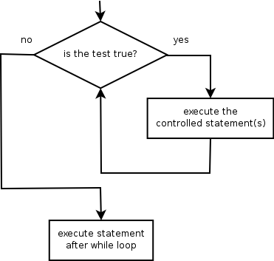
The while loop
while loop: Repeatedly executes its
body as long as a logical test is true.
  while (test) {
  statement(s);
  }
Example:
  int num = 1; // initialization
  while (num <= 200) { // test
  System.out.print(num + " ");
  num = num * 2; // update
  }
  // output: 1 2 4 8 16 32 64 128

Slide 23
Example while loop
  // finds the first factor of 91, other than 1
  int n = 91;
  int factor = 2;
  while (n % factor != 0) {
  factor++;
  }
  System.out.println("First factor is " + factor);
  // output: First factor is 7
  while is better than for because we don't know how many times we will need to increment to find the factor.

Slide 24
Sentinel values
sentinel: A value that signals the end of user input.
  sentinel loop: Repeats until a sentinel value is seen.
Example: Write a program that prompts the user for numbers until the user types 0, then outputs their sum.
  (In this case, 0 is the sentinel value.)
  Enter a number (0 to quit): 10
  Enter a number (0 to quit): 20
  Enter a number (0 to quit): 30
  Enter a number (0 to quit): 0
  The sum is 60

Slide 25
Flawed sentinel solution
What's wrong with this solution?
  Scanner console = new Scanner(System.in);
  int sum = 0;
  int number = 1; // "dummy value", anything but 0
  while (number != 0) {
  System.out.print("Enter a number (0 to quit): ");
  number = console.nextInt();
  sum = sum + number;
  }
  System.out.println("The total is " + sum);

Slide 26
Changing the sentinel value
Modify your program to use a sentinel value of -1.
  Example log of execution:
  Enter a number (-1 to quit): 15
  Enter a number (-1 to quit): 25
  Enter a number (-1 to quit): 10
  Enter a number (-1 to quit): 30
  Enter a number (-1 to quit): -1
  The total is 80

Slide 27
Changing the sentinel value
To see the problem, change the sentinel's value to -1:
  Scanner console = new Scanner(System.in);
  int sum = 0;
  int number = 1; // "dummy value", anything but -1
  while (number != -1) {
  System.out.print("Enter a number (-1 to quit): ");
  number = console.nextInt();
  sum = sum + number;
  }
  System.out.println("The total is " + sum);
Now the solution produces the wrong output. Why?
  The total was 79

