Slide 1
Arrays
Multidimensional array: an array of arrays, elements of which are accessed with multiple integer indexes
Defining a two-dimensional array:
double[][] temps = new double[3][5];
Rows & columns:
Think of two-dimensional array as a grid. The first bracket is the number of rows and the second bracket is the number of columns.

Slide 2
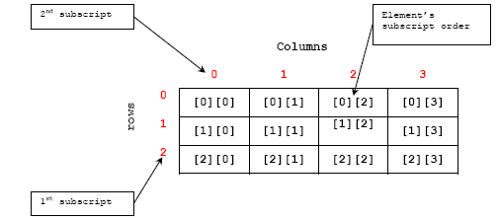
Array Picture

Slide 3
Arrays as parameters
Pass a two dimensional array similar to an array.
  public static void findMin (int[] listOfNum) {
  // find the lowest number in array
  }
  public static void findMin (int[][] grid) {
  // find the lowest number in grid
  }

Slide 4
Printing Arrays
Print a two dimensional array similar to an array.
  -System.out.println (Arrays.toString(temps));
  -System.out.println (Arrays.deepToString(temps));

