Slide 1

Video Game Take Over
Jasmine Brown; Andrea Constantinof, PhD; Torina Lewis, PhD
Clark Atlanta University, Hbcu Up Program

Slide 2
Introduction
Video games have been around for almost 70 years, capturing the mind of its users. There have been many popular upgrades and changes made to the counsels and disk. Video game purchases were primarily made in-store or ordered online. In today's market, gamers are now downloading and encountering matches with friends online. Although many factors influence the decline in the shipment of video games, we observe rank, critic score, and the video game platform as having a significant impact on video game shipping rates. Machine learning algorithms are created and used to predict the shipping rates of video games. Information in this study can be useful for companies that invent video games and stores that sell video games. Companies can alter product manufacturing to tailor their marketing efforts and stores can determine how much of particular products will be needed. The techniques described have the ability to increase revenue.

Slide 3
Research Question
Which variables impact the shipment of video games?

Slide 4
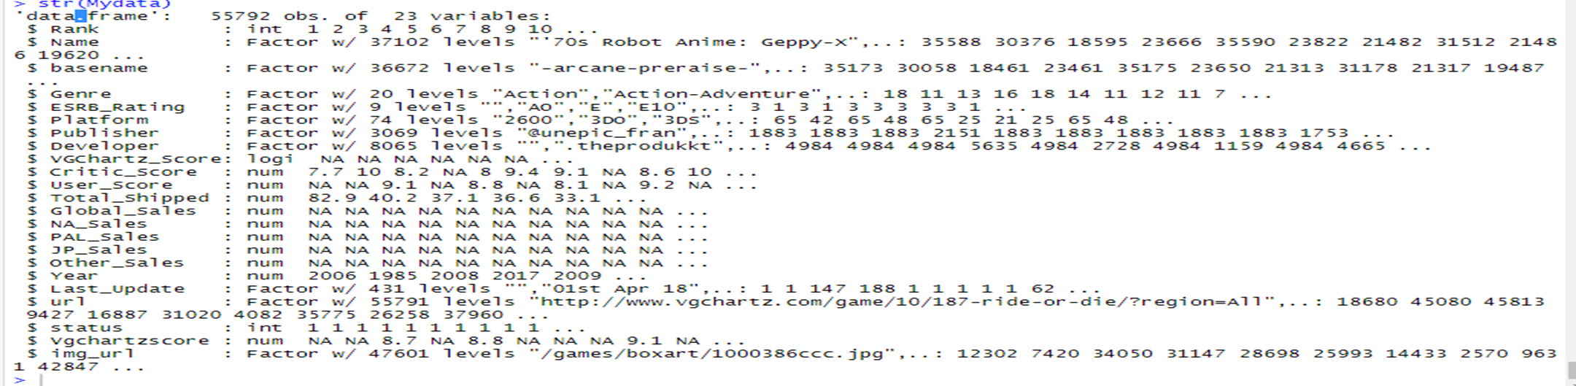
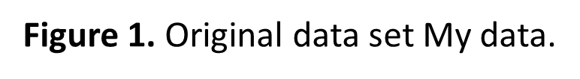
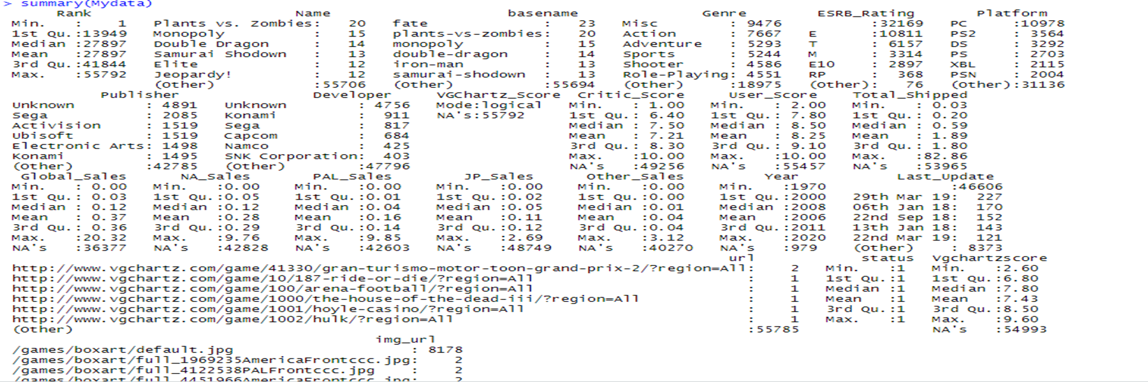
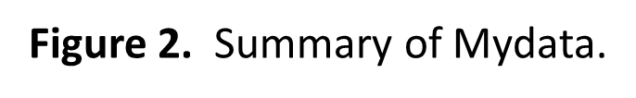
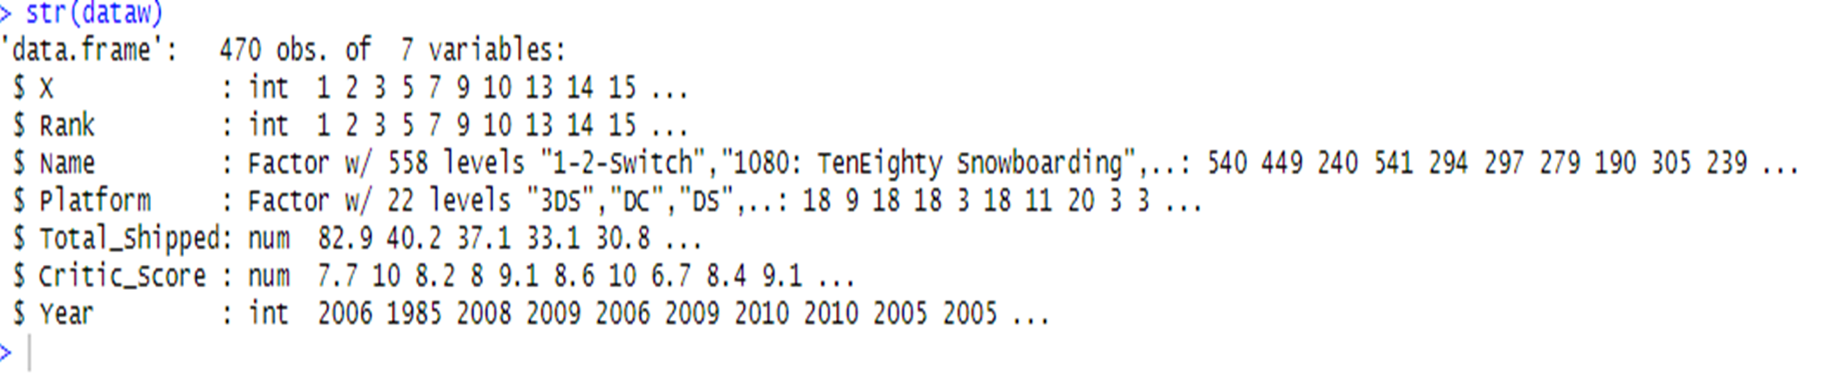
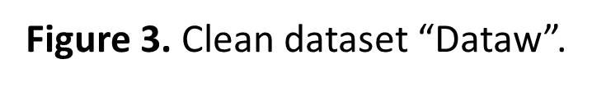
Data Sets

Slide 5
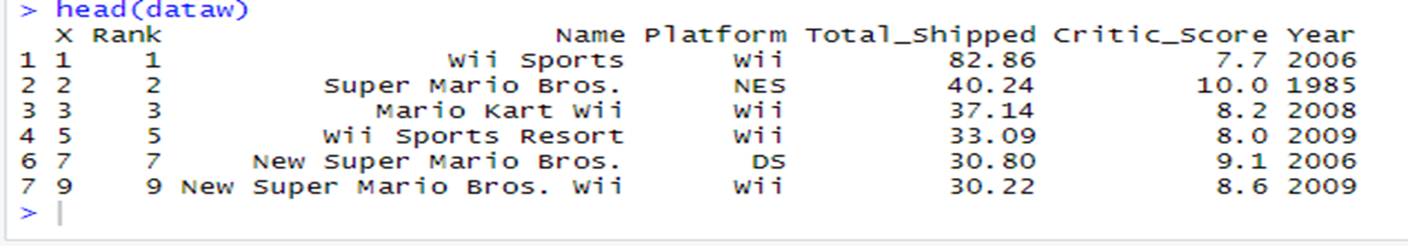
Methods: Data Wrangling
Data wrangling is one of the most important components of data science. It is the process used to map raw data to a format appropriate for the data to be analyzed. The original data set selected for the study contained 23 variables and 540,000 observations. Packages in RStudio serves as templates for simplifying the computer code. Dplyr, plyr, tidyr were the packages used in the data wrangling process. Data wrangling techniques used in this research were selecting, indexing, and mutating data to obtain a clean data set. The clean data set included 6 variables and 586 observations.

Slide 6
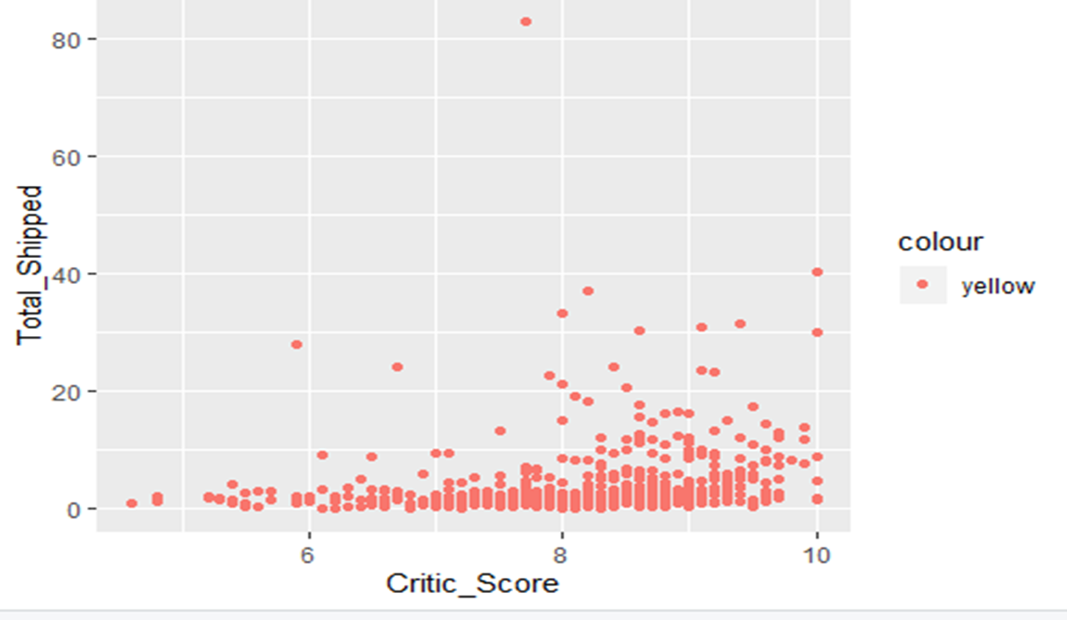
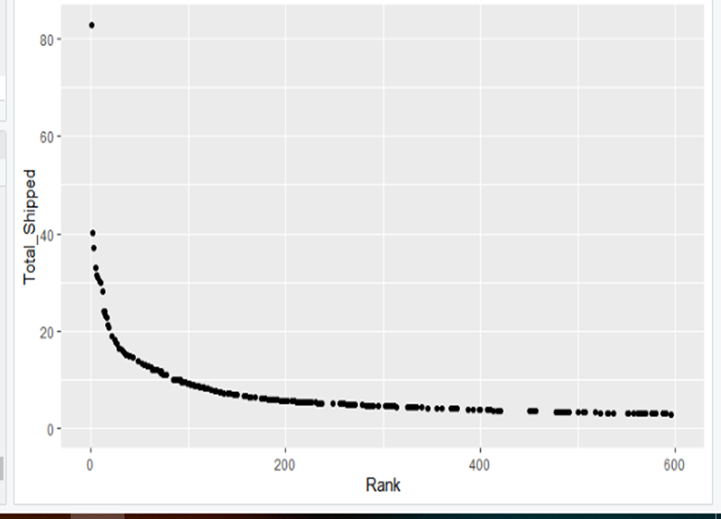
Methods: Statistical Analysis
Figure 4: Shows the Relationship between Rank and total shipped. This relation is significant because the lower the rank the higher the total shipped.
Figure 5: Shows the relationship between the critic score and total ship. This relationship seems to be positively correlated. There is a resemblance of a line between the variables. It is determined that the Wii has the most games shipped.

Slide 7
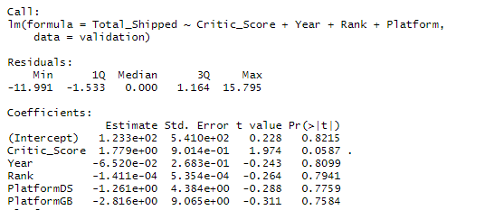

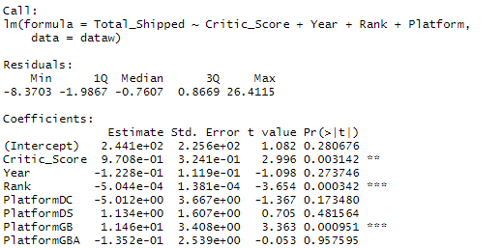

Machine Learning
The plot and models are now created for the understanding of the data. Since my dependent variable is a numerical value, linear regression will be used for the machine learning technique. Total shipped is the dependent variable used the remainder of the variables independent. Before the linear model was created, we had created a training and testing data set. The training data set includes 80% of the data and the testing data set contains 20% of the data. The overall p-value for the model is statistically significant. To measure the accuracy of the model, we used cross-validation. The training data was split into 5 parts randomly. Similar results were found. Figure 8 is the model for the training set, and figure 9 is the model with the validation set.

Slide 8
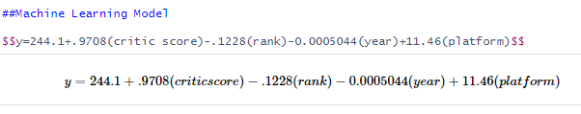
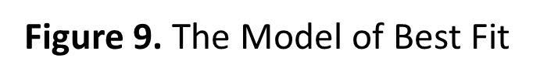
Results
Figure 8 shows that the critic score, rank, platform, are significant variables to predict the total shipped because the p-value is between 0 and 0.001. The Overall p-value for the model is significant. A lower p-value determines that the variable is statistically significant. The multiple R square is 0.375. This variable show how close the independent variables are close to the line of best fit. The closer R squared is to 1, the better the model is. Therefore, this model can be better. The Root mean squared error is an average of the variance. This number is based on the units of your independent variable. It can range from 0 to any infinity. The smaller the number, the better the model. My RMSE is 4.379 this this low compared to the highest number of total shipped. Overall all the cross validation, training, and testing models give approximately the same R squared value. Thus this model is useful in predicting the total shipped but can be better.

Slide 9
Acknowledgements
I would like to acknowledge my faculty mentor, Dr. Torina Lewis for her expressed support, and the HBCU-UP. I would also like to thank Dr. Andrea Constantin, my data science mentor for all her guidance and support. This research opportunity was sponsored by the National Science Foundation, award number 1700408 and 1818682.

Slide 10
References
Kirubi, Rush. “Video Game Sales with Ratings.” Kaggle, 30 Dec. 2016, www.kaggle.com/rush4ratio/video-game-sales-with-ratings.

