Slide 1

Semi-supervised Learning Survey - 20 years of evaluation
Subarna Chowdhury Soma
SJSU ID: 014549587

Slide 2
Paper
A survey on semi-supervised learning
Jesper E. van Engelen &Holger H. Hoos
Received: 3 December 2018 / Revised: 20 September 2019 / Accepted: 29 September 2019 /
Published online: 15 November 2019

Slide 3
Overview
Semi-supervised learning
Basic Concepts and Assumptions
Taxonomy of Semi-supervised learning methods
Semi-supervised learning methods
Conclusions and future scope

Slide 4
Semi-supervised Learning
In supervised learning, one is presented with a set of data points consisting of some input x and a corresponding output value y. The goal is, then, to construct a classifier or regressor that can estimate the output value for previously unseen inputs
In unsupervised learning, no specific output value is provided; goal is to infer some underlying structure from the inputs
Semi-supervised learning is about making use of unlabeled data. It is useful when the available labeled data is small.Unlabeled data is cheap Although not every type of unlabeled data is useful

Slide 5
Basic Concepts and Assumptions
Assumptions of semi-supervised learning
An important pre-condition of semi-supervised learning is that the underlying data distribution, p(x), contains information about the posterior distribution p(y|x). Considering this condition, we can use unlabeled data to gain information about p(x), and thereby about p(y|x).
The smoothness assumption : if two samples x and x1 are close in the input space, their labels y and y1 should be the same
The low-density assumption : the decision boundary should not pass through high-density areas in the input space
The manifold assumption : same low-dimensional manifold datapoints should have the same label

Slide 6
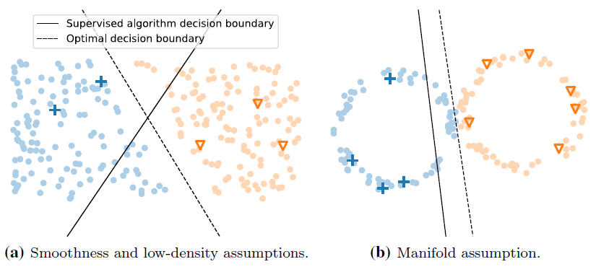
Illustrations of the semi-supervised learning assumptions.

Slide 7
Basic Concepts and Assumptions
Connection to Clustering
According to Chapelle et al. 2006b, data points that belong to the same cluster come from the same class. This assumption is called the semi-supervised learning assumption of clusters.

Slide 8
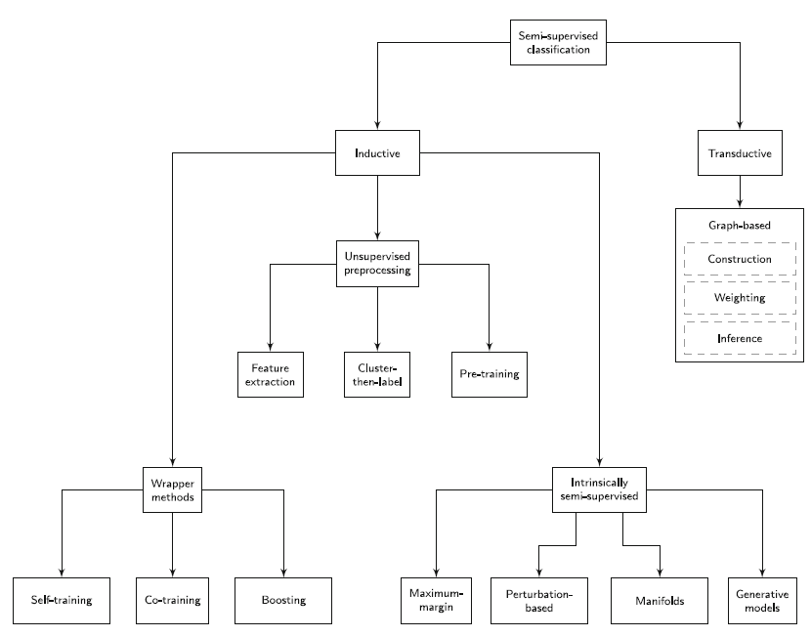
Taxonomy of Semi-supervised learning methods

Slide 9
Inductive methods
Inductive methods build a classifier to generate predictions for any point in the input space
To train the classifier, unlabeled data can be used.
Once, a model is built from the training phase and later can be used to predict the new data point labels.

Slide 10
Inductive methods
1. Wrapper methods
2. Unsupervised pre-processing
3. Intrinsically semi-supervised

Slide 11
1. Wrapper methods
In the training step, one or more supervised classifiers are trained using the labeled data and pseudo-labeled data from earlier iteration steps.
Next, to infer labels from the previously trained unlabeled data, the resulting classifiers are used in the pseudo-labeled step.
Most confident predictions are used as the pseudo-label at the next iteration.

Slide 12
1. Wrapper methods
1. 1 Self-training:
This approach uses one supervised classifier that is re-trained iteratively based on its most confident predictions
1.2 Co-training:
Here classifiers are iteratively re-trained on the most confident predictions of each other
For co-training to succeed, the classifiers are supposed to be adequately different
1.3 Boosting:
Like conventional boosting methods, they build ensemble classifiers by sequentially building individual classifiers
Moreover, each individual classifier is trained using both the labeled data and the most confident predictions of previously trained unlabeled data like before

Slide 13
2. Unsupervised pre-processing
Unsupervised preprocessing, either extract useful features from unlabeled data, pre-cluster the data or use an unsupervised manner to compute the initial parameters of a supervised learning procedure

Slide 14
2. Unsupervised pre-processing
2. 1 Feature Extraction:
These methods try to find a transformation of the input data that helps to improve classification and makes it computationally efficient
2.2 Cluster-then-label:
Cluster-then-label procedures form a group of methods that explicitly join the clustering and classification processes
At first, it uses an unsupervised or semi-supervised clustering algorithm to all the input data, and then use the resulting clusters lead the classification process
2.3 Pre-training:
This approach naturally fits in deep learning areas where each layer of the hierarchical model is a latent representation of the input data.
In pre-training methods, a decision boundary is conducted by unlabeled data before applying supervised training

Slide 15
3. Intrinsically semi-supervised
Here unlabeled data is directly incorporated into the objective function or optimization procedure of the learning part.
Most of these methods are direct extensions of supervised learning methods by transforming objective functions to include unlabeled data.

Slide 16
3. Intrinsically semi-supervised
3. 1 Maximum Margin:
These methods aim to maximize the distance between the given data points and the decision boundary
The semi-supervised low-density assumption is the basis of these approaches
3.2 Perturbation-based:
The perturbation-based methods directly incorporate the smoothness assumption.
This concept implies that when a data point is perturbed with a small amount of noise, the predictions for noisy and clean inputs should not be different

Slide 17
3. Intrinsically semi-supervised
3.3 Manifolds:
According to the manifold assumption: (a) the input space is composed of multiple lower-dimensional manifolds on which all data points lie and
(b) data points sharing the same lower-dimensional manifold have the same label
3.4 Generative Models:
Generative approaches model the process that generates data.
For classification problems, a generative model is conditioned on a given y label.

Slide 18
Transductive methods
Transductive algorithms do not produce a predictor that can operate over the entire input space
Actually, transductive methods yield a set of predictions for the provided unlabeled data.
Therefore, a training phase and a testing phase are not distinguishable
Some well-established transductive graph-based methods are:
General framework for graph-based methods,
Inference in graphs,
Probabilistic label assignments: Markov random fields

Slide 19
Future scope
1. One important issue to address in near future is, possible performance degradation caused by the introduction of unlabeled data. Limited supervised techniques only perform better than their supervised counterparts or base learners in specific cases (Li and Zhou 2015; Singh et al. 2009).
2. Recent studies have shown that perturbation-based methods with neural networks consistently outperform their supervised counterparts. This flexibility of using considerable advantage of using neural networks should be explored more and should gain more popularity in the field of semi-supervised neural networks.
3. Recently, automated machine learning (AutoML) has been used widely to achieve the robustness of the models. These approaches include meta-learning and neural architecture for automatic algorithm selection and hyperparameter optimization. While AutoML techniques are successfully being used to supervised learning, there is a lack of improvement of research in the semi-supervised field. This field should be studied more to bring striking results to semi-supervised approaches.

Slide 20
Future scope
4. Another important step towards the advancement of semi-supervised approaches are having standardized software packages or library dedicated to this domain. Currently, some generic packages like the KEEL software package do exist that include a semi-supervised learning module (Triguero et al. 2017).
5. One vital sector that needs serious attention from researchers is building a strong connection between clustering and classification. Essentially, both approaches are a special branch of semi-supervised, where either only labeled or unlabeled data is considered. The recent hype in generative models can be seen as a good sign to address this field.

Slide 21
Key References:
J. E. van Engelen and H. H. Hoos, “A survey on semi-supervised learning,” Machine Learning, vol. 109, no. 2, pp. 373–440, feb 2020.
Bengio, Y., Delalleau, O., & Le Roux, N. (2006). Chapter 11. Label propagation and quadratic criterion. In O. Chapelle, B. Schölkopf, & A. Zien (Eds.), Semi-supervised learning (pp. 193–216). Cambridge: The MIT Press.
Bengio, Y., Delalleau, O., & Le Roux, N. (2006). Chapter 11. Label propagation and quadratic criterion. In O. Chapelle, B. Schölkopf, & A. Zien (Eds.), Semi-supervised learning (pp. 193–216). Cambridge: The MIT Press.
Goldberg, A. B., Zhu, X., Singh, A., Xu, Z.,&Nowak, R. D. (2009).Multi-manifold semi-supervised learning. In Proceedings of the 12th international conference on artificial intelligence and statistics (pp. 169–176).
Haffari, G. R., & Sarkar, A. (2007). Analysis of semi-supervised learning with the Yarowsky algorithm. In Proceedings of the 23rd conference on uncertainty in artificial intelligence (pp. 159–166).

Slide 22
Thanks

