Slide 1
Software Specification and Design
Sirisin Kongsilp & James Brucker

Slide 2
Subject of the Course
Software Specification & Design

Slide 3


Subject of the Course
Software Specification and Design
Specification of what?
How do you know if your design works?
Is it what the customer wants?

Slide 4
New Subject of the Course
Software Specification and Design
Requirements and
Analysis and
and Implementation
and Testing
and Documentation
and Process

Slide 5
Content
Topics of study
  Will follow the textbook (see next slides).
Software Projects
  Point-of-Sale (POS) system - from textbook
  Requirements, UI, features differ from textbook
Case Studies
  From Head First O-O Analysis & Design
  Design principles & patterns practice
How to do a Project following a Process
  using Unified Software Development Process (UP)

Slide 6
Topics
Software Processes
  just enough “process” for this course
  intro to Waterfall and UP processes
Iterative & Evolutionary Approach to Software
  Emphasis on Analysis, Specification, and Design
Discovering and Documenting Requirements

Slide 7
Topics
Analysis and Modeling
  Analyze Requirements
  Domain Modeling
  Implementation Modeling
  UML as visual modeling tool

Slide 8
More Topics
Design a solution
  Principles to guide design decisions
  Design Patterns
Validation: testing and review
Documentation: project, process, and many others
Technology & Tools
  issue tracking
  version control
  software API & frameworks (JPA, Log4J, ...)

Slide 9
This Course & Development Lifecycle
The workflows:
  requirements
  analysis
  design
  implementation
  testing
  configuration management
  project management
  environment (tools)
  deployment
Emphasis here
but we do these, too

Slide 10
Skills to Learn
Analysis & Design using OO Design Principles
Design Patterns - recognize when to apply
Technology for:
  Authentication and Authorization
  Data Persistence (JPA)
  Frameworks
  Version control
  Issue tracking
  Reverse engineering of UML from code
  Lots of Java
Learn to follow a process as part of a team

Slide 11
Required Level of Study
Reading: about 60 pages per week
Doing: project work each week
Writing: grammatically correct English documents
Individual Effort:
your grade is based on your effort and performance
Time Commitment:
9-12 hours per week outside of class

Slide 12
Learning
Read assigned material before class each week.
Take notes: summarize important points.
Participate in discussions.
Avoid distraction: don't play games or chat in class or lab.
  Anyone who does will be asked to leave.

Slide 13

Main Textbook
“People often ask me which is the best book to introduce them to OO design.
... Applying UML and Patterns has been my unreserved choice.”
-- Martin Fowler
700 Baht at KU Books (discount for this course).

Slide 14
Main Textbook
If you don't read this book,
you will not pass this course.

Slide 15

Other Books
For OO Design Principles, we will use this (only some chapters).
Amusing case studies make it easy to remember the principles.

Slide 16
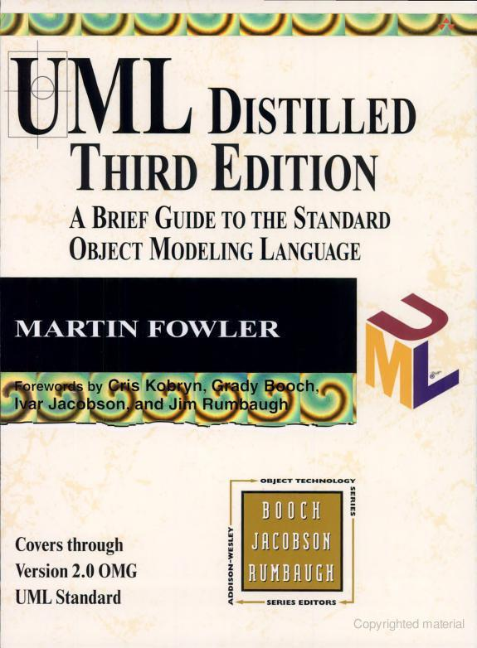
Other Books
For learning UML.
Chapter 2 is good intro to software process.

Slide 17





Using the Textbook
Easy to read, but written for developers
Agile UP Inception is not Waterfall Requirements phase... involve Stakeholders ... Risk ...
what
???
Craig Larman

Slide 18
Textbook
Strengths:
  Excellent for O-O Analysis and Design
  Emphasizes iterative development
  Author conveys real-world experience
Weaknesses:
  Fuzzy about process and how docs fit together.
  Bias towards Agile methods.
  Some gaps you have to research for yourself.
  Redundant

Slide 19
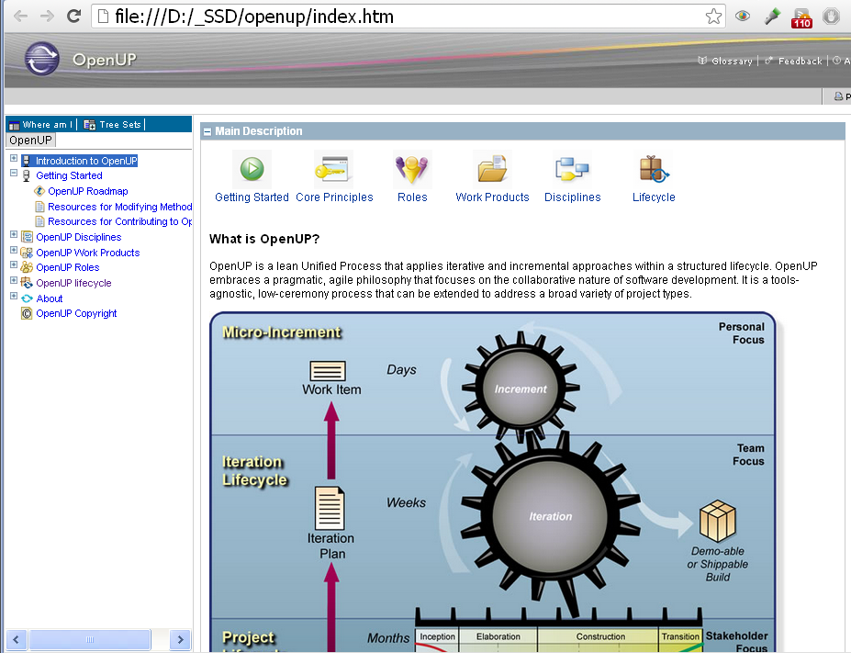
Other Resources
Online RUP and OpenUP Process Frameworks
guidance
templates
descriptions

Slide 20
Other Resources
Class Web & Wiki
Articles - occasional, famous articles
Templates - for documents you will write
Examples
You can contribute to Wiki
Teaching Assistants
TBA
Contact them as much as you like!

Slide 21
No Lecture Slides
Do you want a PowerPoint education?
    slides lack depth and detail
Slide material is in Textbooks and Other Resources.

Slide 22
Locations
Class Wiki:
http://se.cpe.ku.ac.th/wiki
(links to course on main page)
Course Materials:
http://se.cpe.ku.ac.th/219243
SVN: http://se.cpe.ku.ac.th/svn/219243
Downloads and Resources (UP, Books, Tools):
http://se.cpe.ku.ac.th

