Slide 1
Requirements

Slide 2
Develop A Vision
Gain agreement on the problem to solve
Identify stakeholders
Define system features and function
Define system boundaries
Identify constraints on the system

Slide 3
Develop Requirements
Should we try to specify all the requirements at beginning of a project?
Why?

Slide 4
Problem with early complete req'ts
In a study of projects that use waterfall style, complete requirements they found...
what % of the features were never used?
what % of the features were used rarely?

Slide 5
Changing Requirements
On average, what % of the requirements will change?

Slide 6
When do requirements in UP?
In the UP, in what phase(s) are requirements gathered and written?

Slide 7
Do you remember this?
Time
Phases
Process Workflows
Inception
Elaboration
Construction
Transition
Business Modeling
Requirements
Analysis & Design
Implementation
Test
Deployment
Supporting Workflows
Configuration Mgmt
Management
Environment
Preliminary
Iteration(s)
Iter.
#1
Iter.
#2
Iter.
#n
Iter.
#n+1
Iter.
#n+2
Iter.
#m
Iter.
#m+1
Iterations

Slide 8
Unified Process
Unified Software Development Process
... Rational Unified Software Development Proc.
Rational Software... bought by IBM
Why "Unified" process?
Waterfall - not the original name by Royce
Spiral Method - by Boehm
Booch method by Grady Booch
Object Modeling Technique by James Rumbaugh
Objectory and Use Cases by Ivar Jacobsen

Slide 9
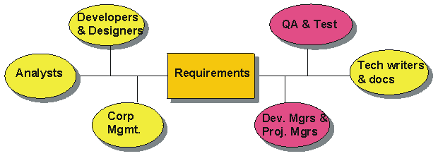
Important Requirement Concepts
Types of requirements (FURPS+)
Characteristics of good requirements
How to elicit
How to document
Verify requirements
Manage requirements
Tracability

Slide 10
Requirements Goals: CMMI Guidelines
SG 1: Develop Customer Requirements
Stakeholder needs, expectations, constraints, and interfaces are collected and translated into customer requirements.
SG 2: Develop Product Requirements
Customer requirements are refined and elaborated to develop product and product-component requirements.
Notes:
State the goals. State that there are 3 specific goals in the Requirements Development PA. Discuss the goal statements. Ask the students to find the 3 specific goals in the book.
Remind the students that the process area also has generic goals. Ask the students to find the generic goals in the book.
Use this process area as a vehicle to have the students find process area components.

Slide 11
Requirements Goals: CMMI Guidelines
SG 3: Analyze and Validate Requirements
The requirements are analyzed and validated, and a definition of required functionality is developed.
Notes:
State the goals. State that there are 3 specific goals in the Requirements Development PA. Discuss the goal statements. Ask the students to find the 3 specific goals in the book.
Remind the students that the process area also has generic goals. Ask the students to find the generic goals in the book.
Use this process area as a vehicle to have the students find process area components.

Slide 12
Types of Requirements
What does "FURPS" mean?

Slide 13
FURPS
Give an example of each type:
Functional
Usability
Reliability aka "Dependability"
Performance
Supportability

Slide 14
FURPS
Give an example of each type:
Functional | Create sales report Process sale
Usability | Display should be readable at a distance of 1 meter
Reliability aka "Dependability" | The application should never crash
Performance | Returns reply to query within 1 second 99% of the time under normal load.
Supportability | Can be used on any computer supported by Java SE 6 or newer with at least 1GB RAM.

Slide 15
FURPS+
What does the "+" mean?

Slide 16
Some "+" requirement types
implementation | language and tools, resource limits
interface | must interface with other systems
operations | managing the software after its installed
packaging | media, box
platform | OS, hardware; can be part of "Supportability".
legal | licensing issues, liability
Larman, section 5.4 and 7.4

Slide 17
Give examples
implementation
interface
operations
packaging
legal
Larman, section 5.4

Slide 18
Classify these requirements
POS should be written in Java.
The display should be readable by person of normal eyesight at a distance of 1 meter.
Must be able to process sales and refunds.
Must be able to control a cash drawer the adheres to JavaPOS standard. The cash drawer manufacturer shall provide a driver written in Java.
should have GUI management interface for managing user accounts, connection to store's product catalog, and examining logs.

Slide 19
Classify these Requirements
Must run on Linux supported by Java SE 5.0 or newer.
If network connection to the store product catalog is down, the POS should still be able to process sales using (a) recently cached product data, and (b) manual key-in of prices by POS operator.

Slide 20
Documenting Requirements
In what form are they written?
What documents are related to requirements?
(Larman, 5.5)
  use case model (mostly functional req.)
  supplementary requirements specification
  glossary, data dictionary
  business rules

Slide 21
Eliciting Requirements
What are some techniques for finding requirements?

Slide 22
Eliciting Requirements
Actively Involve Customer & Stakeholders
Interviews
Joint Application Development (JAD)
Brain storming
Vision
Other techniques
Observation
Procedure manuals
Interfaces - how it connects to other systems

Slide 23
Requirements Activities
From Bruegge (OOSE):
identify stakeholders
identify scenarios: concrete examples of how the system is used... or will be used
learn about existing system -- observation, interview, procedure manuals, workflow
develop use cases: considate scenarios.
Use cases define the scope of the project
identify relationships between use cases
identify non-functional requirements

Slide 24
Why Manage Requirements?
Why?

Slide 25
Manage Requirements
Agree on how and where requirements will be written
Procedure for how a requirement is reviewed and accepted
Procedure for requirement change requests
The impact of changing a requirement should be studied
  what work products need to change?
  what is effect on other requirements?
  how much will it cost?
Review impact with stakeholders and get sign-off

Slide 26
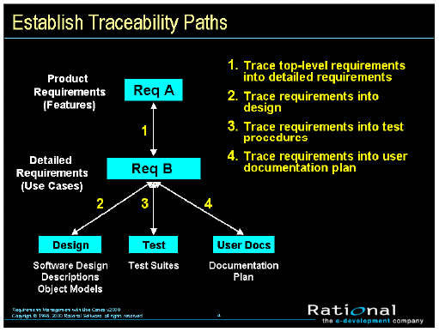
Requirement Tracing

Slide 27
Writing Requirements
What is a Use Case?
Why write requirements as Use Cases instead of a list of required features?

Slide 28
Guidelines for Writing Use Cases
See Larman, chapter 6-7
See Cockburn, Writing Effective Use Cases (ebook), the first few pages.

Slide 29
Guidelines for Good Requirements
What are some criteria for good requirements?

Slide 30
Good Requirements
Clear
  both client and developers can understand
  use domain terms
Unambiguous
Consistent
Unique - no redundancy
Feasible
Testable or verifiable
Customer needs, not implementation details

Slide 31
What's wrong with these requirements?
The system should be able to handle many simultaneous users.
The system should never crash.
The UI should not be coupled to the Tax Adapter class
Hardware requirements for server are:
  Intel Quad Core 2.4 GHz cpu
  4GB DDR400 memory
  minimum 160GB serial ATA disk drive

Slide 32
Advantages of Use Cases
Client can understand and contribute.
Requirements are in context -- a usage pattern or a story
client describes needs as a story.
help grou related requirements together
help avoid forgetting requirements
help identify non-functional requirements
easier to specify alternatives
alternative paths help make the system more robust.

Slide 33
Use Case Guideline 1
Each step in use case should be:
1. interaction between actor and system, or
2. action performed by system
  do something that changes state of system
  verify something
1. cashier enters item code 2. pos displays item description and price | 1. cashier needs to enter barcode 2. there are many items in the inventory

Slide 34
Use Case Guideline 2
Use concise wording. Omit words like "the", "a" or verbose descriptions.
1. cashier enters item code 2. pos displays item description and price | 1. The cashier locates the barcode symbol on the item and enters the item's barcode into system 2. The POS appends a line showing item description, unit price, and item subtotal

Slide 35
Use Case Guideline 3
Write use cases in terms of intention.
Avoid:
User Interface details
implement specific wording
1. cashier enters item code 2. cashier authenticates himself to system | 1. cashier scans the stock code 2. cashier types in login and password

