Slide 1
Testing Exercises

Slide 2
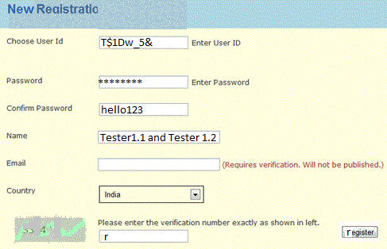
List the Defects on this Page
Include bad web design, readability, grammar. 5 minutes.
#Defects
0 – 4: Try harder
5 – 6: Average
7 – 8: Good
9 – 10: Excellent
10+: You're a Tester!
Image is on lms.ku.ac.th, Week 7 item.

Slide 3
Defects
Web Page Visual Issues
Background color is not uniform in the title
"Enter User ID" and "Enter password" text is redundant. Change to tooltip text or delete.
No explanation of what characters are allowed in user id or password.
Captcha is hard to read.
Lines are not uniformly spaced (excess space after Choose userid line).
"register" button should be at bottom, not to the right edge.
* Name, Email, Country should come before user id and password.
"Please enter the verification number" is wrong – captcha not a number. "in left" => "at left".
Content
Text ‘Registration’ is misspelled.
"Required" is misspelled.
*register" should have capital "R" and font is inconsistent.
"Confirm password" field shows password as plain text. Should be encrypted.
"Name" input field has no apparent limit on length of name.
Controls
No button to request a new captcha.
No "cancel" button.

Slide 4
Source
http://www.softwaretestinghelp.com/software-testing-exercises-to-test-your-skills/

Slide 5
Triangle Program
Write test cases for the following exercise.
Work in group of 2, or alone if you prefer.
Group of 3 is not OK.
Do not consult or copy from other groups.
Write your answer on paper or in Google Docs.
For exercise 2, please use a table:
Test Description | example input | expected output
Valid equilateral triangle (a = b = c) | 1, 1, 1 1000, 1000, 1000 | equilateral
Test if app accepts f.p. values | 1000, 1.0e3, 9.2E-2 | isoceles

Slide 6
Triangle Program
A program reads 3 numbers from the input. The numbers are lengths of sides of a triangle.
The program computes the type of triangle and prints:
equilateral if all sides are equal length
isosceles exactly two sides are equal length
right a right triangle (has 90 degree angle)
scalene three unequal sides
not a triangle lengths are not a valid triangle

Slide 7
Find the Defects
1. Find at least 3 defects in this specification.
2. Design test cases:
  group test cases into equivalence classes:
  inputs that can be expected to produce the same qualitative result. E.g. 2, 2, 2 and 50, 50, 50
  test boundary cases
  domain test cases - validate domain of inputs
  diabolical (weird, evil, malicious) test cases
Time Limit: 15 minutes

Slide 8
Typical Answer
Test for a valid scalene triangle
Test for a valid equilateral triangle
Three test cases for valid isosceles triangles (a=b, b=c, a=c, remaining side different)
One, two or three sides has value 0 (5 cases)
Any one value is negative
Sum of two numbers equals the third (e.g. 1,2,3) is not a triangle: try with 3 permutations a+b=c, a+c=b, b+c=a
Sum of two numbers is less than the third, e.g. 1,2,5. Try 3 permutations.
Non-integer values
Too few values
Too many values
Non-numeric values (1, two ,3)
Diabolical: 3E200, 4E200, 5E200 or (for the patient)
300000...00000 4000000...00000 5000000...00000

Slide 9
List your tests not in "typical tests".

