Slide 1
Reviews

Slide 2
Kinds of Reviews
Inspection
Code Review - Inspection of Code
Technical Review
Walk-through
Desk check
Self-review

Slide 3
Inspection
This is the most formal kind of review.
Purpose: find defects.
How To:
1. Choose work product to inspect.
2. Choose 4-5 people, including a moderator
3. Prepare: Everyone reads the work product in advance and notes suspected defects.
4. Inspection meeting: confirm defects & log them
Inspections may proposal correction (e.g. words in document)
5. Rework: author fixes defects from inspection log

Slide 4
Inspection Meeting
Moderator guides inspectors through work product.
Ask inspectors for defects.
Other inspectors (and author) confirm each defect, or discuss why they disagree.
Inspectors agree on fix (for document) or leave it to author to fix (code).
Record each defect in log.
Purpose is not for author to teach or explain.
Everyone must objectively examine the work

Slide 5
After the Inspection
Rework: author fixes the work product.
Follow-up: inspectors individually review the revised work and approve or not approve it.
Acceptance: once all inspectors approve, the work product is accepted.

Slide 6
Inspection is NOT...
Review of style
Attempt to improve or optimize design (*)
Evaluation of the author
Subjective evaluation of quality
(*) Infosys: inspectors use a separate form to record comments, offer insights and ideas.

Slide 7
Is Inspection Worth the Time?
Inspection involving 5 people & takes 10-20 man-hours, about half the time is preparation.
Inspection finds 5 - 10 defects, on average.

Slide 8
Defect Injection and Detection
Injected
Detected without Inspections
New Gap
Detected with Inspections
25
20
Gap
15
Defects/KLOC
10
5
0
START
REQ
HLD
LLD
CODE
UT
IT
ST
SHIP
Activity
Source: Ron Radice , ‘Software Inspections:Past, Present, and Future.’, Software Technology Conference, Salt Lake City, Utah, May, 2001

Slide 9
Cost of Defect Removal
Defects found
Low Maturity
CMM 1
Mature
CMM 3
Very Mature CMM 5
Removal Cost $25 $105 $385 $620 $1150 $6500
Source: B. Boehm, 1981 and C. Jones, 1990
Notes: 1. A defect found at requirement phase costs $25 to fix.
If the same defect is found at Unit Testing, the cost will be $620
2. UT= Unit Test
SIT/SAT= System Integration & Test/System Acceptance Test

Slide 10
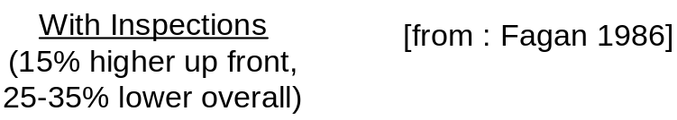
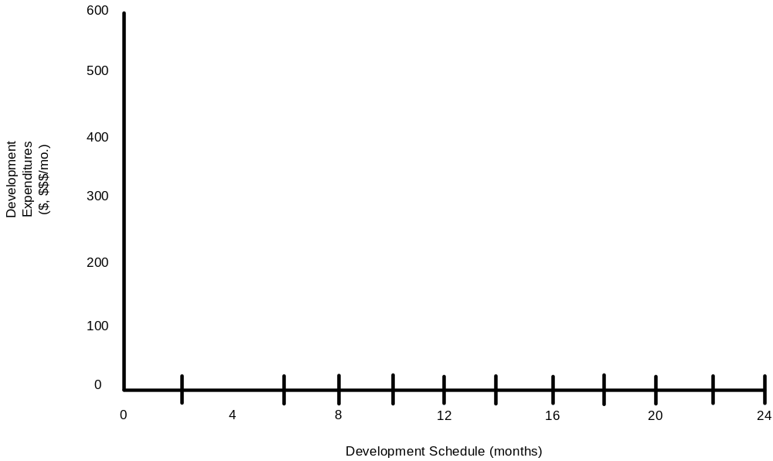

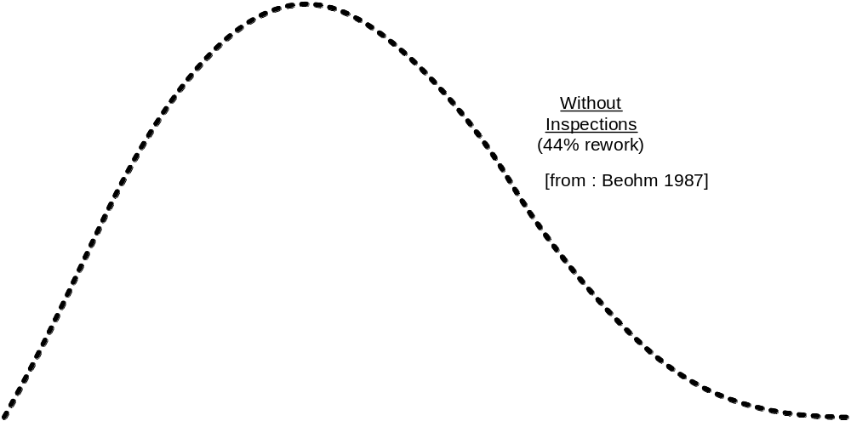
Software Development Spending Profiles
Development
Expenditures
($, $$$/mo.)
Without Inspections
44% rework
Boehm 1987
Source: The Institute of Electrical and Electronics Engineers (IEEE)

Slide 11

Benefit Ratio of Inspection
Before Review/Inspection
After Implemented Review/Inspection
19%
Reduce 31%
in rework
12%
Rework Effort
8%
3%
4%
1%
Req. Design Code Test Post-Release
Formal Review/Inspection increased design effort by 4%
Decreased rework effort by 31%
Source: Vu, J., ‘Software Process Improvement Journey’, 8th Software Engineering Process Group Conference San Jose, California March, 1997.

Slide 12
Percentage of Rework on Projects
TRW 30% (Boehm ,1987)
NASA-SEL 40% (McGarry, 1987)
Hewlett-Packard 33% (Duncker, 1992)
Raytheon 41% (Dion, 1993)
Rework = Waste or Scrap

Slide 13
Conclusion:
Inspection Saves Time & Money

Slide 14
How Much Time?
Inspection Type
Checking Rate
Logging Rate
Architecture
2 – 3 Pages Per Hr (PPH)
2 - 3 PPH
Requirements
2 - 3 PPH
2 - 3 PPH
Preliminary Design
3 – 4 PPH
3 – 4 PPH
Detailed Design
3 – 4 PPH
3 – 4 PPH
Source Code
100 – 200 LOC Per Hour (LPH)
100 – 200 LPH
Test Plan
5 – 7 PPH
5 – 7 PPH
Fixes and Changes
50 – 75 LPH
50 – 75 LPH
User Documentation
8 – 20 PPH
8 – 20 PPH
Source: Radice, ‘High Quality Low Cost Software Inspections’, 2002.

Slide 15
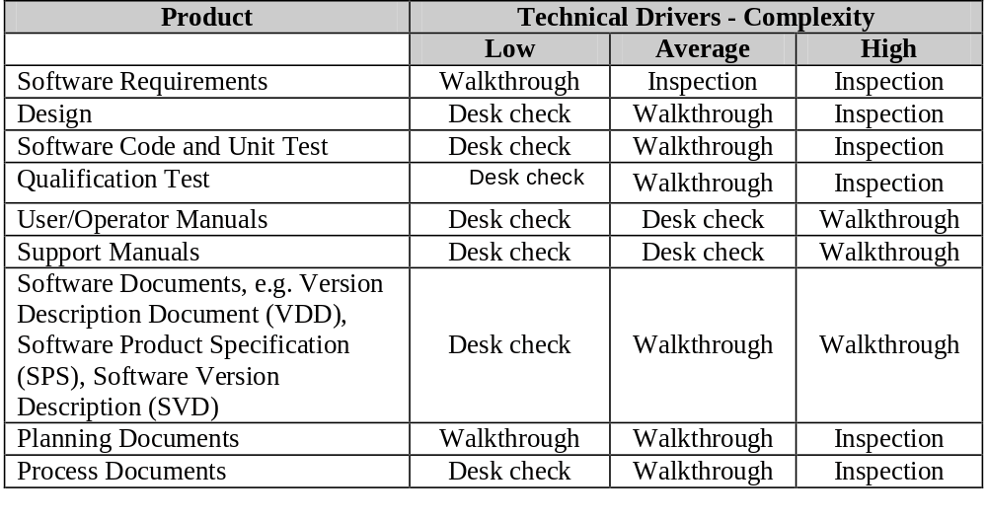
What to Inspect?
Source: Prof. Claude Laporte, U. of Quebec, Dept of Software and IT Engineering

Slide 16
Example Inspection Form

Slide 17
Code Review
Inspection of Code.
Special Characteristics of Code Review:
  Focus on finding defects, not on fixing them.
  Inspectors should be skilled & knowledgable of technology.
  Don't discuss alternatives or ideas.
  May refactor code during inspection to make it more readable, and find more defects.

Slide 18
Walk-through
The author of software product "walks" a small group through the software.
Purpose:
  find defects
  review conformity to standards
  improve the software
  consider alternative implementations
  share knowledge
  train participants
Record:
  log defects, non-conformance, summary of ideas (SAD)

Slide 19
Checklist
Inspections should use a checklist.
Contents of checklist depend on kind of thing being inspected!
Self-review and desk check more effective if you have a checklist. But its not required.

Slide 20
Example Checklist
Requirements Specification (RS)
RS 1 (TESTABLE) – All requirements are verifiable (objectively)
RS 2 (TRACEABLE) – All requirements must be traceable to a systems specification, contractual/proposal clause.
RS 3 (UNIQUE) – Requirements must be stated only once
RS 4 (ELEMENTARY) – Requirements must be broken into their most elementary form
RS 5 (HIGH LEVEL) – Requirement must be stated in terms of final need, not perceived means (solutions)
RS 6 (QUALITY) – Quality attributes have been defined.
RS 7 (HARDWARE) – Is hardware environment is completely defined (if applicable).
RS 8 (SOLID) – Requirements are a solid base for design
Source: Gilb, T., Graham, D., ‘Software Inspection’, Addison Wesley, 1993.

Slide 21
Example Checklist for C++ Code (CC)
CC1 (COMPLETE) - Verify that the code covers all the design.
CC2 (INCLUDES) - Verify that includes are complete.
CC3 (INITIALIZATION) - Check variable and parameter initialization:.
CC4 (CALLS) - Check function call formats:
CC5 (NAMES) - Check name spelling and use:
CC6 (STRINGS) Check that all strings are:
CC7 (POINTERS) - Check that:
  Pointers are initialized NULL,
  Pointers are deleted only after new, and
  New pointers always deleted after use.
CC8 (OUTPUT FORMAT) - Check the output format:
  Line stepping is proper.
  Spacing is proper.
CC9 (PAIRS) - Ensure the { } are proper and matched.
CC10 (LOGIC OPERATORS) - Verify that the proper use of ==, =, //, and so on.
etc.
Adapted from: Humphrey, W., ‘Introduction to the Personal Software Process’, Addison Wesley, 1997.

Slide 22
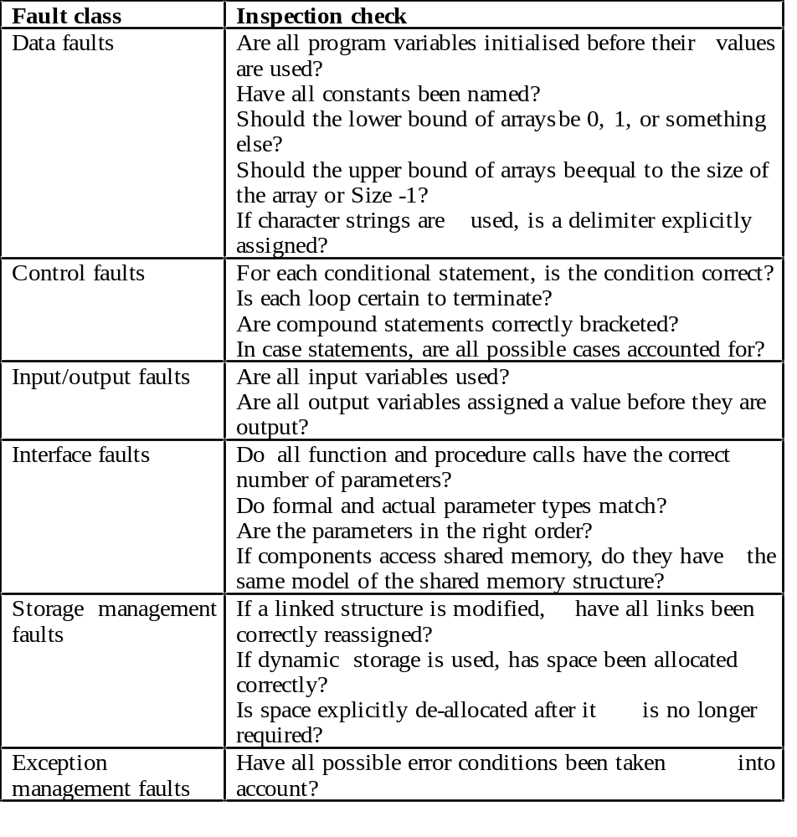
Another Code Inspection checklist

Slide 23
Exercise: Checklist for Java
Defect Type | Desription

Slide 24
Code Review Checklist
Applied Software Project Management, page 90.
… some items on the checklist are outside the usual scope of Inspection. For example:
  Efficiency
  Reusability (this can be a waste of time)

Slide 25


References
Karl Weigers, Peer Reviews in Software - A Practical Guide.
Applied Software Project Management, ch 5.
Tom Gilb, Software Inspection.
R. Radice, High Quality Low Cost Software Inspections.
Some slides from workshop at NECTEC by Prof. Claude Leporte, U. of Quebec.

