Slide 1
Balancing Planned & Agile Processes
Tailoring to Fit Project Characteristics

Slide 2
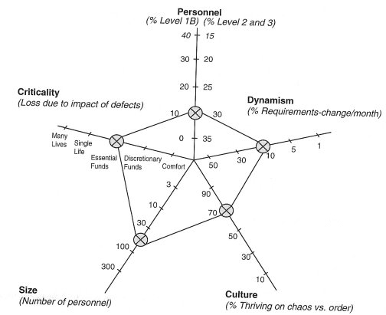
Most Projects have Mixed Traits

Slide 3
Risk Areas
Adapt your process (Agile or Planned-based) using risk.
The key question:
"Is it less risk to add this practice, or less risk to omit it?"
Examples:
a) up-front design
b) rapid delivery of functionality

Slide 4
Key Risks Areas
Based on study of many projects, Boehm & Turner define major risk areas.
Environmental Risks:
technology, stakeholders, operating environment of product
Agile Risks:
risk resulting from some Agile practices
Plan-driven Risks:
risk resulting from some plan-based practices

Slide 5
Environmental Risks
E-Tech: technology uncertainties
E-Coord: many diverse stakeholders to coordinate
E-Complex: complex system-of-systems

Slide 6
Agile Risks
A-Scale: project size and criticality
A-YAGNI: use of simple design or YAGNI
A-Churn: personnel turn-over or churn
A-Skill: not enough people skilled in Agile methods
Plan-driven Risks
P-Change: rapid change
P-Speed: need for rapid results
P-Emerge: emergent requirements
P-Skill: not enough people skilled in Plan-based methods

Slide 7
Question
1) For each "risk" on previous slide, why is it a risk to project outcome?
2) Why is personnel turn-over (churn) a risk for agile but less a risk for plan-based process?

Slide 8
The Process
Step 1: Rate the project's risks.
If uncertain, "buy" information via prototyping, data collection, and analysis.
Step 2: If Agile Risks or Plan-driven Risks dominate, then prefer the other process type (plan-driven or agile).
Step 3: If neither dominate, tailor process using risk-driven agile or risk-driven plan-based as appropriate.
…
Step 5: Monitor progress & risks. Adjust your process as needed.

Slide 9
What is "risk-driven"?
Boehm & Turner refer to "risk-driven Agile", "risk-driven Plan-based".
This means that risk is used to tailor the process.

Slide 10
Exercise
1. Rate the risk areas in your project. Use this scale:
0 = minimal risk or not present
1 = some (moderate) risk
2 = serious but manageable risk
3 = very serious but manageable risk
4 = critical or "showstopper" risk.
2. Rate the risks in Thai National e-Payment project.

Slide 11
Process Selction & Tailoring
How can you tailor a process based on the risk areas?

Slide 12
Specific Practices
What can we do to reduce risks?

Slide 13
Reducing Environmental Risks
E-Tech Create prototype
Reuse or buy existing software
Training on technology
E-Coord Stakeholder win-win
CRACK representative(s)
E-Complex Design & test architecture early

Slide 14
Reducing Agile Risks
A-Size Early architecture design,
use design patterns
Longer iterations
Subsettable stories(?)
A-YAGNI Use high-level "change-prescient"
architecture & design patterns
A-Churn Project-completion bonuses
Pair programming, walk-throughs,
personnel backup
A-Skill Hire skilled agile developer

Slide 15
Reducing Plan-driven Risks
A-Change Don't write detailed specifications
Don't do a lot of up-front design,
but do strive for "change-prescient"
architecture.
Short iterations, staged release.
P-Speed Short iterations, staged release.
Pair-programming, time-boxing.
Component-based design w/ interfaces
to enable parallel development.
P-Emerge Short iterations, demos, dedicated
customer representative.
P-Skill Hire skilled planned-based developer

Slide 16
Monitor your Process
Don't forget Step 5: Monitor progress & risks.

Slide 17
Add Risks to your SDP
The SDP contains a section on "risk management".
Apply this method to identify process risks & document.
Tailor your process to reduce risks.
Use SDP to remind you to monitor risks, and adapt.

Slide 18
Conclusions from the book
Assess your own projects (5-axis graph), identify risks.
Combine both discipline & agility.
Build your process up – don't tailor down.
Focus less on methods – more on people, values, communication, and managing expectations.

Slide 19
Resources
B. Boehm & R. Turner, Balancing Agility and Discipline.
B. Boehm & R. Turner, "Observations on Balancing Agility and Discipline". This article contains verbatim the important part of Conclusions chapter from the book.

