Slide 1
Analysis

Slide 2
Analysis Activity
Analyse the customer's requirements,
the domain of the application,
the context in which the software will be used,
the kinds of users,
the goals of user classes,
...

Slide 3
Purpose of Analysis
According to USDP book:
yield a more precise specification of the requirements, including a use case model

Slide 4
Goals of Analysis
Define the problem the customer is trying to solve.
Understand the requirements.
Understand the application domain, at least the parts related to the software system you will create and the requirements.
k

Slide 5
Use Cases
From The Unified Software Development Process (Booch, Jacobson, Rumbough):
1. UC must be kept as independent of each other as possible.
2. UC must be written in the language of the customer.
3. Each UC must be structured as a complete and intuitive specification of functionality.
"they

Slide 6
Analysis Classes
A model of the system, as specified by customer & others, without regard to how it will be implemented.
Are involved in functional requirements.
Responsibilities are specified at a high level.
Associations are for "business" relationships

Slide 7
3 types of Analysis Class
Boundary class - interaction between system & actors
Entity class - object or information that is long-lived
Control class - transactions, sequencing, or control of other objects

Slide 8
Examples
Browse books
Book Browse UI - Boundary class
Books - Entity classes
Book Reservation - Entity class
Reservation Processer - Control class

Slide 9
Messages
Use messages to show communication between classes.
Messages are not operations (analysis classes don't usually have operations assigned to them).

Slide 10
Collaboration Diagram
Use a collaboration diagram to show communication among analysis classes in a use case.

Slide 11
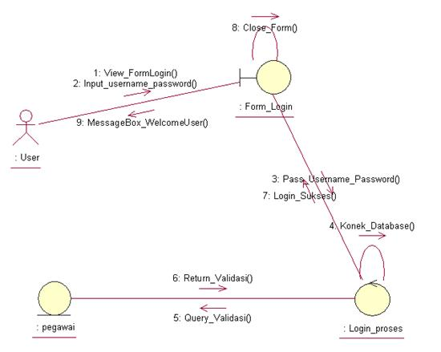
Not quite correct
This is a collaboration diagram, but level of abstraction is not correct for analysis. What's wrong?

Slide 12
OK to omit sequence numbers
USDP authors state:
omit sequence numbers in collaboration diagram if it adds too much clutter or obscures the interactions.

