Slide 1
Process Questions

Slide 2
Assigning Tasks
As team leader assigning tasks to developers, what are the 3 most important factors to consider when deciding the work to assign?
1.
2.
3.

Slide 3
Assigning Tasks
As team leader assigning tasks to developers, what are the 3 most important factors to consider when deciding the work to assign?
1. Developer's interests
2. Developer's capabilities
3. Opportunity to improve their skill/knowledge
Ref: TSPBOK, section 4.5 "Developing team members"
Credit: Chinnaporn

Slide 4
Benefits of CM
Give examples of problems that CM should control.
1.
2.
3.
4.

Slide 5
Benefits of CM
Give examples of problems that CM should control.
1. Simultaneous updates (over-writing another's work)
2. Lack of notification of updates to artifacts
3. Management of multiple versions. Large projects have versions like "release", "dev", "experimental". Must be able to quickly fetch & work with any version.
4. Unauthorized changes to artifacts, e.g. plans or documents.
Ref: RUP library, Credit: Chonnipa

Slide 6
Tester ... aka "QA"
What are desirable attributes for a tester?
1.
2.
3.
4.
…
10.

Slide 7
Tester ... aka "QA"
What are desirable attributes for a tester?
1. Attention to detail
2. Communicates well and clearly (with developers)
3. Patience
4. Willingness to learn
5. Skillful at prioritizing – why?
6. Time management - since testing is unlimited, must be able to decide how to allocate his time for best effect.

Slide 8
Tester ... aka "QA"
More desirable skills:
7. Good organizational skill - must keep track of emails, test plans, test suites, versions, both sent and received.
8. Adaptability - requirements change, focus changes, product design changes
9. Thinks "outside the box" - look beyond the SRS and the testing tools. What does the customer or user want the software to do? Do your own market research.
10. Advocate for customer (user) perspective.

Slide 9
Tester ... aka "QA"
Refs:
https://leantesting.com/resources/effective-software-tester/ (the 10 shown here)
http://www.softwaretestinghelp.com/10-qualities-that-can-make-you-a-good-tester/ (similar to above, this is a good site for testers)
http://www.softwaretestinghelp.com/software-tester/ (16 characteristics, a really good list. Highly recommend.)

Slide 10
Kittinan: check your punctuation!
Check your grammar, too.
clearly communication for discussing with developer , understanding customer requirement clearly , discreet
Why we should have WAR ( Weekly Activity Report )?
- The important goal of WAR is reporting a performance, problem ,strength and weakness
...and many more

Slide 11
RUP Phases
1. In RUP, which phase is focused on design?
______________
credit: Kittinan
2. What other activity (workflow) is also heavily performed in the same UP phase as design?
______________

Slide 12
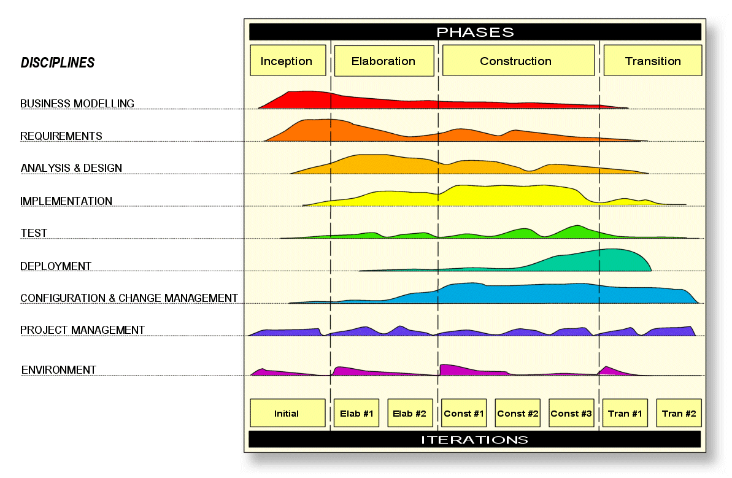

Slide 13
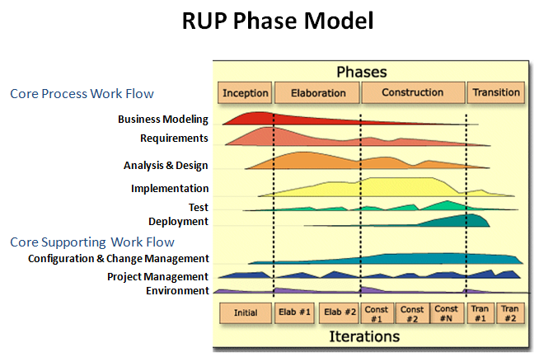

Slide 14
Iterative Development
What are some advantages of iterative development?
1.
2.
3.
4.
5.

Slide 15
Iterative Development
What are some advantages of iterative development?
1. product is broken down & implemented as managable chunks
2. more visibility of progress, & better communication
3. unstable requirements don't hold up progress
4. more opportunity for feedback from customer, as he sees incremental versions of the product
5. increase customer trust
6. identify and correct problems early. "Problems" can be in req't, design, technology, implementation, etc.

Slide 16
Iterative Development
Ref: Software Engineering, Sommerville, sect. 3.4
Credit: Manasawin, Chonnipa

Slide 17
Back to Basics... I waterfall
What some advantages of the waterfall process?
1.
2.
3.

Slide 18
Back to Basics... I waterfall
What some advantages of the waterfall process?
1. can make predictive plans early in project
2. as result of #1, can make cost estimate early
3. avoids overhead of iterative planning and rework resulting from changes in design
Ref: UML Distilled, chapter 2.
Credit: Jim

Slide 19
Back to Basics... I waterfall
What some advantages of the waterfall process?
1. can make predictive plans early in project
2. as result of #1, can make cost estimate early
3. avoids overhead of iterative planning and rework resulting from changes in design
Ref: UML Distilled, chapter 2.
Credit: Jim

Slide 20
I want to use waterfall!
For what kind of projects in waterfall process suitable?
1. (about size)
2. (related to architecture)

Slide 21
I want to use waterfall!
For what kind of projects in waterfall process suitable?
1. small project
2. doesn't require high-level planning/design of system architecture
Ref: [http://istqbexamcertification.com/what-is-iterative-model-advantages-disadvantages-and-when-to-use-it/]
[http://istqbexamcertification.com/what-is-waterfall-model-advantages-disadvantages-and-when-to-use-it/]
Credit: Nut

Slide 22
I still want to use waterfall!
Name 3 characteristers a project should have for waterfall approach to be likely to succeed other than the 2 from previous slide.
1.
2.
3.

Slide 23
I still want to use waterfall!
Name 3 characteristers a project should have for waterfall approach to be likely to succeed.
1. requirements are clearly understood in advance
2. requirements not likely to change (much)
3. method of solution is also well understood
Ref: a) by inference of the criticisms of waterfall. b) Software Project Management in Practice.

Slide 24
I found a bug!
If you are CM and find a defect in a document, is it your responsibility to report or track down the defect?

Slide 25
Not my job?
If you are CM and find a defect in a document, is it your responsibility to report or track down the defect?
"No - PMC should be the one to track down those defect." Credit: Nabhat
Ref: Software Project Management in Practice by Pankaj Jalote

Slide 26
Who is Responsible for Quality?
Quality is everyone’s responsibility.
This seems to be concensus opinion.
Ref:
http://www.softwaretestinghelp.com/who-is-responsible-for-software-quality/
http://blog.utest.com/2014/05/20/who-is-responsible-for-software-quality/

Slide 27
More Bugs... or Defects
What is a defect?

Slide 28
More Bugs... or Defects
What is a defect?
A defect is something that causes the software to be inconsistent with the requirements or customer needs.
Ref: Software Project Management in Practice, sect. 5.1
Credit: Nichamon

Slide 29
Where to bugs come from?
"I couldn't possibly have done that... it must have been someone else..."
In what activities are defects injected into work products?
1.
2.
3.
4.

Slide 30
Where do bugs come from?
In what activities are defects injected into work products?
1. requirements specification
2. high level design
3. detailed design
4. coding
Ref: Software Project Management in Practice, sect. 5.1
Credit: Nichamon

