Slide 1
Intro to Software Processes

Slide 2
Objective of Software Development
Need
(or Idea)
Product
Produce a software product that fulfills a need or realizes an idea.

Slide 3
Divide work into steps
Need
(or Idea)
_?_
_?_
_?_
_?_
Some steps or activities are needed to go from need to product.
What are the steps?

Slide 4
Don't "re-invent the wheel" deciding what to do.
Need
(or Idea)
___
___
___
___
Deciding what to do takes time, and you might omit some important steps. Or do them ineffectively.
Based on experience (and analogy to other disciplines) we have some processes that have worked well.

Slide 5
What is a Software Process?
A process is a method for doing or producing something.
A software process is a method for producing software.
"Producing software" includes
specification
design
construction
documentation
transition
maintenance
improvement
Managing the project involves
planning
obtaining resources
measuring
tracking progress
review
analyzing results and acting on them

Slide 6
Do You Have a Software Process?

Slide 7
Do You Have a Software Process?
Everyone who develops software uses a process.
Process may be implicit or informal.
You may not be aware of it (not "defined").
It changes over time.

Slide 8
Why a Defined Process?
(This is to try to convince you that a defined software process is a good thing.)
Let's look at why software projects fail or succeed.
See separate slides.

Slide 9
Benefits of a Defined Process
Saves time
  less time spent on planning, estimates, decisions
Predictable - enables planning & scheduling
Repeatable
Trackable - observed progress compared to plan
Enables Quality Assurance
Provides a basis for improvement
  revise process based on experience
Ref: http://www.acm.org/crossroads/xrds6-4/software.html (2000)

Slide 10
The Role of Process
People
Technology
Methods
The Desired Product

Slide 11

The Role of Process
People
Technology
Methods
"the glue that binds [guides] people, methods, and technology to create a product."
Process
The Desired Product

Slide 12
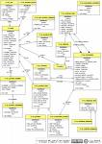
A Model for a Software Process
People
Technology
Roles:
Methods
Task
Task
Analysis
Design
Implement
Test
Activities:
Use Case
Description ...
Prerequisite...
Main Scenaria
1.....
2.....
3.....
Extensions: ...
Artifacts:
. . . . .
Desired Product
Communicate:
Measurements, Milestones, Documents

Slide 13
What is the Most Common Software Process?

Slide 14
What is the Most Common Software Process?
"Code and fix"
ad hoc (chaos)
My Software Process
My process since high school FORTRAN programming (really!)
1. think about the problem, doodle on paper
2. start coding
3. as code grows, I realize that I need to improve parts of it.
  modify code for the new, improved design.
  goto step 2.

Slide 15
Name some software process models?
"Software process" can be …
Software development process
Software lifecycle process

Slide 16
Process Models
Waterfall
Rapid Prototype
Spiral (?)
Iterative and Incremental

Slide 17
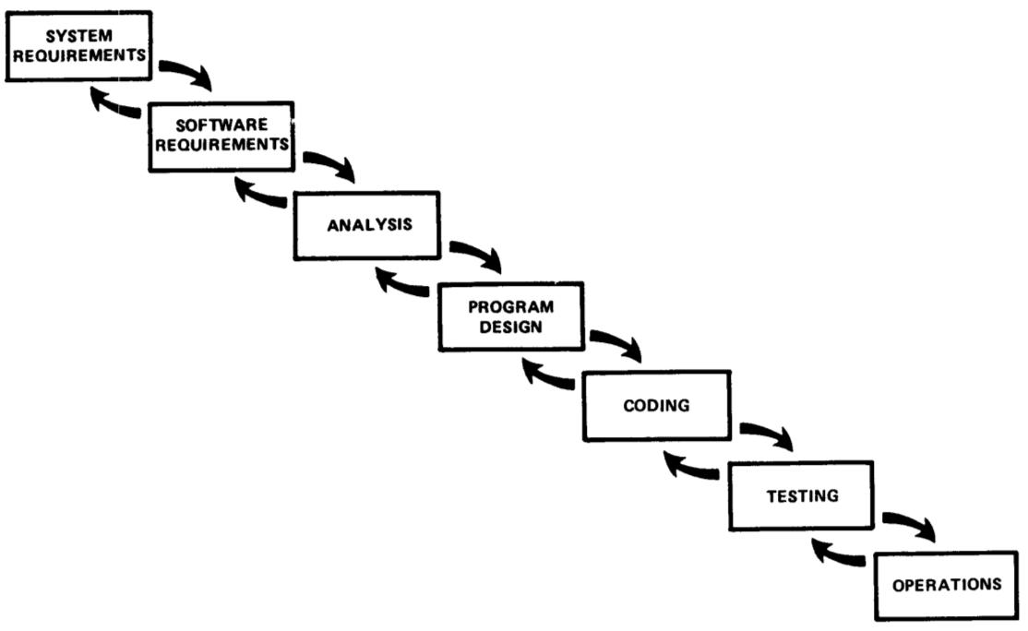
Waterfall
Winston Royce, Managing the Dev't of Large Software Systems (1970)
Still commonly used.
Not as simple as often portrayed.

Slide 18
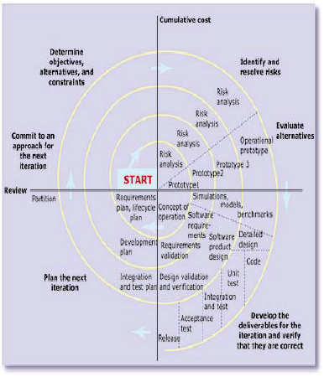
Spiral Process
Barry Boehm, at TRW.
Emphasis on risk reduction
Looks like iterative and incremental or evolutionary

Slide 19
Iterative and Incremental
Characteristics
  time-boxed iterative development
  plan based
  architecture centric
  address risks early
  implement requirements based on priority
  accommodate change
Unified Software Development Process - a framework
  Rational UP
  OpenUP

Slide 20
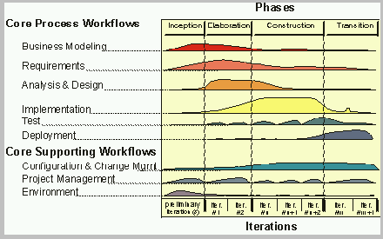
UP Disciplines and Workflow
Workflows related to different areas of concern.
Workflow contains activities and tasks.

Slide 21
Other "Disciplined" Processes
Team SoftwareProcess (TSP)
Personal Software Process (PSP)
  objective is to improve personal productivity through staged sequence of activities
  measure and analyze: time, defects
  improvement through reflection and planning

Slide 22
Personal Software Process (PSP)
Objective: provide a disciplined process for SEs to...
improve estimation and planning skills
reduce defects in their products
be able to manage their own schedule & work quality

Slide 23
PSP Approach
Engineers progress through 6 levels, improving their process.
PSP0: measure the time you spend on planning, design, coding, test, and post mortem (retrospective)
PSP0.1: measure output LOC. Add coding standard and process improvement proposal (PIP).
PSP 1.0: Estimate program size using level 0 data. Make a test plan.
PSP 1.1: Add planning. Estimate time from program size.
PSP 2.0: Add design & code review. Emphasis on defect removal and prevention.
PSP 2.1: Add design specification.
PSP 3: Apply an iterative process to PSP2.1.

Slide 24
PSP Tools and Support
Humphrey emphasizes use of scripts, forms, and checklists to guide the user.
A useful tool is Process Dashboard (Sourceforge).
this tool includes the PSP scripts and forms, and generates reports for you.

Slide 25
Agile Manifesto
We are uncovering better ways of developing
software by doing it and helping others do it.
Through this work we have come to value:
Individuals and interactions over processes and tools
Working software over comprehensive documentation
Customer collaboration over contract negotiation
Responding to change over following a plan
That is, while there is value in the items on
the right, we value the items on the left more.

Slide 26
Some Agile Processes
eXtreme Programming
  Kent Beck: Chrysler
Scrum - called "more a management technique"
  iterative development in "Sprints"
  daily stand-up meeting
  small, democratic teams
Crystal
  a family of methods to address different types of projects
Synchronize and Stabilize (Microsoft process)

Slide 27
Agile Process Characteristics
create customer "value" at each iteration
welcome evolving requirements
working software as primary measure of progress
lack of up-front architecture design (YAGNI)
simplicity of design (XP: "do the simplest thing that ...")
small, self-organizing teams at one site (preferred)
frequent customer feedback
shared understanding instead of comprehensive documents … but they do write docs

Slide 28
Classic Mistakes: People
These practices are predictably likely to fail
Reliance on Heros (super-programmers)
Poor work environment: noisy, distractions
Adding people to a late project
"adding developers to a late project makes it later"

Slide 29
Classic Mistakes: Process
These practices are predictably likely to fail
Unrealistic schedule
Poor planning
Avoiding difficult decisions

Slide 30
Classic Mistakes: Product
Requirements often lead to failure...
Feature creep, or requirements churn
Gold plating
Treating R&D project as development project

Slide 31
Classic Mistakes: Technology
Requirements often lead to failure...
Silver bullet thinking: don't expect technology to provide improvement in productivity
Using unfamilar or unstable technology
"Let's use Lavarel because we want to learn it"
Lack of version control
Related:
Don't keep a "personal copy" outside of project VC.

Slide 32
Problem of Teaching Software Process
1. We learn on small, one-semester projects.
2. Projects often succeed based on heroic effort or super-programmers.
3. Programs aren't deployed or supported.
4. We are still learning, so process seems awkward.
Problem:
our process doesn't scale to larger projects.
benefits of many practices aren't visible.

Slide 33
Approach of this Course
Emphasis on understanding the elements of a process.
What is there purpose?
How can they help your projects?
How to do them practically?

Slide 34
Extra slides
(you can stop here)

Slide 35
Exercise 2
What process practices or activities did you use in your ExceedVote project?
Did you assign roles?

Slide 36
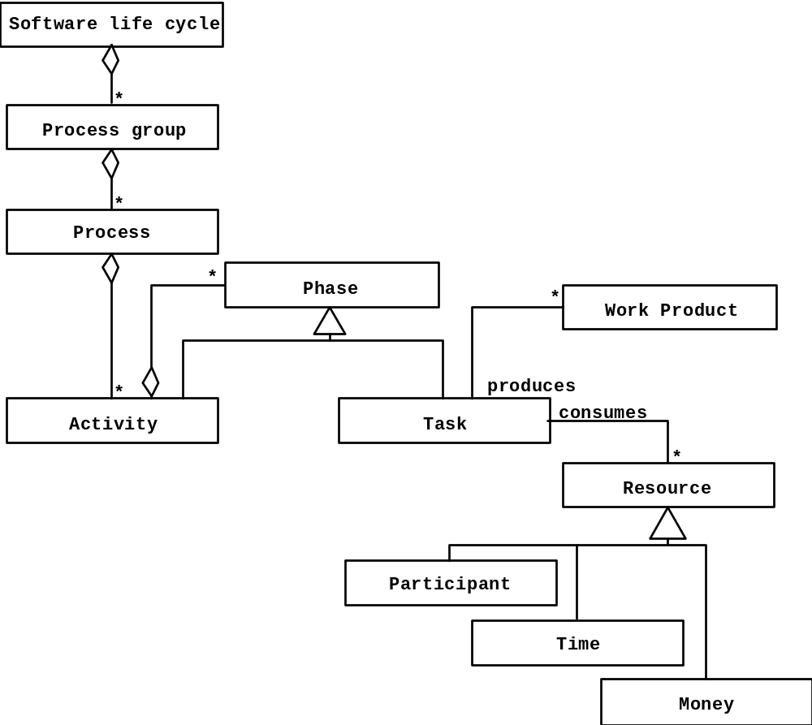
Model of Development Process
source: Bruegge, OOSE

Slide 37
Some Terms
Software Life Cycle
Software Life Cycle Model
Software Development Life Cycle [Model]
Software Process
Software Process Model
  aka: Defined Software Process

Slide 38
What is a Software Lifecycle?
Stages of existence of software.
Each stage represents a different state of software.
Idea

Slide 39
What is a Life Cycle Model
A model of the phases that software goes through
Serves as a guide for management of software development
Models omit some real-life complexity and detail

Slide 40
Typical Lifecycle Model
Inception of idea
  vision
  business case
Analysis
Design
Implementation
Acceptance
Deployment
  transition
  training & education
Maintenance and Support
End of Support
Retirement
  end of useful life
  transition or archiving
GREEN = part of the process, not life cycle

