Slide 1
Software Process Models

Slide 2
Objective of Software Development
Need
(or Idea)
Product
Produce a software product that fulfills a need or realizes an idea.

Slide 3
Approach: divide and conquer
Need
(or Idea)
_?_
_?_
_?_
_?_
Some steps or activities are needed to go from need to product.
What are the steps?

Slide 4
Don't "re-invent the wheel" deciding what to do.
Need
(or Idea)
___
___
___
___
Deciding what to do takes time, and you might omit some important steps. Or do them ineffectively.
Based on experience (and analogy to other disciplines) we have some processes that have worked well.

Slide 5
What is a Software Process?
A process is a method for doing or producing something.
A software process is a method for producing software.
"Producing software" includes
specification
design
construction
documentation
transition
maintenance
improvement
Managing the project involves
planning
obtaining resources
measuring
tracking progress
review
analyzing results and acting on them

Slide 6
Do You Have a Software Process?
Everyone who develops software uses a process.
Process may be implicit or informal.
You may not be aware of it (not "defined").
It changes over time.

Slide 7
Why a Defined Process?
(This is to try to convince you that a defined software process is a good thing.)
Let's look at why software projects fail or succeed.
See separate slides.

Slide 8
Benefits of a Defined Process
Saves time
  less time spent on planning, estimates, decisions
Predictable - enables planning & scheduling
Repeatable
Trackable - observed progress compared to plan
Enables Quality Assurance
Provides a basis for improvement
  use what you learn from past experience
Ref: http://www.acm.org/crossroads/xrds6-4/software.html (2000)

Slide 9
The Role of Process
People
Technology
Methods
The Desired Product

Slide 10

The Role of Process
People
Technology
Methods
"the glue that binds [guides] people, methods, and technology to create a product."
Process
The Desired Product

Slide 11
Process Models
Model for discussing, thinking, and applying software processes
  think, analyze
  plan
  do
  review
  improve

Slide 12
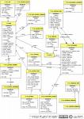
A Model for a Software Process
People
Technology
Roles:
Methods
Task
Task
Analysis
Design
Implement
Test
Activities:
Use Case
Description ...
Prerequisite...
Main Scenaria
1.....
2.....
3.....
Extensions: ...
Artifacts:
. . . . .
Desired Product
Communicate:
Measurements, Milestones, Documents

Slide 13
What is the Most Common Software Process?

Slide 14
What is the Most Common Software Process?
1. "Code and fix"
2. ad hoc (chaos)
My Software Process
My process since high school FORTRAN programming (really!)
1. think about the problem, doodle on paper
2. start coding
3. as code grows, I realize that I need to improve parts of it.
  modify code for the new, improved design.
  goto step 2.

Slide 15
Name some software process models?
"Software process" can be …
Software development process
Software lifecycle process

Slide 16
Review

Slide 17
How many Programmers does it take to change a light bulb?
?

Slide 18
How many Programmers does it take to change a light bulb?
None.
A defective light bulb is a hardware problem.

Slide 19
How many Software Engineers does it take to change a light bulb?

Slide 20
How many Software Engineers does it take to change a light bulb?
Six.
Analyst to write the specification.
Architect to design a light-bulb changing procedure.
Developer to change the light bulb.
Tester to test it.
Documenter to write project reports.
Auditor to verify that the process was followed.

Slide 21
4 key factors in development speed
1. People
– ability, knowledge, skills, motivation
2. Process
– Customer focus
– QA, risk management, lifecycle planning, revision control, ...
3. Product
– Size and characteristics, phasing
4. Technology
– Product or software development environment
– Tools

Slide 22
Exercise 2
What process "procedures" or "activities" did you use in your POS project?

Slide 23
Process Disadvantages
overhead
diminish sense of spontaneity or creativity
may be the wrong process for the job
初
心
Beginner's mind:
the beginner's mind sees many possibilities,
the expert's mind sees only one.

Slide 24
Problems with an Implicit Process
What are problems of this approach (implicit process)?

Slide 25
Problems with an Implicit Process
1. Depends a lot on motivated, talented individuals.
  what happens if your best programmer/architect quits?
2. Not repeatable or predictable.
  if you can't predict how long the next project will take, then how can you bid (estimate cost)?
3. Stress / burn-out.
  Too much pressure on team.
  Uncertainty and O.T. lead to frustration, burn-out.
  No slack time for HR development.

Slide 26
Another Problem...
1. We learn programming on small projects.
2. We develop an implicit process that works well...
we get "A"s in our courses!
Obviously, we are great "software engineers"!
Problem:
our implicit process doesn't scale to large problems.

Slide 27
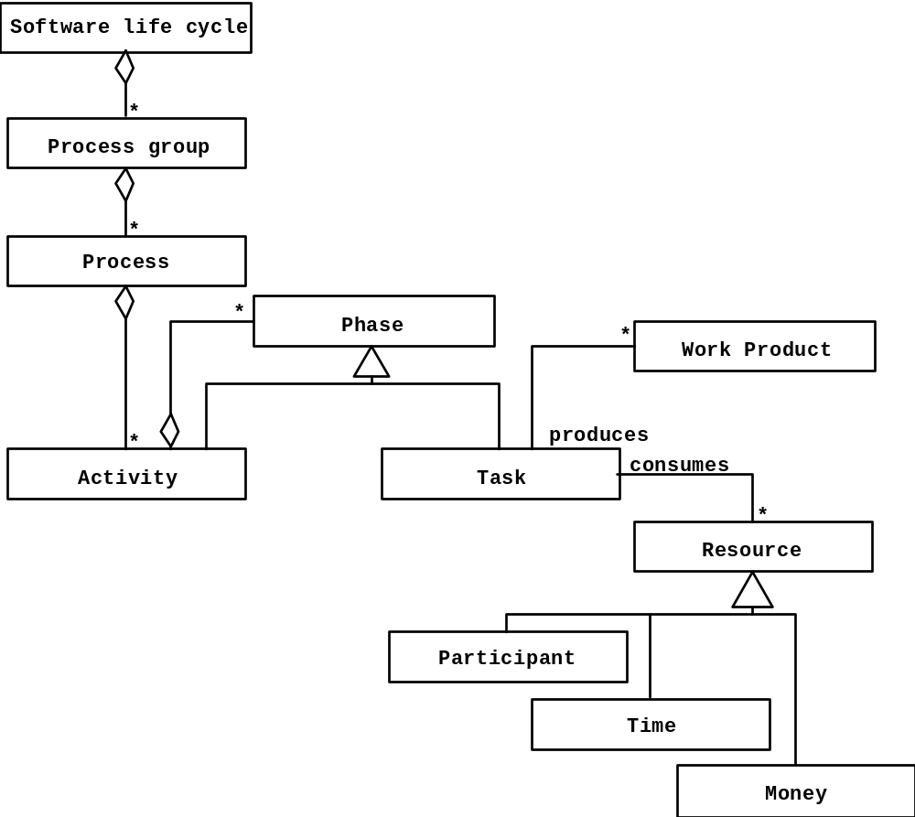
Model of Software Life Cycle
source: Bruegge, OOSE

Slide 28
Classical Process Models
Waterfall
Rapid Prototype
V-Model
  going down V: waterfall
  going up the V: unit test, integration test, V&V, acceptance test
See Schach slides for examples

Slide 29
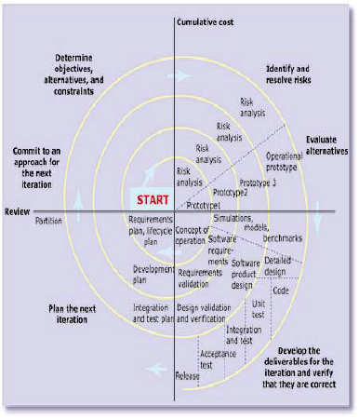
Spiral Process
Activities are performed repeatedly.
Each time, new features are added

Slide 30
Iterative and Incremental
Unified Software Development Process is the most common
  Rational UP
  OpenUP
Characteristics
  plan based
  architecture centric
  address risks early
  implement requirements based on priority
  accommodate change

Slide 31
Other "Disciplined" Processes
Well documented, prescriptive
Team software process (TSP)
Personal Software Process (PSP)
  objective is to improve personal productivity through staged sequence of activities
  measure and analyze: time, defects
  improvement through reflection and planning

Slide 32
Agile Manifesto
We are uncovering better ways of developing
software by doing it and helping others do it.
Through this work we have come to value:
Individuals and interactions over processes and tools
Working software over comprehensive
documentation
Customer collaboration over contract negotiation
Responding to change over following a plan
That is, while there is value in the items on
the right, we value the items on the left more.

Slide 33
Agile Process Characteristics
provide customer "value" at each iteration
welcome evolving requirements
working software as primary measure of progress
lack of up-front architecture design (YAGNI)
simplicity of design (XP: "do the simplest thing that ...")
small, self-organizing teams at one site (preferred)
frequent customer feedback
shared understanding instead of comprehensive documents (but they do write docs)

Slide 34
Agile Process Core Practices
CRACK customer representative onsite
  Collaborate
  Representative
  Authorative
  Committed
  Knowledgeable
Test-driven development
  write test cases first
  constant verification using automatic testing

Slide 35
Agile Process Core Practices (2)
running software at each iteration
frequent face-to-face communications
competant teams
reflection on how to be more effective
well documented, readable code
(XP) pair programming
(XP, Scrum) limit or forbid overtime work

Slide 36
12 Principles of Agile Development
http://agilemanifesto.org/principles.html

Slide 37
Some Agile Processes
eXtreme Programming
  Kent Beck: Chrysler
Scrum (called "more a management technique")
  processes as black boxes
  daily stand-up meeting
Crystal
  a family of methods to address different types of projects
Synchronize and Stabilize (Microsoft process)

Slide 38
Scrum
www.controlchaos.com
  graphic: www.controlchaos.com/about
  audio and video presentation
  interesting "White Papers"
Ken Schwaber, "Scrum Development Process", OOPSLA'95.
  the original Scrum article
Scrum articles:
http://www.controlchaos.com/old-site/articles.htm

Slide 39
Scrum
Easy to add to existing software development process
Often used as "first step" to test benefits of agile dev't
Easy to combine with:
  UP, OpenUP
  XP

Slide 40
Software Process Models
General Models for Software Processes
and Process Improvement

Slide 41
Frameworks for Software Processes
There are frameworks for analyzing, evaluating, and (maybe) improving a software process. Best known:
ISO 12207, Software Life Cycle Processes
IEEE 1074, Standard for Software Life Cycle Processes

Slide 42
IEEE Std 1074: Standard for Software Lifecycle
Process Group
IEEE Std 1074
Project
Management
Pre-
Development
Develop-
ment
Post-
Development
Cross-
Development
(Integral Processes)
> Project Initiation
>Project Monitoring
&Control
> Software Quality
Management
> Concept
Exploration
> System
Allocation
> Requirements
Analysis
> Design
> Implemen-
tation
> Installation
> Operation &
Support
> Maintenance
> Retirement
> V & V
> Configuration
Management
> Documen-
tation
> Training
source: Bruegge, OOSE
Processes

Slide 43
IEEE 1074
IEEE Standard for Developing a Software Project Life Cycle Process
Software Project Life Cycle Model
Software Process Architect
Select SPLCM
Select activities
OPAs
uses
incorporates
Software Project Life Cycle

Slide 44
IEEE 1074 Activity Groups (1)
1. Management Activities
Project Initiation
Project Planning
Project Monitoring and Control
2. Pre-Development
Concept Exploration
System Allocation (Architecture Design)
Software Importation

Slide 45
IEEE 1074 Activity Groups (2)
3. Development
Software Requirements
Design
Implementation
4. Post-Development
Installation
Operation and Support
Maintenance
Retirement

Slide 46
IEEE 1074 Activity Groups (3)
5. Support
Evaluation
Software Configuration Management
Documentation Development
Training

Slide 47
Milestone
A scheduled event used to measure progress.
A milestone should be an event with "success" criteria that can be objectively evaluated.
Milestone
Elicit Requirements
Analyze Requirements
Write Specification
Review & Approval
Activities:
Baseline Specification

Slide 48
Artifacts
Final Deliverables
  What should we have when we’re finished? (not “what code should we write”)
Interim Deliverables
  What do we need to get the job done?
Internal vs. External Artifacts

Slide 49
Key Artifacts
Interim
Final
Requirements
Analysis & Design Models
Plan Documents
Test Plans, Procedures, Results
Meeting Minutes
Demo Builds
Code Libraries
API Documents
Executables
User Documents
Release Notes
Delivery Bundle
Install Documents

Slide 50
Process Essentials
The following slides are from
CMU 11-791 Software Engineering and IT

Slide 51
Key Process Concepts
Test Infrastructure Early
Reduce Technical Risk
Reduce Schedule Risk
Team for Success
Effective Meetings
Keep Models Updated
Incremental Approach
Synchronize & Stabilize
Code Reviews
Use Bug Tracking
Use Version Control

Slide 52
Test Infrastructure Early
Example: “Which web app framework should I use?”
  Different costs & tradeoffs
  Training, documentation
  Ease of use, stability
  Platform issues, bugs, performance
If there is more than one technology choice for your
infrastructure, a skilled subteam should test or
prototype to enable a clear decision

Slide 53
Reduce Technical Risk
Examples:
  Adopting very new technology
  Novel first use of technology
  No “safer” alternative
Perform a feasibility study (or “proof of concept”)
which demonstrates that the new technology will
work for the function you intend to implement,
on the platform you wish use

Slide 54
Reduce Schedule Risk
Examples:
  Low confidence in estimates
  No data for approach / technology
  Large-scale tasks
    content creation, test data creation, knowledge / rule development, etc.
Gather data on a sample task, extrapolate
Consider automation, tools
Create contingency plan

Slide 55
Team for Success
Leverage skills of team members
  Training / examples for others
  Mentoring, subgroups
  Infrastructure development / support
“Inviting commitment” vs. “Unilateral task assignment”
Frequent post-mortems, process adjustments whenever necessary

Slide 56
Run Effective Meetings
Agenda
  Review action items from last meeting
  Discuss new issues (elicit in meeting, too)
  Assign new action items
  Schedule next meeting
Minutes
  Document attendance (note latecomers)
  Send an email update if you can’t attend!
  Document progress on old action items
  Document decisions and pending issues
  Document new action items
  Email to all members

Slide 57
Effective Meetings [2]
Meeting Roles
  Moderator
    Run the agenda, keep discussion focused and concise
    Make sure all voices are heard
    Tangents noted for later, or saved for a sub-meeting
  Scribe
    Responsible for meeting minutes
  Timekeeper
  Meeting roles should rotate among team members (week to week, phase to phase)

Slide 58
Effective Meetings [3]
Keep meetings brief
  One hour should suffice, except for a working meeting
  The more people, the shorter the meeting (e.g. whole-project meetings should be kept short)
  Spawn sub-group meetings to discuss substantive issues in more detail
  Subgroups report back in main project meeting

Slide 59
Effective Meetings [4]
Participation is essential
  Arrive on time, don’t leave early
  Everyone has a voice
  If absence is unavoidable:
    Send an update to the meeting leader via email
    Read meeting minutes asap and clarify if necessary
    Don’t allow your absence to disrupt the project

Slide 60
Issue-Based Development
Organize teamwork around issues to be resolved as well as code to be written
Document discussion, assumptions, alternative solutions, and resolution for each issue
If assumptions change later, an alternative can be explored
(More in Bruegge & Dutoit)

Slide 61
Keep Models Up To Date
Models are only useful if they describe what you are doing
Models get out of date easily
  Details become visible during development
  Design changes
Link issue resolution to action items: update appropriate models

Slide 62
Consider an
Incremental Approach
When working with a hard deadline
A means of mitigating technical and schedule risks
Guarantee you have something to deliver
Development is a series of stable, tested increments
  PRO: Always have working system
  CON: Extra overhead?

Slide 63
Synchronize & Stabilize
“Test early, test often”
At level of individual class, module, or entire system
Synergy with incremental approach
Mitigates estimation risk in system integration
Microsoft’s approach (Cusamano, 1997)

Slide 64
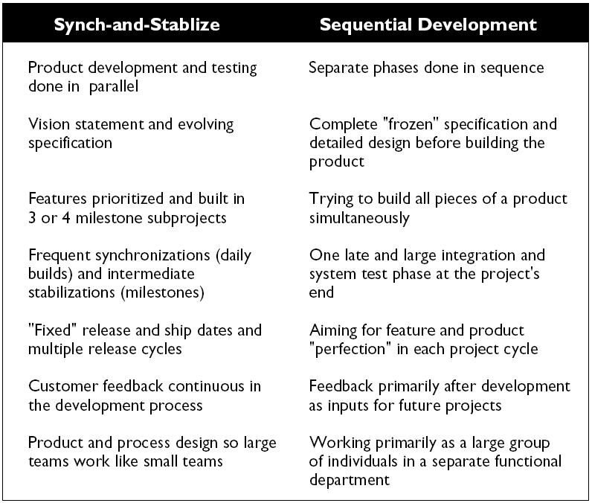
(from Cusamano, 1997)

Slide 65
Use Bug Tracking
Manage enhancements, fixes to
  Code
  Test Suites
  On-line resources (web)
  Written documentation
(See Bugzilla slides from last lecture)

Slide 66
Code Reviews
At each milestone
One module per review
Code examined in advance
Developer leads the meeting
Issues put into bug tracking system
  Source code issues (style, doc)
  Design/implementation mismatches
  Defects
Side-effect: other developers learn how the module works (useful)

Slide 67
CVS: Concurrent Versions System
CVS Home Page:
http://www.cvshome.org/
CVS for new users:
http://www.cvshome.org/new_users.html
Jim Blandy’s tutorial:
http://www.cvshome.org/docs/blandy.html
The Cederqvist manual:
http://www.cvshome.org/docs/manual/cvs.html

Slide 68
Subversion: A Better CVS
http://subversion.tigris.org

Slide 69
Process Improvement

Slide 70
Frameworks for Process Improvement
There are frameworks for analyzing, evaluating, and (maybe) improving a software process. Best known:
Capability Maturity Model Integrated (CMMI), and its earlier version CMM-SW (CMM for Software).
Software Process Improvement Capability Determination (SPICE), ISO 15504, a framework for assessing and comparing software processes.
ISO 9000 - a family of standards for "quality managed systems". Requires a map of all key processes; documented procedures and assessment.

Slide 71
Overview of CMMI - Maturity Levels

Slide 72
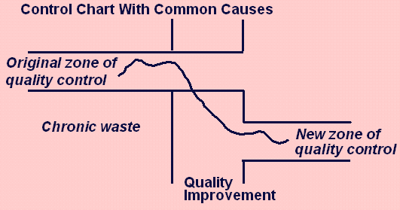
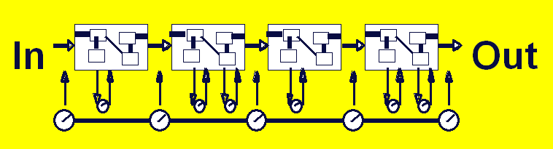
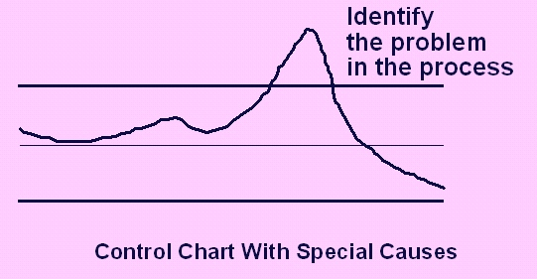



Overview of CMMI - Maturity Levels
5
"Optimizing"
Focus on process improvement;
4
Process measurements; adapt to problems to reduce variance; predictable performance
“Quantitatively
Managed"
3
“Defined"
Process and procedures are standard, managed, improved over time
2
has process model but varies project to project; repeatable
"Managed"
1
ad hoc
not repeatable
"Performed"
0
Outcome
depends
on “heroes”
“Incomplete"

Slide 73
Overview of CMMI - KPA

Slide 74
The CMMI definition of "process"
A “process” [as used in the CMMI Product Suite] consists of activities that can be recognized as implementations of practices in a CMMI model.
These activities can be mapped to one or more practices in CMMI process areas to allow a model to be useful for process improvement and process appraisal. (In Chapter 2, see the definition of “process area” and a description of how this term is used in the CMMI Product Suite.)

Slide 75
SPICE (ISO 15504)
Software Process Improvement and Capability Evaluation
Bloated ISO standard ... not popular outside the EU
5 Types of Processes
1. Engineering
2. Supporting
3. Management
4. Organizational
5. Customer-supplied

Slide 76
Open UP definition of process
An organization of method content into partially ordered sequences for [completing] a software project
What is "method content"?
Roles
Tasks
Artifacts (inputs and outputs)
Guidance
  checklists
  concept documents
  knowledge resources

Slide 77
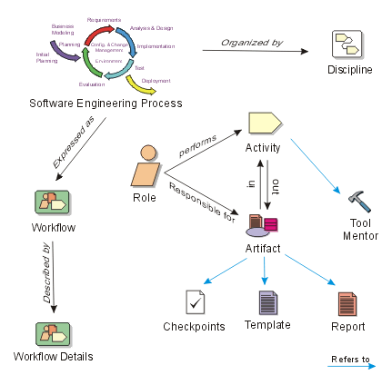
RUP Process Model

Slide 78
What are Roles? Name some...

Slide 79
What are Tasks? Name some...

Slide 80


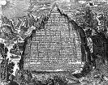
What are Artifacts?
Some ancient artifacts
http://www.crystalinks.com/emeraldtablet.html

Slide 81
Software Development Plan
Includes the "Project Management Plan"
What areas does it address?

Slide 82
Software Development Plan

Slide 83
Configuration Management
In your project there are...
280 source code files
12 files for user documentation
8 project documents (deliverable) such as
SRS
Software Architecture Document
...

Slide 84
Configuration Management (2)
How do you know...
which ones have been tested?
where is the "release 1.0" final version?
have they been reviewed?
what bugs or issues remain (in each file)?

Slide 85
Configuration Management (3)
Configuration Mgmt is part of Development Plan
What artifacts do you want to manage?
Source code
Built code (which one is version 1.0?)
Change requests
Change notification
Bug & Issue tracking

Slide 86
CM: Process
Artifacts
what do you want to manage?
Tasks / Activities
  xx
  xx
  xx
Guidance / Standards:
naming convention
version numbering convention
repository organization
what documents go where?
directory structure

Slide 87
Activities and processes (again)
Roles
Activity
Input
Output
IEEE xxxx
1. blah blah
2. blah blah
3. blah blah
Tools, technology
Guidance, standards, procedures

Slide 88
Review of Important Concepts

Slide 89
What is a Process?

Slide 90
How many Programmers does it take to change a light bulb?
?

Slide 91
How many Programmers does it take to change a light bulb?
None.
A defective light bulb is a hardware problem.

Slide 92
How many Software Engineers does it take to change a light bulb?

Slide 93
How many Software Engineers does it take to change a light bulb?
Six.
Analyst to write the specification.
Architect to design a light-bulb changing procedure.
Developer to change the light bulb.
Tester to test it.
Documenter to write project reports.
Auditor to verify that the process was followed.

Slide 94
How many Programmers does it take to write a "Hello World" program?
?

Slide 95
How many Programmers does it take to write a "Hello World" program?
One.

Slide 96
How many eXtreme Programmers does it take to write a "Hello World" program?
?

Slide 97
How many eXtreme Programmers does it take to write a "Hello World" program?
Two
XP requires that you always do "pair programming".
But they can write "Hello World" much faster.

Slide 98
How many people to write a IEEE1074 compliant "Hello World" program?

Slide 99
How many people to write a IEEE1074 compliant "Hello World" program?
Seven.
Software Process Architect to design the process.
Analyst to write the specification.
Architect to design the program.
Developer to write it.
Tester to test it.
Documenter to write the user guide.
Auditor to verify that the process was followed.

