Slide 1
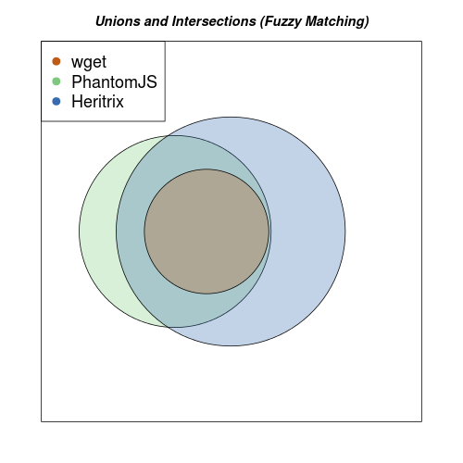
24,589
39,830
23,036
63,550

