Slide 1
Archiving Deferred Representations Using a Two-Tiered
Crawling Approach
Justin F. Brunelle, Michele C. Weigle, and Michael L. Nelson
Old Dominion University
iPRES2015
11/04/2015

Slide 2
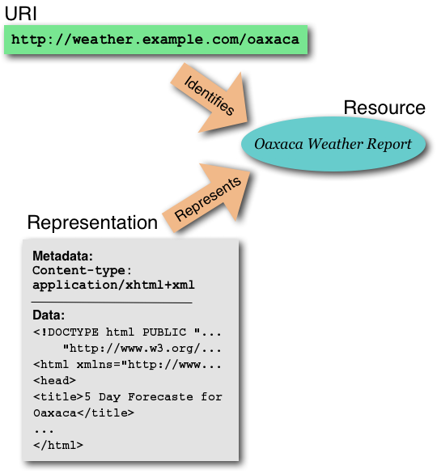
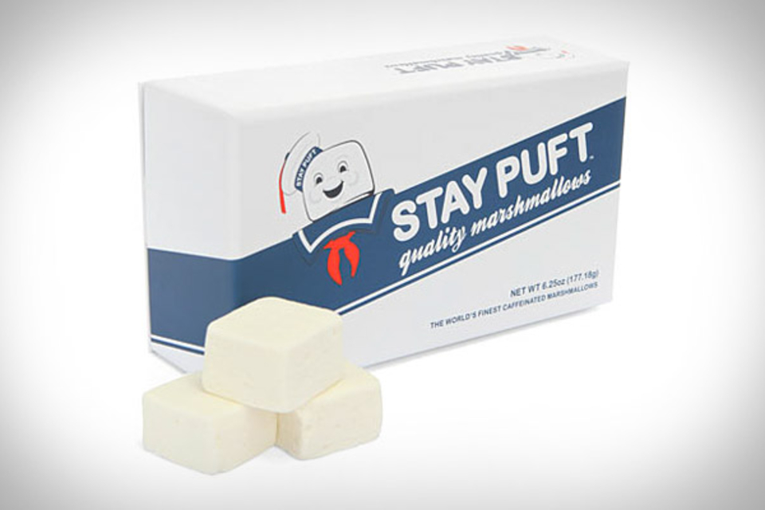
A simpler time...

Slide 3
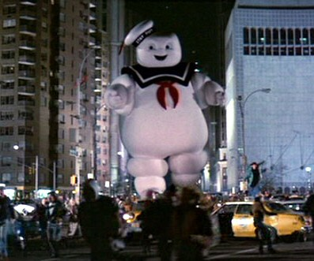
Mass hysteria. Human sacrifices. Dogs and cats living together.
<iframe><script>...</script></iframe>

Slide 4
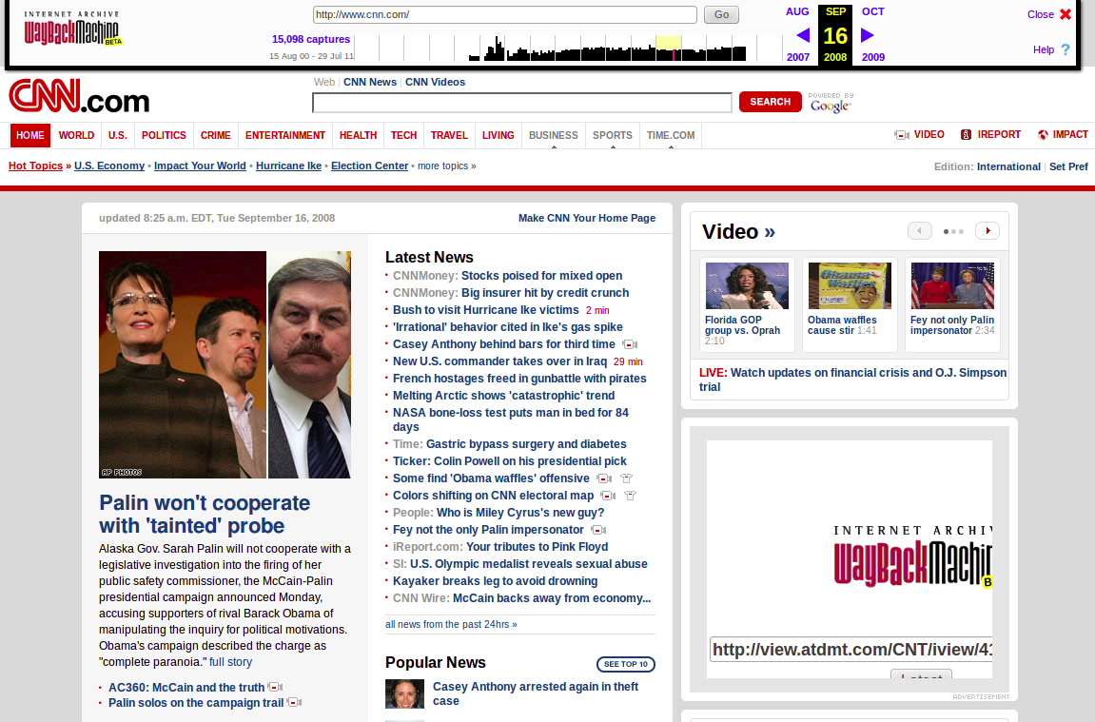
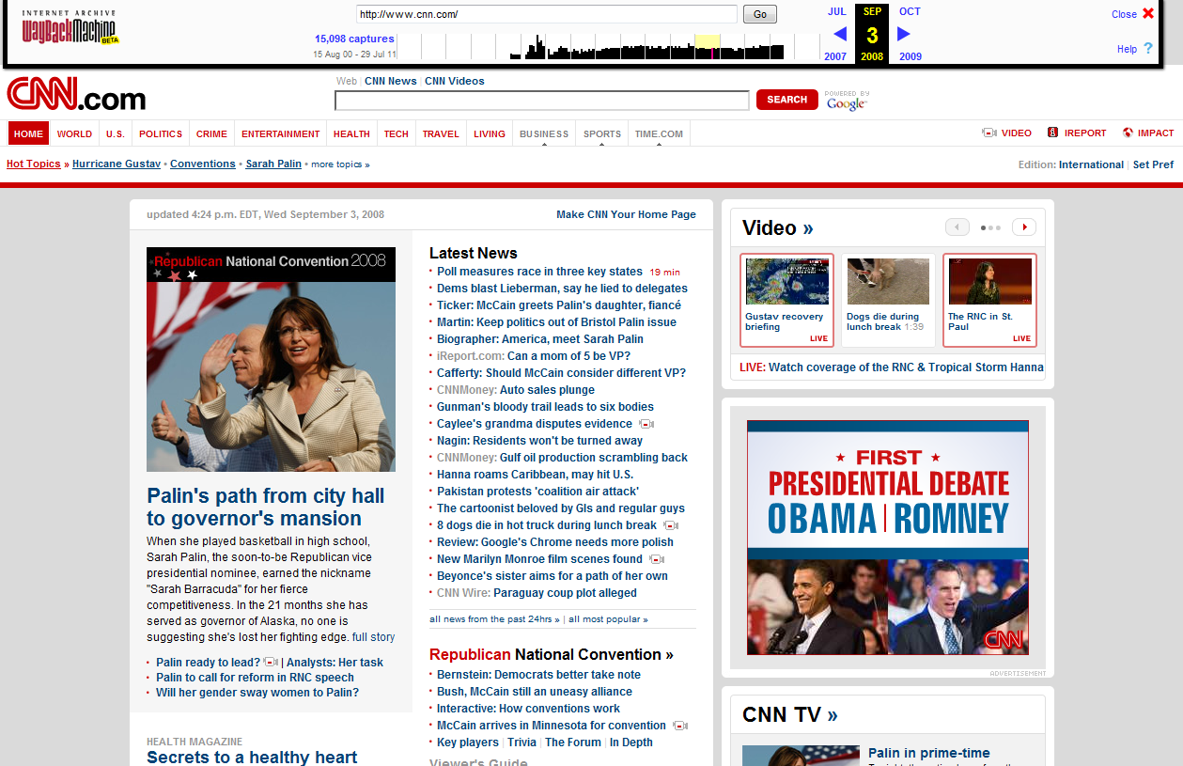
Missing resources (bad) and Temporal violations (worse)
http://ws-dl.blogspot.com/2012/10/2012-10-10-zombies-in-archives.html

Slide 5
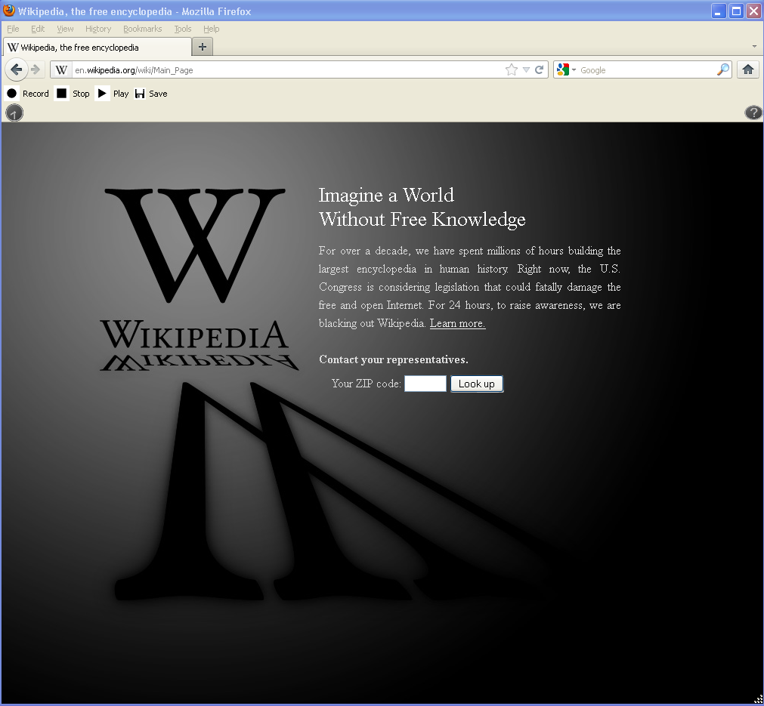
http://en.wikipedia.org/wiki/Main_Page January 18th, 2012
Notes:
Wikipedia protest is important because it represents the internet dissent over the legislation. This is a snapshot of wikipedia on january 18th, 2012.

Slide 6
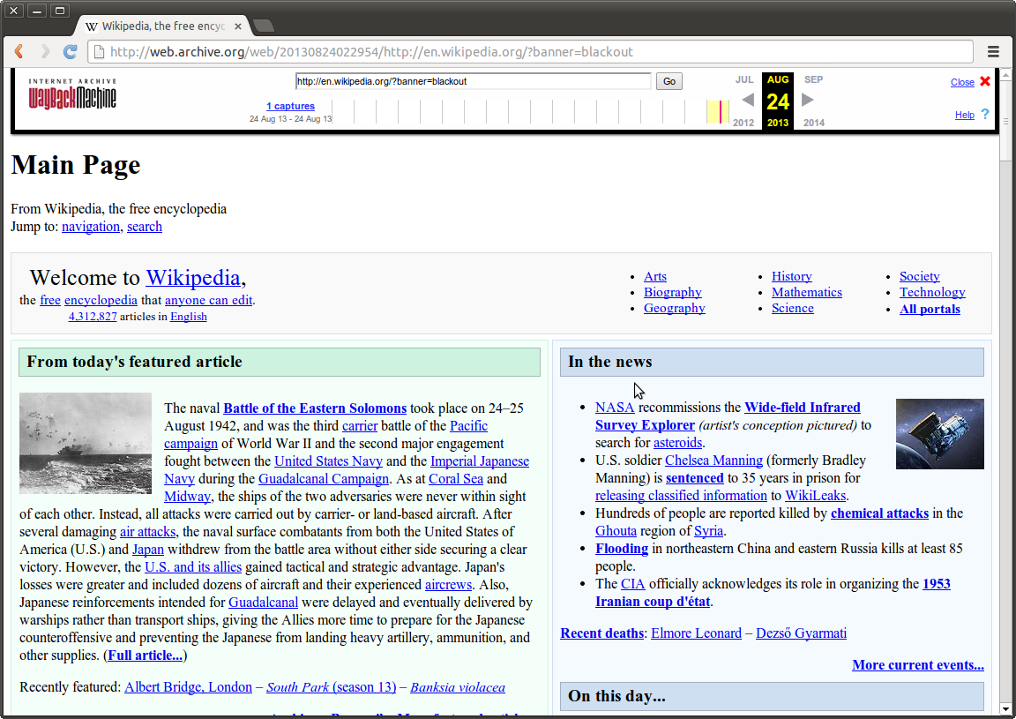
http://web.archive.org/web/20120118110520/http://en.wikipedia.org/wiki/Main_Page:
January 18th, 2012
Notes:
At the time, the Internet Archive had a 60-month quarantine for their archived pages. We had to wait 6 months before discovering that the Internet Archive did not capture the splash page, either.

Slide 7
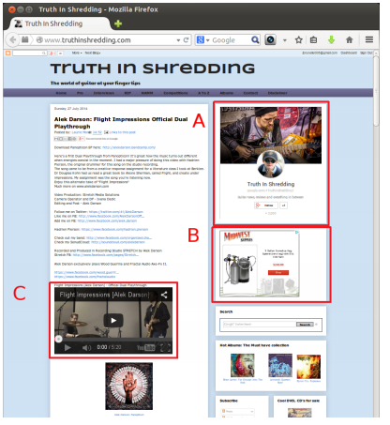
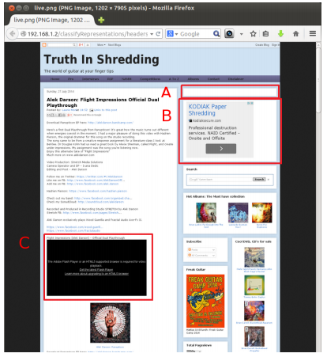
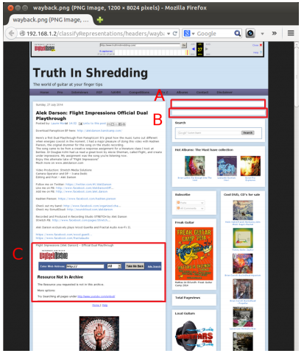
Not all tools can crawl equally
Live Resource
PhantomJS Crawled
Heritrix Crawled, Wayback replayed

Slide 8
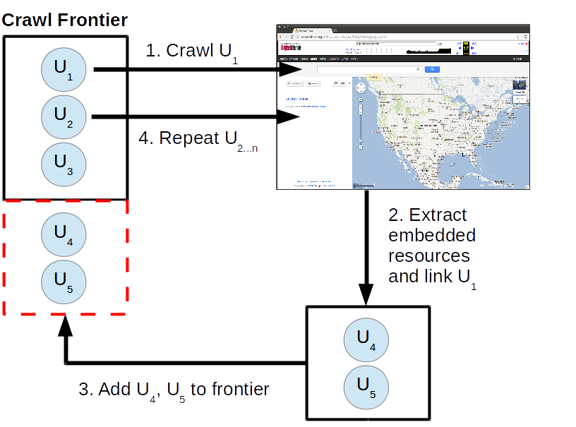
Current
Workflow
Dereference URI-Rs
Archive
representation
Extract embedded
URI-Rs
Repeat

Slide 9
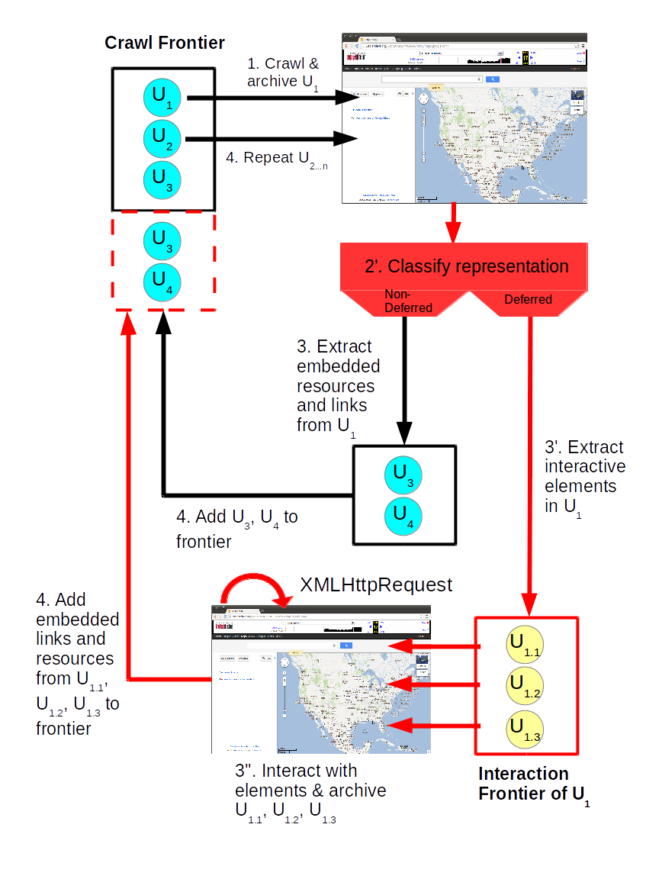
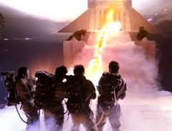
Proposed Workflow

Slide 10
Current workflow not suitable for deferred representations
<script> tags alone are not indicative of a deferred representation. JavaScript can be played back in the archives!
Two-tiered crawling approach to optimize performance
Use PhantomJS to run JavaScript, interact with the representation

Slide 11
Current workflow not suitable for deferred representations
More URI-Rs in the crawl frontier
<script> tags alone are not indicative of a deferred representation. JavaScript can be played back in the archives!
Two-tiered crawling approach to optimize performance
Use PhantomJS to run JavaScript, interact with the representation
Runs more slowly but more deeply

Slide 12
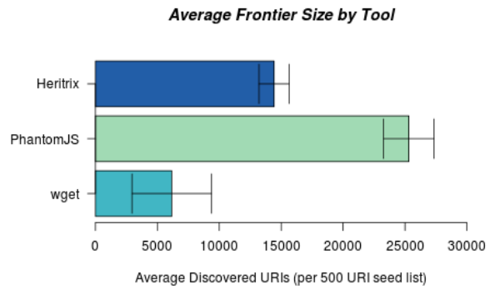
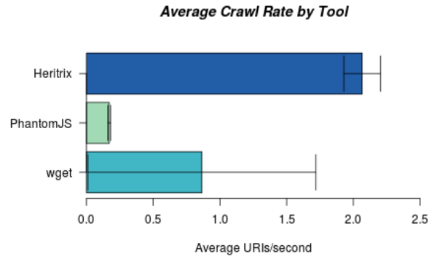
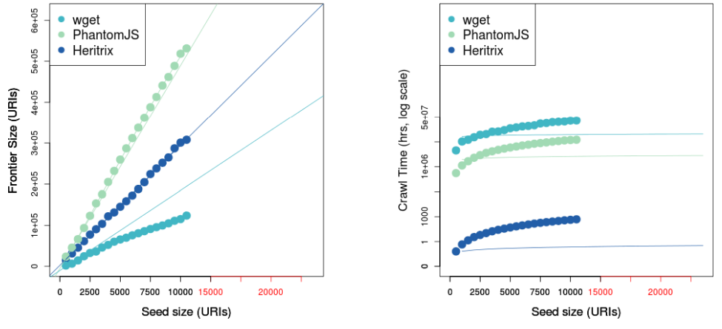
Run-time & Frontier size PhantomJS vs. Heritrix
To appear: iPres2015

Slide 13
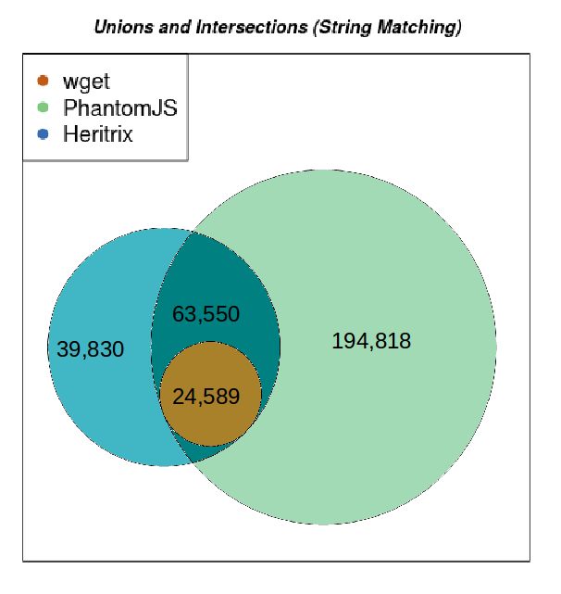
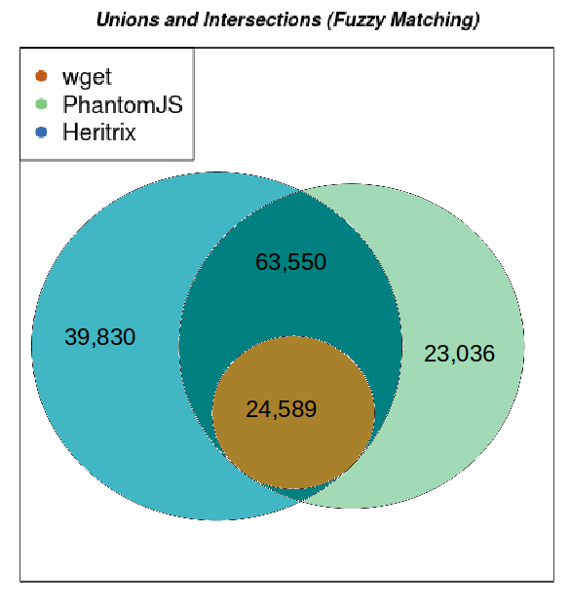

Slide 14
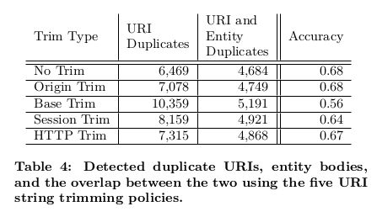
Trim Policy | Original URI-R | Trimmed URI-R
No Trim | http://example.com/folder/index.html?param=value | http://example.com/folder/index.html?param=value
Origin Trim | http://example.com/folder/index.html?callback=cs.odu.edu | http://example.com/folder/index.html
Base Trim | http://example.com/folder/index.html?param=value | http://example.com/folder/index.html
Session Trim | http://example.com/folder/index.html?param=value&sessionid=12345 | http://example.com/folder/index.html?param=value
HTTP Trim | http://example.com/folder/index.html?param=value&httpParam=http://www.test.com/ | http://example.com/folder/index.html?param=value

Slide 15
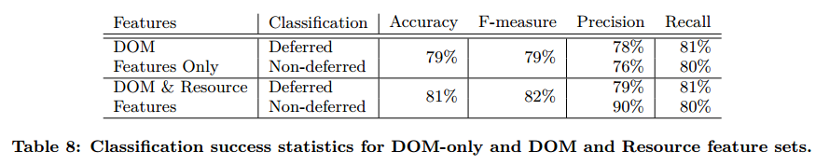
Constructed a classifier for Deferred Representations

Slide 16
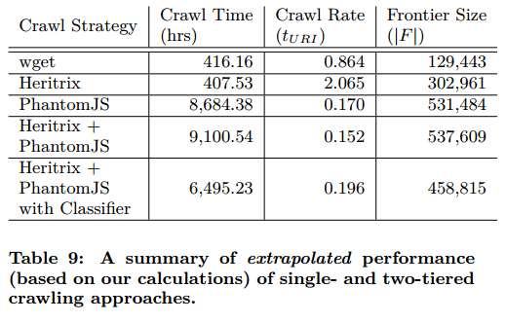
Performance metrics of a two-tiered crawling approach

Slide 17
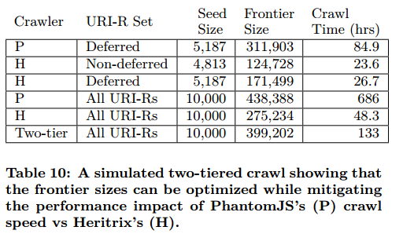
The classifier helps crawl deferred representations most efficiently

Slide 18

Current & Future Work
Using PhantomJS to execute actions on the client
  Pushing buttons
  Selecting drop-downs
  Archiving resulting representation changes
Represent representation state in WARCs
  Graph structure of embedded resources
  Replay in the Wayback Machine
http://ws-dl.blogspot.com/2015/06/2015-06-26-phantomjsvisualevent-or.html

Slide 19
Backups

Slide 20
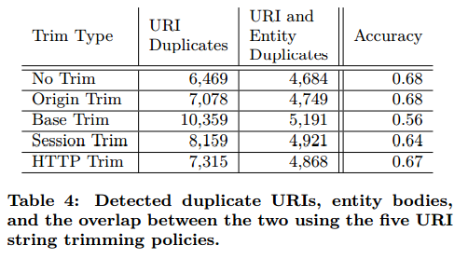

Slide 21
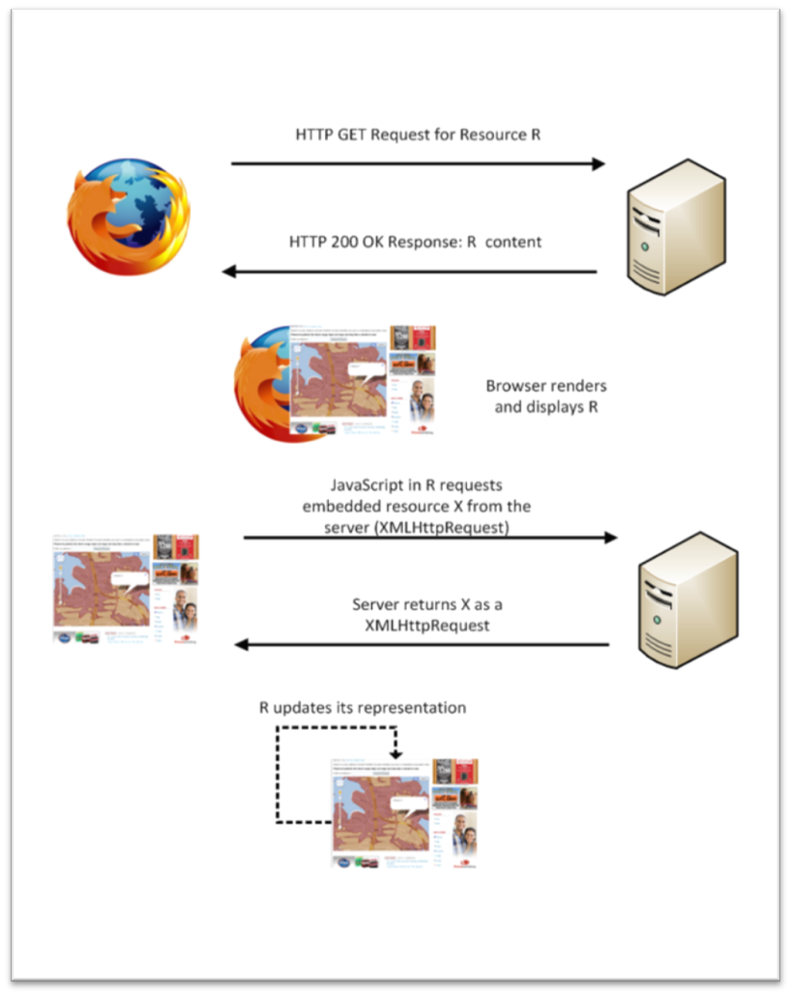
Web Browsing Process
User-controlled
Interaction
Environment
variables

Slide 22
Web Browsing Process
At any given time, users get “a” representation.
There is no longer “the” representation that archives target.

