Slide 1
Archiving Deferred Representations Using a Two-Tiered Crawling Approach
Justin F. Brunelle, Michele C. Weigle, and Michael L. Nelson
Old Dominion University
Department of Computer Science
iPres 2015

Slide 3


Problem!
The archives contain the Web as seen by crawlers

Slide 4
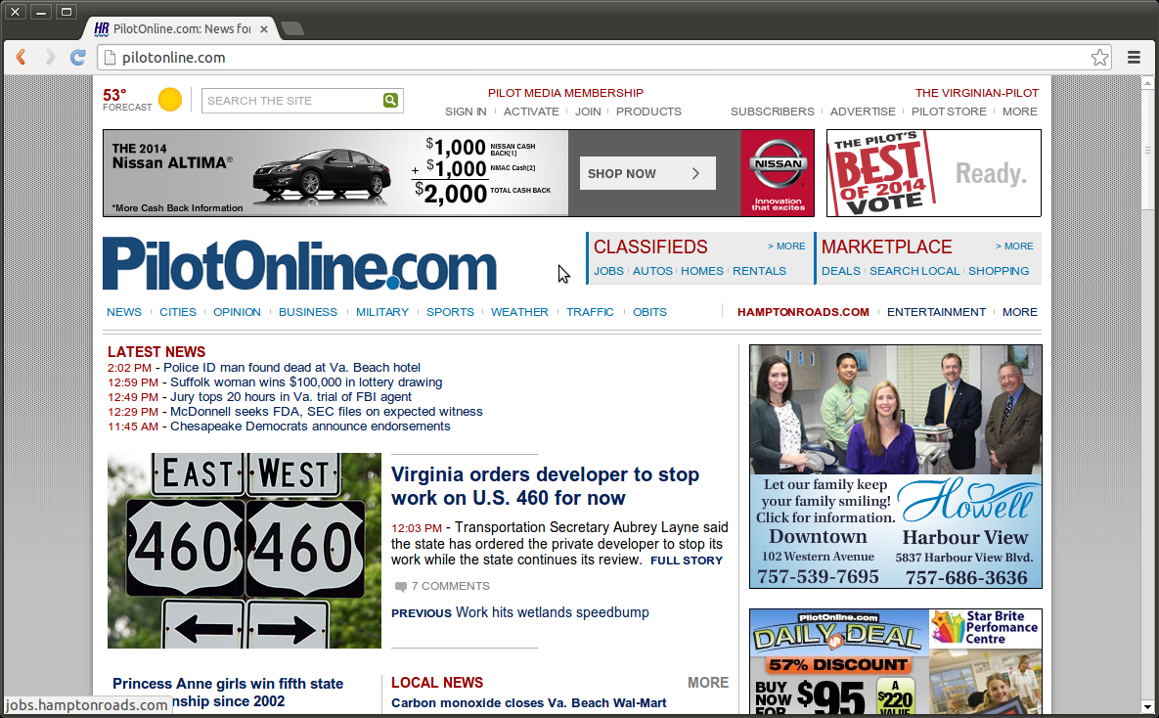
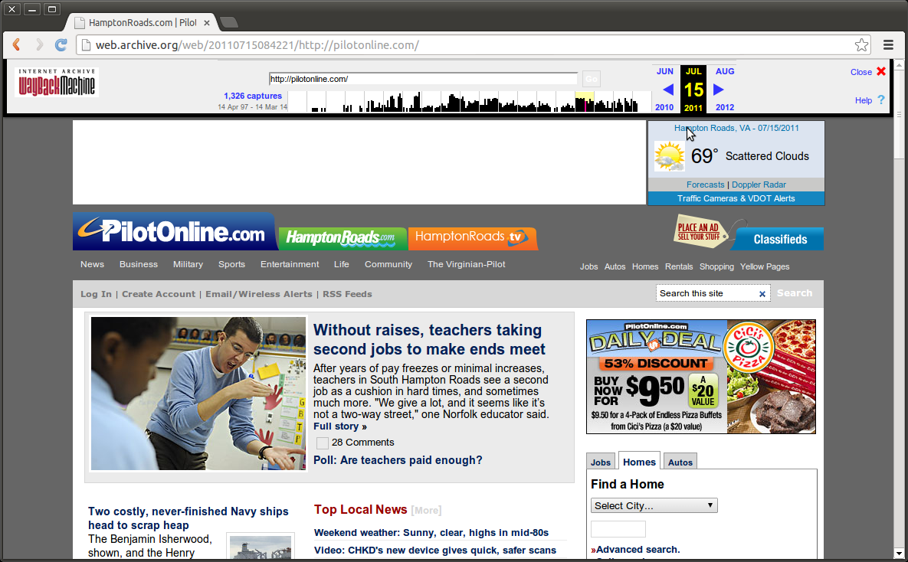
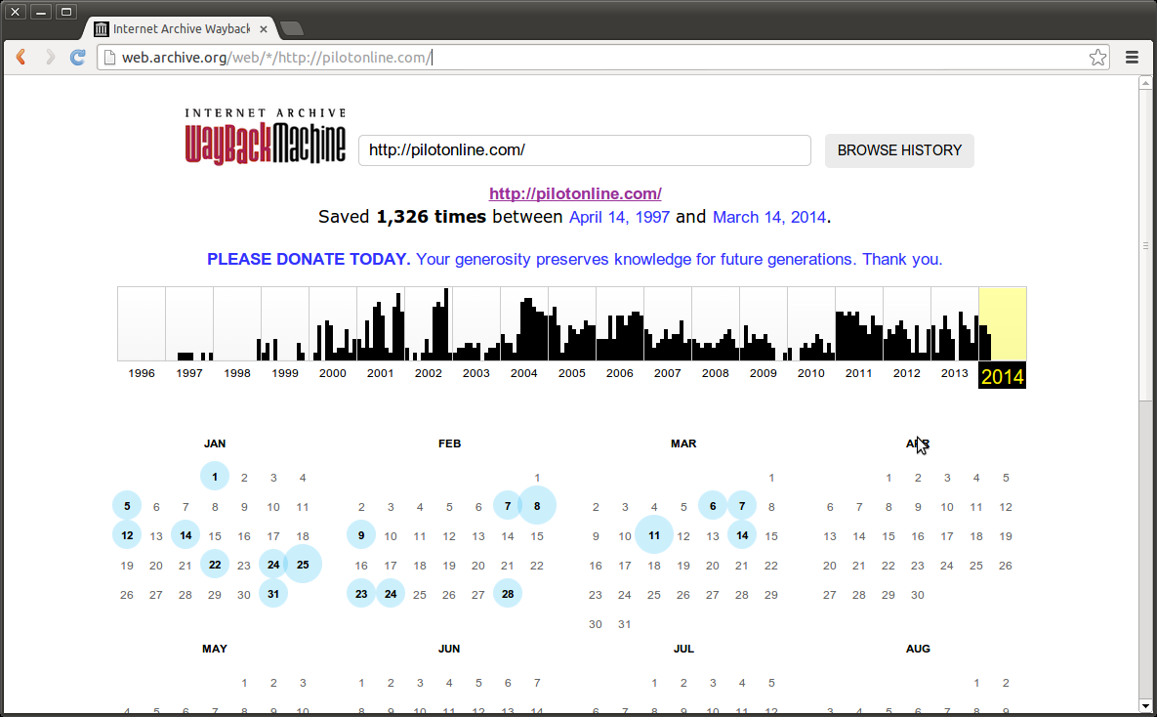
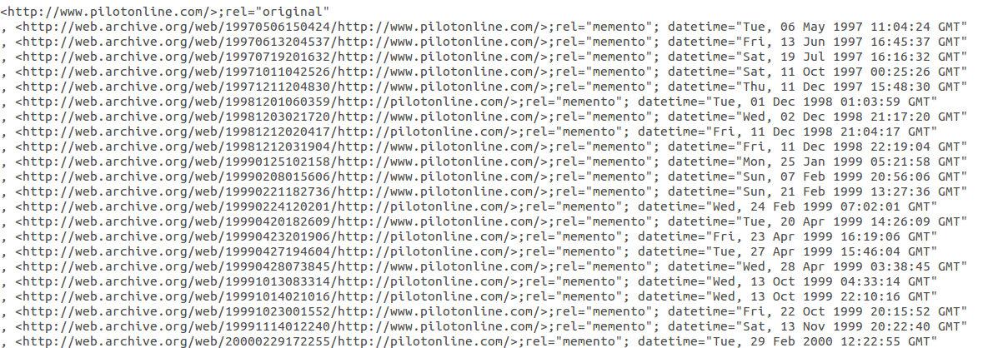
Mementos
URI-R: Live-Web
Resource Identifier
URI-M: memento
Identifier
URI-T: TimeMap
Identifier

Slide 6
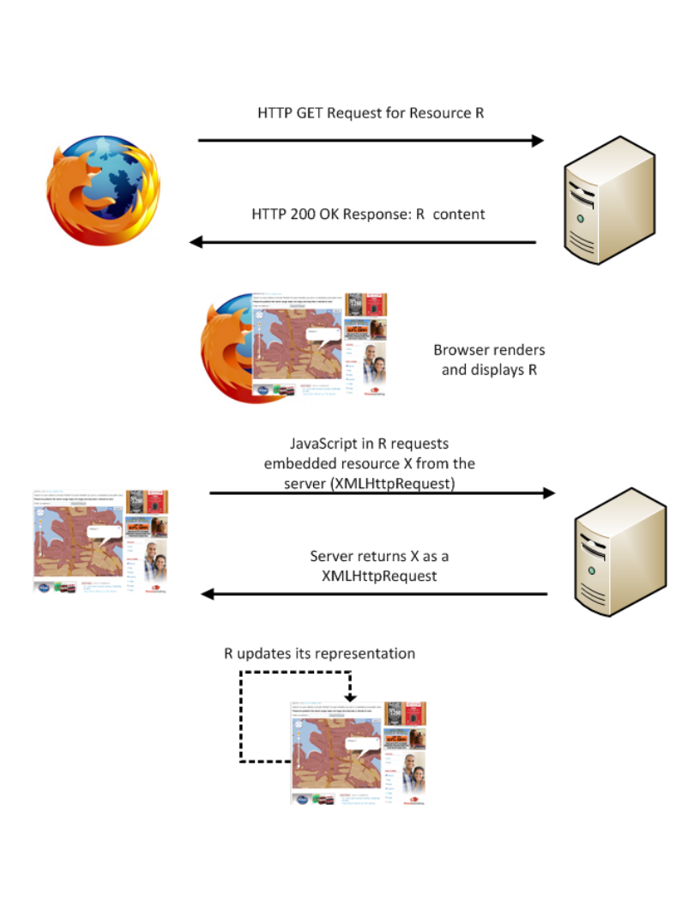



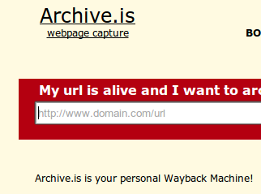

Web Browsing Process
Archival Tools stop here

Slide 7
Web Browsing Process
Archival Tools stop here
Still not solved!

Slide 8
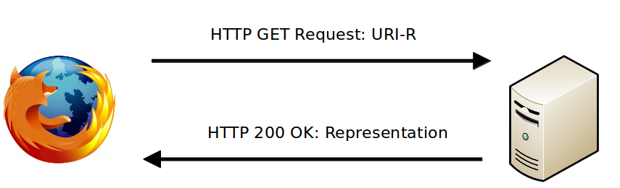
Submitted for Publication
Web technologies change how we interact!
Deferred
representations

Slide 9
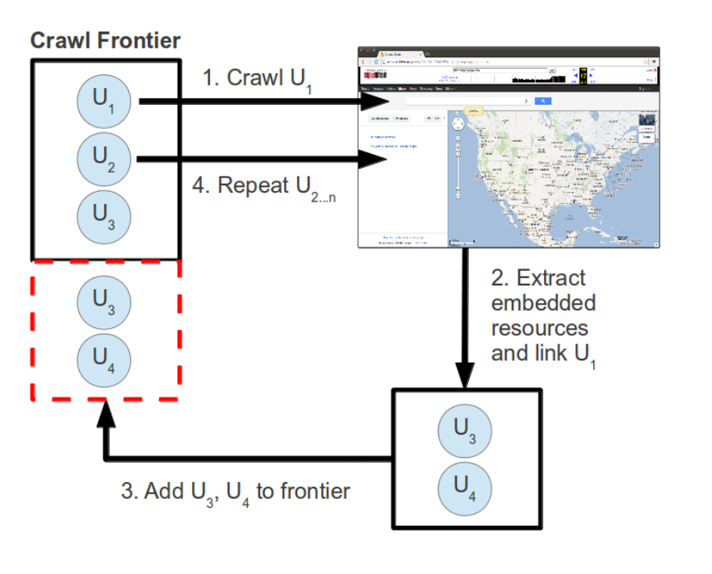
Current Crawl Process

