Slide 1
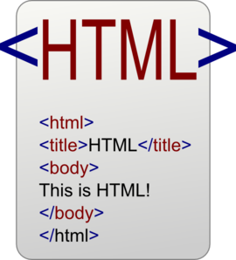




Deferred
Nondeferred
Deferred after
other event
Nondeferred; with interaction
Nondeferred
Deferred at s0
Deferred on interaction
HTTP GET
HTTP GET
HTTP GET
HTTP GET
HTTP GET
onload
onload
ononline

