Slide 1
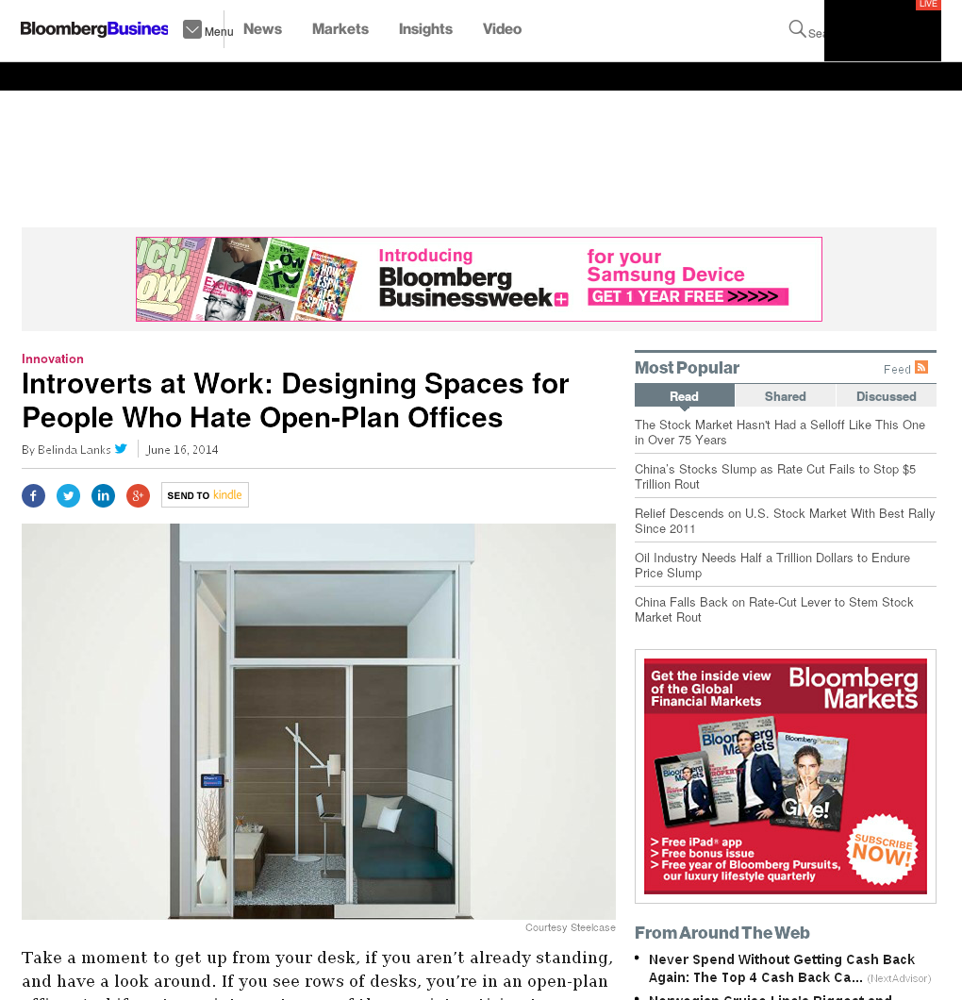

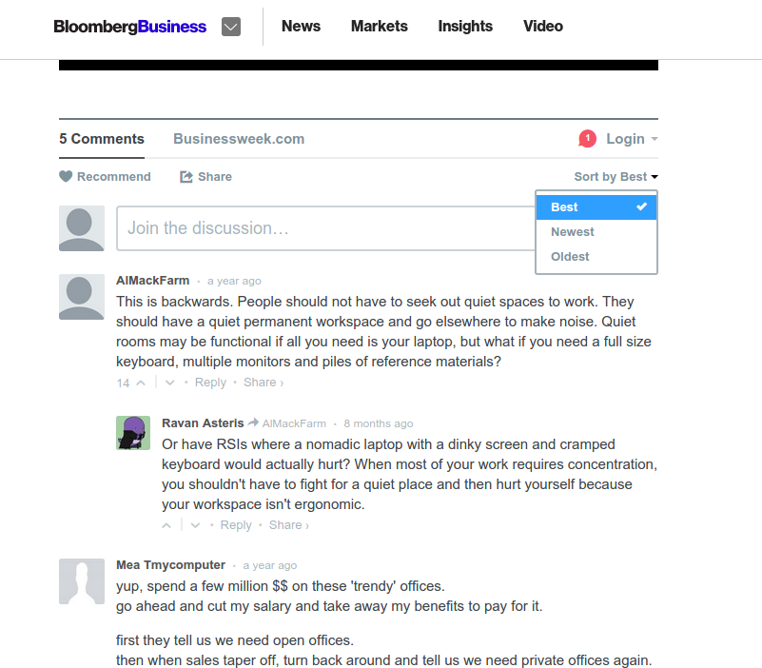


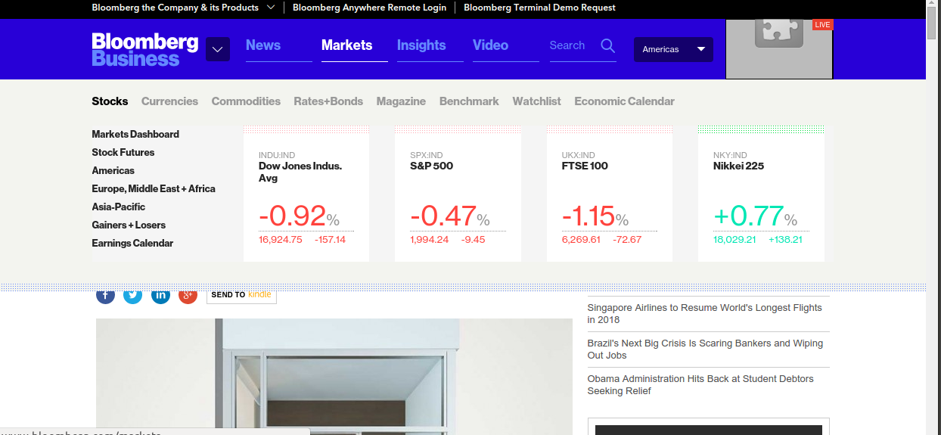
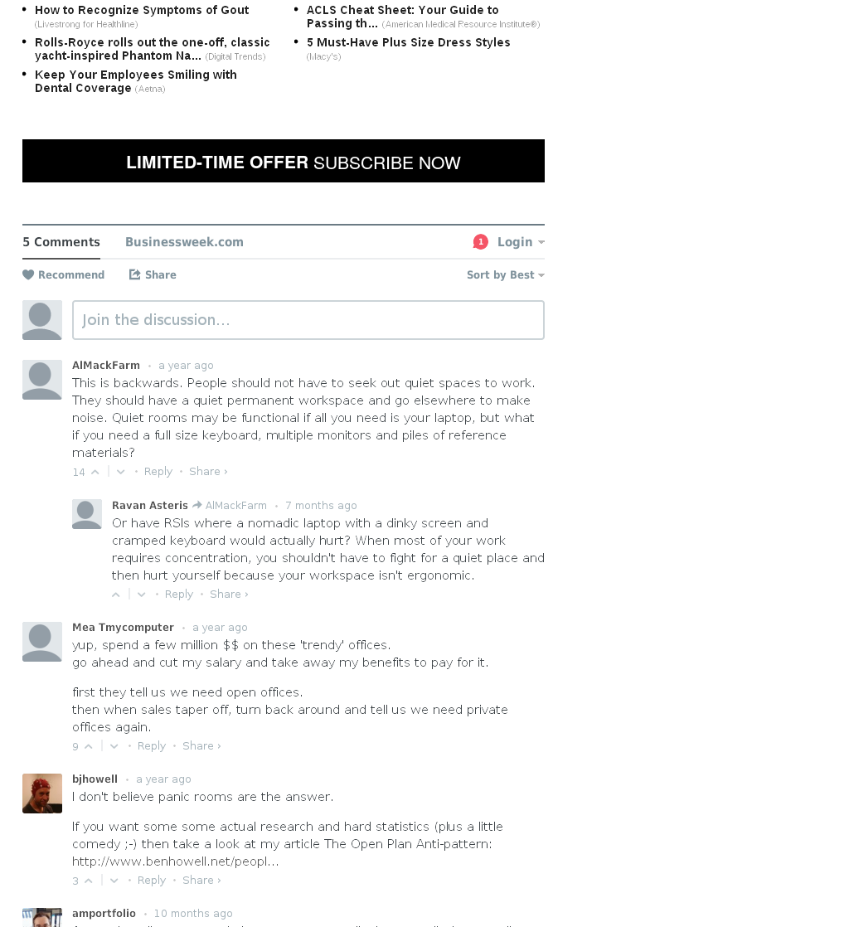
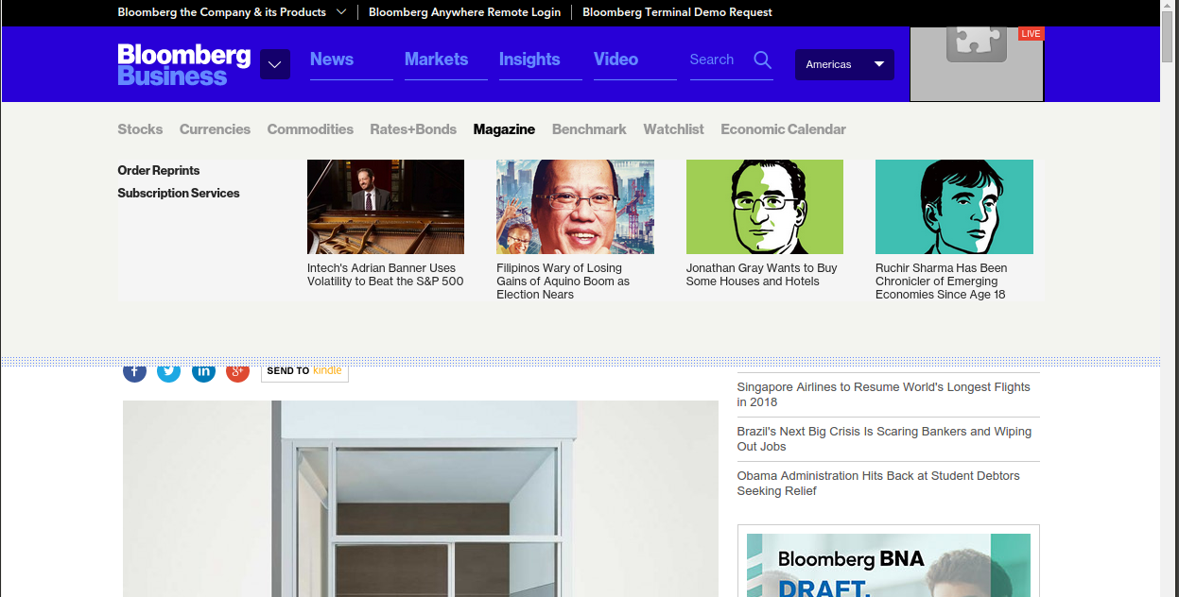
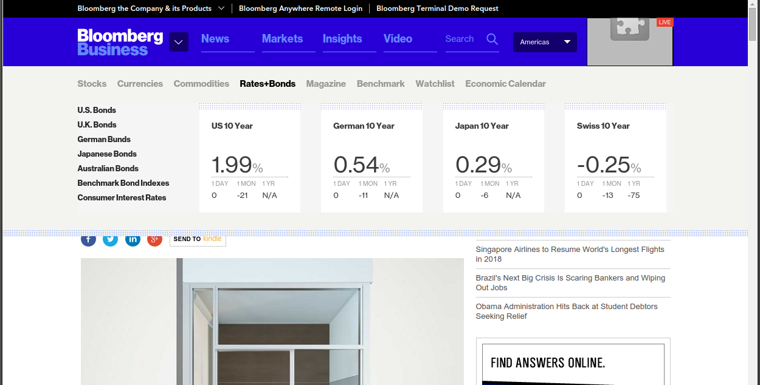
onMouseOver P
onClick Ps
s0
mouseOver
click
click
s1
mouseOver
s2
http://www.bloomberg.com/bw/articles/2014-06-16/open-plan-offices-for-people-who-hate-open-plan-offices

